Slide 1


Travelling Salesman Problem using MPI
Sokratis Bartzis

Slide 2
Problem description
Find a way to pass from every vertice in a graph, only once per vertex, minimizing the distance travelled

Slide 3
Parallelize the analytical solution ?
Execution time: O(n!)
Parallelism won’t provide speedup for n > 20

Slide 4
Genetic Algorithms
Generally faster
Provides a good-enough solution, but not the best
Meaningful to parallelize

Slide 5
How they work ?
New generation created from previous mutations and crossovers
{ 5, 3, 8, 0, 2, 4, 6, 7, 1, 9, 5} : Distance = 51,2 km
Mutate
4
{0, 3, 7, 8, 9, , 1, 5, , 2, 0}
6
Population
Crossover
{2, 1, 0, 5, 4,
8, 7, 3, 9, 6, 2}
{4, 6, 3, 5, 1,
2, 0, 8, 9, 7, 4}

Slide 6
Parallelism ? Add more circles!

Slide 7
MPI Implementation
Master
Curr Gen
Total Best
Path Fitness
{5, 4, 1, 0, …, 5} 0.16
{7, 3, 4, 0, 1, 5, 6, 2, 8, 9, 7}
Best Distance
34,9 km
{3, 9, 2, 7, …, 3} 0.13
{8, 4, 1, 9, …, 8} 0.17
Slave 0
Slave 1
Slave N
Curr Gen
Local Best
Curr Gen
Local Best
Path Fitness
{6, 2, 8, 0, …, 6} 0.11
{8, 2, 0, 1, 3, 4, 6, 5, 7, 9, 8}
Path Fitness
{0, 4, 5, 9, …, 0} 0.19
{7, 3, 4, 0, 1, 5, 6, 2, 8, 9, 7}
Local Best Dist
42,5 km
Local Best Dist
34,9 km
{2, 7, 1, 0, …, 2} 0.12
{8, 2, 3, 7, …, 8} 0.15
{9, 3, 5, 2, …, 9} 0.23
{1, 4, 2, 8, …, 1} 0.28

Slide 8
Master’s Loop
Master reads a number of points (x, y) from file
Sends cities to slaves
Create an initial generation (different routes)
Calculate distances
Update total best route if better has been found
Create new generation (mutate/crossover)
Probe for new bests from slaves
Repeat from step 1 until exit condition met

Slide 9
Slave’s Loop
Slaves receive a number of cities from master
Create an initial generation (different routes)
Calculate distances
Update local best route if better has been found
Send new local to master if found in this gen
Create new generation (mutate/crossover)
Repeat from step 1 until MPI_Abort

Slide 10
Program Termination
A number of generations have passed with no new best route (2000 in my program)
A total number of generations is reached (not implemented)
Other (Ideas ?)

Slide 11
How to evaluate ?
Analytical solution is already beaten in terms of execution time
(14 cities => more than 1000 seconds exec. time)
Simply compare execution times with different number of processes for the genetic mpi solution ?

Slide 12
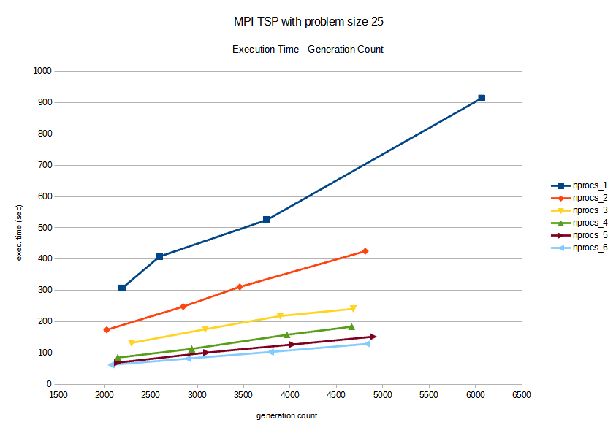
Evaluation (1)

Slide 13
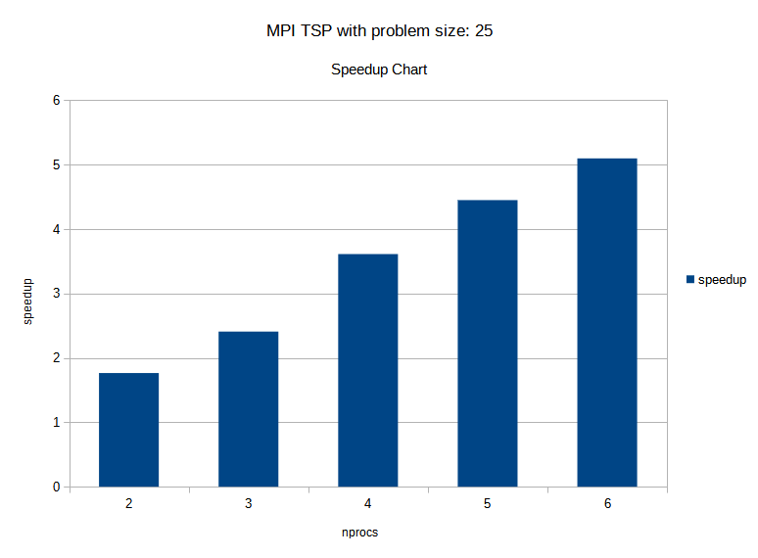
Evaluation (2)

Slide 14


Conclusion
Achieved speedup, but not linear
Genetic algorithms:
adequate solution in reasonable execution time

