Slide 1
Access to Care by State

Slide 2
California

Slide 3
Background
We are trying to determine which counties in California have comparatively more access or less access to hospital care.
A statistical model using data from across the country is used to identify those counties that have more or less than the model expects the specific county to have.

Slide 4
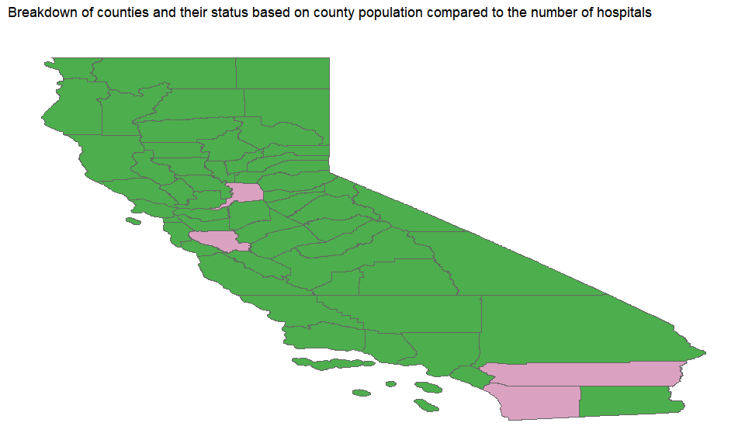
County Map

Slide 5
County Data
Counties with above or below the number of hostpitals expected.
## # A tibble: 4 x 5 ## County Population Hospitals Expected `Model Result` ## <chr> <chr> <dbl> <dbl> <chr> ## 1 Riverside 2M 16 19 Under ## 2 Sacramento 2M 9 13 Under ## 3 San Diego 3M 16 27 Under ## 4 Santa Clara 2M 10 16 Under

