Slide 1
Access to Care

Slide 2
California

Slide 3
Background
We are trying to determine which counties in California have comparatively more access or less access to hospital care.
A statistical model using data from across the country is used to identify those counties that have more or less than the model expects the specific county to have.

Slide 4
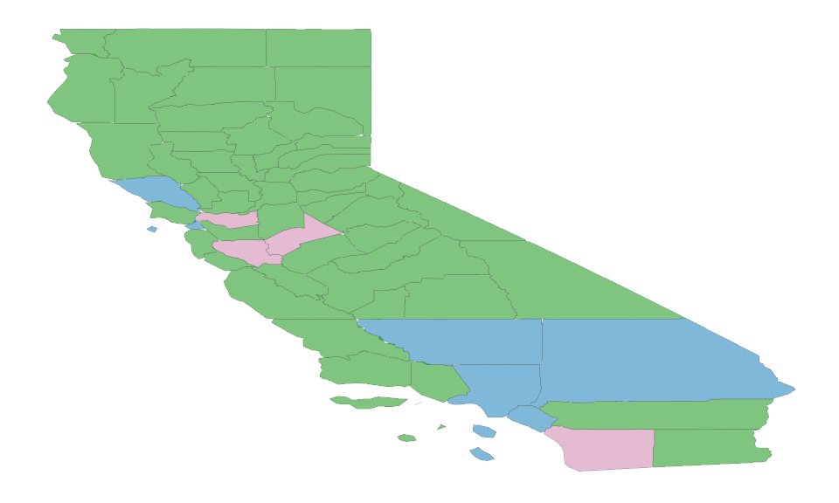
County Map

Slide 5
County Data
Counties with above or below the number of hostpitals expected.
## # A tibble: 58 x 5 ## County Population Hospitals Expected `Model Result` ## <chr> <chr> <dbl> <dbl> <chr> ## 1 Alameda 2M 13 11 Acceptable ## 2 Alpine 1K 0 1 Acceptable ## 3 Amador 37K 1 1 Acceptable ## 4 Butte 225K 4 2 Acceptable ## 5 Calaveras 45K 1 1 Acceptable ## 6 Colusa 21K 0 1 Acceptable ## 7 Contra Costa 1M 0 8 Under ## 8 Del Norte 27K 1 1 Acceptable ## 9 El Dorado 184K 2 2 Acceptable ## 10 Fresno 975K 7 7 Acceptable ## # … with 48 more rows

