Slide 1
Access to Care

Slide 2
California

Slide 3
Background
We are trying to determine which counties in California have comparatively more access or less access to hospital care.
A statistical model using data from across the country is used to identify those counties that have more or less than the model expects the specific county to have.

Slide 4
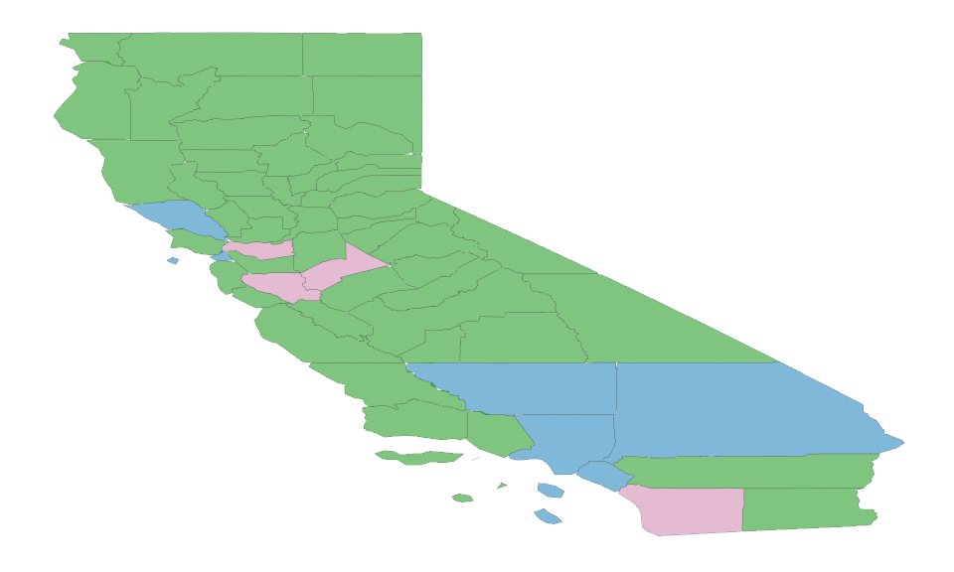
County Map

Slide 5
County Data
Counties with above or below the number of hostpitals expected.

