Slide 1
Access to Care
RStudio

Slide 2
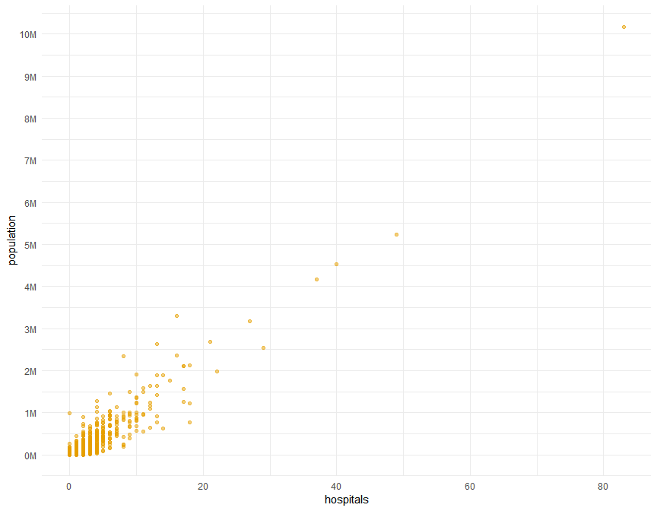
County population vs hospitals

Slide 3
Model
## ## Call: ## lm(formula = hospitals ~ population, data = hospital_sample) ## ## Coefficients: ## (Intercept) population ## 7.027e-01 7.907e-06

Slide 4
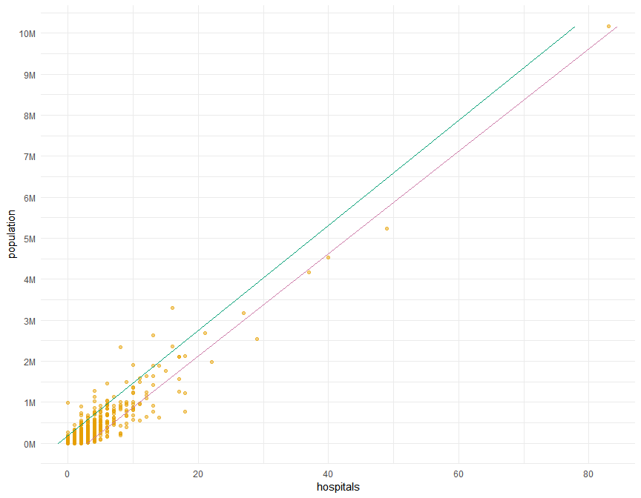
Overlay the model

