Slide 1
Access to Care
RStudio

Slide 2
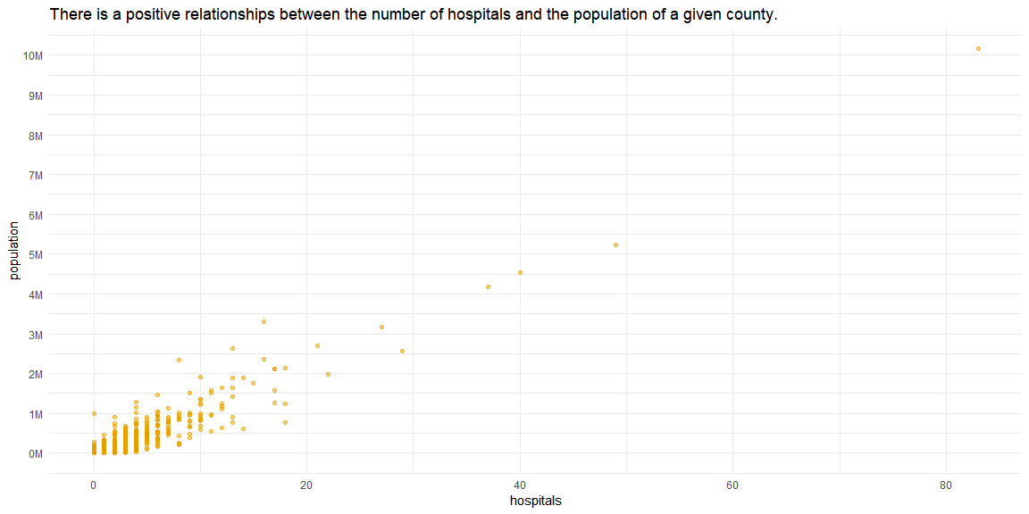
County population vs hospitals

Slide 3
Model
## [1] "lm(formula = hospitals ~ population, data = hospital_sample)" ## [2] "Residuals:" ## [3] " Min 1Q Median 3Q Max " ## [4] "-10.7909 -0.7106 0.0908 0.2498 8.3805 " ## [5] "Coefficients:" ## [6] " Estimate Std. Error t value Pr(>|t|) " ## [7] "(Intercept) 7.027e-01 3.942e-02 17.83 <2e-16 ***" ## [8] "population 7.907e-06 1.182e-07 66.90 <2e-16 ***" ## [9] "---" ## [10] "Signif. codes: 0 '***' 0.001 '**' 0.01 '*' 0.05 '.' 0.1 ' ' 1"

Slide 4
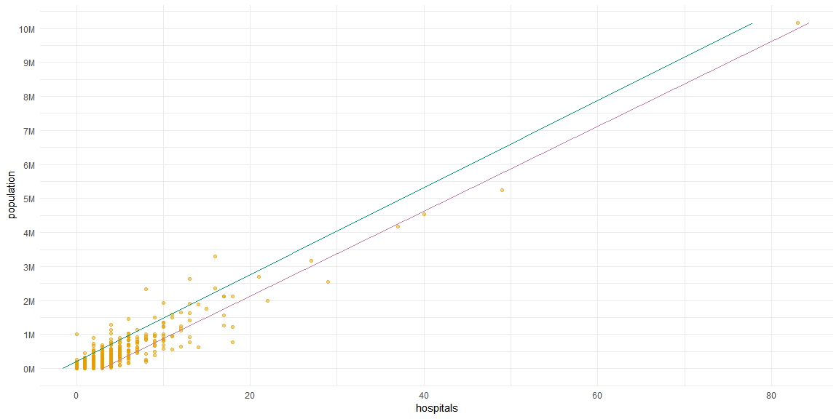
Overlay the model

