Slide 1
Solace & Bosch IoT Showcase
Pictures
Hybrid IoT Event Mesh

Slide 2
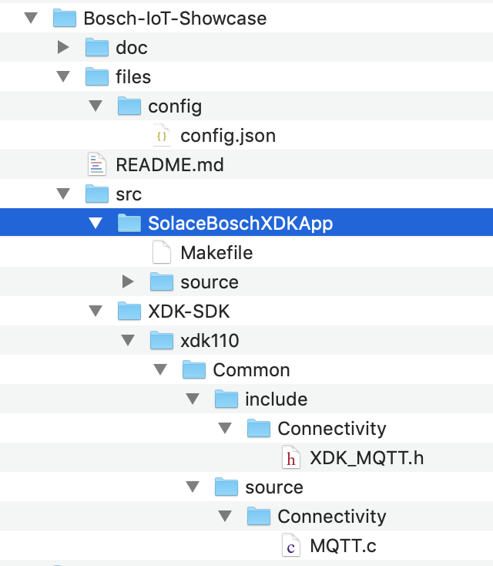
project_file_structure.png
Config file:
Goes onto SD Card
The XDK Workbench Eclipse Project
Patches required for the XDK SDK

Slide 3

Xdk_workbench_install_dir_mac.png

Slide 4
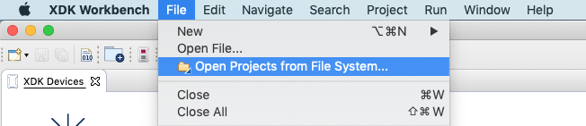
open_project.png

Slide 5
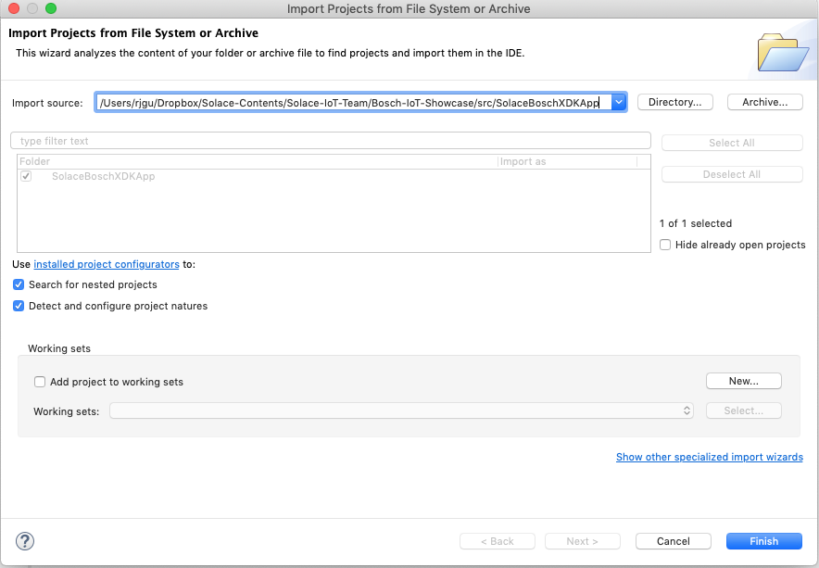
import_project.png

Slide 6
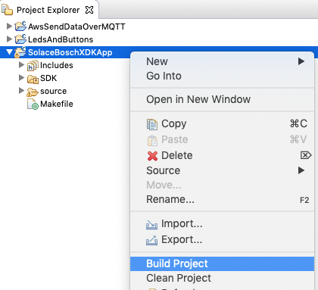
build_project.png

Slide 7
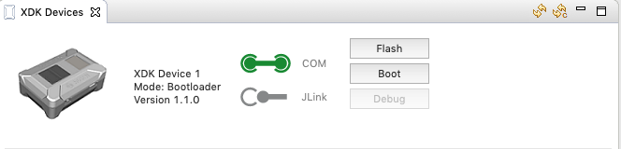
xdk_devices_panel.png
Shows with mode the device is in:
Bootloader (you can flash)
Application (you can reboot)
Refresh then list
Change device from Application to Bootloader mode.

Slide 8
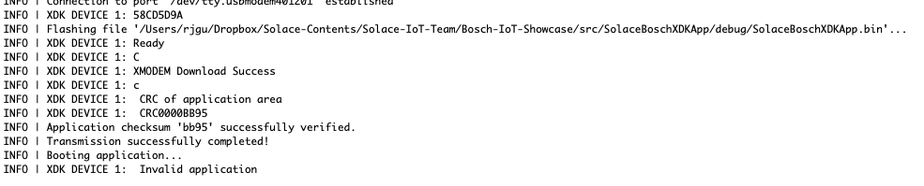
flashing_invalid_app.png

Slide 9
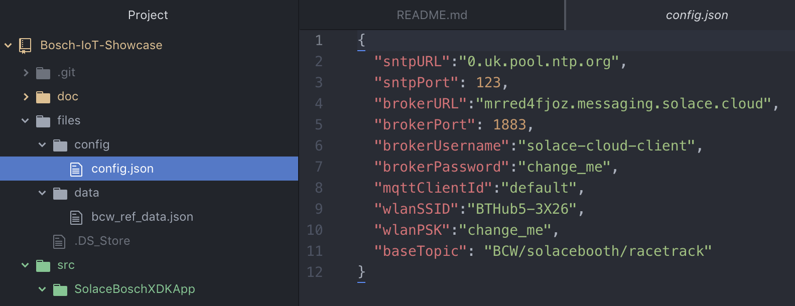
config.png

Slide 10
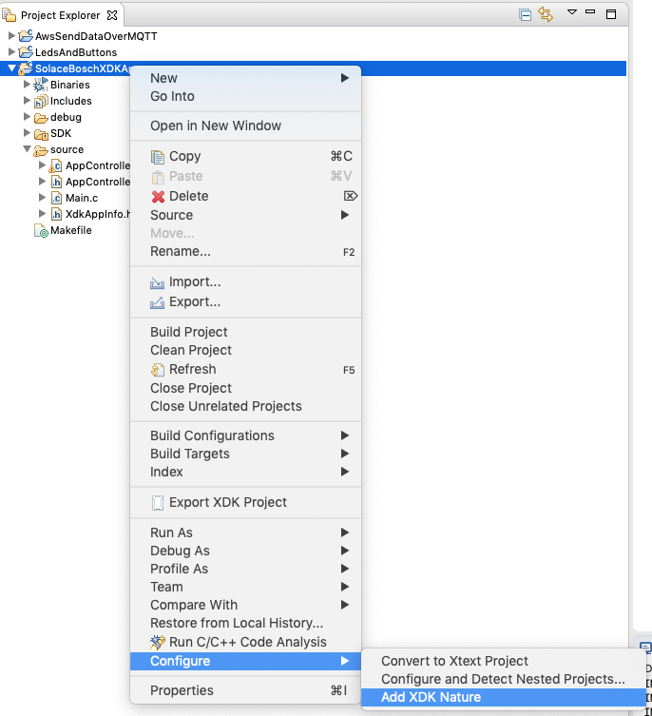
add_xdk_nature.png

Slide 11
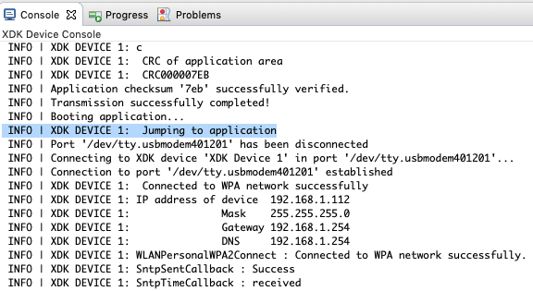
console_log_1.png

Slide 12
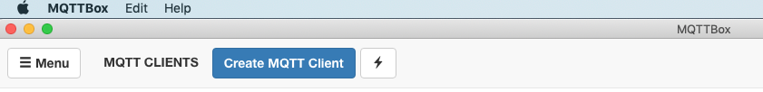
mqtt-box-create-client.png

Slide 13
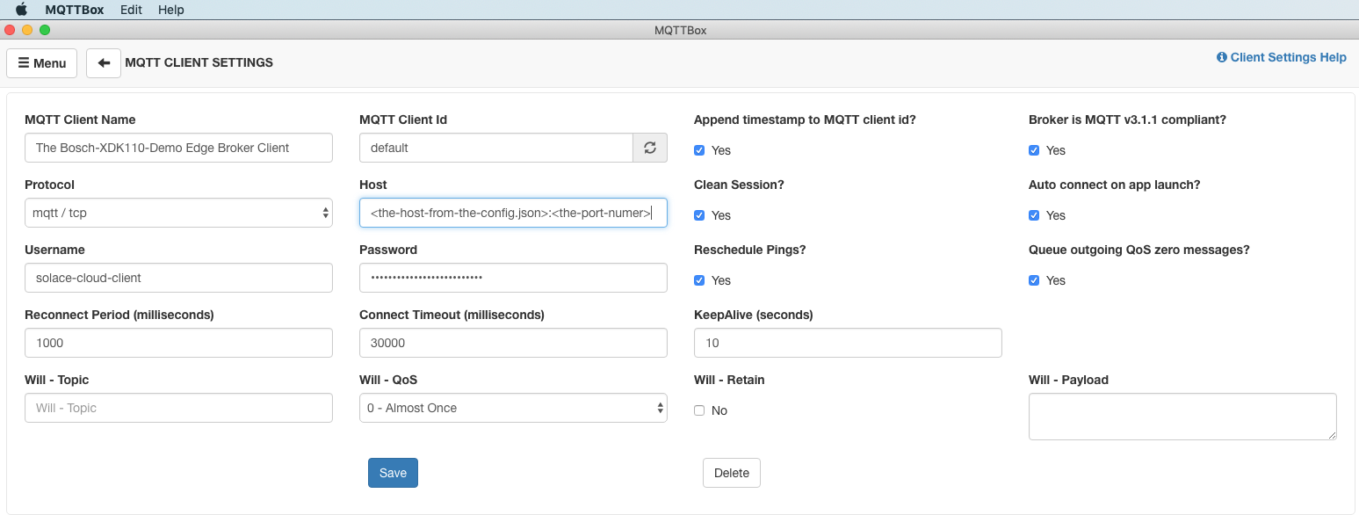
mqtt-client-settings.png
Descriptive name
Host:Port
Password for broker

Slide 14
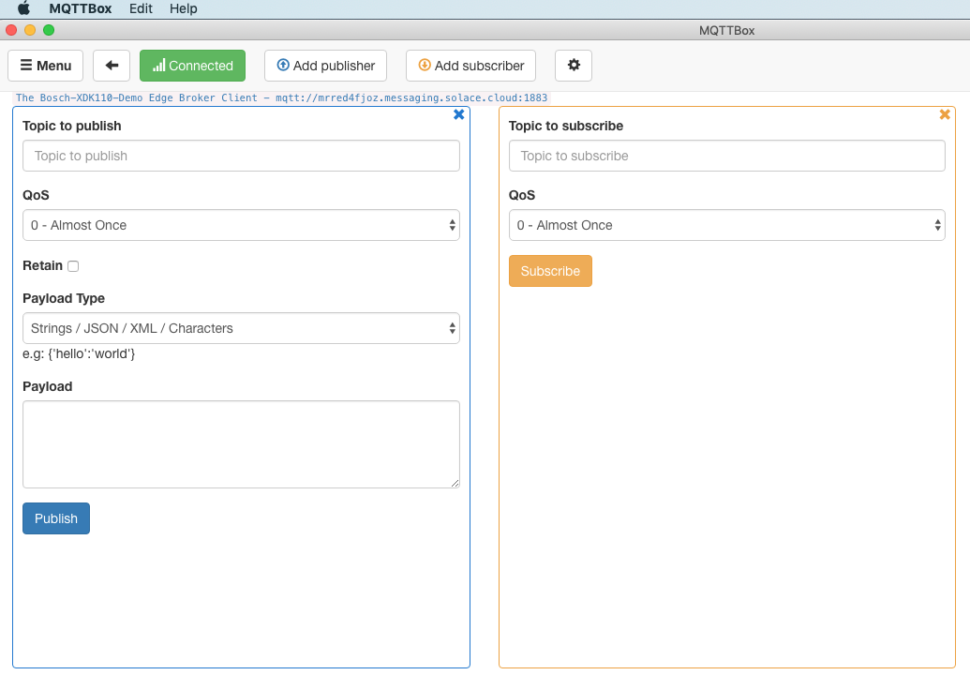
mqtt-box-connected.png

Slide 15
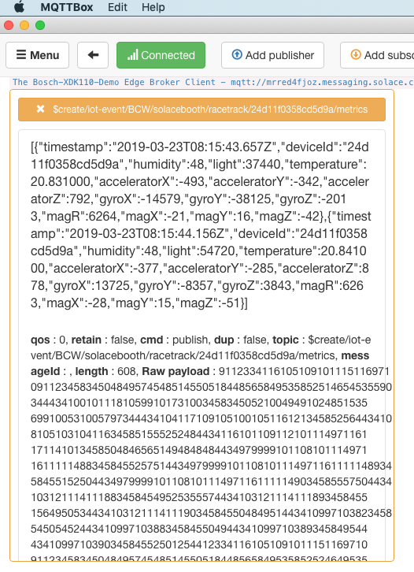
mqtt-box-subscribe-to-metrics.png

