Slide 1

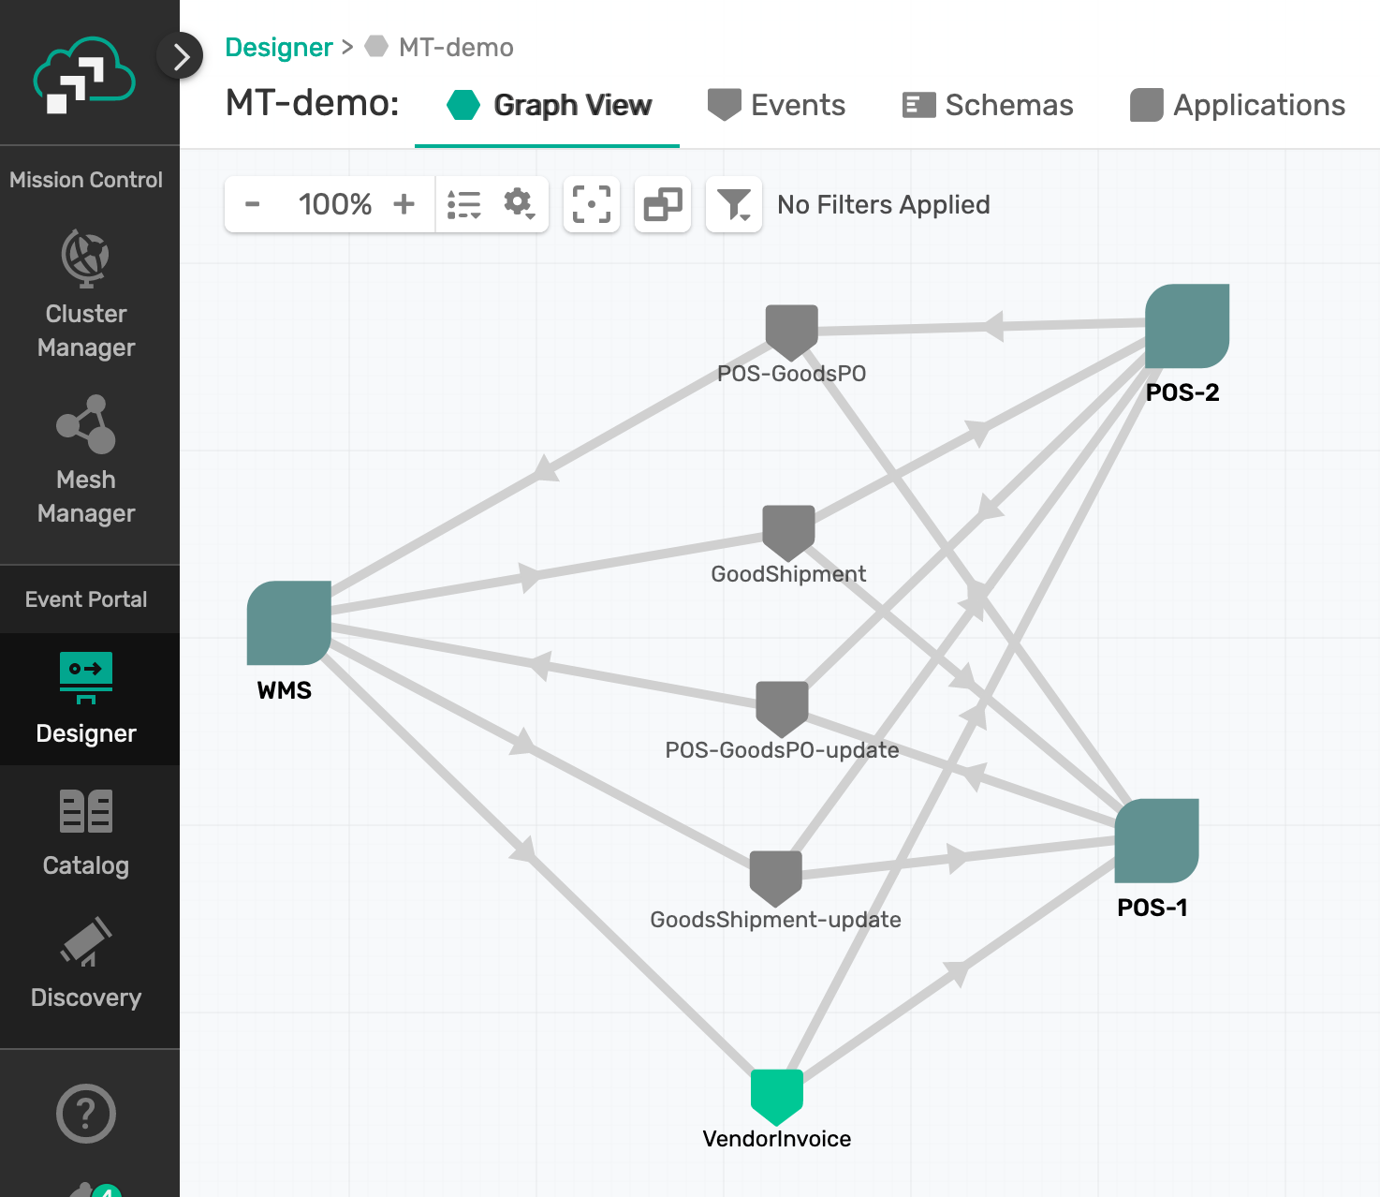
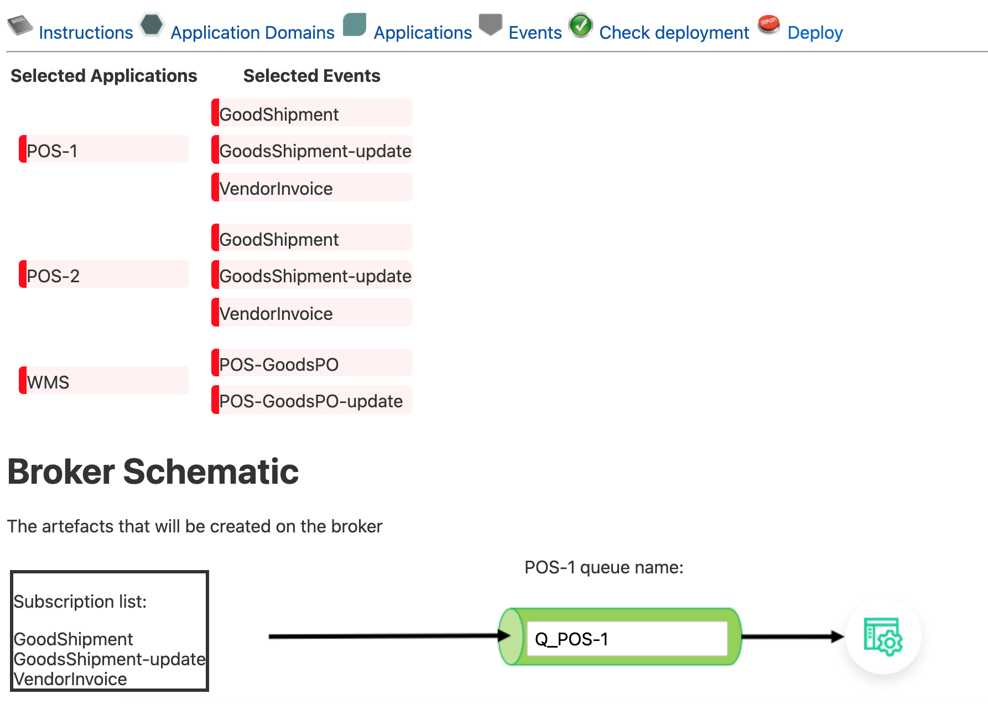

Event Portal API
Portal2SEMP
SEMP v2
API

