Slide 1
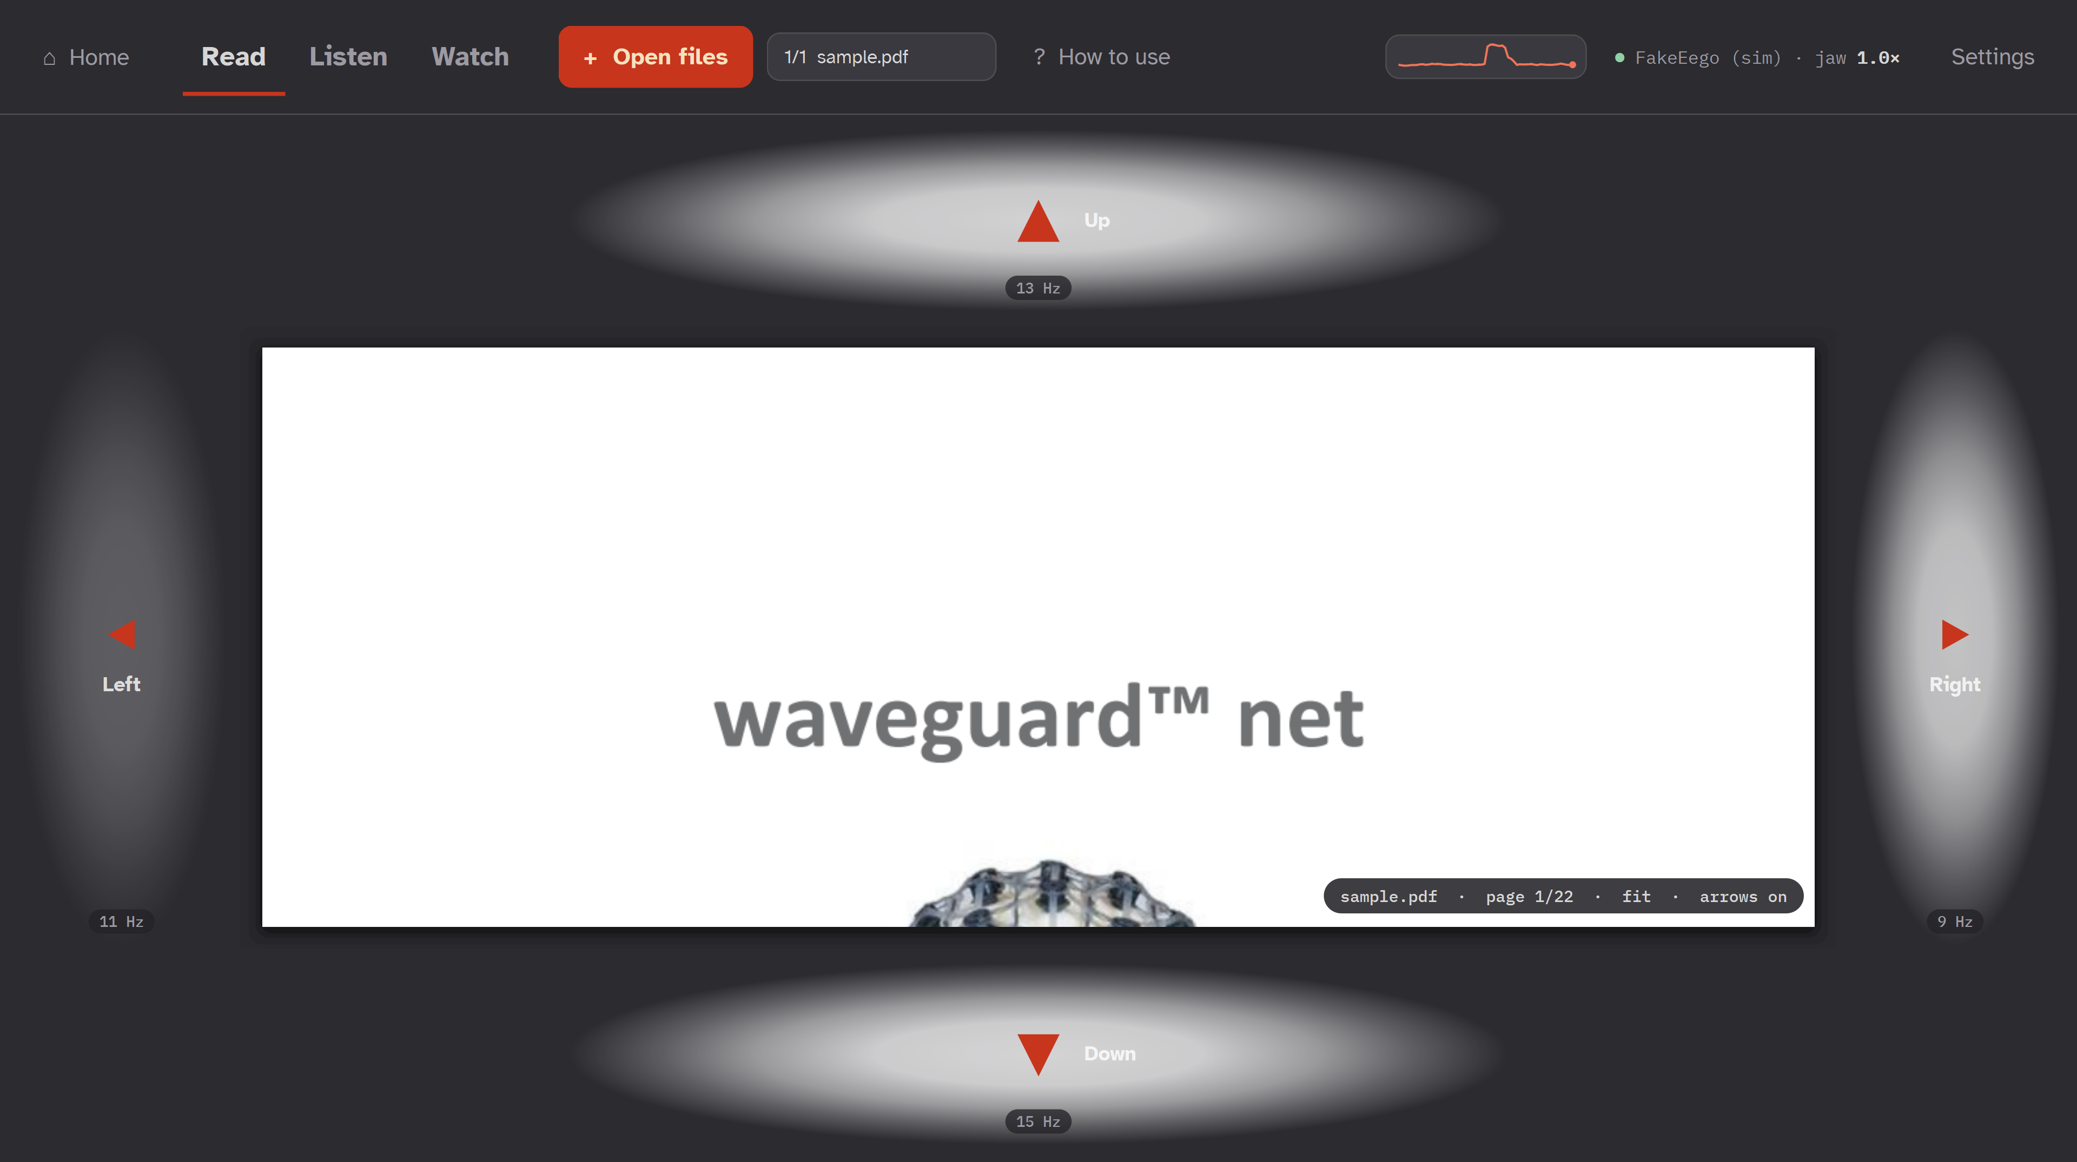
NC STATE NEUROTECH BCI HACKATHON · ANT NEURO TRACK
Hands-Free Viewer
Read, listen and watch with your eyes and jaw. No hands needed.
Look at a glowing arrow to scroll or skip
Clench your jaw to play, pause and zoom
The real app: four flickering arrows around a PDF
Team 7 · Takoda Moore · Bhoomi Mehta · Mahek Ripal Shah · Sola Corrado · Fisher White
Notes:
Hi, we're Team 7. We built the Hands-Free Viewer: a desktop app that lets someone read PDFs, listen to audio and watch video using only where they look and their jaw, recorded live from ANT's 24-electrode eego headset.

Slide 2
WHO IT'S FOR
Their hands don't work. Their eyes and jaw do.
1
High spinal cord injury
2
ALS (limb onset)
Paralysed from the neck down, but jaw, face and eyes usually work fully
Hands and arms go first; jaw and eyes often keep working for years
3
Muscular dystrophy, SMA, tremor
4
Everyday hands-busy moments
Too weak or too unsteady for a mouse or touchscreen
Cooking, repairs, a manual mid-task, lying in a hospital bed
Not for people with photosensitive epilepsy: the targets flicker at 9–15 Hz.
Notes:
Who is it for? Anyone whose hands don't work but whose eyes and jaw do: high spinal cord injury is the clearest case, also limb-onset ALS, muscular dystrophy, SMA, severe tremor. And everyday hands-busy moments, which makes it scalable beyond medical use.

Slide 3
HOW IT WORKS
Two signals the headset picks up reliably
ANT eego cap
→
LSL stream
→
Hands-Free Viewer
24 electrodes · 500 Hz
live over Wi-Fi to the laptop
Python desktop app
LOOK
CLENCH
Flicker (SSVEP)
Jaw muscle (EMG)
Each arrow pulses at its own rate (9, 11, 13 or 15 times a second). Stare at one and the visual cortex pulses at that rate too. We match 2 s of the back-of-head channels (O1, O2, Pz, P3, P4) against each rate.
Clenching fires the chewing muscles under the temple electrodes (T7, T8, T9, T10): a 30–100 Hz burst many times above rest. One, two or three clenches, or a hold, each do something different.
→ scroll, turn pages, skip 15 s
→ play / pause, back / forward, zoom
Notes:
The cap streams 24 channels at 500 Hz over LSL into our Python app. We use two signals. Look: each arrow flickers at its own rate and your visual cortex echoes it, which we detect with canonical correlation. Clench: the jaw muscles under the temple electrodes give a huge 30 to 100 hertz burst.

Slide 4
WHAT YOU CAN DO
One app: read, listen, watch
Read PDF
Listen audio
Watch video
Look at an arrow
Clench once
Look at a side arrow
scroll; past the edge turns the page
play / pause
skip back / forward 15 s
Clench twice
Clench twice
Clench once
arrows off / on, to read without flicker
back 15 s (hold to keep going)
play / pause
Hold a clench
Clench 3 times
Clench 2 or 3 times
zoom in / out
forward 15 s (hold to keep going)
back / forward 15 s
Also: blinks or an experimental eye roll instead of the jaw · open any PDFs, songs and videos · keyboard backup (1 / 2 / 3, arrows, J)
Notes:
Three tabs. Read: look at an arrow to scroll; clench twice to switch the flicker off while reading; hold a clench to zoom. Listen: one clench plays or pauses, two go back 15 seconds, three go forward, and holding keeps skipping. Watch: look at the skip arrows or use the same clenches. Blinks or an eye roll can replace the jaw.

Slide 5
RESULTS
It works on real EEG
96%
0
100%
2 days
flicker accuracy
wrong arrows
jaw clench
same results
at 11–15 Hz, averaged across both wearers
8/8 on the PDF, 4/4 on video, replaying real EEG into the app
6/6 in replay; 92–100% in every calibration
wearer1: jaw and every viewer rate 84–100% in 3 sessions, on 2 laptops
2 wearers · ANT eego 24-channel cap · scored with the same code the app runs live
Notes:
Results on real EEG from two teammates. Flicker at 11 to 15 hertz averaged 96 percent. Replaying a real recording into the app gave every arrow correctly and zero wrong arrows, and caught all 6 jaw clenches. And it held up the next day on a different laptop.

Slide 6
FLICKER RATES TESTED
11–15 Hz works for both people
What we chose
The viewer uses 9, 11, 13 and 15 Hz: well spaced, and 88–100% for wearer1.
What we learned
9–10 Hz overlaps the brain's own alpha rhythm, so for some people (wearer2: 66–77%) it can fire falsely. Each profile can swap its rates.
Notes:
We tested ten flicker rates on both wearers. 11 to 15 hertz was strong for both. 9 and 10 hertz overlap the brain's natural alpha rhythm, which is why wearer2 scored lower there, so each profile can pick its own rates.

Slide 7
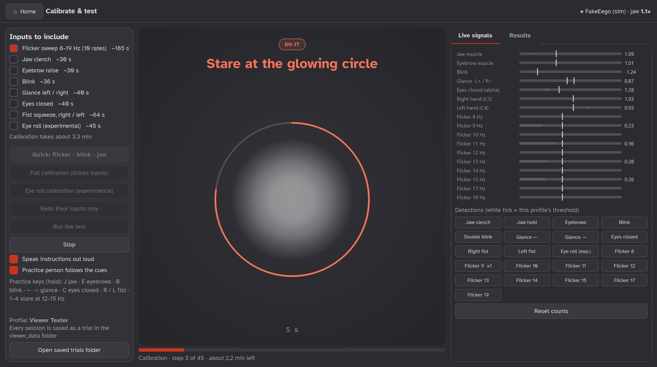
BEYOND THE DEMO
Built for a real person to use
✓
Profiles
each wearer keeps their own thresholds and best rates
✓
Guided calibration
randomized, spoken out loud: no need to read the screen
✓
Live test
scored hit rate, reaction time and false alarms
✓
Every session saved
raw EEG kept, re-scored with new code
✓
Open data
Calibration screen: spoken cue, countdown ring, live meters for every signal
40 min of anonymized EEG, published on GitHub
Notes:
This isn't just a demo. Each person gets a profile; calibration is randomized and spoken out loud so someone lying down doesn't need to read the screen; there's a scored live test; every session's raw EEG is saved; and we published 40 minutes of anonymized EEG on GitHub.

Slide 8
WHAT'S NEXT
From two teammates to the people it's for
Honest limits
Next steps
Tested on 2 able-bodied wearers
Accuracy measured in calibration and replay; live use is next
Flicker excludes photosensitive epilepsy
Test with spinal cord injury and ALS users
Adapt thresholds as the cap settles during a session
More apps on the same two signals: messaging, smart home
Code, data and results: github.com/solacorrado/eeg-interpreter
Thank you · Team 7
Notes:
To be honest about limits: two able-bodied wearers so far, and accuracy comes from calibration and replay. Next we want to test with spinal cord injury and ALS users, and put more apps on the same two signals. Everything is open on GitHub. Thank you.

