Slide 1
Fixed Point FFT
with rounding support

Slide 2
CONTENTS:
Fixed-point representation
Fixed-point Arithmetic
Rounding methods
Python and integers
FFT Algorithm

Slide 3
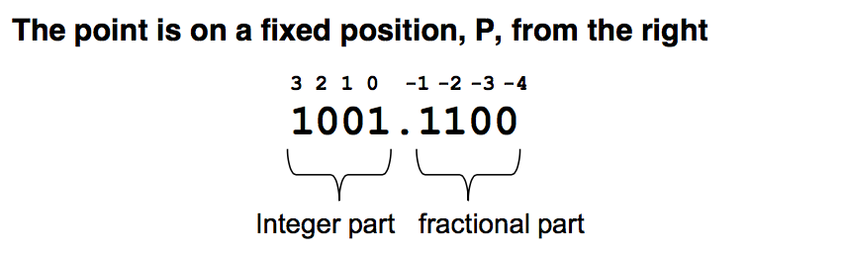
Fixed-point representation
RESOLUTION?
SCALED VALUE? 10011100b (156)d
SCALE FACTOR? 2^(-4) = 1/16
MAPPING TO DIFFERENT SCALE FACTOR?
NEGATIVE VALUE? Second complement

Slide 4
Fixed-point Arithmetic
ADDING and SUBTRACTING:
V = scaled value, S = scaled factor
Only numbers with same resolution!
Mapping?
V₃ = V₁ + V₂ S₁ = S₂ = S₃ -> ADDING
V₃ = V₁ - V₂ S₁ = S₂ = S₃ -> SUBTRACTING
OVERFLOW?

Slide 5
Fixed-point Arithmetic
MULTIPLICATION:
V₃ = V₁ * V₂, S ₃ = S₁ * S₂
Because: a*s1*b*s2 = (a*b)*(s1*s2)
Rounding?
Overflow? YES! Be careful!

Slide 6
Fixed-point Arithmetic
DIVISION:
V₃ = V₁ / V₂, S ₃ = S₁ / S₂
Because: (a*s1)/(b*s2) = (a/b)*(s1/s2)
Rounding?
Overflow?
Saturation? Built-in limits

Slide 7
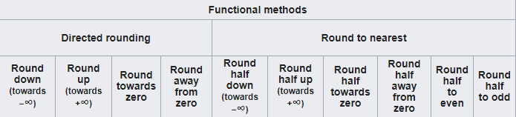
Rounding methods
Two approaches (functional):
Directed rounding
Round to nearest
Other? Randomized

Slide 8
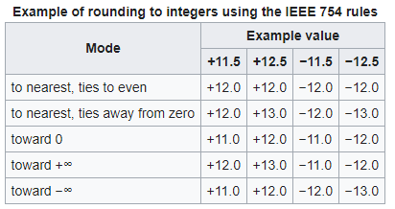
Rounding methods
STANDARD IEEE-754

Slide 9
Python and integers
Python2 versus Python3
Long vs int
32bits or unlimited
PyLongObject
Sign and magnitude
Two’s complement

Slide 10
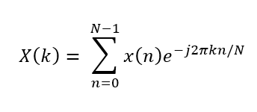
FFT Algorithm
What is FFT?
DFT formula:
What is problem with this?
Can we do better?

Slide 11
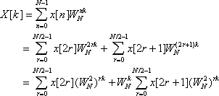
FFT Algorithm
We can….
Gauss(1805) or Cooley + Tukey (1965)

Slide 12
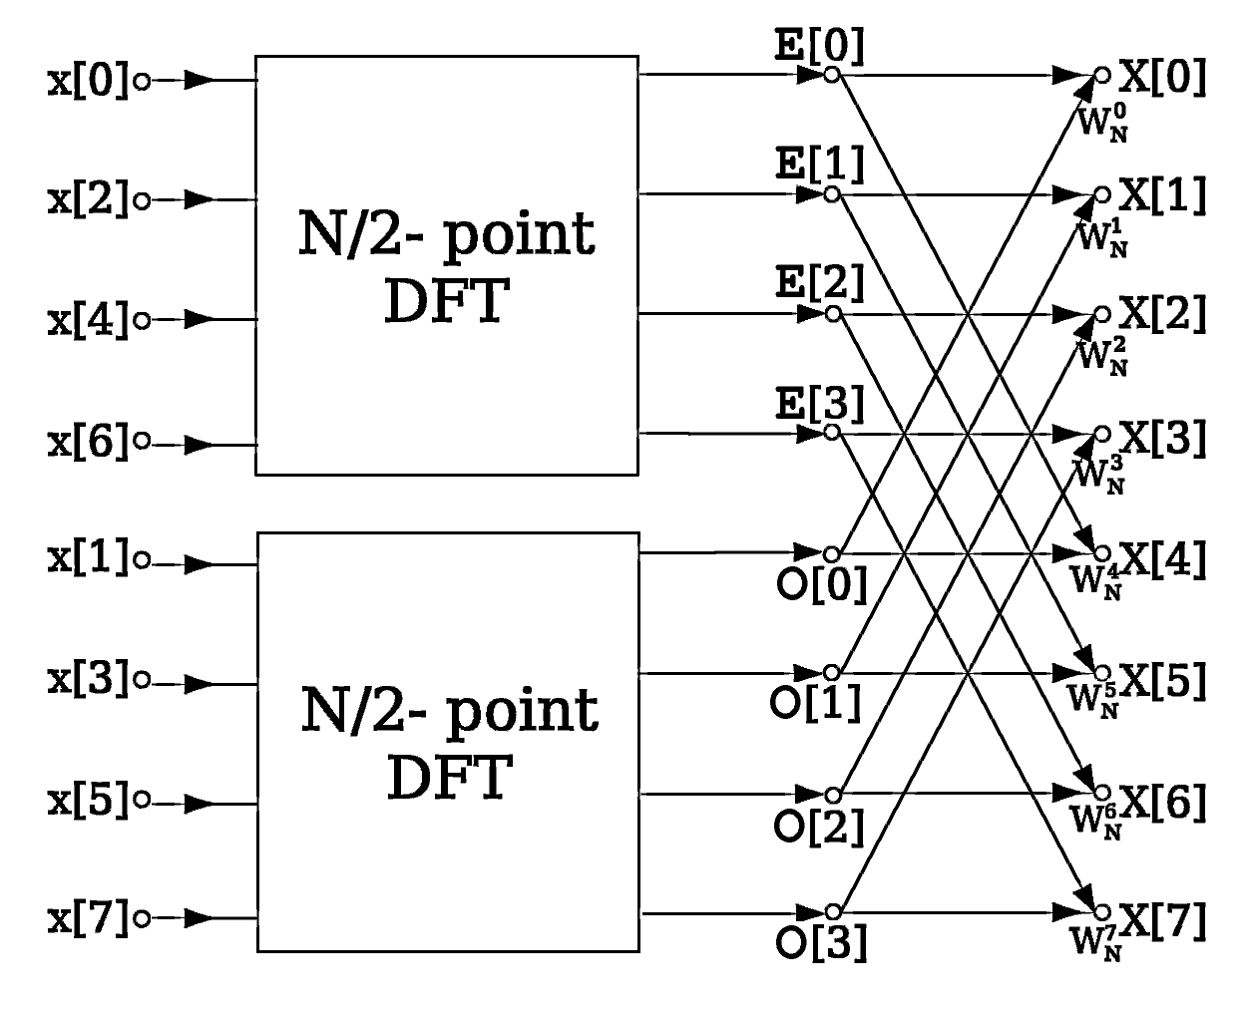
FFT Algorithm
Butterfly

