Slide 1

THE SYRIAN PRIVATE UNIVERSITY
FACULTY OF COMPUTER & INFORMATICS ENGINEERING
Learning Management System LMS
Prepared By:
Sulaf Walid Al-Samarra
Supervised by
Dr. Akram Masouh
October 2026

Slide 2
Project Importance
Localization-First Paradigm
Low-Overhead Infrastructure
Software Engineering Rigor
Eliminates cognitive friction and layout fragmentation by engineering native Right-to-Left (RTL) navigation from inception.
Reduces strict dependency on expensive foreign SaaS cloud platforms via a zero-configuration SQLite/Django deployment.
Validates full Requirements Traceability Matrices (RTM) and model-driven UML behavioral modeling in higher education ecosystems.

Slide 3
Project Goals
01
02
03
04
Native RTL MVT Architecture
End-to-End Academic Workflows
Heuristic At-Risk Analytics
59-Requirement Traceability
Architect a responsive Django web platform with 100% Arabic UI alignment using Bootstrap 5 RTL.
Implement complete course lifecycles, automated quiz grading, file submissions, and forums.
Develop rule-based algorithms to flag struggling students based on task engagement and grades.
Map all functional capabilities directly to UML behavioral models and unit testing specifications.

Slide 4
Literature Review and Previous Work
Al-Mashaqbeh (2023)
Investigated adaptive LMS in Arab higher education; noted post-hoc translations cause severe RTL rendering breakage.
Silva (2023)
Evaluated MVT vs MVC; proved Django MVT coupled with optimized ORM yields superior template rendering speed.
Al-Hassan (2023)
Established CSS logical property standards for native RTL layout compliance across mobile and desktop.
Otto & Thornton (2021)
Demonstrated zero-configuration SQLite ACID compliance as optimal for low-overhead academic LMS prototypes.
Al-Rahman (2025)
Showed rule-based at-risk heuristics improve student retention, though microservice setups remain over-complex.

Slide 5
Comparison of previous studies
System / Study | Tech Stack | Key Feature 1 | Key Feature 2 | Strengths & Limitations
Moodle | PHP, MySQL | Question Banks | SCORM Plugins | Robust ecosystem; heavy RTL overhead and complex UI.
Canvas LMS | Ruby, React | Modern UX / API-First | Mobile Ecosystem | Excellent UX; high SaaS licensing cost and rigid localization.
Open edX | Python, Microservices | Massive Scale MOOC | XBlock Framework | High scalability; extreme infrastructure deployment complexity.
Al-Rahman (2025) | Python, ML, REST | ML At-Risk Prediction | Content Recommendations | Predictive power; heavy resource demands and no native RTL.
Proposed System | Django MVT, SQLite | Native Arabic RTL | Heuristic Analytics | Zero-cost deployment, native RTL, lightweight & tailored.

Slide 6
General Functional System Requirements:
ID | General Functional Requirement
FR-G01 | The system must allow Secure Authentication & Authorization
FR-G02 | The system must allow Course & Multimedia Lifecycle Management
FR-G03 | The system must allow Assessment & Evaluation Engine
FR-G04 | The system must allow Institutional Analytics & Communication

Slide 7
Non-Functional Requirements
ID | Description | Non-functional requirement
NFR-01 | Flawless rendering across desktop, tablet, and mobile device viewports | Responsive Design
NFR-04 | PBKDF2 SHA256 password hashing and CSRF token protection | Data Security
NFR-06 | Native Arabic RTL layout structure from base HTML templates up. | Native Localization
NFR-010 | Rule-based calculations to track student engagement and flag academic risk | Intelligent Analytics

Slide 8
Functional requirements for the current project
REQ-030 | Create Assignment | Teacher creates a new assignment with title, description, file attachment, and deadline. | 3
REQ-031 | View Assignment Details | Student views assignment requirements, instructions, and due dates. | 3
REQ-032 | Submit Assignment | Student uploads a file or enters text as an assignment solution before the deadline. | 3
REQ-033 | View Submissions | Teacher views the list of students who submitted the assignment and those who did not. | 3
REQ-034 | Grade Assignment | Teacher enters a grade and adds text feedback for each assignment submission. | 3
REQ-035 | View Grade & Feedback | Student views their assignment grade and reads the teacher's feedback. | 3
REQ-036 | Start Quiz | Student starts an available quiz with a countdown timer display if a time limit is set. | 4
REQ-037 | Auto-Grade Objective Qs | System automatically calculates quiz grade based on stored correct answers upon submission. | 4
REQ-038 | View Instant Quiz Result | System displays student's grade and correct answers compared to their responses. | 4
REQ-039 | View Student Grade Log | Student views a summary of all grades (assignments + quizzes) in a specific course. | 4
REQ-040 | Export Course Grades | Teacher exports the student grades table for a course to an Excel/CSV file. | 4
REQ-041 | Post Course Announcement | Teacher publishes an announcement visible on the course homepage to all enrolled students. | 4
REQ-042 | View Announcements | Students and admins view course-specific or platform-wide announcements. | 4
REQ-043 | Post Discussion Question | Student posts a question or starts a discussion thread in the course forum. | 4
REQ-044 | Reply to Discussions | Teacher or students reply to questions posted in the discussion forum. | 4
REQ-045 | View Course Progress Bar | System calculates and displays student's course completion percentage based on activity. | 4
REQ-046 | Student Dashboard | Student views comprehensive overview: enrolled courses, upcoming tasks, and announcements. | 4
REQ-047 | Teacher Dashboard | Teacher views quick statistics: enrolled students, pending grading, and course averages. | 4
REQ-048 | Identify At-Risk Students | Teacher filters and identifies students with unsubmitted assignments or low progress (heuristic). | 5
REQ-049 | Assignment Submission Notif. | System sends an internal notification to the teacher when a student submits an assignment. | 5
REQ-050 | Grade/Announcement Notif. | System sends a notification to the student when graded or when a new announcement is posted. | 5
REQ-051 | View Personal Academic Cal. | Student views assignment due dates and quiz schedules in a simplified calendar interface. | 5
REQ-052 | Advanced Course Search | User searches courses using keywords, category filter, or teacher name. | 5
REQ-053 | Bookmark/Favorite Course | Student adds course to favorites list for quick dashboard access. | 5
REQ-054 | Download Course Materials | Student downloads attached files from course content if permitted. | 5
REQ-055 | Submit Feedback/Support | User submits technical feedback or an issue report to the system administrator via a form. | 5
REQ-056 | Duplicate Course | Teacher/Admin copies existing course structure to create a new one quickly. | 5
REQ-057 | Archive Completed Courses | System moves completed courses to an archive section, hiding them from main UI. | 5
REQ-058 | Granular Permission Mgmt | Admin modifies sub-role permissions (e.g., restrict course deletion). | 5
REQ-059 | Manual Database Backup | Admin clicks a button to export the current SQLite database backup. | 5

Slide 9
Development Methodology:
Incremental Development Model
Incremental 1 (Initialization & Requirements): Completion of literature review, stakeholder analysis, and finalization of the 59-item RDB (REQ-001 to REQ-059).
Incremental 2 (System Design): Approval of UML behavioral/structural diagrams, ERD, and architectural blueprint.
Incremental 3 (Core Implementation): Delivery of Increment 1 & 2 (Authentication, Admin Panel, Course & Content Management).
Incremental 4 (Advanced Modules): Delivery of Increment 3 (Assignments, Quizzes, Discussions, Analytics Dashboards [REQ-030 to REQ-059]).
Incremental 5 (Testing & Evaluation): Execution of system test cases, RTM verification, and final thesis defense preparation.

Slide 10
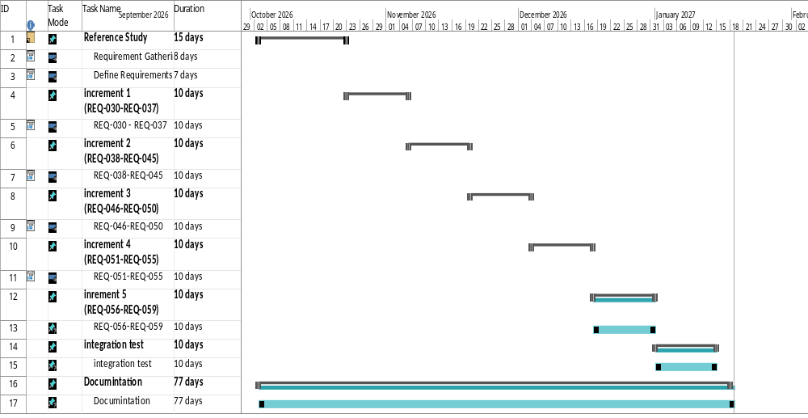
Project Plan (Gantt Chart)

