Slide 1
Chapter 21: Information Retrieval

Slide 2
Chapter 21: Information Retrieval
Relevance Ranking Using Terms
Relevance Using Hyperlinks
Synonyms., Homonyms, and Ontologies
Indexing of Documents
Measuring Retrieval Effectiveness
Web Search Engines
Information Retrieval and Structured Data
Directories

Slide 3
Information Retrieval Systems
Information retrieval (IR) systems use a simpler data model than database systems
  Information organized as a collection of documents
  Documents are unstructured, no schema
Information retrieval locates relevant documents, on the basis of user input such as keywords or example documents
  e.g., find documents containing the words “database systems”
Can be used even on textual descriptions provided with non-textual data such as images
Web search engines are the most familiar example of IR systems

Slide 4
Information Retrieval Systems (Cont.)
Differences from database systems
  IR systems don’t deal with transactional updates (including concurrency control and recovery)
  Database systems deal with structured data, with schemas that define the data organization
  IR systems deal with some querying issues not generally addressed by database systems
    Approximate searching by keywords
    Ranking of retrieved answers by estimated degree of relevance

Slide 5
Keyword Search
In full text retrieval, all the words in each document are considered to be keywords.
  We use the word term to refer to the words in a document
Information-retrieval systems typically allow query expressions formed using keywords and the logical connectives and, or, and not
  Ands are implicit, even if not explicitly specified
Ranking of documents on the basis of estimated relevance to a query is critical
  Relevance ranking is based on factors such as
    Term frequency
      Frequency of occurrence of query keyword in document
    Inverse document frequency
      How many documents the query keyword occurs in
        Fewer ➔ give more importance to keyword
    Hyperlinks to documents
      More links to a document ➔ document is more important

Slide 6
Relevance Ranking Using Terms
TF-IDF (Term frequency/Inverse Document frequency) ranking:
  Let n(d) = number of terms in the document d
  n(d, t) = number of occurrences of term t in the document d.
  Relevance of a document d to a term t
    The log factor is to avoid excessive weight to frequent terms
  Relevance of document to query Q
n(d, t)
TF (d, t) = log
1 +
n(d)
∑
TF (d, t)
r (d, Q) =
t∈Q
n(t)

Slide 7
Relevance Ranking Using Terms (Cont.)
Most systems add to the above model
  Words that occur in title, author list, section headings, etc. are given greater importance
  Words whose first occurrence is late in the document are given lower importance
  Very common words such as “a”, “an”, “the”, “it” etc. are eliminated
    Called stop words
  Proximity: if keywords in query occur close together in the document, the document has higher importance than if they occur far apart
Documents are returned in decreasing order of relevance score
  Usually only top few documents are returned, not all

Slide 8
Similarity Based Retrieval
Similarity based retrieval - retrieve documents similar to a given document
  Similarity may be defined on the basis of common words
    E.g., find k terms in A with highest TF (d, t ) / n (t ) and use these terms to find relevance of other documents.
Relevance feedback: Similarity can be used to refine answer set to keyword query
  User selects a few relevant documents from those retrieved by keyword query, and system finds other documents similar to these
Vector space model: define an n-dimensional space, where n is the number of words in the document set.
  Vector for document d goes from origin to a point whose i ^{th} coordinate is TF (d,t ) / n (t )
  The cosine of the angle between the vectors of two documents is used as a measure of their similarity.

Slide 9
Relevance Using Hyperlinks
Number of documents relevant to a query can be enormous if only term frequencies are taken into account
Using term frequencies makes “spamming” easy
    E.g., a travel agency can add many occurrences of the words “travel” to its page to make its rank very high
Most of the time people are looking for pages from popular sites
Idea: use popularity of Web site (e.g., how many people visit it) to rank site pages that match given keywords
Problem: hard to find actual popularity of site
  Solution: next slide

Slide 10
Relevance Using Hyperlinks (Cont.)
Solution: use number of hyperlinks to a site as a measure of the popularity or prestige of the site
  Count only one hyperlink from each site (why? - see previous slide)
  Popularity measure is for site, not for individual page
    But, most hyperlinks are to root of site
    Also, concept of “site” difficult to define since a URL prefix like cs.yale.edu contains many unrelated pages of varying popularity
Refinements
  When computing prestige based on links to a site, give more weight to links from sites that themselves have higher prestige
    Definition is circular
    Set up and solve system of simultaneous linear equations
  Above idea is basis of the Google PageRank ranking mechanism

Slide 11
Relevance Using Hyperlinks (Cont.)
Connections to social networking theories that ranked prestige of people
  E.g., the president of the U.S.A has a high prestige since many people know him
  Someone known by multiple prestigious people has high prestige
Hub and authority based ranking
  A hub is a page that stores links to many pages (on a topic)
  An authority is a page that contains actual information on a topic
  Each page gets a hub prestige based on prestige of authorities that it points to
  Each page gets an authority prestige based on prestige of hubs that point to it
  Again, prestige definitions are cyclic, and can be got by
  solving linear equations
  Use authority prestige when ranking answers to a query

Slide 12

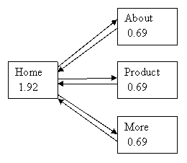
Google’s PageRank
Original Paper: http://infolab.stanford.edu/~backrub/google.html
  Based on Random Surfer/Walk Model
  PR(A) = (1-d) + d (PR(T1)/C(T1) + ... + PR(Tn)/C(Tn))
Page Rank Explained: http://www.cs.princeton.edu/~chazelle/courses/BIB/pagerank.htm

Slide 13
Synonyms and Homonyms
Synonyms
  E.g., document: “motorcycle repair”, query: “motorcycle maintenance”
    Need to realize that “maintenance” and “repair” are synonyms
  System can extend query as “motorcycle and (repair or maintenance)”
Homonyms
  E.g., “object” has different meanings as noun/verb
  Can disambiguate meanings (to some extent) from the context
Extending queries automatically using synonyms can be problematic
  Need to understand intended meaning in order to infer synonyms
    Or verify synonyms with user
  Synonyms may have other meanings as well

Slide 14
Concept-Based Querying
Approach
  For each word, determine the concept it represents from context
  Use one or more ontologies:
    Hierarchical structure showing relationship between concepts
    E.g., the ISA relationship that we saw in the E-R model
This approach can be used to standardize terminology in a specific field
Ontologies can link multiple languages
Foundation of the Semantic Web (not covered here)

Slide 15
Indexing of Documents
An inverted index maps each keyword K_{i} to a set of documents S_{i} that contain the keyword
  Documents identified by identifiers
Inverted index may record
  Keyword locations within document to allow proximity based ranking
  Counts of number of occurrences of keyword to compute TF
and operation: Finds documents that contain all of K₁, K₂, ..., K_{n}.
  Intersection S₁∩ S₂ ∩..... ∩ S_{n}
or operation: documents that contain at least one of K₁, K₂, …, K_{n}
  union, S₁∩ S₂ ∩..... ∩ S_{n},.
Each S_{i} is kept sorted to allow efficient intersection/union by merging
  “not” can also be efficiently implemented by merging of sorted lists

Slide 16
Measuring Retrieval Effectiveness
Information-retrieval systems save space by using index structures that support only approximate retrieval. May result in:
  false negative (false drop) - some relevant documents may not be retrieved.
  false positive - some irrelevant documents may be retrieved.
  For many applications a good index should not permit any false drops, but may permit a few false positives.
Relevant performance metrics:
  precision - what percentage of the retrieved documents are relevant to the query.
  recall - what percentage of the documents relevant to the query were retrieved.

Slide 17
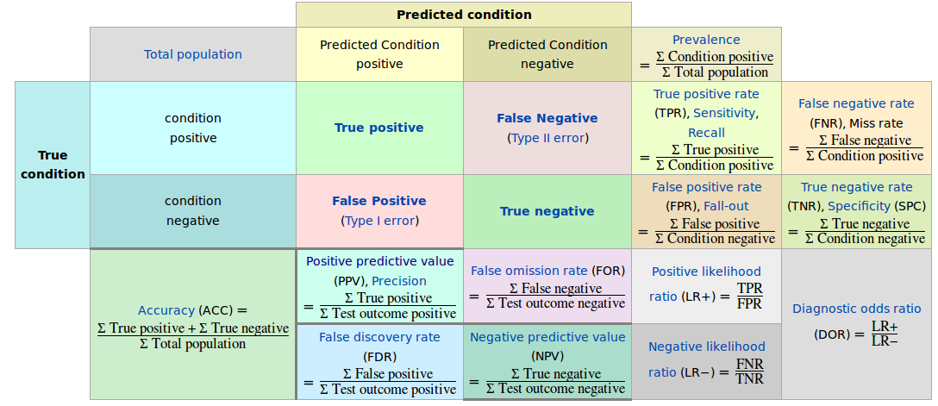
Measuring Retrieval Effectiveness

Slide 18
Measuring Retrieval Effectiveness (Cont.)
Recall vs. precision tradeoff:
    Can increase recall by retrieving many documents (down to a low level of relevance ranking), but many irrelevant documents would be fetched, reducing precision
Measures of retrieval effectiveness:
  Recall as a function of number of documents fetched, or
  Precision as a function of recall
    Equivalently, as a function of number of documents fetched
  E.g., “precision of 75% at recall of 50%, and 60% at a recall of 75%”
Problem: which documents are actually relevant, and which are not

Slide 19
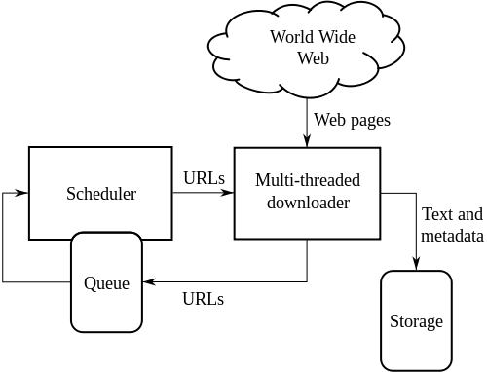
Web Search Engines
Web crawlers are programs that locate and gather information on the Web
  Recursively follow hyperlinks present in known documents, to find other documents
    Starting from a seed set of documents
  Fetched documents
    Handed over to an indexing system
    Can be discarded after indexing, or store as a cached copy
Crawling the entire Web would take a very large amount of time
  Search engines typically cover only a part of the Web, not all of it
  Take months to perform a single crawl

Slide 20
Web Crawling (Cont.)
Crawling is done by multiple processes on multiple machines, running in parallel
  Set of links to be crawled stored in a database
  New links found in crawled pages added to this set, to be crawled later
Indexing process also runs on multiple machines
  Creates a new copy of index instead of modifying old index
  Old index is used to answer queries
  After a crawl is “completed” new index becomes “old” index
Multiple machines used to answer queries
  Indices may be kept in memory
  Queries may be routed to different machines for load balancing

Slide 21
Information Retrieval and Structured Data
Information retrieval systems originally treated documents as a collection of words
Information extraction systems infer structure from documents, e.g.:
  Extraction of house attributes (size, address, number of bedrooms, etc.) from a text advertisement
  Extraction of topic and people named from a new article
Relations or XML structures used to store extracted data
  System seeks connections among data to answer queries
  Question answering systems

Slide 22
Directories
Storing related documents together in a library facilitates browsing
  Users can see not only requested document but also related ones.
Browsing is facilitated by classification system that organizes logically related documents together.
Organization is hierarchical: classification hierarchy

Slide 23
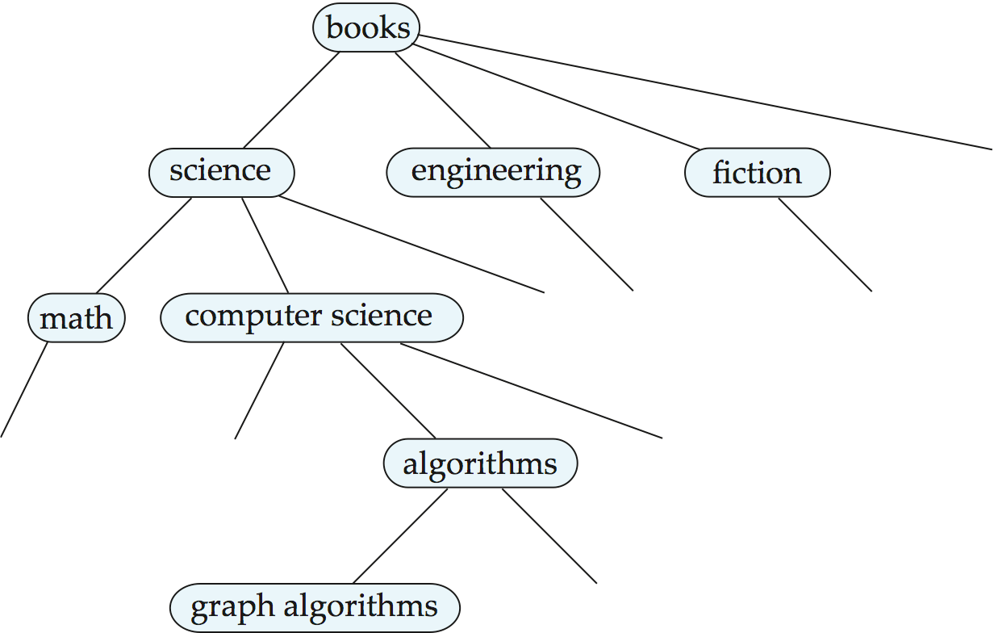
A Classification Hierarchy For A Library System

Slide 24
Classification DAG
Documents can reside in multiple places in a hierarchy in an information retrieval system, since physical location is not important.
Classification hierarchy is thus Directed Acyclic Graph (DAG)

Slide 25

A Classification DAG For A Library Information Retrieval System

Slide 26
Web Directories
A Web directory is just a classification directory on Web pages
  E.g., Yahoo! Directory, Open Directory project
  Issues:
    What should the directory hierarchy be?
    Given a document, which nodes of the directory are categories relevant to the document
  Often done manually
    Classification of documents into a hierarchy may be done based on term similarity

Slide 27
End of Chapter

