Slide 1
Course Code: CSE207 (Data Structures)
Course Instructor:
Tanni Mittra
Lecturer
Department of CSE
CSE, East West University

Slide 2
Course Information
Textbook:
Data Structure – A Pseudocode Approach with C - Richard F. Gilberg, Behrouz A. Forouzan.
Mark Distribution
Class Participation 5%
Assignments 5%
Quiz 10%
1st Mid Term Exam 15%
2nd Mid Term Exam 20%
Final Exam 20%
Lab 25%

Slide 3
Objectives of course
The objective of this course is to make the students of Computer Science familiar with the basic and advanced data structures
To teach them how to choose appropriate data structure for improving the performance of a program.
Choose the appropriate data structure and algorithm design method for a specified application.
Choose appropriate Data structures to develop software system

Slide 4
Topic Covered
Understand the concept of Data Structures
Distinguish between data structures and Data types
Learn how data structure are organized in computer
Describe the characteristics of common types of data structure
Understand the Abstract Data Type
Describe the advantages of Abstract Data Type

Slide 5
What is Data?
Data are simply values or set of values.
Data is the number or description of name, quantity, nature of a person, subject or product
Data may be in different language, pattern i.e. sign, letter, picture etc
Data need to represent in machine code to operate or understand by computer.
Example: To make pay roll management system of a company we need name, designation, salary and code of an employee. So the value of all these filed is data. i.e. Mr.X, SO, 50k.
‘Data’ is plural form of ‘Datum’

Slide 6
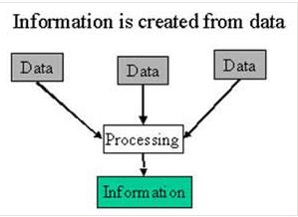
Information
Information is data that has been processed in such a way as to be meaningful to the person who receives it.
Information can be explained as any kind of understanding or knowledge that can be exchanged with people
Example: Mobile No of a customer including his name and age

Slide 7
Knowledge
Data becomes information, which in turn is processed as knowledge, then finally manifested in a physical way as decisions and actions
knowledge is the appropriate collection of information
When someone "memorizes" information then they have amassed knowledge
By knowledge we mean human understanding of a subject matter that has been acquired through proper study and experience
Knowledge
Information
Data

Slide 8
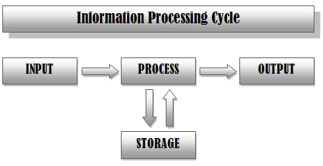
Information Processing Cycle
The sequence of events in processing information
They are:
Input—entering data into the computer.
Processing—performing operations on the data.
Storage—saving data, programs, or output for future use.
Output—presenting the results.

Slide 9
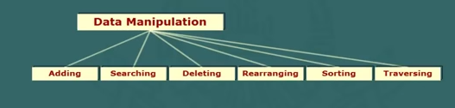
Introduction of Data Structure
Study of various ways of organizing data in a computer
Information is manipulated by systematic and step by step procedure called Algorithm
Manipulation means adding, deleting, searching, rearranging data items

Slide 10
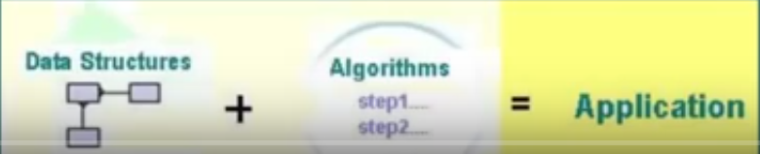
Introduction of Data Structure
Data structures are used in several disciplines
Used by operating system, compilers and database management systems, data communications and so on
Algorithm together with data structures are used in several applications
Common applications are image processing, digital signal processing , simulations, numerical computations, cryptography , data compressions and generic studies.

Slide 11
Data Types
Data types are required for efficient coding of program
Two types are primitive and composite
Primitive types are the most basic data types available within programing language.
Example:
boolean stores logical values true or false . Basic operations are AND, OR and NOT
integer type can assume different set of values depending on compiler system and basic operations are arithmetic and comparison.
These types serve as the building blocks of data manipulation .
Primitive data types are also called atomic and irreducible data types

Slide 12
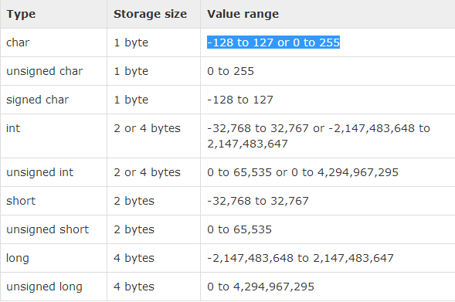
Data Types
Ranges of primitive data types depends on the number of bits allocated by the compiler and hardware circuit.
Typically an integer ranges from -2,147,483,648 to 2,147,483,647
Character type ranges from -128 to 127 or 0 to 255
Operations on primitive data types are often included in the CPU instructions set

Slide 13
Data Types
Composite Data Type
Complex data type are defined using combination of primitive data type
Composite data type can be arrays, strings and vectors
An array is a collection of homogeneous data types
Vectors are mathematical explanation of arrays
String in a combination of characters

Slide 14
Why we need Data Structures
Primitive and composite data types are sufficient for solving problems
The early computer application depended on the built in data types of programming language
Primitives data types are not always sufficient to solve advanced problem
Need for advanced data types arose due to the new paradigm of object oriented approach
Data structure are meant to serve this special needs

Slide 15
Data structures
It is a programming construct that stores a collection of data items
Actually its not just an extension of composite data type
Two significant differences are:
First, it encompasses both primitive and composite data type
Secondly, it includes some kind of relationship among the data types
For example: string

Slide 16
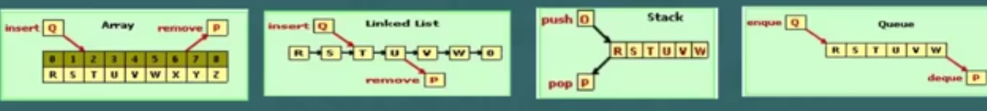
Classification of Data Structure
Data Structures are classified into two types: Linear and Non-linear
A structure in which data elements are organized in in sequence is referred to as linear
Examples are: arrays, linked lists, stacks and queue

Slide 17
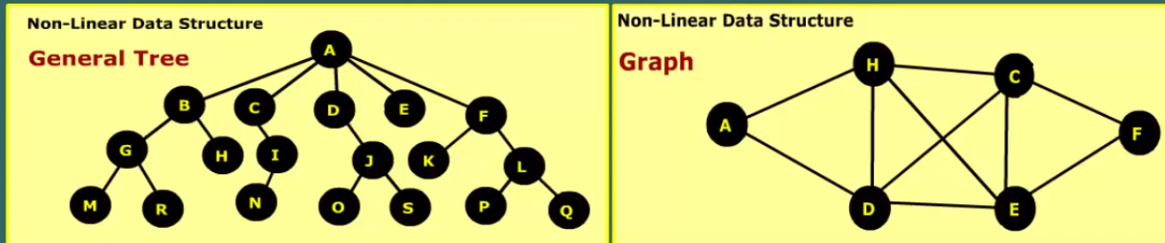
Classification of Data Structure
Non-linear data structure
Relationship between data items can be hierarchical
Linkage may be single or bi-directional
Common example: tree and graph

Slide 18
Basic Operations
The data in the data structures are processed by certain operations. The particular data structure chosen largely depends on the frequency of the operation that needs to be performed on the data structure.
Traversing
Searching
Insertion
Deletion
Sorting
Merging

Slide 19
User Defined data structure
Stack, queue and tree are general purpose data structure, called classic data structures
We can also create our own data structure called user defined data structure
For example we can define a data structure to store records of 100 employees
Each record consists of employee name , designation and salary
The code fragment in C might be as follows:
The element of employee array can be accessed using C notation as follows:
EMP[0].name

Slide 20
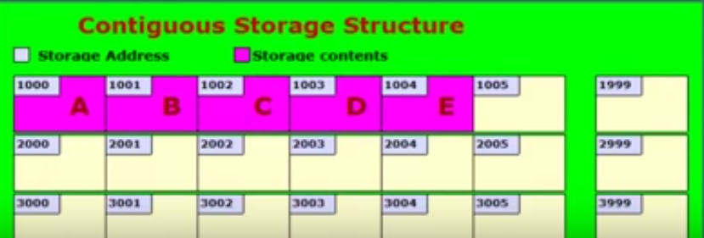
Storage Structures
It describes how the data item are stored in the memory
Provides a map how the data elements are allocated memory space
Elements are stores in consecutive and disjoint storage of memory location
Each location is identified by unique number called memory address
To access the elements we need the address of the first element

Slide 21
Abstract data Type
ADT is a new concept to describe data structures
ADT combined the description of data structure and associated operations
ADT has following characteristics:
Provides description of elements in terms of data type
Defines relationship among individual elements
Valid operation and parameter are to be passed
Error condition associated with the operations

Slide 22
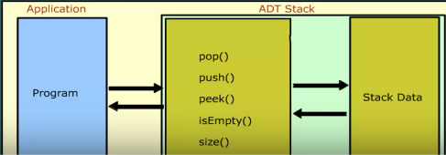
Abstract data Type
Set of operations associated with ADT is called interface
Elements of ADT data structure are manipulated through an interface
Implementation of data operations and data items are hidden from the application program
For example: An stack ADT contains operations like pop, push, peek, size, isempty

Slide 23
All built in primitive data types are ADT
For example: in floating point type we can not add a new operation say exponentiations
We can not enhance or shrink the range of allowed values
That means ADT does not allow how the data structures would be coded
It also does not provide how the data items are stored in memory
Implementation is hidden from the user
Some high level language provide supports to ADT
C supports built in struct type
C++ class construct can be used as ADT
JAVA ADT can be expressed as interface

Slide 24
Advantages of ADT
Some advantages over the conventional data structures
ADT is reusable and robust and is based on OOP and SE
Can be reused at several places and it reduces coding effort
Encapsulation ensures that data can not be corrupted

