Slide 1
CSE207
Pointers

Slide 2
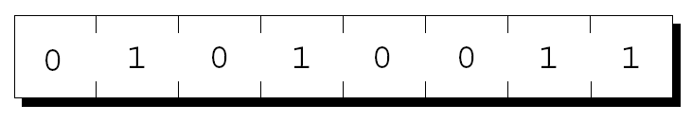
Pointer Variables
2
The first step in understanding pointers is visualizing what they represent at the machine level.
In most modern computers, main memory is divided into bytes, with each byte capable of storing eight bits of information:
Each byte has a unique address.

Slide 3
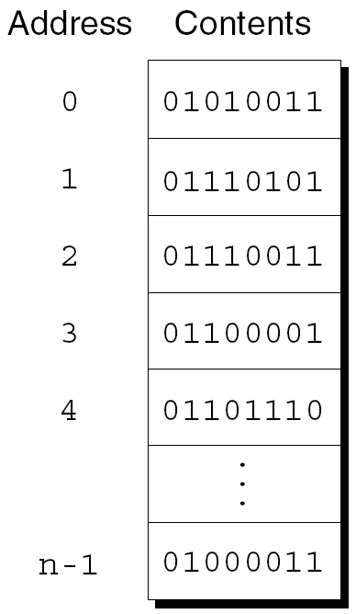
Pointer Variables
3
If there are n bytes in memory, we can think of addresses as numbers that range from 0 to n – 1:

Slide 4
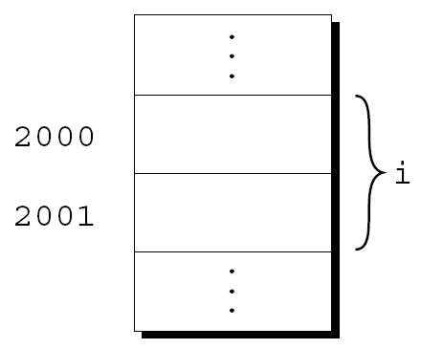
Pointer Variables
4
Each variable in a program occupies one or more bytes of memory.
The address of the first byte is said to be the address of the variable.
In the following figure, the address of the variable i is 2000:

Slide 5
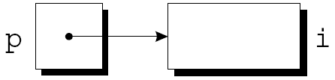
Pointer Variables
5
Addresses can be stored in special pointer variables.
When we store the address of a variable i in the pointer variable p, we say that p “points to” i.
A graphical representation:

Slide 6
Declaring Pointer Variables
6
Pointer variables can appear in declarations along with other variables:
int i, j, a[10], b[20], *p, *q;
C requires that every pointer variable point only to objects of a particular type (the referenced type):
int *p; /* points only to integers */
double *q; /* points only to doubles */
char *r; /* points only to characters */
There are no restrictions on what the referenced type may be.

Slide 7
Pointer Variable Declaration and Initialization
Pointer declaration
Multiple pointers require using a * before each variable definition
int *myPtr1, *myPtr2;
Can define pointers to any data type
It’s crucial to initialize p before we use it.
Initialize pointers to 0, NULL, or an address
0 or NULL – points to nothing (NULL preferred)

Slide 8
The Address and Indirection Operators
8
C provides a pair of operators designed specifically for use with pointers.
&
To find the address of a variable, we use the & (address) operator.
*
To gain access to the object that a pointer points to, we use the * (indirection) operator.

Slide 9
Pointer Operators
& (address operator)
Returns address of operand
int y = 5;
int *yPtr;
yPtr = &y; /* yPtr gets address of y */
yPtr “points to” y
y
yptr
y
yPtr
5
500000
600000
600000
5
Address of y is value of yptr

Slide 10
The Address Operator
It’s also possible to initialize a pointer variable at the time it’s declared:
int i;
int *p = &i;

Slide 11
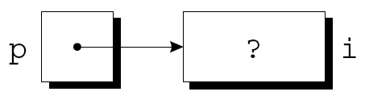
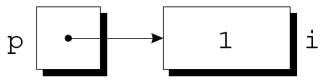
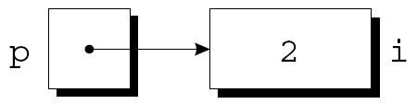
The Indirection Operator
p = &i;
i = 1;
printf("%d\n", i); /* prints 1 */
printf("%d\n", *p); /* prints 1 */
*p = 2;
printf("%d\n", i); /* prints 2 */
printf("%d\n", *p); /* prints 2 */

Slide 12
The Indirection Operator
Applying the indirection operator to an uninitialized pointer variable causes undefined behavior:
int *p;
printf("%d", *p); /*** WRONG ***/
Assigning a value to *p is particularly dangerous:
int *p;
*p = 1; /*** WRONG ***/

Slide 13
Pointer Assignment
C allows the use of the assignment operator to copy pointers of the same type.
Assume that the following declaration is in effect:
int i, j, *p, *q;
Example of pointer assignment:
p = &i;

Slide 14
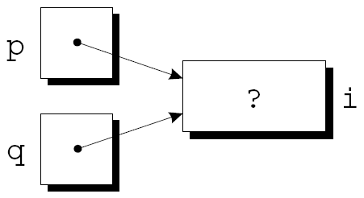
Pointer Assignment
Another example of pointer assignment:
q = p;
q now points to the same place as p:

Slide 15

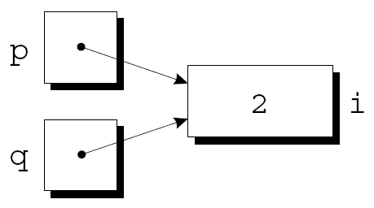
Pointer Assignment
If p and q both point to i, we can change i by assigning a new value to either *p or *q:
*p = 1;
*q = 2;
Any number of pointer variables may point to the same object.

Slide 16
Pointer Assignment
Be careful not to confuse
q = p;
with
*q = *p;
The first statement is a pointer assignment, but the second is not.
The example on the next slide shows the effect of the second statement.

Slide 17
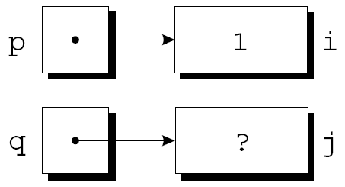
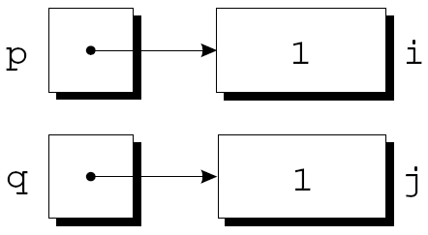
Pointer Assignment
p = &i;
q = &j;
i = 1;
*q = *p;

Slide 18
Comparing Pointers
You may compare pointers using >,<,== etc.
Common comparisons are:
check for null pointer if (p == NULL) …
check if two pointers are pointing to the same location
if (p == q) … Is this equivalent to
if (*p == *q) …
Then what is if (*p == *q) …
compare two values pointed by p and q

Slide 19
6.4 Pointers in Function References (!IMPORTANT!)
In C, function references are call-by-value except when an array name is used as an argument.
An array name is the address of the first element
Values in an array can be modified by statements within a function
To modify a function argument, a pointer to the argument must be passed
scanf(“%f”, &X); This statement specifies that the value read is to be stored at the address of X
The actual parameter that corresponds to a pointer argument must be an address or pointer.

Slide 20
Call by reference
void swap2(int *aptr,
int *bptr)
{
int temp;
temp = *aptr;
*aptr = *bptr;
*bptr = temp;
return;
}
main()
{
int x = 2, y = 3;
printf("%d %d\n“,x,y);
swap2(&x, &y);
printf("%d %d\n“,x,y);
}
Changes made in function swap are done on original x and y and.
So they do not get lost when the function execution is over

Slide 21
Pointer Arithmetic
Four arithmetic operations are supported
+, -, ++, --
only integers may be used in these operations
Arithmetic is performed relative to the variable type being pointed to
MOSTLY USED WITH ARRAYS (see next section)
Example: p++;
if p is defined as int *p, p will be incremented by 4 (system dependent)
if p is defined as double *p, p will be incremented by 8(system dependent
when applied to pointers, ++ means increment pointer to point to next value in memory

Slide 22
6.2 Pointers and Arrays
The name of an array is the address of the first elements (i.e. a pointer to the first element)
The array name is a constant that always points to the first element of the array and its value can not be changed.
Array names and pointers may often be used interchangeably.
Example
int num[4] = {1,2,3,4}, *p, q[];
p = num;
q = p; // or q = num;
/* above assignment is the same as p = &num[0]; */
printf(“%i”, *p); // print num[0]
p++;
printf(“%i”, *p); // print num[1]
printf(“%i”, *q); // print num[0]
printf(“%i”, *(p+2)); // print num[2]

Slide 23
Two Dimensional Arrays
A two-dimensional array is stored in sequential memory locations, in row order.
int s[2][3] = {{2,4,6}, {1,5,3}};
int *sptr = &s[0][0];
Memory allocation:
s[0][0] 2
s[0][1] 4
s[0][2] 6
s[1][0] 1
s[1][1] 5
s[1][2] 3
A pointer reference to s[0][1] would be *(sptr+1)
A pointer reference to s[1][1] would be *(sptr+4)
row offset * number of columns + column offset

Slide 24
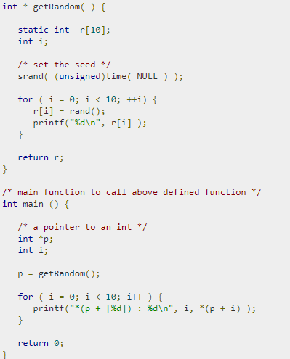
Return pointer from functions

Slide 25
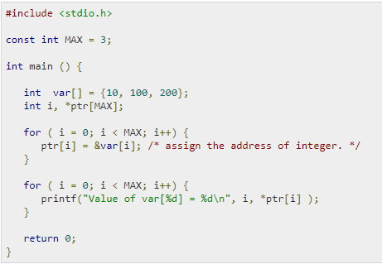
Array pointer

