Slide 1
Binary Trees

Slide 2
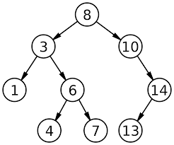
Binary trees
A binary tree is an ordered tree having at most two nodes
Node at left side of a node is called left node and at right side is called right node
No nodes can have more than two subtree
Subtrees are designed as left and right subtree.

Slide 3
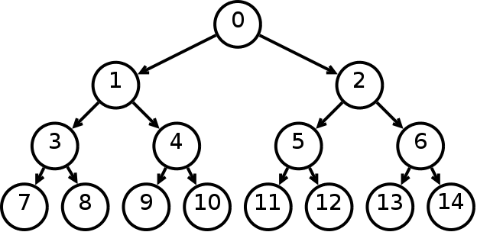
Complete Binary tree
Every nodes (except leaf) having two nodes
Maximum number of nodes in Level i is 2^{i .} i.e. nodes in level 0= 2⁰ = 1, level 1 = 2¹ = 2
In a tree of height, h
Leaf/leaves are at level h is 2^{h}
Number of nodes n,
= 2⁰ + 2¹ + 2³ +………..+ 2^{h}
=2^{h+1} -1
n = 2^{levels} -1
In a tree of node n,
The height h is : n = 2^{levels} -1
=> n+1= 2^{levels} = 2^{h+1}
=> log₂ (n+1) = h+1
=> h = log₂ (n+1) -1
L=0
L=1
L=2
L=3

Slide 4
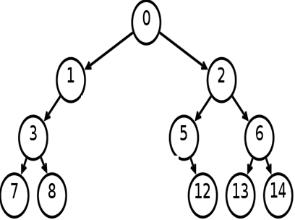
Binary tree from complete binary tree
A binary tree can be obtained from a complete binary tree by pruning

Slide 5
Minimum height of a Binary trees
A binary tree of height h has,
At most 2^{i} nodes in level I
At most 2⁰ + 2¹ + 2³ +………..+ 2^{h} = 2^{h+1} -1 nodes
If the tree has n nodes then,
n <= 2^{h+1} -1
=> h >= log₂ (n+1) -1
A binary tree has at least height of log₂ (n+1) -1 which is a complete binary tree

Slide 6
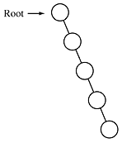
Maximum height of a Binary trees
If the tree has n nodes then the height is n-1
This is obtained when every node has exactly one child (except leaf node)

Slide 7
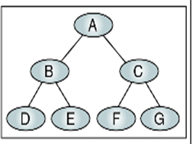
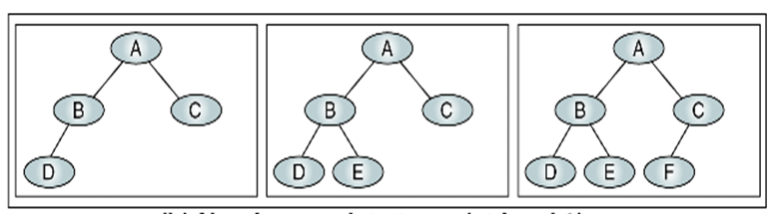
Near Complete Binary Tree
If a tree has the minimum height for its nodes and all nodes in the last level are found on the left is called near complete binary tree.

Slide 8
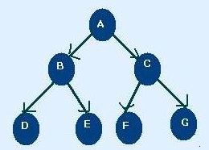
Binary Tree Traversal
Each Node of the tree must be processed once and only once in a predetermined sequence
Two general approach-
Depth First traversal
Breadth first traversal
Depth First traversal, the processing proceeds along a path from the root through one child to the most descendent of that first child before processing a second child
Breadth first traversal (level by level), the processing proceeds horizontally from the roots to all its children (left to right usually) i.e. A B C D E F G

Slide 9
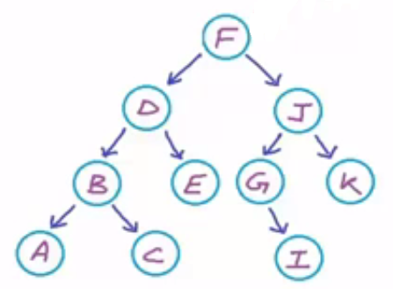
Depth First traversal
Three Standard traversal techniques :
Preorder traversal
<root > <left> <right>
Visit the root
Visit the left subtree
Visit the right subtree
i.e. F D B A C E J G I K
2. Inorder traversal
<left> <root > <right>
Visit the left subtree
Visit the root
Visit the right subtree
i.e. A B C D E F G I J K

Slide 10
Depth First traversal
Three Standard traversal techniques :
Postorder traversal
<left> <right> <root >
Visit the left subtree
Visit the right subtree
Visit the root
i.e. A C B E D I G K J F

Slide 11
Expression Trees
An expression tree is a binary tree with following properties :
Each leaf is an operand
The root and internal nodes are operator
Sub trees are sub expressions with the root being an operator
+
a * (b + c) +d
d
*
a
+
b
c

Slide 12
Infix Traversal
Algorithm infix (tree)
if (tree not empty)
if(tree token is an operand)
print (tree token)
else
print ( open parenthesis)
infix (tree left subtree)
print (tree token)
infix (tree right subtree)
print (close parenthesis)
end if
end if;
+
*
((a * (b + c)) +d)
d
a
+
b
c

Slide 13
prefix Traversal
Algorithm prefix (tree)
if (tree not empty)
print (tree token)
prefix (tree left subtree)
prefix (tree right subtree)
end if;
+*a+bcd
+
*
d
a
+
b
c

Slide 14
Postfix Traversal
Algorithm postfix (tree)
if (tree not empty)
postfix (tree left subtree)
postfix (tree right subtree)
print (tree token)
end if;
abc+*d+
+
*
d
a
+
b
c

