Slide 1
RECURSION

Slide 2
Repetitive Algorithm
Two approaches to writing repetitive algorithms
Iteration
Recursion
A recursive algorithm is one that invokes (makes reference to) itself repeatedly until a certain condition (also known as termination condition) matches
Usually recursion is organized in such a way that a subroutine calls itself or a function calls itself
. Iterative algorithms use repetitive constructs like loops and sometimes additional data structures like stacks to solve the given problems.

Slide 3
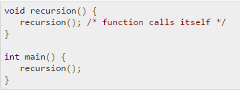
Recursion Example
While using recursion, programmers need to be careful to define an exit condition from the function, otherwise it will go into an infinite loop.
Recursive functions are very useful to solve many mathematical problems, such as calculating the factorial of a number, generating Fibonacci series, etc.

Slide 4
Disadvantages
Greatest space requirement as all function will remain in stack
Greatest time requirement as function calls itself and return overhead

Slide 5
Advantages
Provides a clean and simple way to write code.
Some problems are inherently recursive like tree traversal , quick sort, merge sort e.t.c

Slide 6
Recursion VS Iteration
An Iterative algorithm will be faster than the Recursive algorithm because of overheads like calling functions and registering stacks repeatedly.
Recursive algorithm uses a branching structure, while iterative algorithm uses a looping construct.
Many times the recursive algorithms are not efficient as they take more space and time.
Recursive algorithms are mostly used to solve complicated problems when their application is easy and effective.
recursion is like a selection structure, and which makes code smaller and clean but in iteration code may be longer but it is faster than recursive.

Slide 7
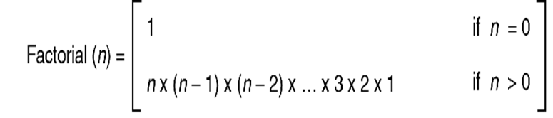
Factorial – A case study
The factorial of a positive number is the product of the integral values from 1 to the number:
n!= n*(n-1)*(n-2)……….3* 2* 1
4!= 4.3.2.1= 24
Iterative Factorial Algorithm definition:

Slide 8
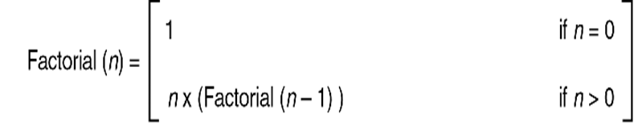
Factorial: Recursive Algorithm
Recursive Factorial Algorithm definition:

Slide 9
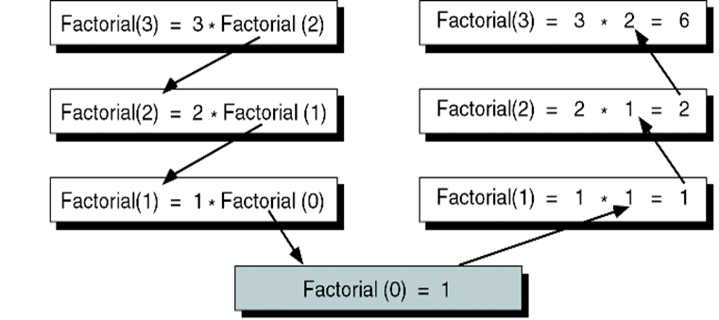
Factorial (3): Decomposition and solution
The recursive solution for a problem involves a two-way journey:
  First we decompose the problem from the top to the bottom
  Then we solve the problem from the bottom to the top

Slide 10
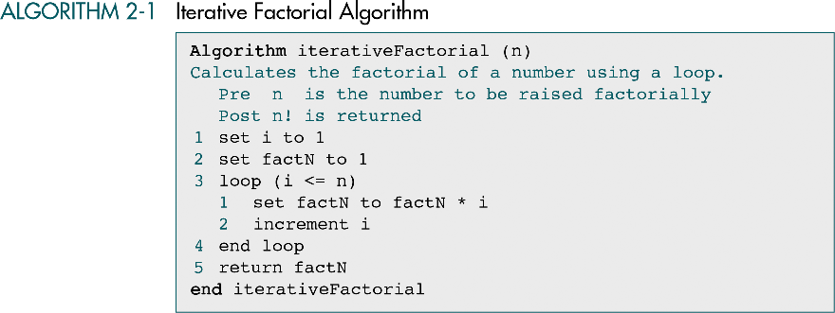

Slide 11
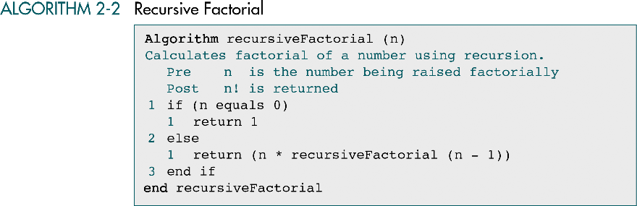

Slide 12
Designing recursive algorithms
The rules for designing a recursive algorithm:
    First, determine the base case.
    Then determine the general case.
    Combine the base case and the general cases into an algorithm

Slide 13
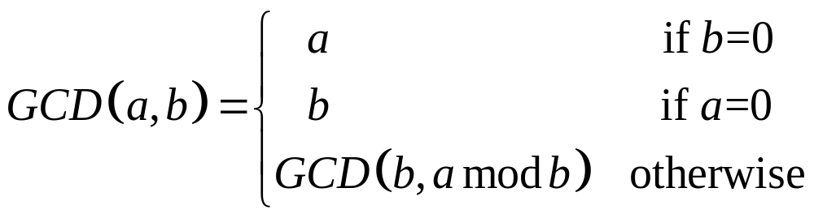
Example-Problem GCD
Determine the greatest common divisor (GCD) for two numbers.
Euclidean algorithm: GCD (a,b) can be recursively found from the formula

Slide 14
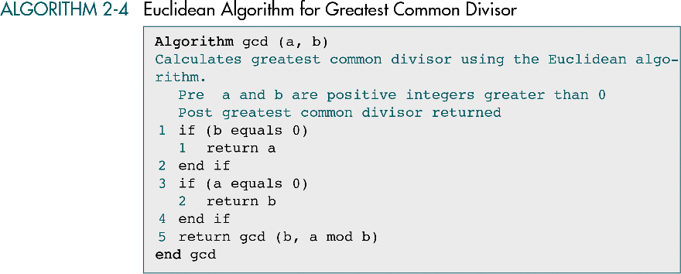
Pseudocode Implementation

Slide 15
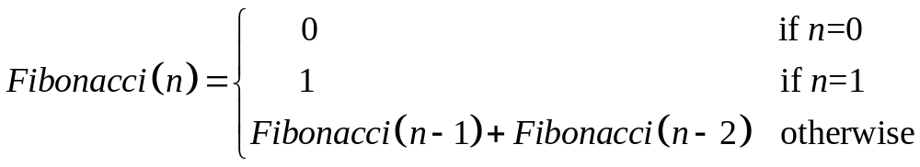
Example-Problem Fibonacci series
Generation of the Fibonacci numbers series.
Each next number is equal to the sum of the previous two numbers.
A classical Fibonacci series is 0, 1, 1, 2, 3, 5, 8, 13, …
The series of n numbers can be generated using a recursive formula

Slide 16
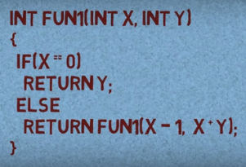
Try Yourself
FUN1(5, 2)

Slide 17
Try Yourself
Write a function that will print binary equivalent of n
For example if n is 21 then binary equivalent is 10101

Slide 18
solution
int convert(int dec)
{
if (dec == 0)
{
return 0;
}
else
{
return (dec % 2 + 10 * convert(dec / 2));
}
}

Slide 19
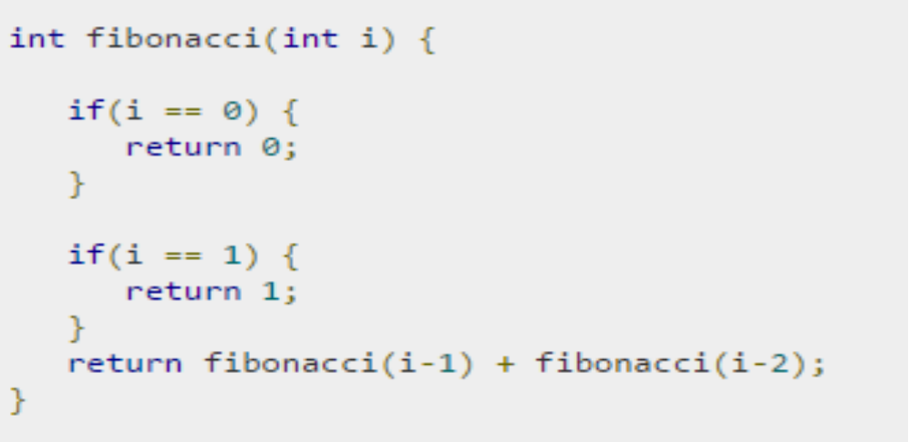
Fibonacci

