Slide 1
Measuring Classifier Performance
→ If the instance is positive and it is classified as positive, it is counted as a true positive.
→ if the instance is positive and it is classified as negative, it is counted as a false negative.
→ If the instance is negative and it is classified as negative, it is counted as a true negative.
→ If the instance is negative and it is classified as positive, it is counted as a false positive.

Slide 2
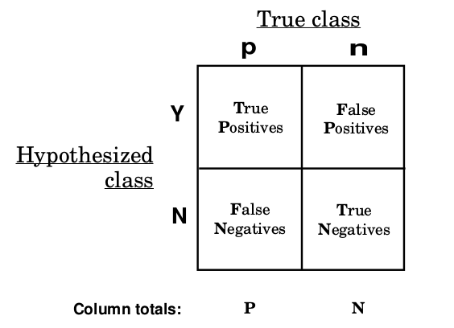
Confusion Matrix

Slide 3
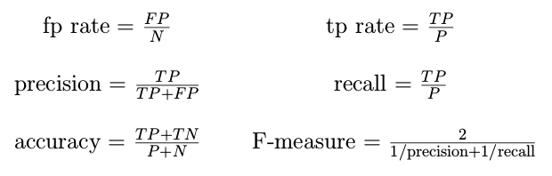
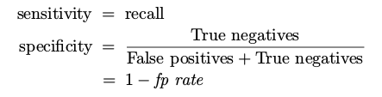
Performance Metrics
→ tp (true positive) rate / Recall / Hit rate / Sensitivity: The proportion of positives that are correctly identified.
→ fp (false positive) rate: The proportions of negatives that are incorrectly identified.
→ Precision / Positive predicted value: The proportion of positively identified that are correct.
→ F-measure: A measure that combines precision and recall. It is the harmonic mean of precision and recall.
→ Specificity: The proportion of negatives that are correctly identified.

Slide 4
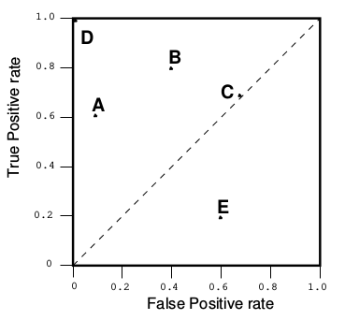
ROC Graph
→ One point in ROC space is better than another if it is to the northwest (tp rate is higher, fp rate is lower, or both) of the first. ( D is better than all other points)
→ Classifiers in the lower left part are known as conservative.
→ Classifiers in the upper right part are known as liberals.
→ the diagonal y=x line represents a random classifier.
→ Classifiers in the lower right triangle performs worse than random classifier.

