Slide 1
Chapter 20: Data Analysis

Slide 2
Chapter 20: Data Analysis
Decision Support Systems
Data Warehousing
Data Mining
Classification
Association Rules
Clustering

Slide 3
Decision Support Systems
Decision-support systems are used to make business decisions, often based on data collected by on-line transaction-processing systems.
Examples of business decisions:
  What items to stock?
  What insurance premium to change?
  To whom to send advertisements?
Examples of data used for making decisions
  Retail sales transaction details
  Customer profiles (income, age, gender, etc.)

Slide 4
Decision-Support Systems: Overview
Data analysis tasks are simplified by specialized tools and SQL extensions
  Example tasks
    For each product category and each region, what were the total sales in the last quarter and how do they compare with the same quarter last year
    As above, for each product category and each customer category
Statistical analysis packages (e.g., : S++) can be interfaced with databases
  Statistical analysis is a large field, but not covered here
Data mining seeks to discover knowledge automatically in the form of statistical rules and patterns from large databases.
A data warehouse archives information gathered from multiple sources, and stores it under a unified schema, at a single site.
  Important for large businesses that generate data from multiple divisions, possibly at multiple sites
  Data may also be purchased externally

Slide 5
Data Warehousing
Data sources often store only current data, not historical data
Corporate decision making requires a unified view of all organizational data, including historical data
A data warehouse is a repository (archive) of information gathered from multiple sources, stored under a unified schema, at a single site
  Greatly simplifies querying, permits study of historical trends
  Shifts decision support query load away from transaction processing systems

Slide 6
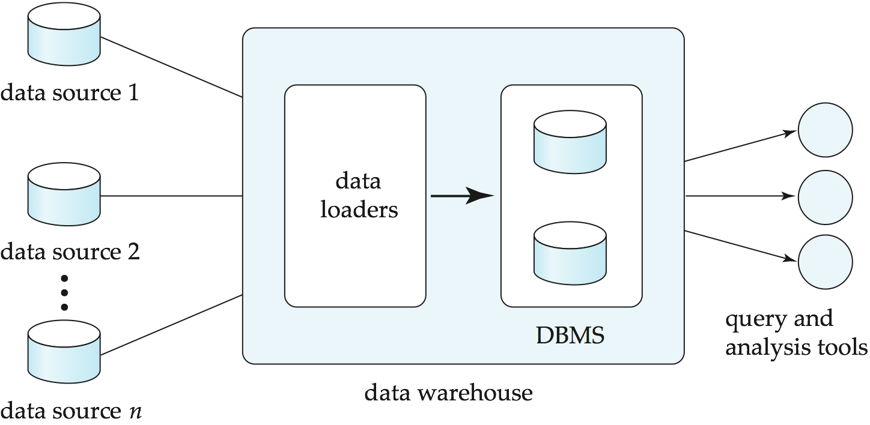
Data Warehousing

Slide 7
Design Issues
When and how to gather data
  Source driven architecture: data sources transmit new information to warehouse, either continuously or periodically (e.g., at night)
  Destination driven architecture: warehouse periodically requests new information from data sources
  Keeping warehouse exactly synchronized with data sources (e.g., using two-phase commit) is too expensive
    Usually OK to have slightly out-of-date data at warehouse
    Data/updates are periodically downloaded form online transaction processing (OLTP) systems.
What schema to use
  Schema integration

Slide 8
More Warehouse Design Issues
Data cleansing
  E.g., correct mistakes in addresses (misspellings, zip code errors)
  Merge address lists from different sources and purge duplicates
How to propagate updates
  Warehouse schema may be a (materialized) view of schema from data sources
What data to summarize
  Raw data may be too large to store on-line
  Aggregate values (totals/subtotals) often suffice
  Queries on raw data can often be transformed by query optimizer to use aggregate values

Slide 9
Warehouse Schemas
Dimension values are usually encoded using small integers and mapped to full values via dimension tables
Resultant schema is called a star schema
  More complicated schema structures
    Snowflake schema: multiple levels of dimension tables
    Constellation: multiple fact tables

Slide 10
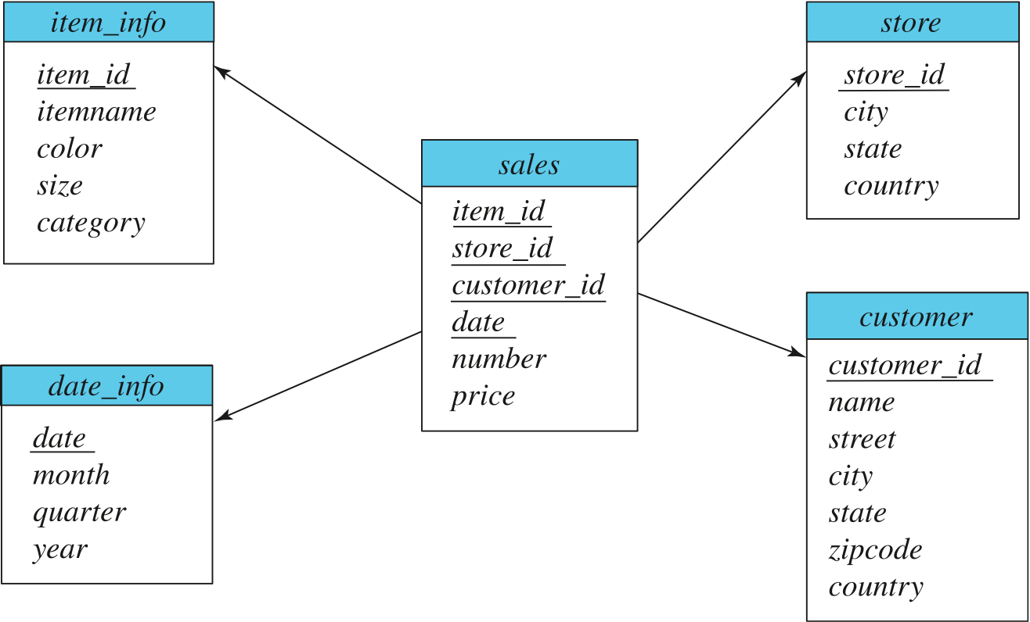
Data Warehouse Schema

Slide 11
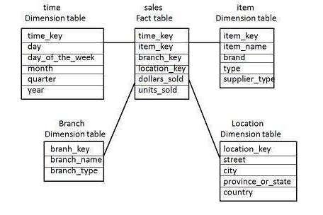
Star Schema
Each dimension in a star schema is represented with only one-dimension table.
This dimension table contains the set of attributes.
The following diagram shows the sales data of a company with respect to the four dimensions, namely time, item, branch, and location.
There is a fact table at the center. It contains the keys to each of four dimensions.
The fact table also contains the attributes, namely dollars sold and units sold.

Slide 12
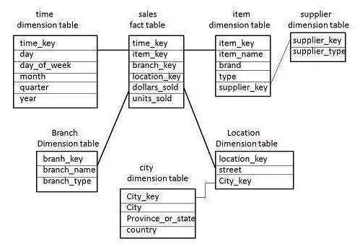
Snowflake Schema
Some dimension tables in the Snowflake schema are normalized or splitted into multiple dimension tables.
Unlike Star schema, the dimensions table in a snowflake schema are normalized. For example, the item dimension table in star schema is normalized and split into two dimension tables, namely item and supplier table.
Now the item dimension table contains the attributes item_key, item_name, type, brand, and supplier-key.
The supplier key is linked to the supplier dimension table. The supplier dimension table contains the attributes supplier_key and supplier_type.

Slide 13
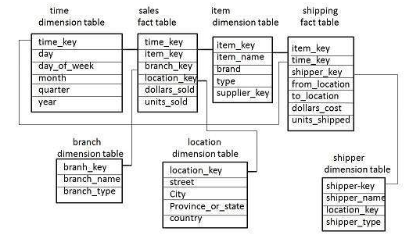
Fact Constellation Schema
A fact constellation has multiple fact tables. It is also known as galaxy schema.
The sales fact table is same as that in the star schema.
The shipping fact table has the five dimensions, namely item_key, time_key, shipper_key, from_location, to_location.
The shipping fact table also contains two measures, namely dollars sold and units sold.
It is also possible to share dimension tables between fact tables. For example, time, item, and location dimension tables are shared between the sales and shipping fact table.

Slide 14
Data Mining
Data mining is the process of semi-automatically analyzing large databases to find useful patterns
Prediction based on past history
  Predict if a credit card applicant poses a good credit risk, based on some attributes (income, job type, age, ..) and past history
  Predict if a pattern of phone calling card usage is likely to be fraudulent
Some examples of prediction mechanisms:
  Classification
    Given a new item whose class is unknown, predict to which class it belongs
  Regression formulae
    Given a set of mappings for an unknown function, predict the function result for a new parameter value

Slide 15
Data Mining (Cont.)
Descriptive Patterns
  Associations
    Find books that are often bought by “similar” customers. If a new such customer buys one such book, suggest the others too.
  Associations may be used as a first step in detecting causation
    E.g., association between exposure to chemical X and cancer,
  Clusters
    E.g., typhoid cases were clustered in an area surrounding a contaminated well
    Detection of clusters remains important in detecting epidemics

Slide 16
Classification Rules
Classification rules help assign new objects to classes.
  E.g., given a new automobile insurance applicant, should he or she be classified as low risk, medium risk or high risk?
Classification rules for above example could use a variety of data, such as educational level, salary, age, etc.
  ∀ person P, P.degree = masters and P.income > 75,000
    ⇒ P.credit = excellent
  ∀ person P, P.degree = bachelors and
  (P.income ≥ 25,000 and P.income ≤ 75,000)
  ⇒ P.credit = good
Rules are not necessarily exact: there may be some misclassifications
Classification rules can be shown compactly as a decision tree.

Slide 17
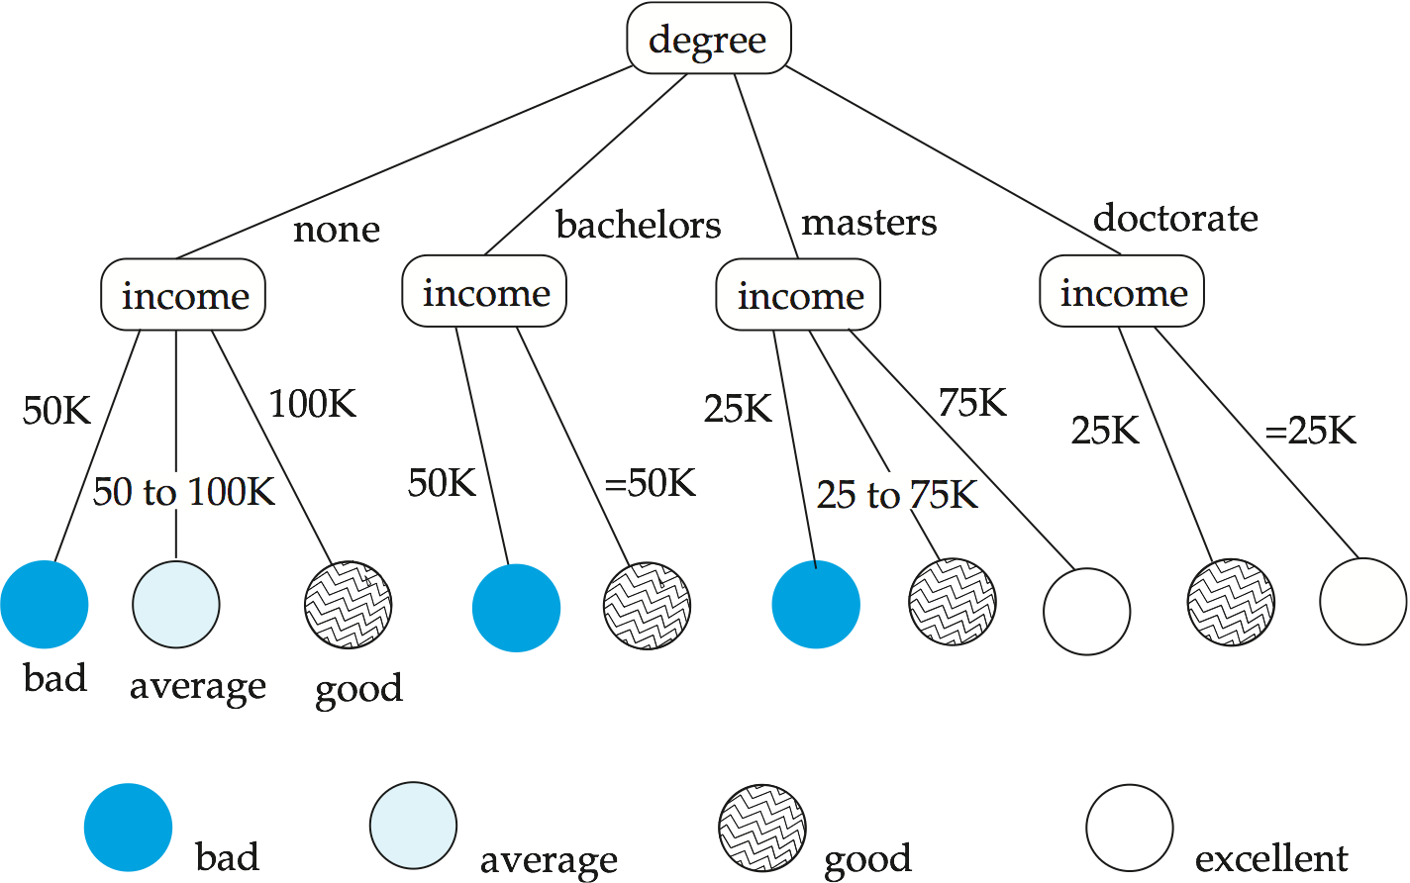
Decision Tree

Slide 18
Construction of Decision Trees
Training set: a data sample in which the classification is already known.
Greedy top down generation of decision trees.
  Each internal node of the tree partitions the data into groups based on a partitioning attribute, and a partitioning condition for the node
  Leaf node:
    all (or most) of the items at the node belong to the same class, or
    all attributes have been considered, and no further partitioning is possible.

Slide 19
Best Splits
Pick best attributes and conditions on which to partition
The purity of a set S of training instances can be measured quantitatively in several ways.
  Notation: number of classes = k, number of instances = |S|,
  fraction of instances in class i = p_{i}.
The Gini measure of purity is defined as
[
Gini (S) = 1 - ∑
  When all instances are in a single class, the Gini value is 0
  It reaches its maximum (of 1 –1 /k) if each class the same number of instances.
k
p²_{i}
i- 1

Slide 20
Best Splits (Cont.)
Another measure of purity is the entropy measure, which is defined as
entropy (S) = – ∑
When a set S is split into multiple sets Si, I=1, 2, …, r, we can measure the purity of the resultant set of sets as:
purity(S₁, S₂, ….., S_{r}) = ∑
The information gain due to particular split of S into S_{i}, i = 1, 2, …., r
Information-gain (S, {S₁, S₂, …., S_{r}) = purity(S ) – purity (S₁, S₂, … S_{r})
k
p_{i}log₂ p_{i}
i- 1
r
|S_{i}|
|S|
purity (S_{i})
i= 1

Slide 21
Best Splits (Cont.)
Measure of “cost” of a split:
Information-content (S, {S₁, S₂, ….., S_{r}})) = – ∑
Information-gain ratio = Information-gain (S, {S₁, S₂, ……, S_{r}})
Information-content (S, {S₁, S₂, ….., S_{r}})
The best split is the one that gives the maximum information gain ratio
r
|S_{i}|
|S|
|S_{i}|
|S|
log₂
i- 1

Slide 22
Finding Best Splits
Categorical attributes (with no meaningful order):
  Multi-way split, one child for each value
  Binary split: try all possible breakup of values into two sets, and pick the best
Continuous-valued attributes (can be sorted in a meaningful order)
  Binary split:
    Sort values, try each as a split point
      E.g., if values are 1, 10, 15, 25, split at ≤1, ≤ 10, ≤ 15
    Pick the value that gives best split
  Multi-way split:
    A series of binary splits on the same attribute has roughly equivalent effect

Slide 23
Decision-Tree Construction Algorithm
  Procedure GrowTree (S )
  Partition (S );
  Procedure Partition (S)
  if ( purity (S ) > δ_{p} or |S| < δ_{s} ) then
  return;
  for each attribute A
  evaluate splits on attribute A;
  Use best split found (across all attributes) to partition
  S into S₁, S₂, …., S_{r},
  for i = 1, 2, ….., r
  Partition (S_{i} );

Slide 24
Other Types of Classifiers
Neural net classifiers are studied in artificial intelligence and are not covered here
Bayesian classifiers use Bayes theorem, which says
p (c_{j} | d ) = p (d | c_{j} ) p (c_{j} )
p ( d )
where
p (c_{j} | d ) = probability of instance d being in class c_{j},
p (d | c_{j} ) = probability of generating instance d given class c_{j},
p (c_{j} ) = probability of occurrence of class c_{j}, and
p (d ) = probability of instance d occuring

Slide 25
Naïve Bayesian Classifiers
Bayesian classifiers require
  computation of p (d | c_{j} )
  precomputation of p (c_{j} )
  p (d ) can be ignored since it is the same for all classes
To simplify the task, naïve Bayesian classifiers assume attributes have independent distributions, and thereby estimate
p (d | c_{j}) = p (d₁ | c_{j} ) * p (d₂ | c_{j} ) * ….* (p (d_{n} | c_{j} )
  Each of the p (d_{i} | c_{j} ) can be estimated from a histogram on d_{i} values for each class c_{j}
    the histogram is computed from the training instances
  Histograms on multiple attributes are more expensive to compute and store

Slide 26
Regression
Regression deals with the prediction of a value, rather than a class.
  Given values for a set of variables, X₁, X₂, …, X_{n}, we wish to predict the value of a variable Y.
One way is to infer coefficients a₀, a₁, a₁, …, a_{n} such that
Y = a₀ + a₁ * X₁ + a₂ * X₂ + … + a_{n} * X_{n}
Finding such a linear polynomial is called linear regression.
  In general, the process of finding a curve that fits the data is also called curve fitting.
The fit may only be approximate
  because of noise in the data, or
  because the relationship is not exactly a polynomial
Regression aims to find coefficients that give the best possible fit.

Slide 27
Association Rules
Retail shops are often interested in associations between different items that people buy.
  Someone who buys bread is quite likely also to buy milk
  A person who bought the book Database System Concepts is quite likely also to buy the book Operating System Concepts.
Associations information can be used in several ways.
  E.g., when a customer buys a particular book, an online shop may suggest associated books.
Association rules:
bread ⇒ milk DB-Concepts, OS-Concepts ⇒ Networks
  Left hand side: antecedent, right hand side: consequent
  An association rule must have an associated population; the population consists of a set of instances
    E.g., each transaction (sale) at a shop is an instance, and the set of all transactions is the population

Slide 28
Association Rules (Cont.)
Rules have an associated support, as well as an associated confidence.
Support is a measure of what fraction of the population satisfies both the antecedent and the consequent of the rule.
  E.g., suppose only 0.001 percent of all purchases include milk and screwdrivers. The support for the rule is milk ⇒ screwdrivers is low.
Confidence is a measure of how often the consequent is true when the antecedent is true.
  E.g., the rule bread ⇒ milk has a confidence of 80 percent if 80 percent of the purchases that include bread also include milk.

Slide 29
Finding Association Rules
We are generally only interested in association rules with reasonably high support (e.g., support of 2% or greater)
Naïve algorithm
  Consider all possible sets of relevant items.
  For each set find its support (i.e., count how many transactions purchase all items in the set).
    Large itemsets: sets with sufficiently high support
  Use large itemsets to generate association rules.
    From itemset A generate the rule A - {b } ⇒b for each b ∈ A.
      Support of rule = support (A).
      Confidence of rule = support (A ) / support (A - {b })

Slide 30
Finding Support
Determine support of itemsets via a single pass on set of transactions
  Large itemsets: sets with a high count at the end of the pass
If memory not enough to hold all counts for all itemsets use multiple passes, considering only some itemsets in each pass.
Optimization: Once an itemset is eliminated because its count (support) is too small none of its supersets needs to be considered.
The a priori technique to find large itemsets:
  Pass 1: count support of all sets with just 1 item. Eliminate those items with low support
  Pass i: candidates: every set of i items such that all its i-1 item subsets are large
    Count support of all candidates
    Stop if there are no candidates

Slide 31
Other Types of Associations
Basic association rules have several limitations
Deviations from the expected probability are more interesting
  E.g., if many people purchase bread, and many people purchase cereal, quite a few would be expected to purchase both
  We are interested in positive as well as negative correlations between sets of items
    Positive correlation: co-occurrence is higher than predicted
    Negative correlation: co-occurrence is lower than predicted
Sequence associations / correlations
  E.g., whenever bonds go up, stock prices go down in 2 days
Deviations from temporal patterns
  E.g., deviation from a steady growth
  E.g., sales of winter wear go down in summer
    Not surprising, part of a known pattern.
    Look for deviation from value predicted using past patterns

Slide 32
Clustering
Clustering: Intuitively, finding clusters of points in the given data such that similar points lie in the same cluster
Can be formalized using distance metrics in several ways
  Group points into k sets (for a given k) such that the average distance of points from the centroid of their assigned group is minimized
    Centroid: point defined by taking average of coordinates in each dimension.
  Another metric: minimize average distance between every pair of points in a cluster
Has been studied extensively in statistics, but on small data sets
  Data mining systems aim at clustering techniques that can handle very large data sets
  E.g., the Birch clustering algorithm (more shortly)

Slide 33
Hierarchical Clustering
Example from biological classification
  (the word classification here does not mean a prediction mechanism)
  chordata
  mammalia reptilia
  leopards humans snakes crocodiles
Other examples: Internet directory systems (e.g., Yahoo, more on this later)
Agglomerative clustering algorithms
  Build small clusters, then cluster small clusters into bigger clusters, and so on
Divisive clustering algorithms
  Start with all items in a single cluster, repeatedly refine (break) clusters into smaller ones

Slide 34
Clustering Algorithms
Clustering algorithms have been designed to handle very large datasets
E.g., the Birch algorithm
  Main idea: use an in-memory R-tree to store points that are being clustered
  Insert points one at a time into the R-tree, merging a new point with an existing cluster if is less than some δ distance away
  If there are more leaf nodes than fit in memory, merge existing clusters that are close to each other
  At the end of first pass we get a large number of clusters at the leaves of the R-tree
    Merge clusters to reduce the number of clusters

Slide 35
Collaborative Filtering
Goal: predict what movies/books/… a person may be interested in, on the basis of
  Past preferences of the person
  Other people with similar past preferences
  The preferences of such people for a new movie/book/…
One approach based on repeated clustering
  Cluster people on the basis of preferences for movies
  Then cluster movies on the basis of being liked by the same clusters of people
  Again cluster people based on their preferences for (the newly created clusters of) movies
  Repeat above till equilibrium
Above problem is an instance of collaborative filtering, where users collaborate in the task of filtering information to find information of interest

Slide 36
Other Types of Mining
Text mining: application of data mining to textual documents
  cluster Web pages to find related pages
  cluster pages a user has visited to organize their visit history
  classify Web pages automatically into a Web directory
Data visualization systems help users examine large volumes of data and detect patterns visually
  Can visually encode large amounts of information on a single screen
  Humans are very good a detecting visual patterns

Slide 37
End of Chapter

Slide 38
Figure 20.01

Slide 39
Figure 20.02

Slide 40
Figure 20.03

Slide 41
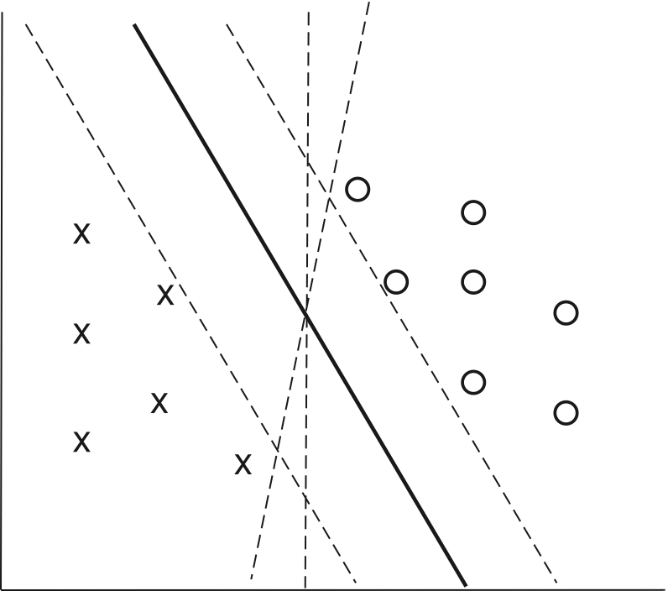
Figure 20.05

