Slide 1
Advanced Topics in Machine learning: Project
University of Bern- 2019
Classifying music genres
Thomas Schaller | Dorian Guyot | Jonathan Péclat

Slide 2
SUMMARY
Task description & Motivation
Challenges
Data preparation
State of the art (prior work)
Our solution
Results

Slide 3
Task description & Motivation
Classify a music in a genre :
Blues, Classical, Country, Disco, Hip Hop
Jazz, Metal, Pop, Reggae, Rock.
Genre
quickly describe music
quite consensual among people
Our solution may help
find music
uninitiated people
Notes:
Classify a music in a genre :
Blues, Classical, Country, Disco, Hip Hop, Jazz, Metal, Pop, Reggae, Rock.
Genre is commonly use to quickly describe a music and is it quite consensual among people
Usage of an automated classification software
Can help people to find music they want to listen to

Slide 4
Challenges
Understand audio waveform
Use FFT
Rather small dataset (1000 sounds)
Data augmentation
Transfer learning

Slide 5
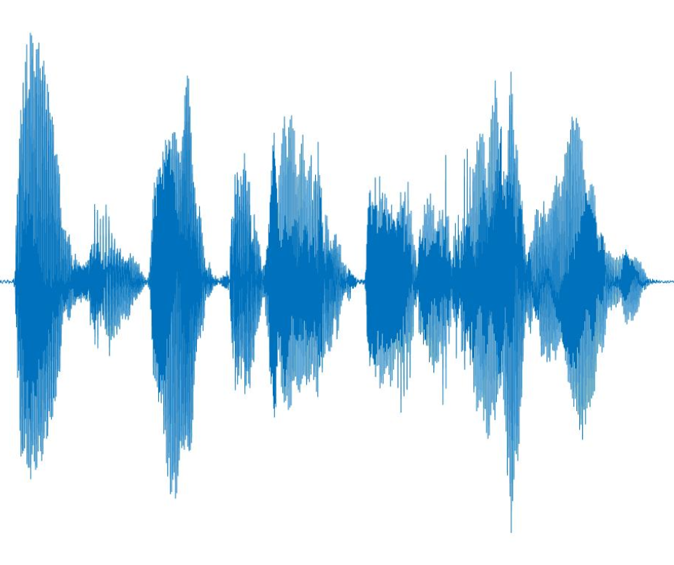
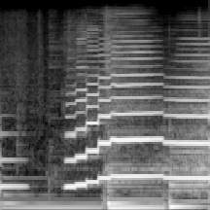
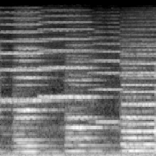
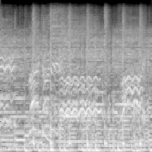
Data preparation
Manual feature extraction: spectrograms (log scale)
Reduced dimensionality (600k to 45k)
Closer to human representation of music
Jazz
Classical
Metal
Frequency
Time
Cherry-picked examples

Slide 6
Data augmentation
GTZAN dataset is small (100 30-seconds samples / genre, 10 genres)
Solutions:
Split the samples in smaller samples (human still able to guess genre)
Rolling window
Color jittering on spectrograms (~white noise)
Further improvements:
Data augmentation directly on audio (pitch and tempo shifting, noise)

Slide 7
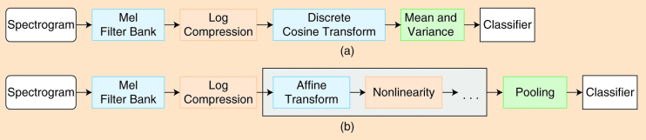
State of the art (prior work)
Feature extraction and conventional ML (~2010)
Deep CNN on spectrogram (Recently)
Deep CNN directly on Waveform (Most recently)
Sample-level CNN
First end-to-end with state of the art performance
90% accuracy on MTAT and 88% on MSD dataset
Recurrent CNN are also promising
Reference: NAM, Juhan, CHOI, Keunwoo, LEE, Jongpil, et al. Deep Learning for Audio-Based Music Classification and Tagging: Teaching Computers to Distinguish Rock from Bach. IEEE Signal Processing Magazine, 2019, vol. 36, no 1, p. 41-51.
Notes:
Moins de texte

Slide 8
Solution 1: custom network
3 times
Conv2D
BatchNorm2d
LeakyRelu
MaxPool2d
Dropout
Linear
LeakyRelu
Dropout
...
Solution 2: transfer learning
Optimizer: Adam
Loss: Cross Entropy
Learning rate: 0.001
Learning Rate reducer
Number of epochs: 50
Keep the smallest loss
Input: 216x216
Output: 10
ResNet18
Linear

Slide 9
Results and analysis: Fully trained model
Before data augmentation | 13% on test set
Before data augmentation | 32%
Conv2D with kernel size of (5,1)
Too much data augmentation | 15%
Good data augmentation | 70%
After adding brightness and contrast | 75% with a loss of 1.13
Results and analysis: Transfer learning
Fixed features | 68% with a loss of 0.92
Finetuning | 95% with a loss of 0.16

Slide 10
Conclusions
Pretty happy about the final result
Frustrated to think about a model for a long time to finally get better result with transfer learning
But it's normal, a model with 175 layers trained on a lot of images
Data augmentation was really important in this project

Slide 11
QUESTIONS ?

