Slide 1
Simple File Upload
Minimalist File Transfer WebApp

Slide 2
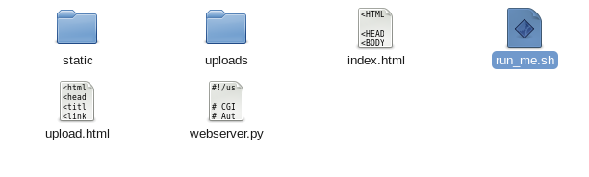
Unzip SimpleFileUpload.zip and open run_me.sh

Slide 3
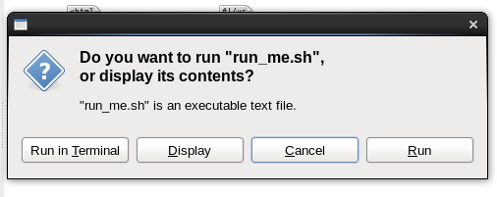
Select Run in Terminal

Slide 4
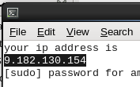
Copy the IP address & enter your Linux password & hit enter

Slide 5
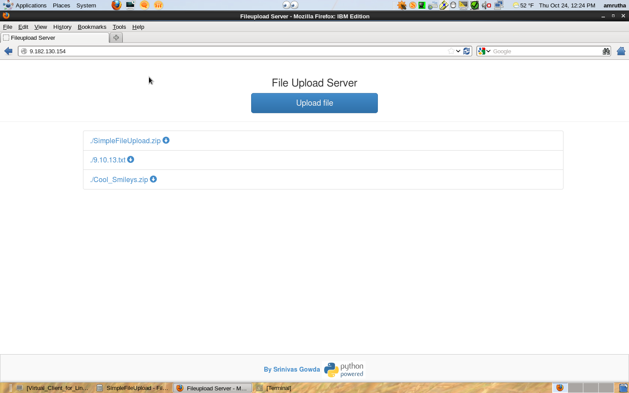
Enter your IP address in any browser

Slide 6
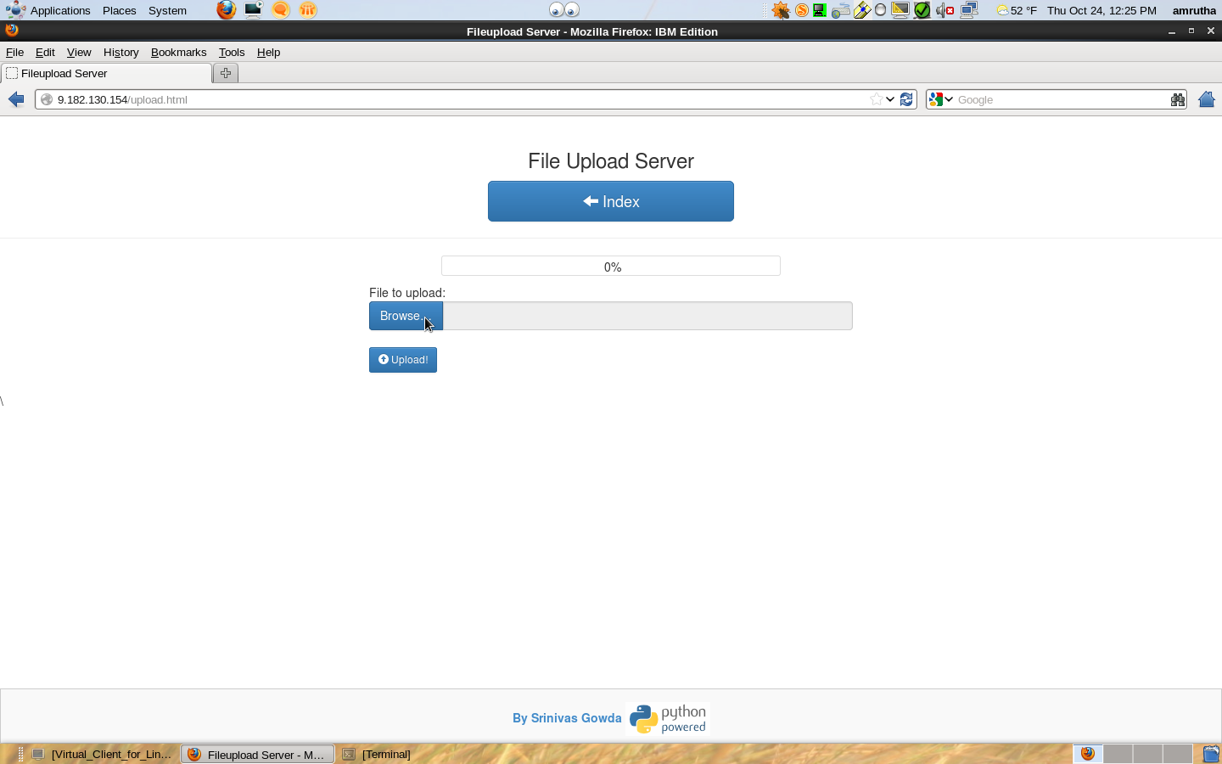
Browse and select the file and click upload

Slide 7
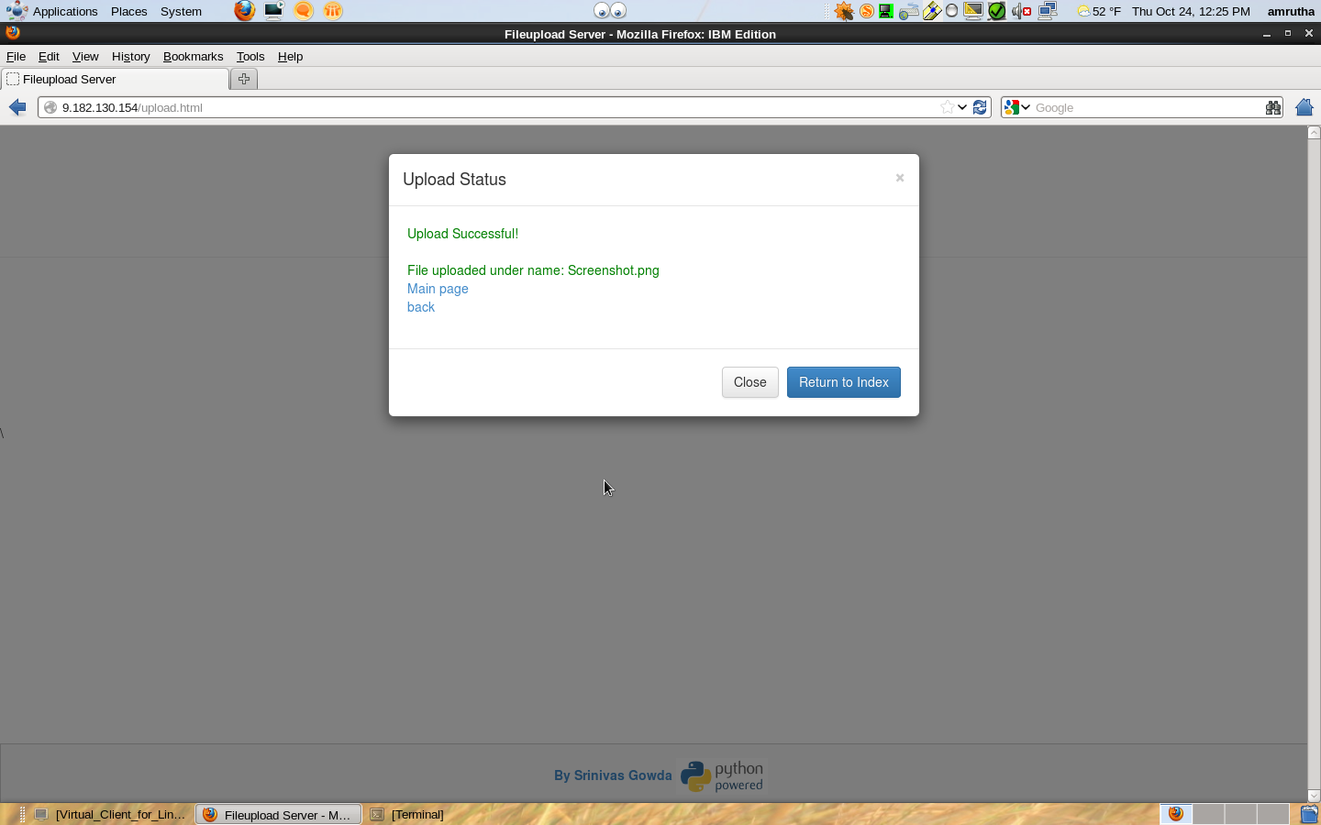
If everything goes well you will see a success message

Slide 8
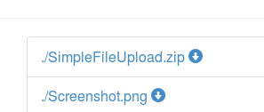
Get back to the main Index page and you will see your file uploaded
You can share your IP address with anyone in the team to share files.

