Slide 1


Ethereum 2.0
Solange Gueiros
Montevideo
dez/2019
Notes:
Ethereum Two point o

Slide 2
About me…
São Paulo - Brazil
BSc Computer Science, Pedagogy
Doing MSc in Digital Currencies
Developer for more than 20 years
Won AirSwap award at EthNewYork – may/2019
Won Waves award at EthBerlin – aug/2019
Notes:
https://medium.com/swlh/a-comprehensive-view-of-ethereum-2-0-serenity-5865ad8b7c62

Slide 3
About me…
Teacher at Blockchain Academy
Developer evangelist at IOVLabs
I do not work at the Ethereum Foundation
Everything here is my own research and personal opinions
Notes:
https://medium.com/swlh/a-comprehensive-view-of-ethereum-2-0-serenity-5865ad8b7c62

Slide 4

Ethereum context
Notes:
https://ethereum.org/assets/

Slide 5
What is this
Smart contract platform
Open-source
Public
Own currency: Ether or ETH.
Notes:
https://medium.com/swlh/a-comprehensive-view-of-ethereum-2-0-serenity-5865ad8b7c62
https://www.coinmama.com/guide/history-of-ethereum

Slide 6
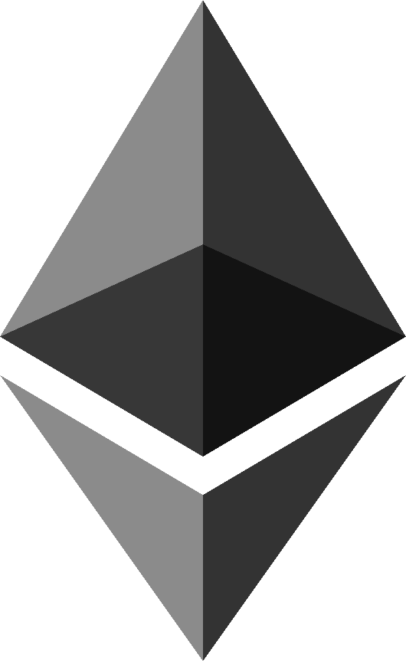
Current status
Notes:
https://ethereum.org/assets/#general-assets

Slide 7
The scalability problem
“world computer”
with around 15 transactions per second ?!?!?
Visa and others can handle
up to 40,000 transactions per second.
Notes:
The network is supposed to be the “world computer”, but at the moment it can only handle around 15 transactions per second, while private companies like Visa can handle up to 45,000 transactions per second.
https://medium.com/swlh/a-comprehensive-view-of-ethereum-2-0-serenity-5865ad8b7c62

Slide 8
Ethereum Roadmap

Slide 9
Ethereum Roadmap
Frontier – Proof of Concept – jul/2015
Homestead – Developer-ready
Metropolis – Current
Serenity – next
Notes:
https://docs.ethhub.io/ethereum-roadmap/ethereum-2.0/eth-2.0-phases/

Slide 10
Hard forks
Notes:
https://ethereum.org/assets/#general-assets

Slide 11
Hard forks in Ethereum
Most of them do not break the chain
(Exception: The DAO)
They are updates and improvements
The miners / validators only need to update the client version
Notes:
Block seven million and 2 hundred eighty

Slide 12
Hard forks in Ethereum
This year (2019):
Constantinople
Istanbul
Notes:
Block seven million and 2 hundred eighty

Slide 13
Constantinople
Notes:
https://ethereum.org/assets/#general-assets

Slide 14
Constantinople
27-28 feb 2019
block number 7,280,000
https://etherscan.io/block/7280000
4 EIPs – Ethereum Improvement Proposal
Notes:
Block seven million and 2 hundred eighty

Slide 15
Istanbul
Notes:
https://ethereum.org/assets/#general-assets

Slide 16
Istanbul
08 dec 2019
block number 9,069,000
https://etherscan.io/block/9069000
6 EIPs – Ethereum Improvement Proposal
Notes:
http://eips.ethereum.org/
https://www.ethernodes.org/Istanbul
Block nine million and sixty thousand

Slide 17
Istanbul
2 new OpCodes
Chainid
Selfbalance
9 new precompiled contracts
Gas changes
Some things cost more, other cost less
Notes:
https://medium.com/mycrypto/ethereums-istanbul-fork-technical-explanation-48a3aef718b0

Slide 18
Istanbul
Security fixes
Improve resilience to denial-of-service attack
Notes:
https://eth.wiki/en/roadmap/istanbul

Slide 19
Istanbul
Make layer 2 solutions based on SNARKs and STARKs more performant
Enable Ethereum and Zcash to interoperate
verify the Equihash PoW
Notes:
https://eth.wiki/en/roadmap/istanbul

Slide 20
Istanbul
Big step to move away from PoW to PoS algorithm
Align the costs of opcodes to computational costs
Notes:
https://eth.wiki/en/roadmap/istanbul

Slide 21
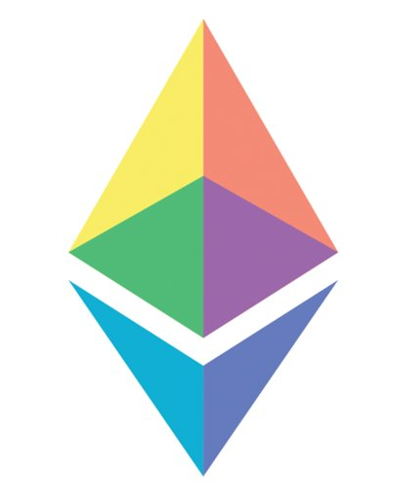
Ethereum 2.0

Slide 22
All the same!
Eth2
Serenity
Ethereum 2.0
Notes:
https://docs.ethhub.io/ethereum-roadmap/ethereum-2.0/eth-2.0-phases/
the term that describes all the updates from Serenity

Slide 23
Ethereum 2.0 Goals
Improve:
Decentralization
Resilience
Security
Simplicity
Longevity
By Ethereum researcher Danny Ryan
Notes:
https://docs.ethhub.io/ethereum-roadmap/ethereum-2.0/eth-2.0-phases/

Slide 24
Serenity

Slide 25
Serenity
Casper - Proof of Stake
Sharding - Scalability
eWASM - A new Ethereum Virtual Machine
Notes:
https://docs.ethhub.io/ethereum-roadmap/ethereum-2.0/eth-2.0-phases/

Slide 26
Serenity Road Map
Phase 0: Beacon Chain (Q1/2020)
Phase 1: Shard Chains (2021)
Phase 2: eWASM (New Ethereum Virtual Machine) (2021)
Phase 3: Continued Improvement (2022)
(the official wiki suggests 6 phases / sub-stages)
Notes:
https://docs.ethhub.io/ethereum-roadmap/ethereum-2.0/eth-2.0-phases/
https://medium.com/swlh/a-comprehensive-view-of-ethereum-2-0-serenity-5865ad8b7c62

Slide 27
Serenity Road Map
it’s not a change that will happen overnight
It can have delays and changes along the way.
As with every software, there is no final version;
there is always improvements and fixes that need to be done.
Notes:
https://docs.ethhub.io/ethereum-roadmap/ethereum-2.0/eth-2.0-phases/

Slide 28
Phase 0

Slide 29
Phase 0
Beacon Chain
Casper: Proof of Stake
ETH2: the new Ether
RANDAO
Notes:
https://medium.com/swlh/a-comprehensive-view-of-ethereum-2-0-serenity-5865ad8b7c62

Slide 30
Beacon Chain

Slide 31
Phase 0 - Beacon Chain
The Beacon Chain will be a separate blockchain from the main Ethereum blockchain.
This new chain will have a Proof of Stake (PoS) consensus algorithm
and it will run in parallel to the main PoW Ethereum blockchain.
Notes:
https://medium.com/swlh/a-comprehensive-view-of-ethereum-2-0-serenity-5865ad8b7c62

Slide 32
Phase 0 - Beacon Chain
Initially, the blockchain will be created for simplicity
and will not support smart contracts or accounts.
It will manage the Casper Proof of Stake protocol for itself and all of the shard chains.
Notes:
https://medium.com/swlh/a-comprehensive-view-of-ethereum-2-0-serenity-5865ad8b7c62

Slide 33
Phase 0 - Beacon Chain
managing validators and their stakes;
nominating the chosen block proposer for each shard at each step;
organizing validators into groups / committees to vote on the proposed blocks;
By Ben Edgington - Blockchain engineering at PegaSys, ConsenSys
Notes:
https://docs.ethhub.io/ethereum-roadmap/ethereum-2.0/eth-2.0-phases/

Slide 34
Phase 0 - Beacon Chain
applying the consensus rules;
applying rewards and penalties to validators;
being an anchor point on which the shards register their states to facilitate cross-shard transactions.
By Ben Edgington - Blockchain engineering at PegaSys, ConsenSys
Notes:
https://docs.ethhub.io/ethereum-roadmap/ethereum-2.0/eth-2.0-phases/

Slide 35

Casper

Slide 36
Phase 0 – Casper
Proof of Stake consensus
Postponed before:
Use of Casper to replacement Ethash consensus has been postponed several times
Delay the difficulty bomb and the obsolescence of PoW
Notes:
https://docs.ethhub.io/ethereum-roadmap/ethereum-2.0/eth-2.0-phases/

Slide 37
Phase 0 – Casper - PoS
Casper FFG = Friendly Finality Gadget
Finality =
once a particular operation has been done…
it will be forever in history
nothing can revert
Notes:
https://docs.ethhub.io/ethereum-roadmap/ethereum-2.0/eth-2.0-phases/
in very loose terms, means that once a particular operation has been done, it will forever be etched in history and nothing can revert that operation

Slide 38
ETH2

Slide 39
Phase 0 - ETH2: the new Ether
new asset for stakers (validators)
to be used on the Beacon Chain
to migrate their ETH from the Eth1 chain to the Eth2 chain
Notes:
https://docs.ethhub.io/ethereum-roadmap/ethereum-2.0/eth-2.0-phases/
https://medium.com/swlh/a-comprehensive-view-of-ethereum-2-0-serenity-5865ad8b7c62/
To be a validator for the new chain:
at least 32 ETH to stake on the original chain.
Another feature of Phase 0 is the introduction of ETH2. A new asset for validators on the new Beacon chain. This new ETH2 will be created as a reward for validating transactions on the Beacon Chain, and also can be purchased by any ETH1. Initially, there won’t be a way to withdraw ETH2 from the beacon chain. If anyone wants to be a validator for the new chain, they will need at least 32 ETH to stake on the original chain.

Slide 40
Phase 0 - ETH2: the new Ether
It will be created using two methods:
As a reward for validating the Beacon Chain (and shards after Phase 1).
Purchasing it for 1 ETH by any user via a registration smart contract at Eth1 chain.
The contract refers to it as a deposit.
Notes:
https://docs.ethhub.io/ethereum-roadmap/ethereum-2.0/eth-2.0-phases/

Slide 41
Phase 0 - ETH2
Currently there is no way to withdraw or transfer ETH2 from the Beacon Chain in Phase 0.
Once deposited in the Eth1.x registration smart contract, the ETH1 is burned.
Beacon Chain validators watch this contract and submit deposit information to the Beacon Chain, which then issues ETH2 to the depositors.
Notes:
https://docs.ethhub.io/ethereum-roadmap/ethereum-2.0/eth-2.0-phases/

Slide 42
Phase 0 - ETH2
Pay attention: they will NOT be able to migrate this ETH2 back (for now).
Because they could be earning interest paid in ETH on the Eth2 chain.
Notes:
https://docs.ethhub.io/ethereum-roadmap/ethereum-2.0/eth-2.0-phases/

Slide 43
Phase 0 completed: ETH1 and ETH2
Two active Ethereum chains:
Eth1 chain - current, PoW main chain
Eth2 chain - new Beacon Chain, PoS
Notes:
https://docs.ethhub.io/ethereum-roadmap/ethereum-2.0/eth-2.0-phases/

Slide 44
RANDAO

Slide 45
Phase 0 - RANDAO
RANDAO – random numbers
A way to combine contributions (individual random numbers) provided by many participants into a single output number.
This will be used to organize validators into block proposers and committees.
Notes:
https://docs.ethhub.io/ethereum-roadmap/ethereum-2.0/eth-2.0-phases/

Slide 46
Clients - Beacon Chain
Are currently being developed
Separately from standard Ethereum clients: Geth, Parity, Pantheon, et al.
Notes:
https://docs.ethhub.io/ethereum-roadmap/ethereum-2.0/eth-2.0-phases/

Slide 47
Phase 0 - Beacon Chain
Beacon Chain might not seem useful.
But is the first component of Ethereum 2.0 to be delivered.
It is the foundation of the entire system.
Notes:
https://docs.ethhub.io/ethereum-roadmap/ethereum-2.0/eth-2.0-phases/

Slide 48
Phase 0 - Beacon Chain
During Phase 0, all user transactions and smart contract computations will still occur on the Eth1 chain
ETH2 is transferable (to and from shards) only in end of Phase 2
Notes:
https://docs.ethhub.io/ethereum-roadmap/ethereum-2.0/eth-2.0-phases/

Slide 49
Phase 1

Slide 50
Phase 1
Shard Chains
Crosslinks
Notes:
https://medium.com/swlh/a-comprehensive-view-of-ethereum-2-0-serenity-5865ad8b7c62/

Slide 51
Shard Chains

Slide 52
Phase 1 - Shard Chains
Sharding is a scalability technique
That allows parallel transactions throughout
Allowing process many transactions concurrently
Notes:
https://medium.com/swlh/a-comprehensive-view-of-ethereum-2-0-serenity-5865ad8b7c62/

Slide 53
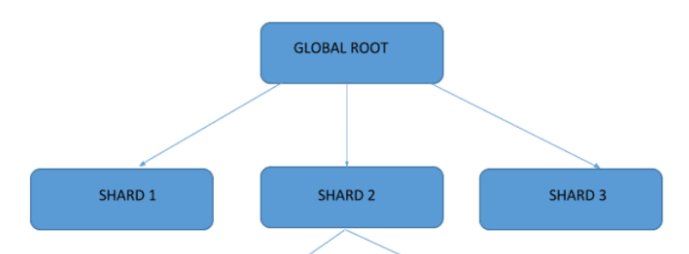
Phase 1 - Shard Chains
The network will be divide across multiple shards
Notes:
https://medium.com/swlh/a-comprehensive-view-of-ethereum-2-0-serenity-5865ad8b7c62/
https://etherworld.co/2018/04/13/what-is-sharding-and-why-is-it-important/

Slide 54
Phase 1 - Shard Chains
Phase 1 does not specify shard chain state execution or account balances.
A trial run for the sharding structure.
It will not scale with shards yet.
The Beacon Chain will treat shard chain blocks as simple collections of bits with no structure or meaning.
Notes:
https://docs.ethhub.io/ethereum-roadmap/ethereum-2.0/eth-2.0-phases/
construction, validity, and consensus on the data of these shard chains.

Slide 55
Phase 1 – Be careful
Each shard can be validated with a small group of validators.
Which makes it easier for a 51% attack
As they only need 51% computing power (or stake) of the shard they are in, instead of the whole network.
Higher centralization
Notes:
https://medium.com/swlh/a-comprehensive-view-of-ethereum-2-0-serenity-5865ad8b7c62/

Slide 56
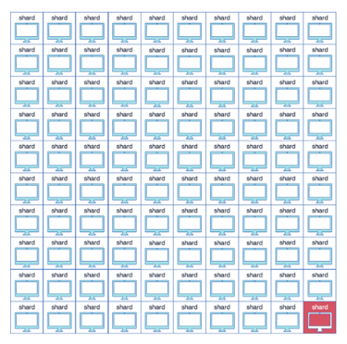
Phase 1 – Shard attack
Solution:
validators don’t choose which chain they validate
Notes:
https://medium.com/swlh/a-comprehensive-view-of-ethereum-2-0-serenity-5865ad8b7c62/

Slide 57
Phase 1 – Shard Chains
Validators will not approve any smart contract, account or asset.
The Eth1 and Eth2 chains will still operate in parallel after Phase 1.
Notes:
https://medium.com/swlh/a-comprehensive-view-of-ethereum-2-0-serenity-5865ad8b7c62/

Slide 58
Crosslinks

Slide 59
Phase 1 - Crosslinks
Crosslinks are a set of signatures from a committee
Also is an infrastructure for asynchronous cross-shard communication.
Notes:
https://docs.ethhub.io/ethereum-roadmap/ethereum-2.0/eth-2.0-phases/

Slide 60
Phase 1 - Crosslinks
Attesting to a block in a shard chain, which can be included into the Beacon Chain.
Crosslinks are the way which the Beacon Chain "learns about" the updated state of shard chains
Notes:
https://docs.ethhub.io/ethereum-roadmap/ethereum-2.0/eth-2.0-phases/

Slide 61
Phase 1 - Crosslinks
Time by time, the current state (the “combined data root”) of each shard gets recorded in a Beacon Chain block as a crosslink.
When the Beacon Chain block has been done, the corresponding shard block is considered finalized
And other shards know that they can trust on it for cross-shard transactions.
Notes:
https://docs.ethhub.io/ethereum-roadmap/ethereum-2.0/eth-2.0-phases/

Slide 62
Phase 1 – for all
In Phase 0, 1, and 2 the main PoW chain (Eth1) will remain live while testing and do the transition to Eth2 chain.
This means that rewards will be paid to both Ethereum 2.0 validators as well as the normal PoW block rewards.
More inflation at beginning but…
Will decrease as the PoW chain is been deactivated.
Notes:
https://docs.ethhub.io/ethereum-roadmap/ethereum-2.0/eth-2.0-phases/

Slide 63
Phase 2

Slide 64
Phase 2
eWASM (New EVM)
Execution Environments (EEs)
Notes:
https://medium.com/swlh/a-comprehensive-view-of-ethereum-2-0-serenity-5865ad8b7c62/

Slide 65
eWASM

Slide 66
EVM - Ethereum Virtual Machine
The EVM is the heart of the Ethereum network
It is the part that handles smart contract deployment and execution.
Notes:
https://medium.com/swlh/a-comprehensive-view-of-ethereum-2-0-serenity-5865ad8b7c62/
All nodes on the system need to run the smart contracts that execute transactions.

Slide 67
Current EVM – The problem
It processes transactions sequentially.
With the PoS and Sharding changes, it need to process transactions in parallel
The current EVM will not be suitable for this.
Notes:
https://medium.com/swlh/a-comprehensive-view-of-ethereum-2-0-serenity-5865ad8b7c62/

Slide 68
Phase 2 - eWASM (New EVM)
Each shard will manage a virtual machine based on eWASM.
It'll support accounts, contracts, state, and other abstractions that we are familiar in solidity.
Notes:
https://medium.com/swlh/a-comprehensive-view-of-ethereum-2-0-serenity-5865ad8b7c62/
Shard chains transition from simple data containers to a structured chain state and Smart Contracts will be reintroduced.

Slide 69
Phase – for all
The entire system will start to come together.
I hope tools like Truffle, Solc, Ganache will support eWASM in Phase 2.
Notes:
https://medium.com/swlh/a-comprehensive-view-of-ethereum-2-0-serenity-5865ad8b7c62/
Shard chains transition from simple data containers to a structured chain state and Smart Contracts will be reintroduced.

Slide 70
Execution Environments

Slide 71
Phase 2 - Execution Environments (EEs)
EE can be constructed in many ways:
a UTXO-style chain
a Libra-style system
a fee market relayer
and others.
Notes:
https://docs.ethhub.io/ethereum-roadmap/ethereum-2.0/eth-2.0-phases/

Slide 72
Phase 2 - Execution Environments (EEs)
Every shard has access to all execution environments
And has the ability to make transactions within them
As well as run and interact with smart contracts.
Fees is still in research and development.
Notes:
https://docs.ethhub.io/ethereum-roadmap/ethereum-2.0/eth-2.0-phases/

Slide 73
And… dApps?

Slide 74
Phase 2 – About dApps
A dApp will have to choose what shard it wants to be on.
That decision is important!
Cross-shard communication differs on Eth2 as it is not synchronous which means some compose may be lost between shards
Notes:
https://docs.ethhub.io/ethereum-roadmap/ethereum-2.0/eth-2.0-phases/
A dApp would have large data to consume all the resources in a given shard to justify spreading itself over multiple ones.

Slide 75
Phase 2
About accounts and smart contracts…
When and how it will be migrated to Ethereum 2.0?
It is an open question yet…
Notes:
https://docs.ethhub.io/ethereum-roadmap/ethereum-2.0/eth-2.0-phases/

Slide 76
Phase 3

Slide 77
Phase 3 - 2022
Cross-shard transactions
Lightweight clients
Super-square charting
Closer ties
Notes:
https://medium.com/swlh/a-comprehensive-view-of-ethereum-2-0-serenity-5865ad8b7c62/

Slide 78
Conclusion

Slide 79
Conclusion
Need to move all the things which are in Ethereum now
How to do it?
Big challenge!!!
Notes:
https://medium.com/swlh/a-comprehensive-view-of-ethereum-2-0-serenity-5865ad8b7c62/

Slide 80
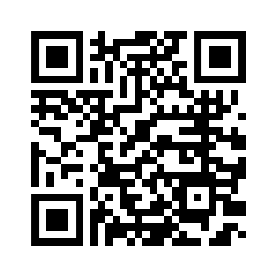
Contact
https://www.linkedin.com/in/solangegueiros/

Slide 81
Contact
blockchainacademy.com.br
iovlabs.org
solangegueiros@gmail.com
https://medium.com/@solangegueiros
https://www.linkedin.com/in/solangegueiros/
twitter, facebook, instagram: solangegueiros

Slide 82
References
https://docs.ethhub.io/ethereum-roadmap/ethereum-2.0/eth-2.0-phases/
https://medium.com/swlh/a-comprehensive-view-of-ethereum-2-0-serenity-5865ad8b7c62
https://eth.wiki/en/roadmap/istanbul
http://eips.ethereum.org/

