Slide 1
Presentation Tool
Wireframes

Slide 2

Première
Present your Ideas
Username
Email id
Password
Password
Login
Copyright© 2015

Slide 3













Subhan
Mohammed Ali
?
3
Projects
Project Name
Tag1, Tag 2
Project Name
Tag1, Tag 2
+
Project Name
Tags
Create New Project

Slide 4
Subhan
Mohammed Ali
Projects
Health App
?
Tag1, Tag 2
Upload Screen
Upload one or more screens to get started
Hot spot
Link
Replace
Transition
Zoom
Pan
Pick tool
Save
Preview
Share

Slide 5

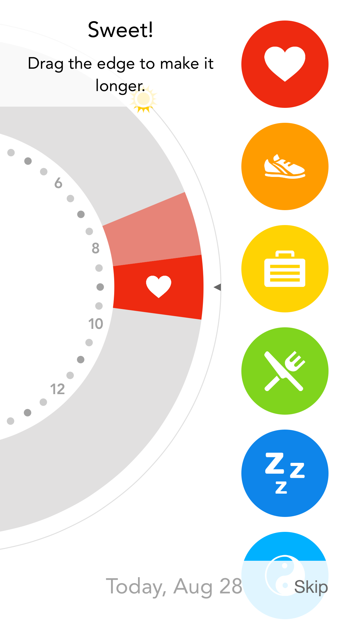
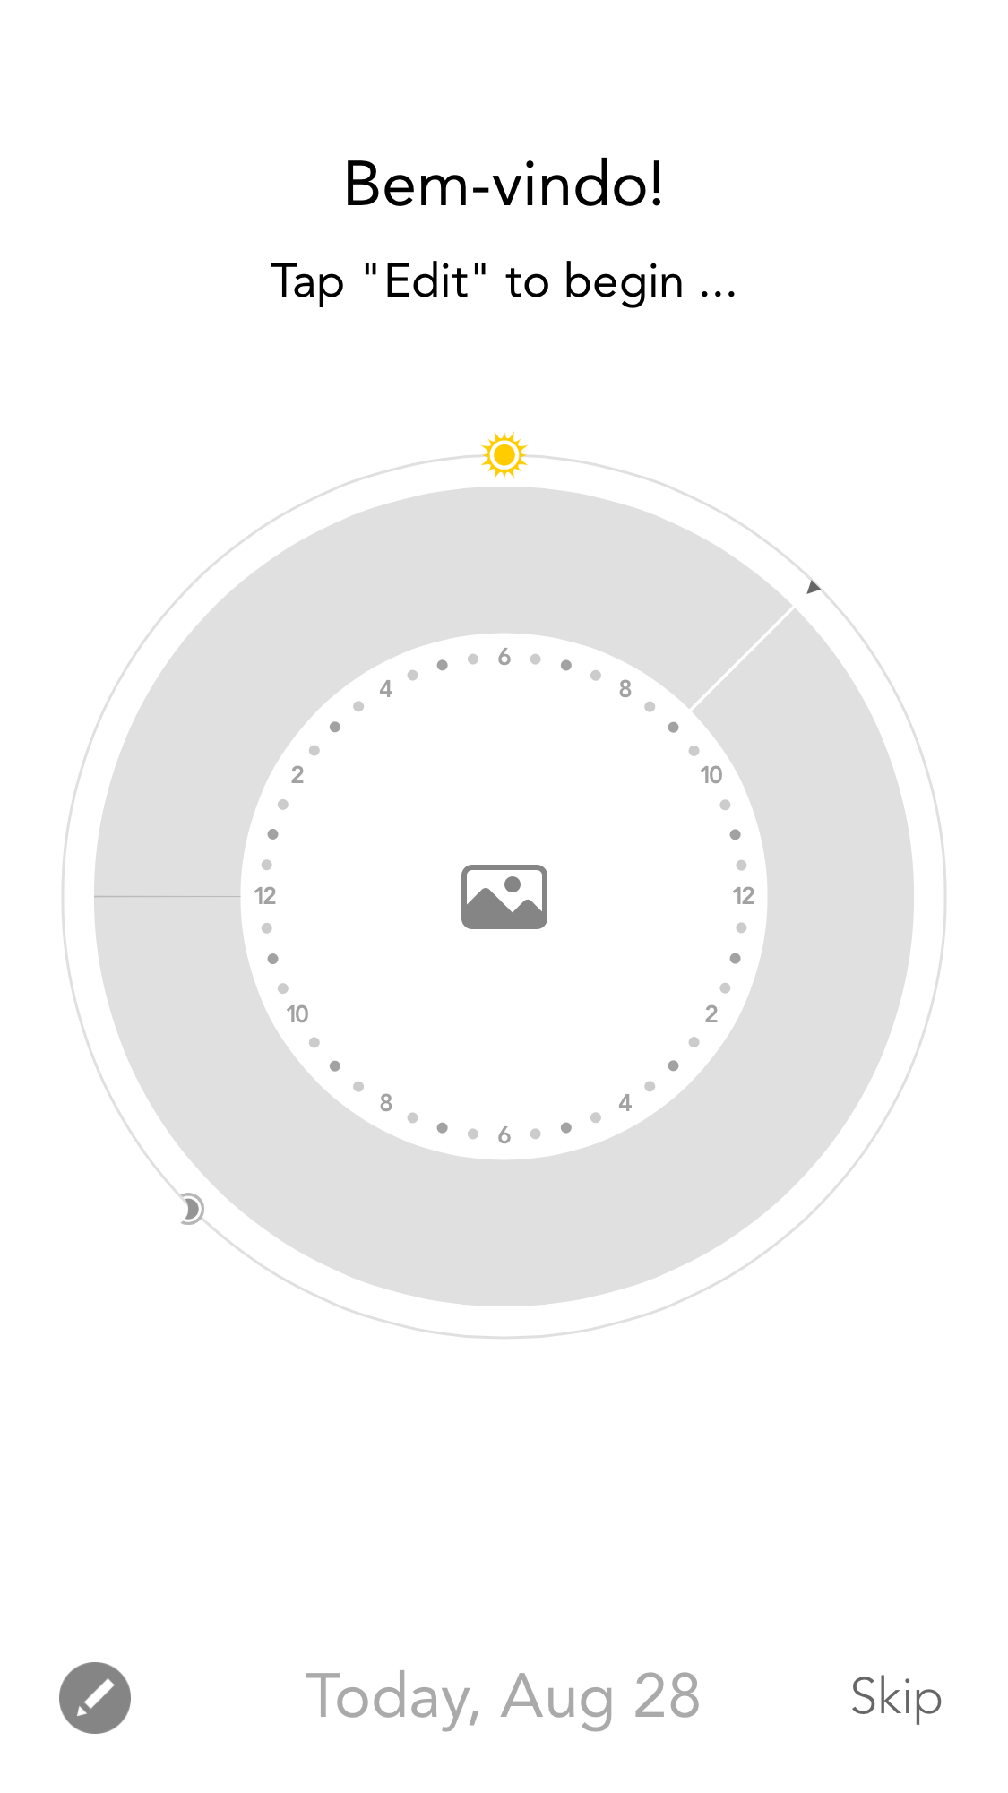
Subhan
Mohammed Ali
Projects
Health App
?
2
Tag1, Tag 2
Upload Screen
Screen3.png
Hot spot
Link
Replace
Transition
Screen1.png
Zoom
Pan
Pick tool
Screen2.png
Save
Preview
Share
Screen3.png

