Slide 1
Code Police Code Theft Detection Tool
September 30, 2022 | Serial-Coders
Shubham Kumar Panday
Prateek Rathore
Poonam Solanke
Amruta Chichani
Bhushan Karmarkar

Slide 2
Content
Overview
Demo
Architecture and Code Walkthrough
Work Distribution
Takeaway
Future Enhancements
Questions and Answers

Slide 3
The Problem Statement
If you are a founder or CEO then you may have already asked yourself this question “What if my code ends up on the internet or with my competitors?”
“Code Police” aims – To detect if the source code from “our” customer’s private repositories is copied to public GitHub repositories.
The use case has emerged from the incidences happened in the past

Slide 4
Development Overview
1 Month
5 Developers
Lot of Passion
~6000
Lines of code
BE ~3500 FE ~2300
75%
Code Coverage Unit + Integration Tests
CI
Build Automation, Tests and Coverage
15
Pending Sonar Issues

Slide 5
DEMO
Notes:
Present end to end prototype workings

Slide 6


Technology Stack
Code Police
Front End
Backend
Design Components
Business Logic
Search Config
Crawler/Searcher
Web API
Test Framework
Storage
Report
S3
DB
React.js
Next.js
React ant design
Jest
Java
Spring
AWS
Github api
MySQL

Slide 7
Search/ Crawl
Analysis
Storage
Report
REST
Front
End
Backend Workflow
Search Config
Packages
Filenames
Code
…..
Transform
Merge
Scheduler
Alerts
Model
Generic REST Framework
Generic DAO Framework
DB
S3
…..

Slide 8
Code Walkthrough
Models
DAO
Rest
Code Coverage Report
Front End

Slide 9
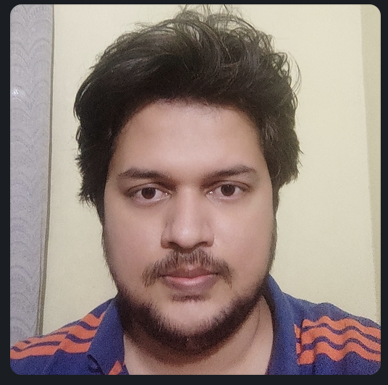


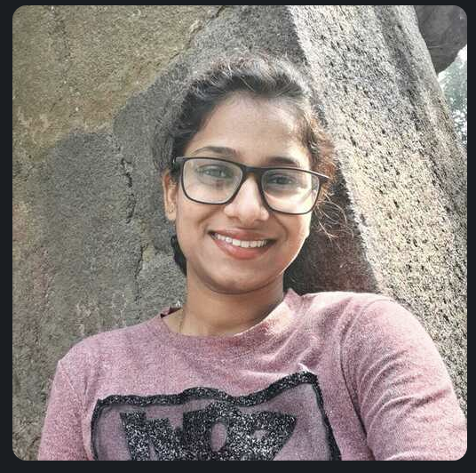

Work Distribution
Shubham Kumar Panday
Front-end design
Development and Testing
Amruta Chichani
Research on GitHub API, POCs
Scheduler
Orchestration
Prateek Rathore
Front-end design
Deployment on Cloud
Poonam Solanke
Jenkins setup, configuration, Junit tests and code coverage report generation
Rest and Dao Framework
Deployment on cloud
Bhushan Karmarkar
Overall Backend Architecture
DAO, REST designing

Slide 10
Future Enhancements
Support for Bitbucket, GitLab, Google Cloud Source Repositories
Algorithm for identifying false-positive cases
Multi-tenancy support (SaaS)
Fully automated CI-CD with deployment on cloud
Zero Sonar issues
Improved Security and Code Quality

Slide 11
Takeaways
Participating in Clairthon '22 is my first hackathon experience. It's very encouraging and inspiring. I have explored learned practical usages of the theory we know. – Amruta
It was my first hackathon I really enjoyed this journey of learning and growing. It opens new horizons for me to explore new technologies. It provides me a platform to learn and implement new ideas. – Poonam
Knowledge about GitHub API – with challenges such as rate limit
Generic DAO and REST layer – pluggable and ready to use in WebApps
New Friends !

Slide 12
Thank You.
Questions?

