Slide 1
Controls
By: Anuj Solanki

Slide 2
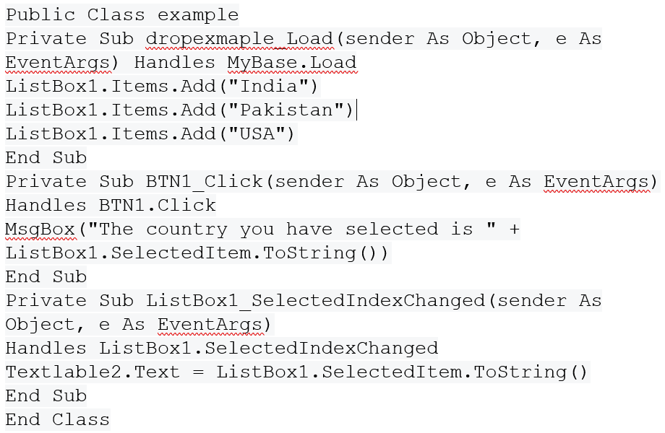
ListBox
As the name suggests, this control works as a way to display a list of items on the application. Users can select any options from the list.

Slide 3
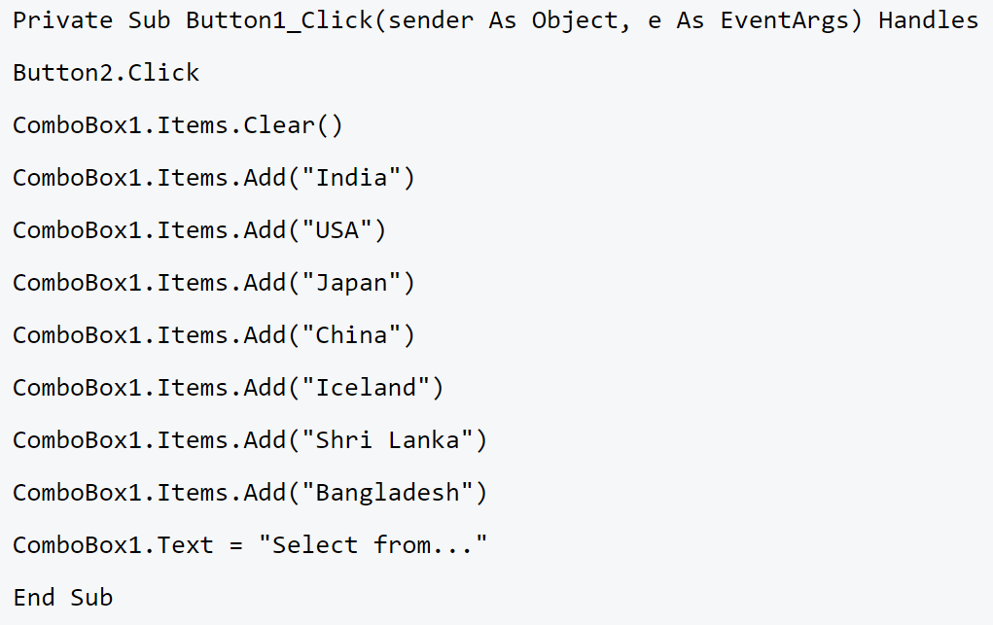
Combo Box
It is similar to the list but it works as a dropdown for the user. A user can enter both text in the box or he can click on the downwards aero on the right side and select any item.

Slide 4
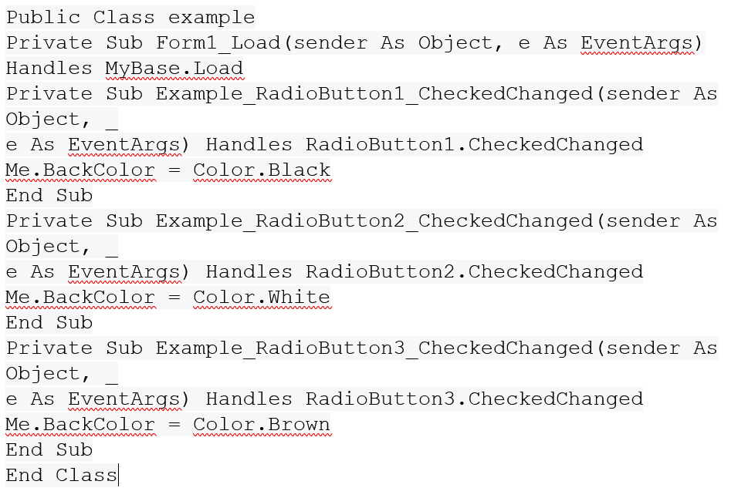
Radio Button
Radio Button is one of the popular ways of limiting the user to pick just one option. The programmer can set any of the buttons as default if needed. These buttons are grouped together.

Slide 5
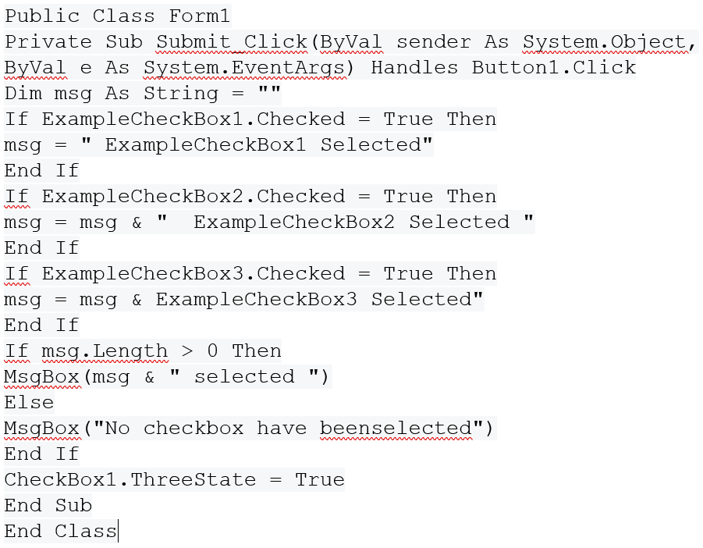
Checkbox
Checkboxes are similar to radio buttons in the way that they are also used in groups, however, a user can select more than one item in the group.

Slide 6
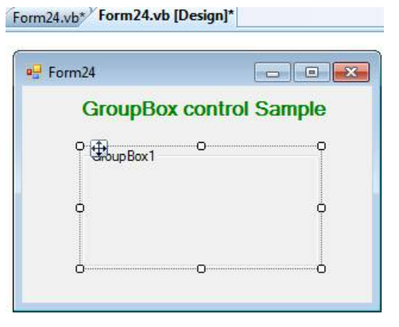
GroupBox
GroupBox is a container of other control. It displays a frame around a group of controls. When you move the GroupBox control, all of its contained will also move.
Drag and drop GroupBox control from the toolbox on the window Form. When you drag and drop the group box, it has a border by default, and its caption is set to the name of the control. You can change its caption.

Slide 7
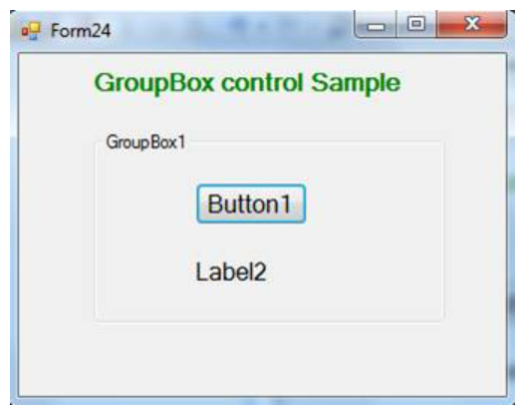
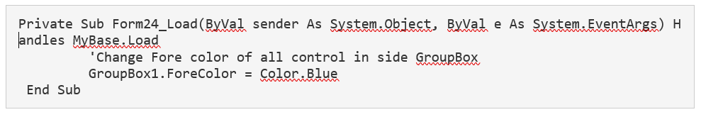
GroupBox is a container of other control.
Example
GroupBox properties
AutoSize: Gets or sets a value that indicates whether the GroupBox resizes based on its contents.
BackColor: Gets or sets the background color for the control.
ForeColor: Change ForeColor of all control inside GroupBox
You can change ForeColor of all control inside GroupBox at a time
The code should be written inside Form Load so that when Form run than code (for changing ForeColor) will be executed.

Slide 8
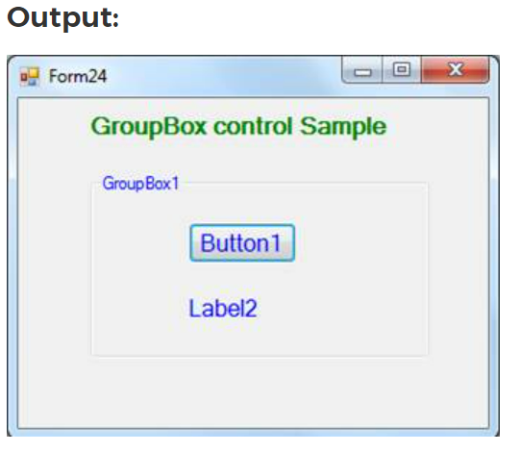
Fore color of all control inside GroupBox will be change When Application run.

Slide 9
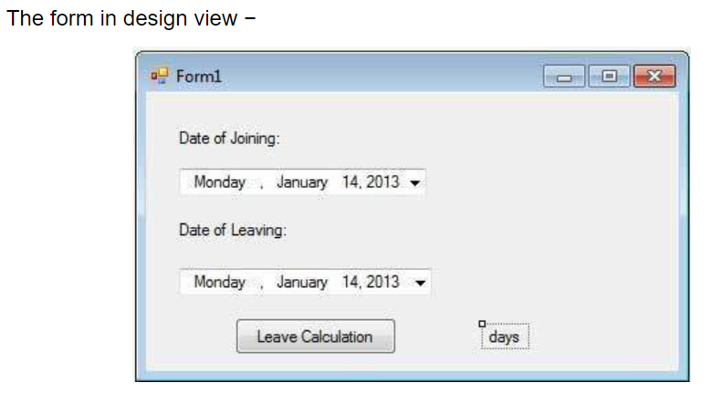
Date Time Picker
In cases where you need to ask the user about date and time, VB.NET has a readymade control that lets the user pick the date and time via a Calendar and a clock. This saves the hassle of creating multiple text boxes for one input. For example create a small application for calculating days of leave.

Slide 10
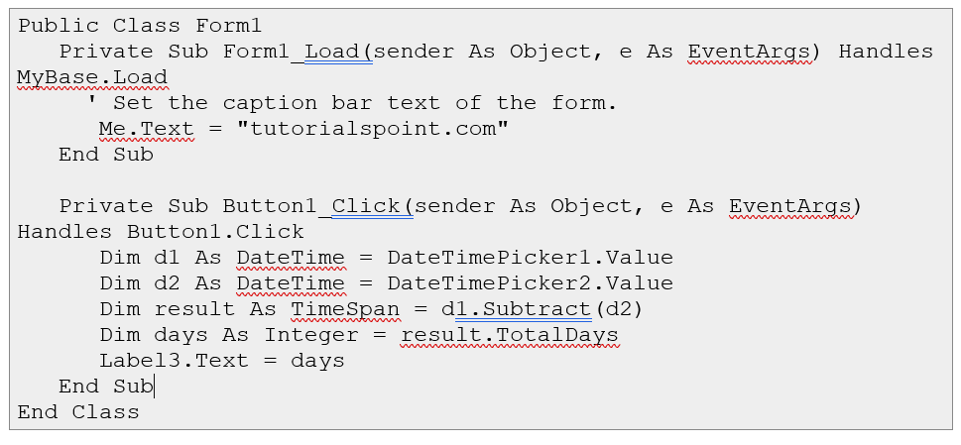

Slide 11
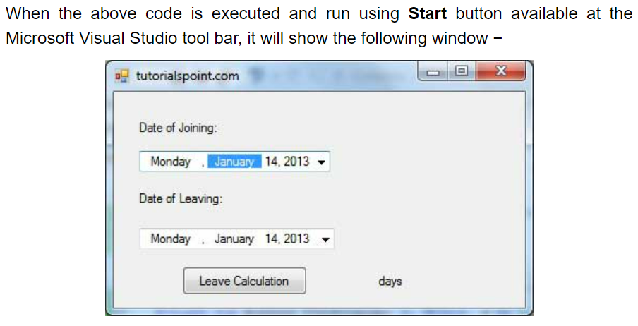
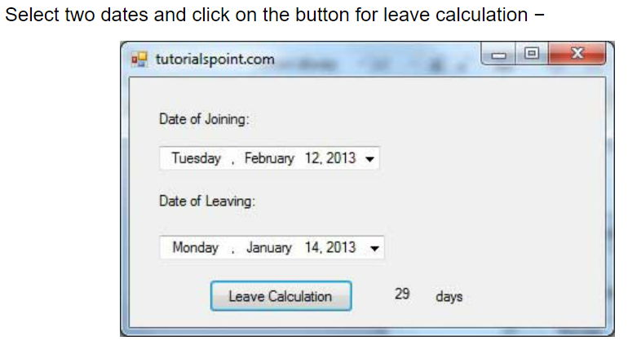

Slide 12
Month Calender
MonthCalendar is a selectable calendar widget. On the MonthCalendar, a user can select a day, or a range of days. The user can also scroll through the months. This control provides many useful options. It is ideal for instant calendars.
BoldedDates. To get started, you can double-click on the MonthCalendar icon in the Toolbox pane in Visual Studio. MonthCalendar has several properties related to bolded dates. In the MonthCalendar, some dates can be bolded to indicate an important event.

Slide 13
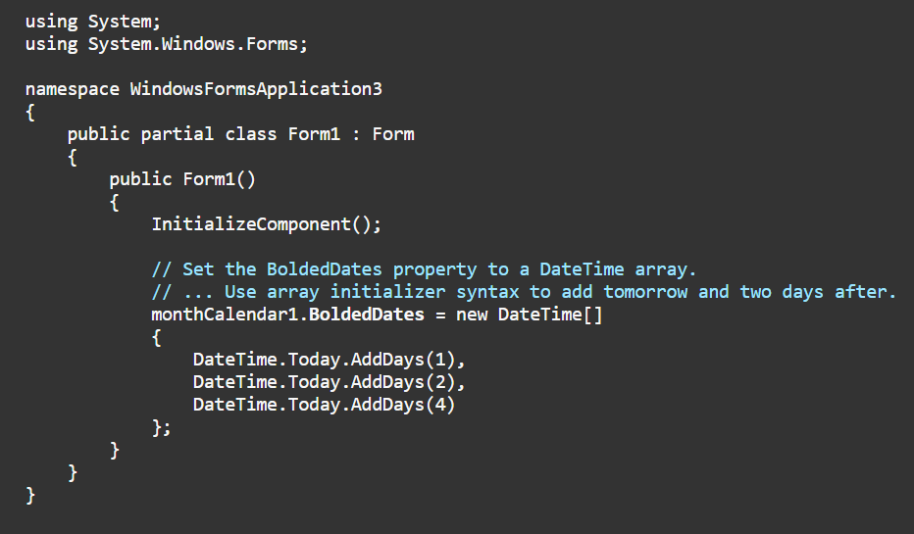

Slide 14
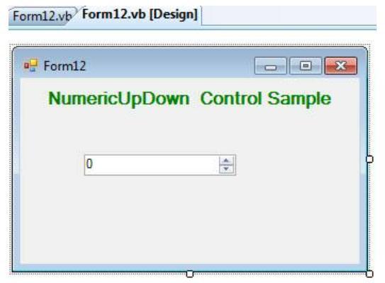
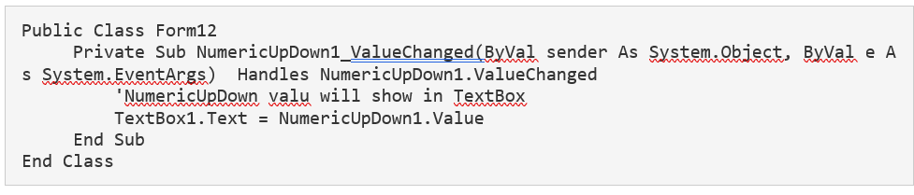
NumericUpDown
NumericUpDown is basically countered that the user can input a number within the specified range. With the Help of NumericUpDown Control, we can enter numeric values, with advanced features like up-down buttons and accelerating auto-repeat.
Drag and drop NumericUpDown Control from the toolbox on window Form.

