Slide 1
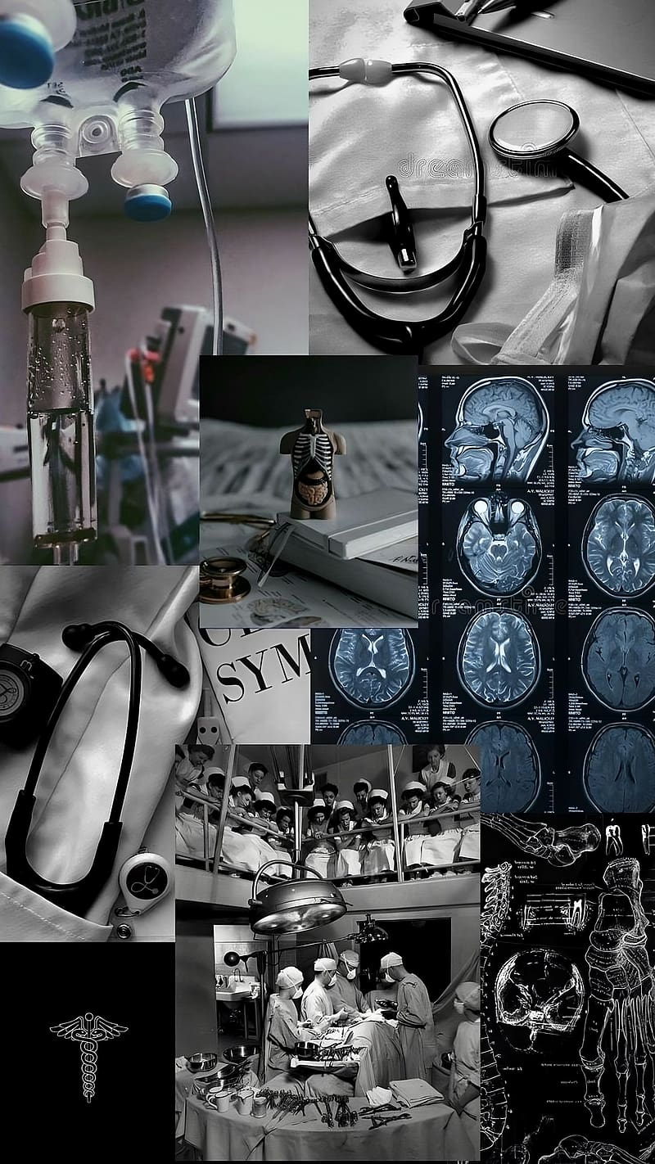
DOCFOLIO
Consult with the best doctors near you.
Team members:
1. Supriya Chandra
2. Dhruv Chaudhary
3. Sonali Chandra
4. Anas Solanki
5. Nikita Kumari

Slide 2
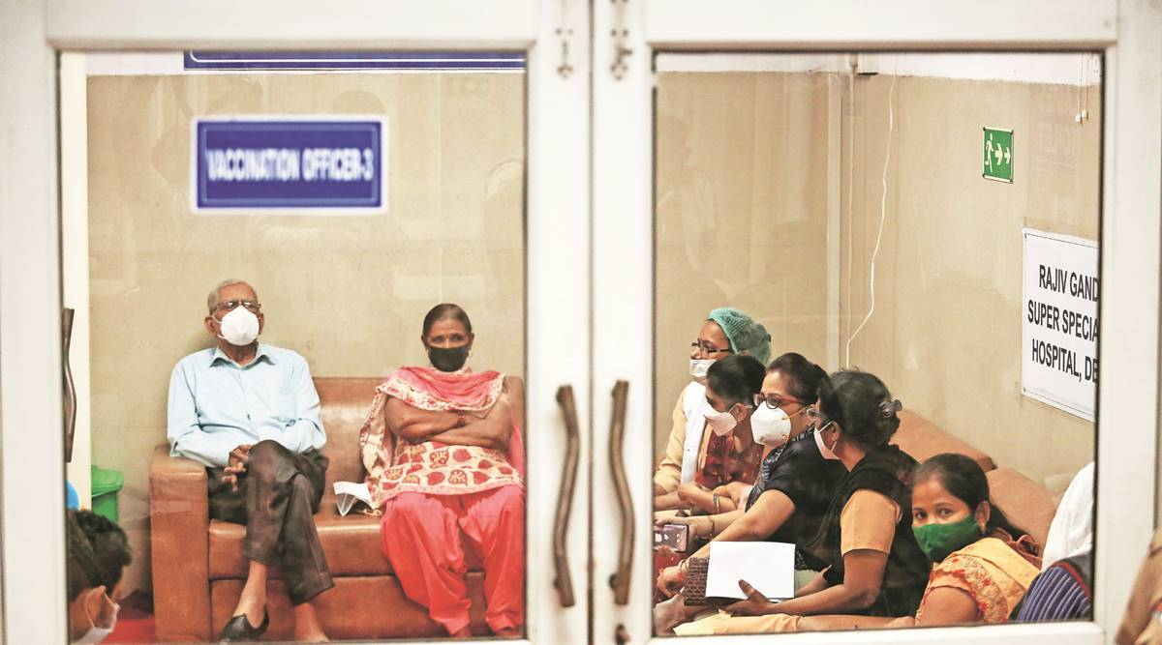
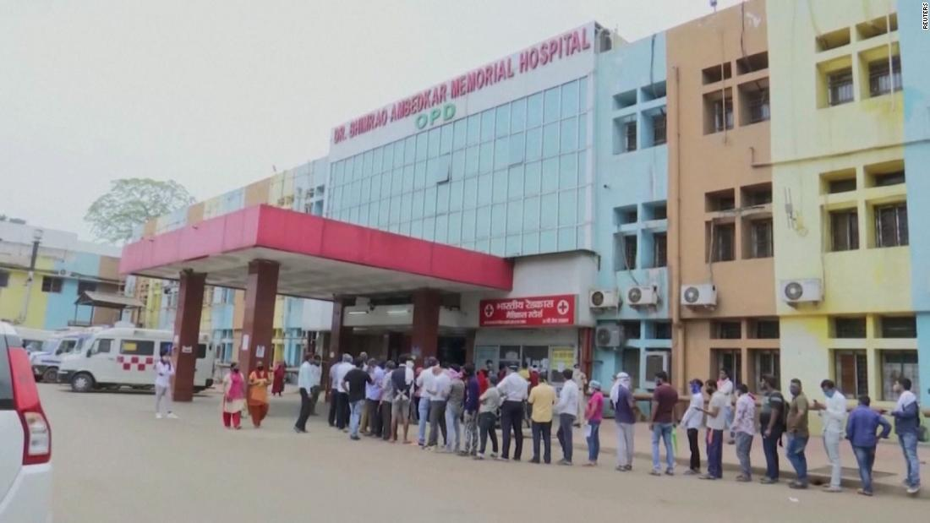
Problem Statement
People can’t find specialized hospitals near them, even when they do they never know if that hospital has a specialized doctor for them.
Patients can’t be sure if the doctors are experienced or not.
Patients usually can’t decide which doctor they want to get an appointment of. Usually the whole treatment is done by different doctors, which results in confusion. As different doctors might have slight variations in their methods.
Patients might be comfortable with only some doctors but they don’t get a chance to choose for themselves, as hospitals just assign a different doctor most of the times.

Slide 3
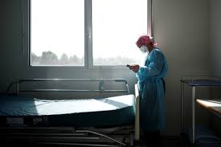
Sometimes it’s not possible for to travel miles to see a doctor, especially for patients suffering from injuries or diseases.
Patients have to wait in long lines just to get an appointment in General OPD.
Patient don’t have the power to choose for themselves.
Patients can’t be sure if the doctors assigned to them are the best in their locality.

Slide 4
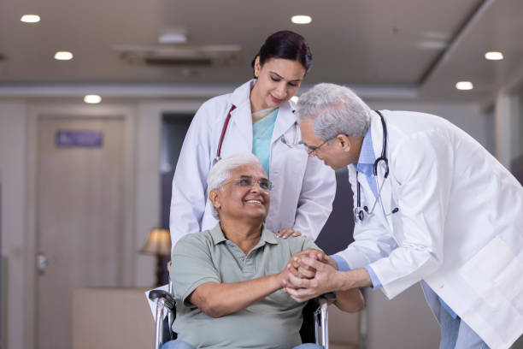
SOLUTIONS
Docfolio gives power in the hand of the patients.
It promotes transparency.
Patients can book appointments online via the app or website.
Doctors register themselves in the app and get reviews and rankings.
The reviews and rankings given by patients will give idea to patients.

Slide 5

Reviews might be helpful for doctors as well to analyse themselves and get inspired to do more.
Patients have the power to book appointments of top doctors near them.
Patients don’t have to travel miles just to get an appointment; they can now easily check Docfolio and see when they can get an appointment from their desired doctors.
Docfolio gives a better doctor-patient interaction.
Docfolio also gives an option of online appointment.
Doctors are also given a space to write about new medical discoveries and interact with fellow doctors.

Slide 6
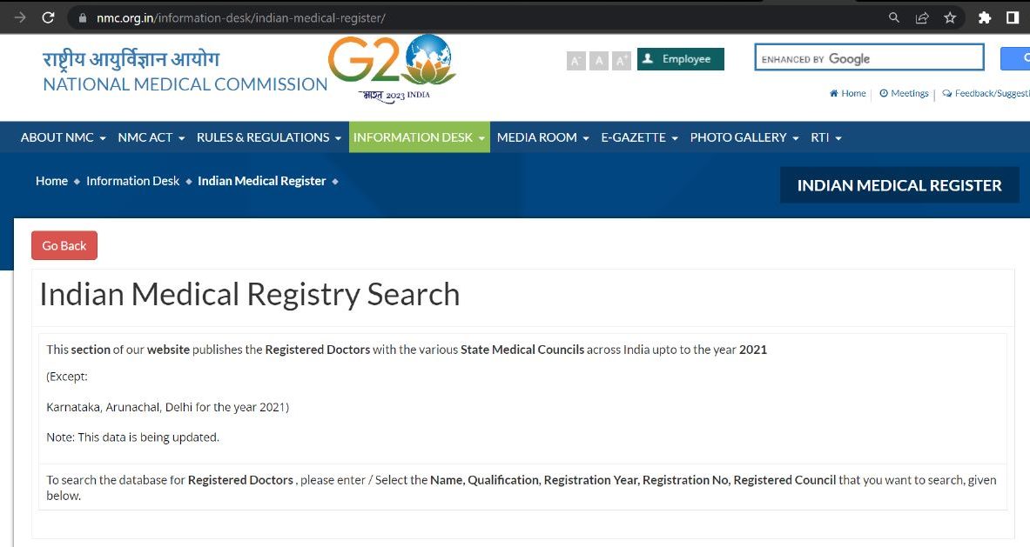
To check authenticity of the doctor’s uploaded certificate

Slide 7
Uniqueness:
In our website, the modes of doctors are available. Users can choose online, offline or hybrid appointments.
Docter’s notes are available.
Users can choose from many choices.

Slide 8
Tech Stack
HTML
CSS
JAVASCRIPT

