Slide 1
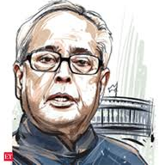
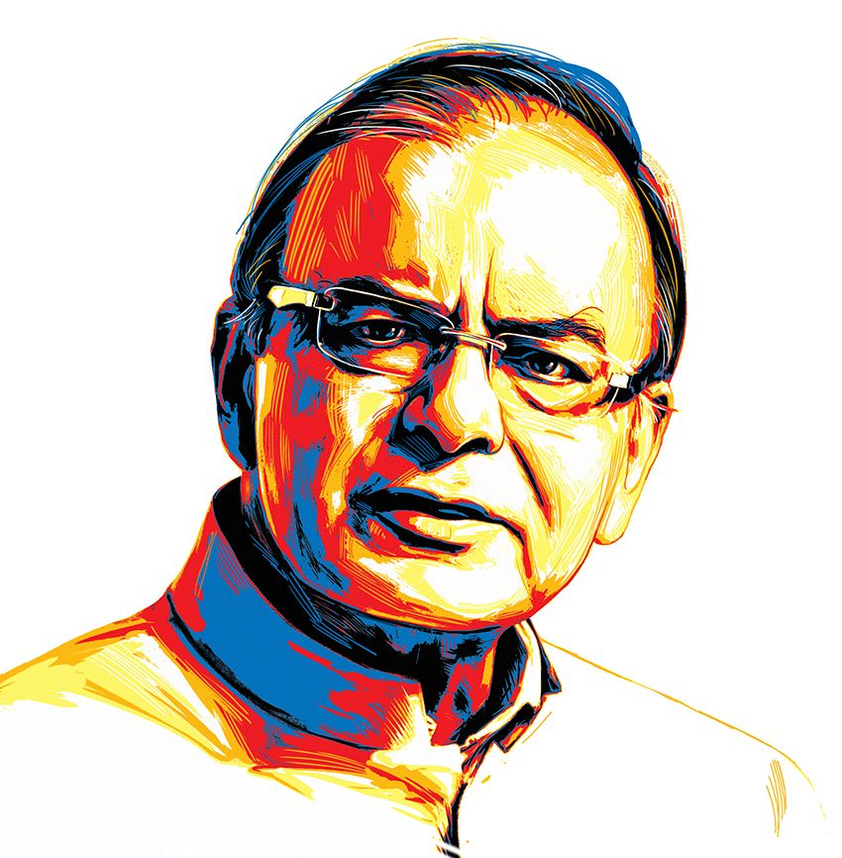
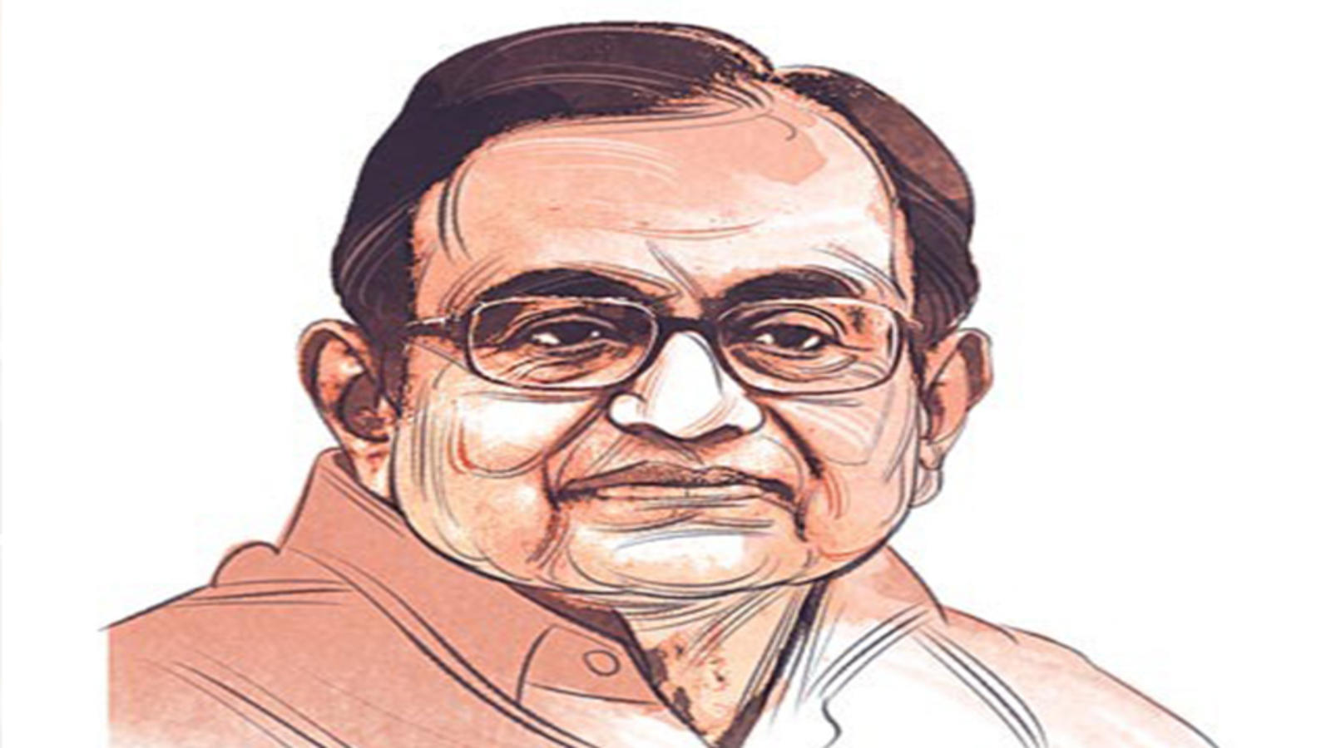
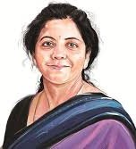
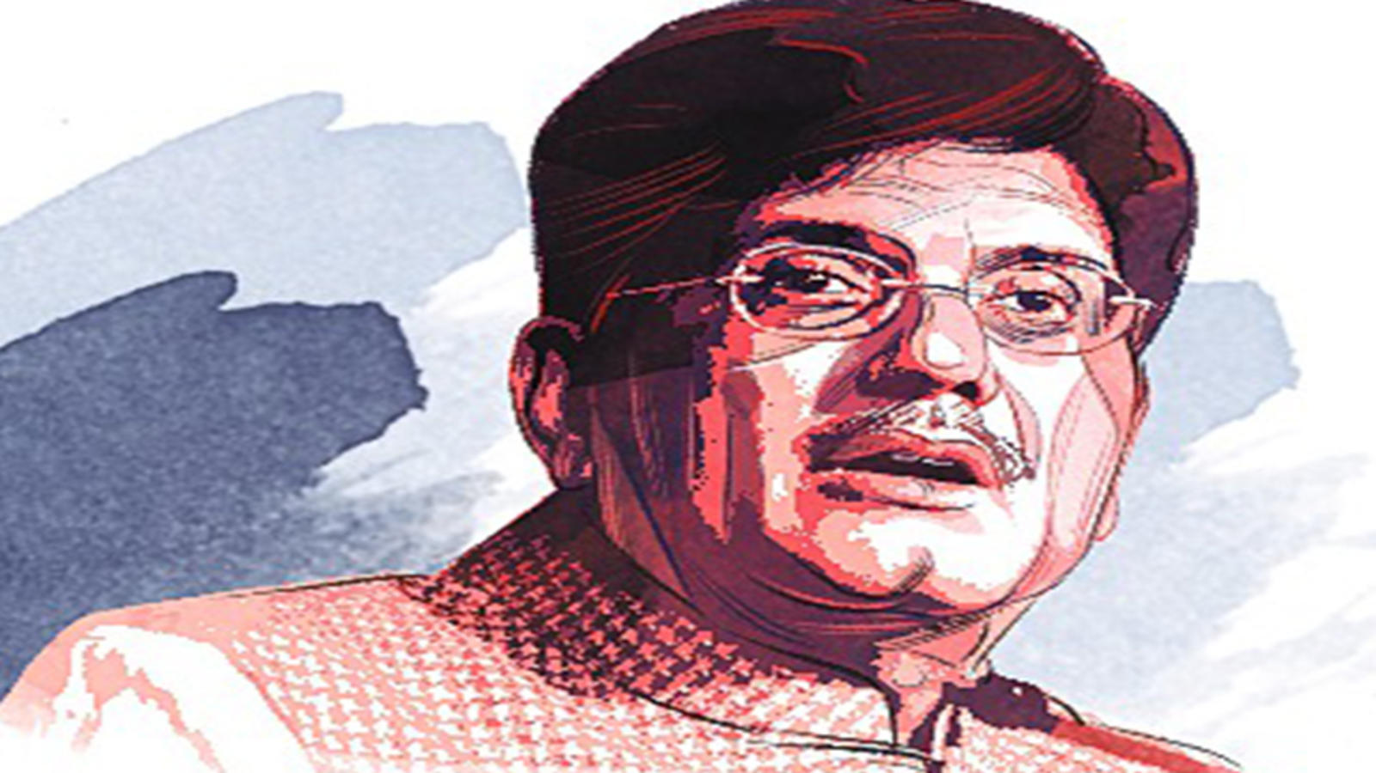
Big Eye of India’s FMs’
A ‘sentiment’ approach to analyse FM’s Speeches
Submitted by:
Pradeep Kumar M
Aniruddh
Harsh Solanki
Anusha
Srinivas Gulla

Slide 2
Content
Project Objective and Introduction to Dataset
Outline
Data Understanding: - Data Pre-processing - Data Processing with EDA
Analysis on Lexicon Dictionary Coverage
Algo selection and coverage expansion
Correlation with Financial Figures

Slide 3
Project Objective and Introduction to Dataset
Ever wondered what makes a Finance Minister’s speech ‘standout’ with an ‘underlying’ message?
This project is an attempt to find out the answer to it through an advanced method
AI-NLP – “Sentiment Analysis”

Slide 4
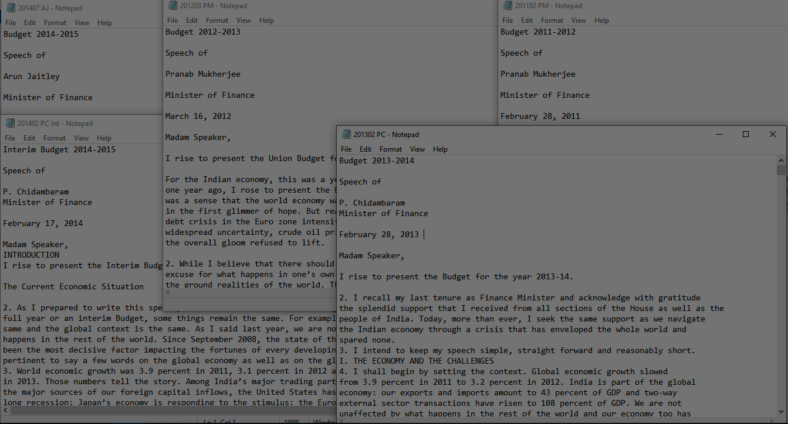
Project Objective and Introduction to Dataset
We’ve collated speeches of Finance Ministers from 2010 to 2019 in .txt files. We’ve also included interim speeches for the years’ 2014 and 2019

Slide 5
Outline
Assigning custom polarity to increase the coverage
Correlation with Financial Figures
NLP Pipeline
Data Pre-processing and EDA
Tokenization
Word frequency
Lemmatization
Word vectorization using SpaCy
Sentiment Dictionary Algorithm (Vadar, AFINN, TextBlob)
Considering decade long financial figures to correlate with each speech
Using regex to extract the meaningful data
Library & Custom Stopwords
Splitting speeches to sentences
Speech .txt files

Slide 6
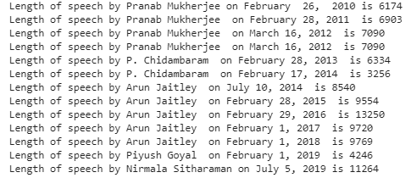
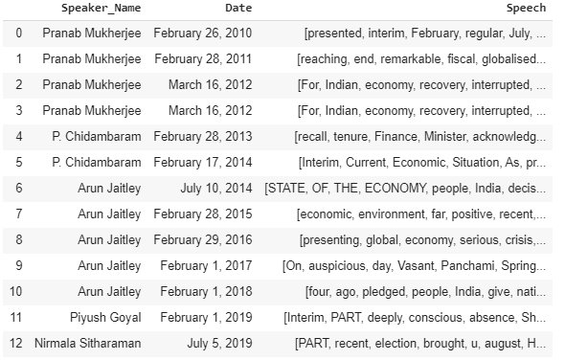
Data Understanding-Data Pre-processing
Created a DataFrame with ‘Speaker Name’, ‘Data’, ‘Speech’ columns
Length of each speech
Challenges:
Each .text file had a different formatting with a wide variety of uncleaned entities like ‘Hinglish words, website links, double space, special symbols, etc.
Stopwords identification suiting the business objective
Unlabelled Data
Solution to overcome:
Using regular expressions and simple tokenization methods, we could clean the data to a usable corpus
In addition to the lexicon stop words(used NLTK, VADER,AFINN), we have also added custom stop words based on its occurrence. We made sure to separate words with ‘not’ and excluded from the list
Open ended challenge

Slide 7
Data Understanding-Data Pre-processing
Removing sentences with only numbers (line numbers)
Removing single character words
Removing single word sentences
w=df[~df.Clean.apply(lambda x: x.isnumeric())]
w=w[~w.Clean.apply(lambda x: x == '')]
w['Clean']=w['Clean'].map(lambda x: re.sub(r"\b[a-zA-Z]\b", '', x))
count = w['Clean'].str.split().str.len()
w=w[~(count==1)]
w['Clean']=w['Clean'].map(lambda x: re.sub(r"\b[a-zA-Z]\b", '', x))

Slide 8
Data Understanding-Data Pre-processing
Custom Stop Words along with standard Stop Words
stop_words = ["Arun", "Jaitley", "Budget",'Minister','Speaker','Madam','Sir','dtype','Nmae','Clean',
'Speech','India','Ju','page','CONTENTS','quo','allow','Name','ne','words','Length','seek',
'scope','Pranab','Mukherjee','Chidambaram','Piyush','Goyal','Nirmala','Sitharaman',
'year','po','stan','cha','object','pre','re','hold','speecha','wi','touc','presented','bs',
'Budg','February','placed','eventuall','fu','far','positi','ear','provided','worl','facing',
'year','sections','ago','popu','different','Indian','morning','Indi','happens','vel','yea',
'said','let','gives','Nehru','Jawaharlal','remain','Anru','fi','VIII','VI','IX','VII','gr',
'iv','Secto','deo','new','item','iii','Chapter','non','ii','ho','litre','years','Fe',
'Naren','Shri','etc','adm','la','fina','august','month','July','july','Vivekananda','Swami',
'Finance','relating','relati', 'NPS','cri','House','gra','kol','Roa','IMF','RWA','aa','AAI',
'AAM','ab','AAR','abs','ACA','ad','ADR','AEC','AI','AIF','AMC','AP','APA','APT','ARC','ARCs',
'AVGC','ATUFS','ASPIRE','hands','know','time','tomorrow','today','Today','eighth','seventh',
'sure','day','eariler','agents','Note','means','given','Prime','run','Annex','write','found',
'example','rest','Ahead','Annexes','Act','intent','gave','member','present','Thiruvalluvar',
'present','joins','clear','taking'] + list(stopwords)

Slide 9
Data Understanding-Data Pre-processing
collect abbreviations from all speaches :- detect abbreviations in format like '(..[atleast 1 caps]...)' and add it as stop word in Spacy vocab
import spacy
nlp = spacy.load("en_core_web_lg")
for speach in all_speach:
str_speach = ' '.join([str(elem) for elem in speach])
z=re.findall('[(]\w*[A-Z]\w*[A-Z]\w*[)]', str_speach)
for i in z:
s=re.findall('[(](.+?)[)]', i)
for j in s:
nlp.vocab[j].is_stop = False
nlp.vocab[i].is_stop = True

Slide 10
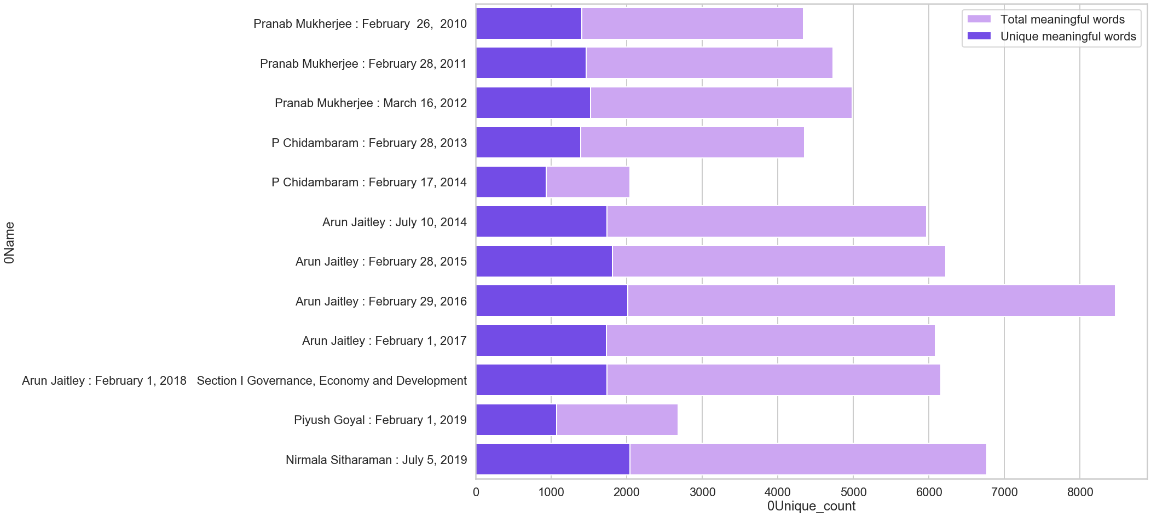
Data Understanding-Data Pre-processing
Considering Bag of Words (BOW) from each speech, here is a graph that indicates how many of the words are unique from all the words

Slide 11
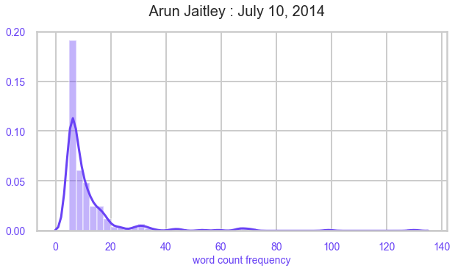
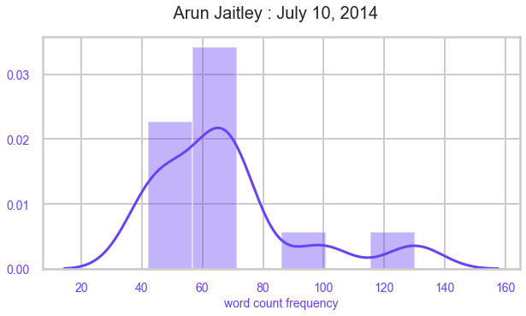
Data Understanding-Data Pre-processing
It is word frequency distribution of speech, We can observe that words with less frequencies are more in number indicating left skewed histogram as above
when we dive into distribution of words with higher frequencies it appears to be near normal distribution
This observation is common among all speeches
it indicates that all FM speeches use some set of common words which are having higher frequencies, commonly used words are shared by all FM speeches.

Slide 12
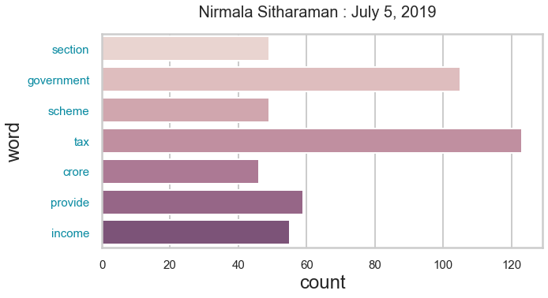
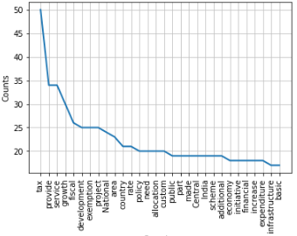
Data Understanding-Data Pre-processing
Here is a specific speech with its most occurring words and counts
Pranab Mukharjee : Feb, 2010

Slide 13
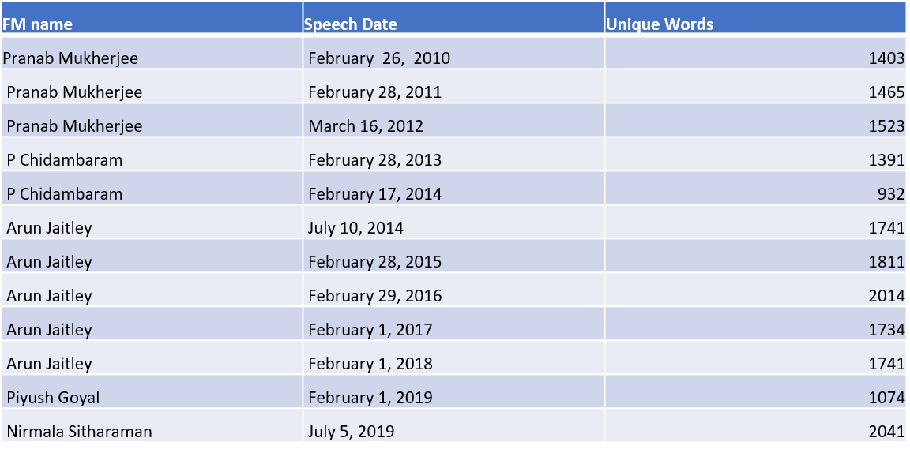
Data Understanding-Data Pre-processing
Unique tokens from each of the speeches

Slide 14
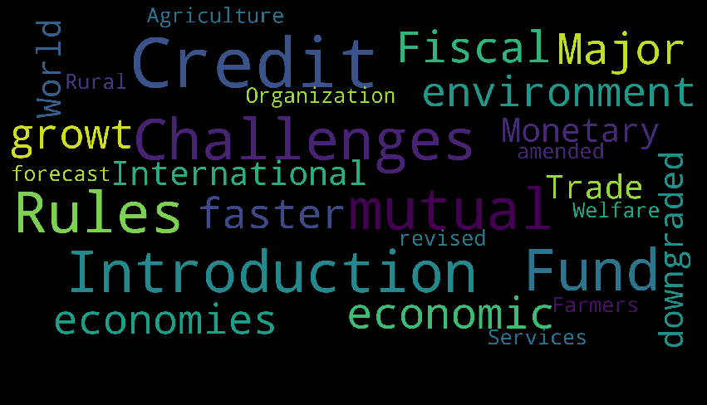
Data Understanding
Word Cloud to Arun Jaitley’s July 10th 2014 Speech

Slide 15
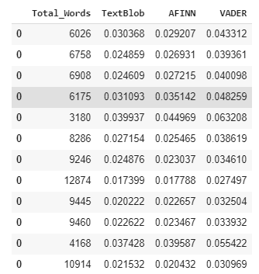
Analysis on Lexicon Dictionary Coverage
We’ve worked on Lexicon Dictionaries of Algos’ like TextBlob, AFINN, VADER
Here are the coverage values to each of the speeches
Nirmala Sitharaman speech had highest mean of 605.000000 positive words
P. Chidambaram speech had lowest mean of 301.500000 positive words
Nirmala Sitharaman speech had highest mean of 288 negative words
Piyush Goyal speech had lowest mean of 96 negative words

Slide 16
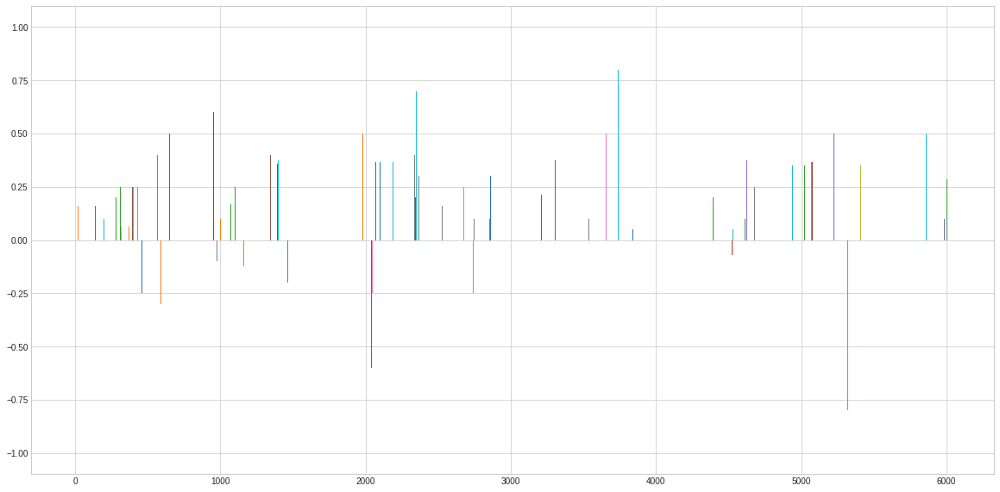
Analysis on Lexicon Dictionary Coverage
This is a representation of sentiment polarity of lexicon words found for the 2010 Pranab Mukharjee speech
As we can see, there are a lot of words with positive polarity over negative polarity

Slide 17
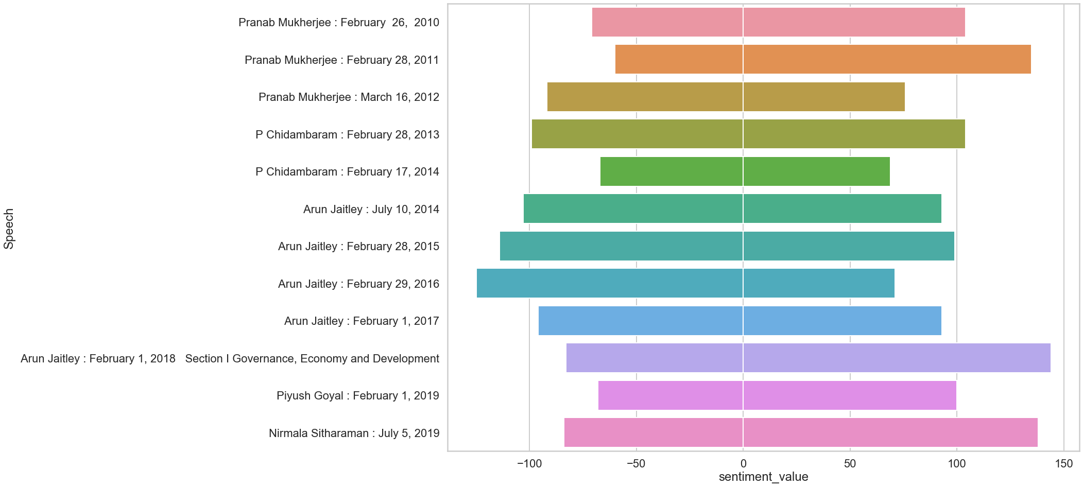
Algorithm selection and coverage expansion
We’ve seen VADER giving us the most coverage. Hence, we selected this algorithm and went ahead to see which are the most common words that have been assigned Zero Polarity. Considering the importance of words, we’ve given custom polarity to these words and tried re-running the model.
Coverage for Vader and AFINN Combined

Slide 18
Algorithm selection and coverage expansion
Coverage for AFINN

Slide 19
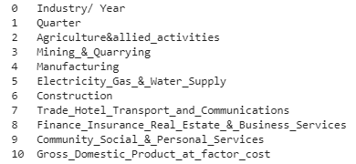
Correlation with Financial Figures
Took the complete Revenue details from different sectors of Government over 2010 to 2019. We will be checking the correlation of industries with each speech to observe the most common bigrams/tri-grams of words associated.

