Slide 1
Assignment

Slide 2
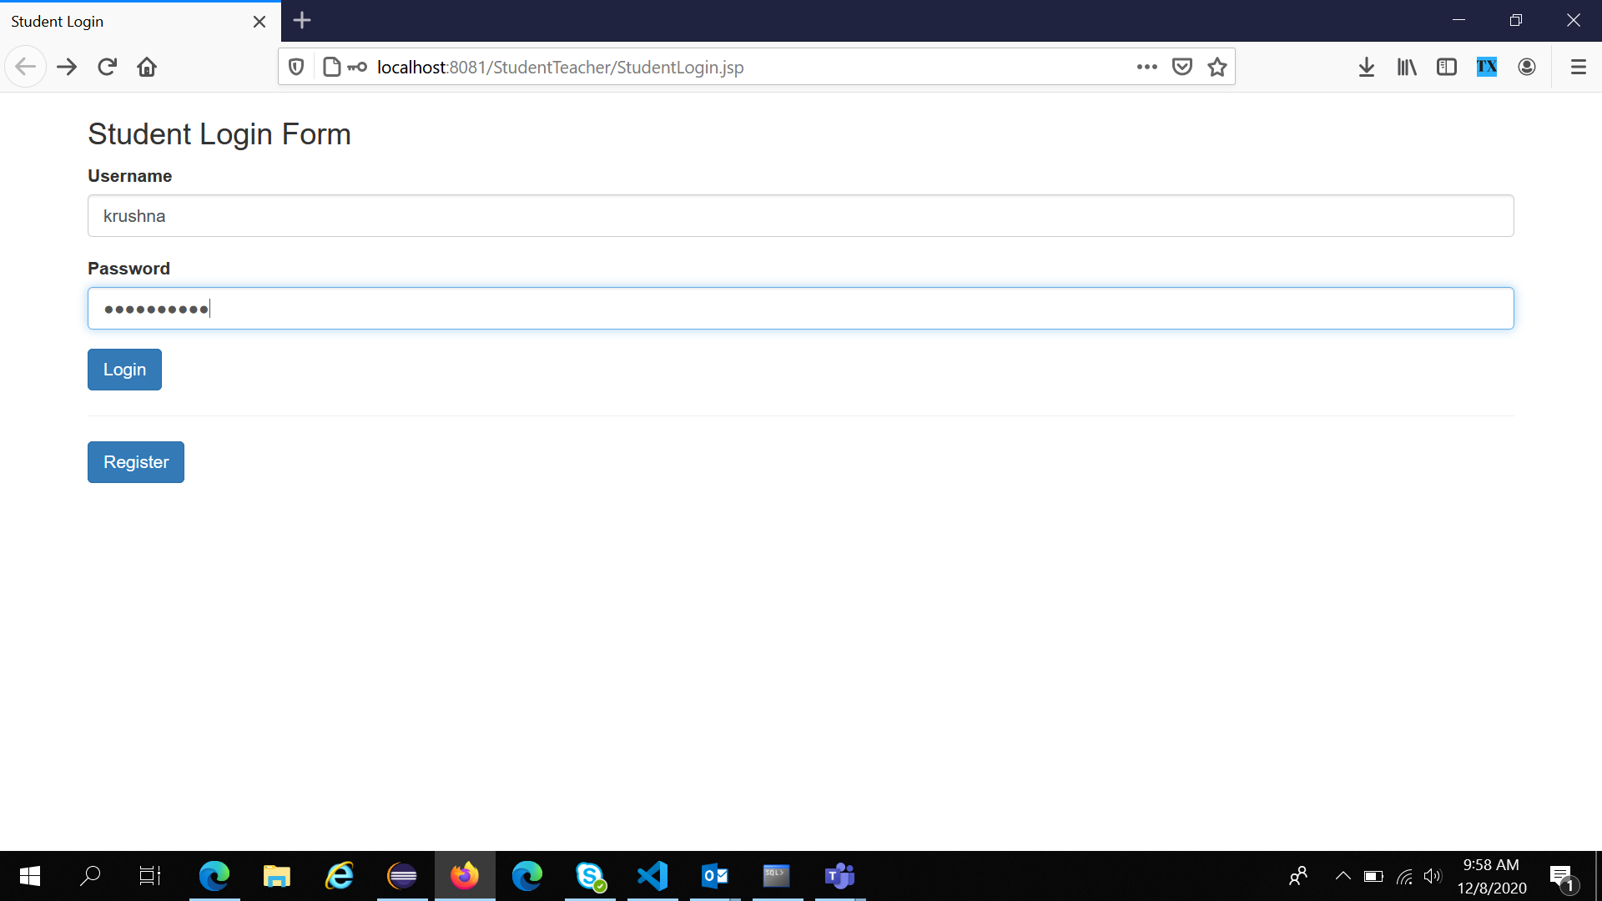
Student Login Form

Slide 3
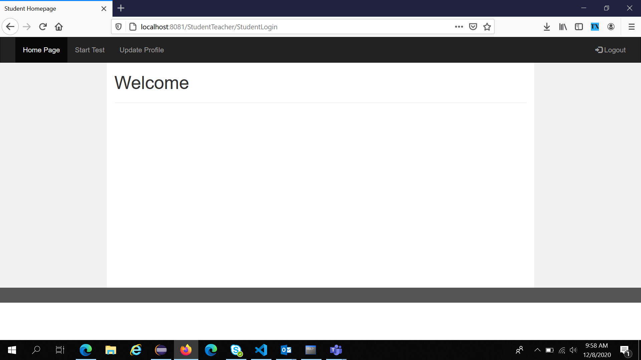
Student Home Page

Slide 4
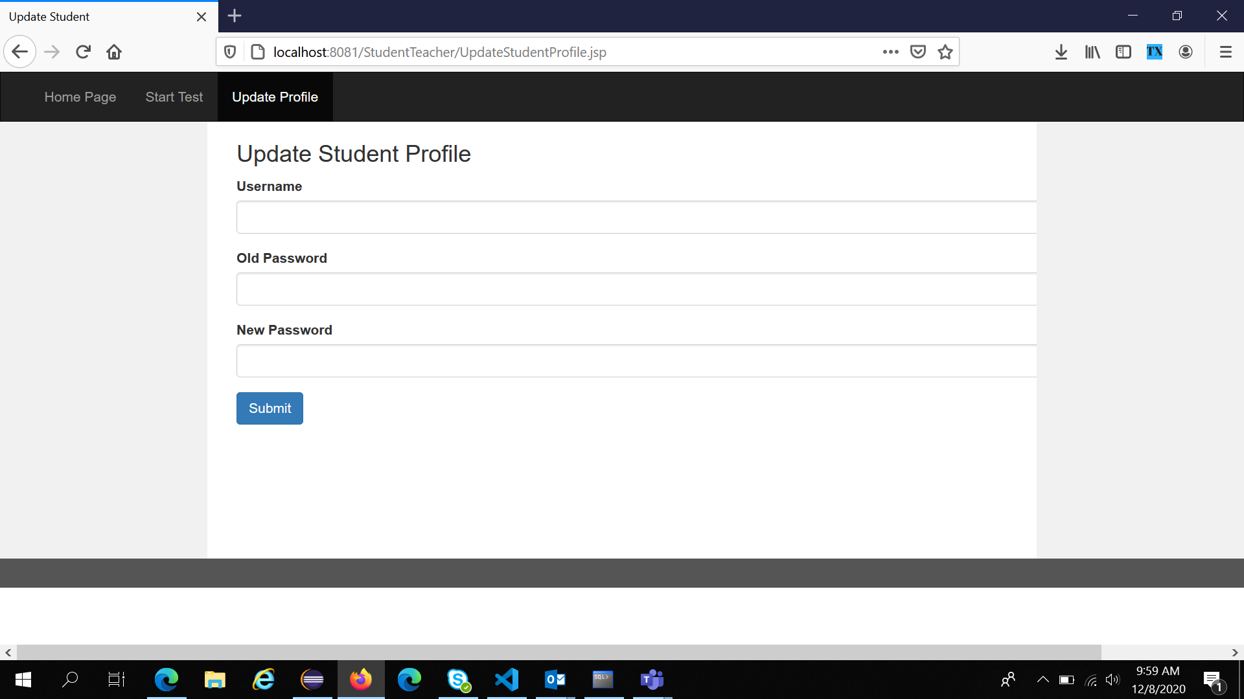
Update Student Profile

Slide 5
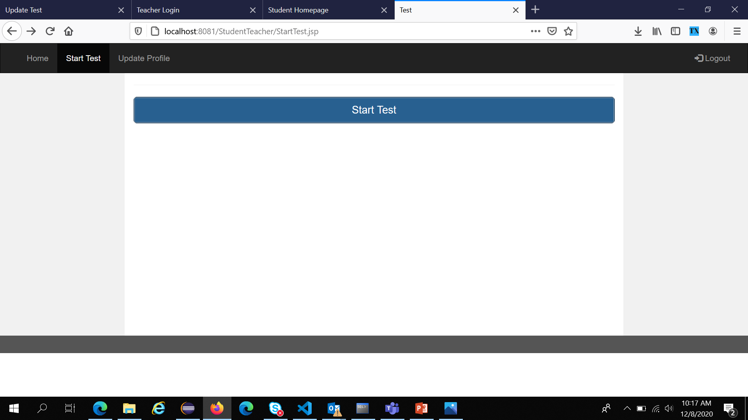
Start Test

Slide 6
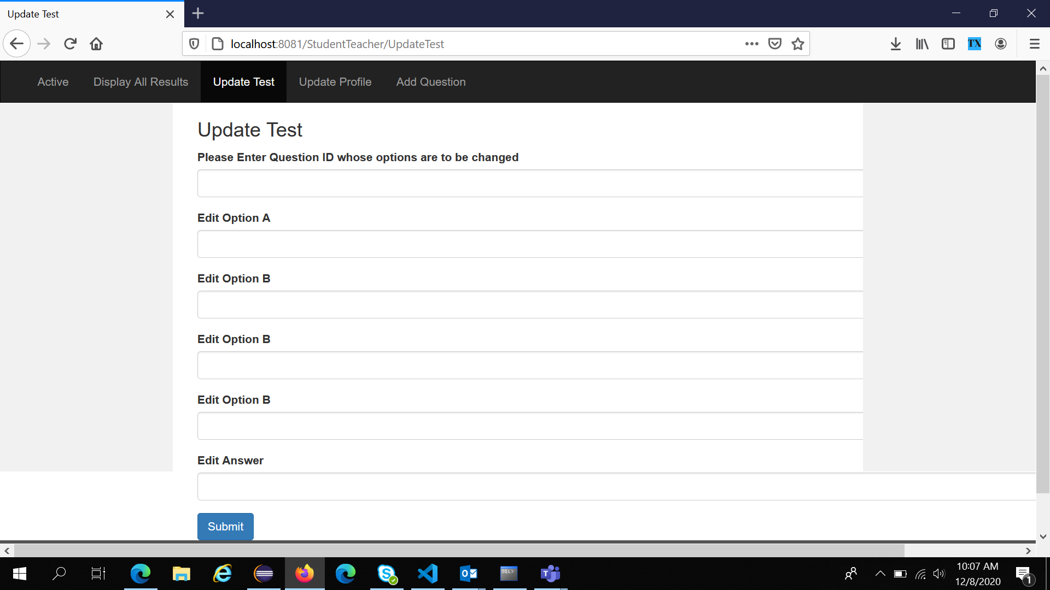
Update Test (Teacher’s feature)

Slide 7
Student Readme
1 Login / Registration Page (StudentLogin.java, StudentRegistration.java)
2 Homepage (StudentHomePage.jsp)
3 Start Test/ Update Profile/ Logout (StartTest.jsp, UpdateStudentProfile.jsp)

Slide 8
Teacher Readme
1 Login / Registration Page (TeacherLogin.java, TeacherRegistration.java)
2 Homepage (StudentHomePage.jsp)
3 Display All Results/ Update Test/ Update Profile/ Add Question Logout (DisplayMultipleResult.jsp, UpdateTest, UpdateTeacherProfile.jsp, AddQuestion.jsp).

