Slide 1
Assignment

Slide 2
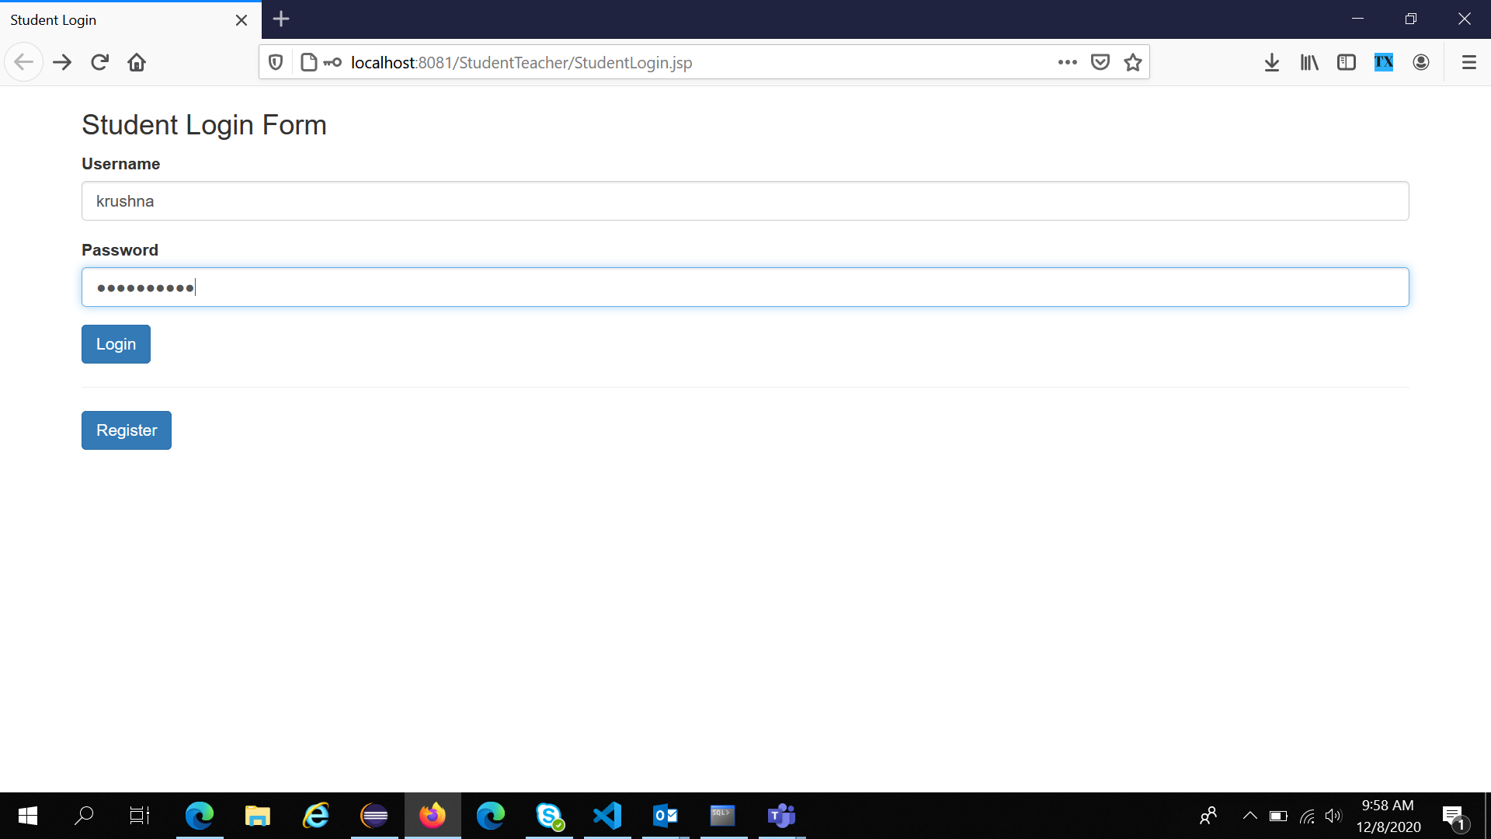
Student Login Form

Slide 3
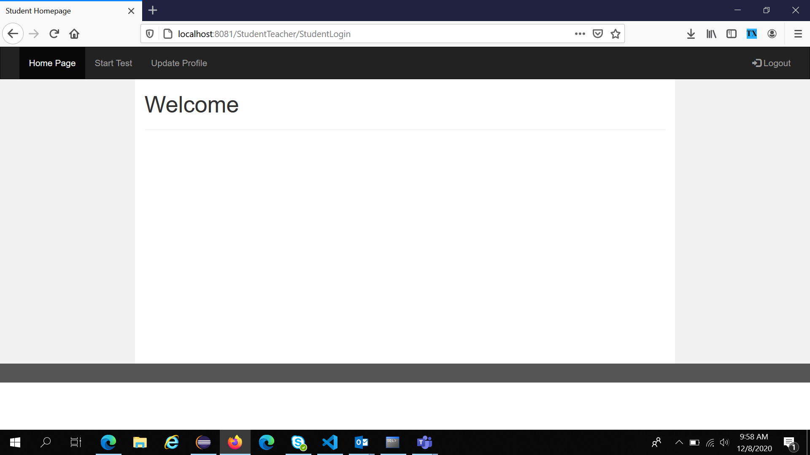
Student Home Page

Slide 4
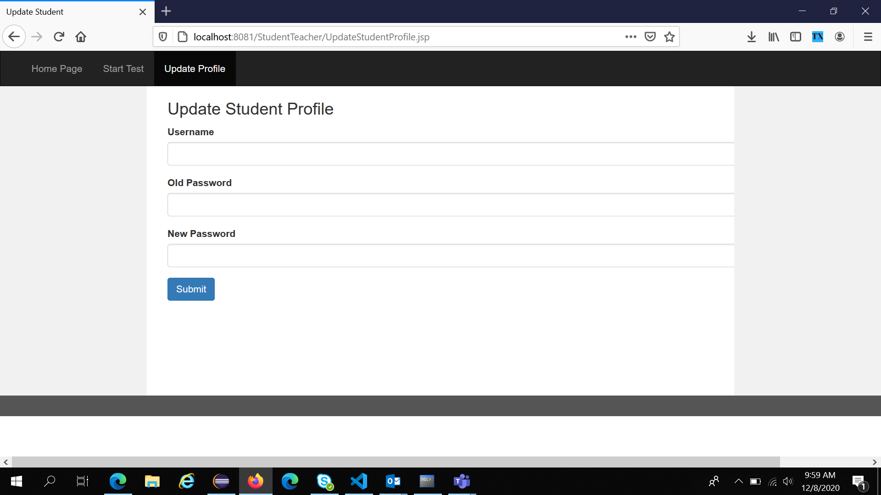
Update Student Profile

Slide 5
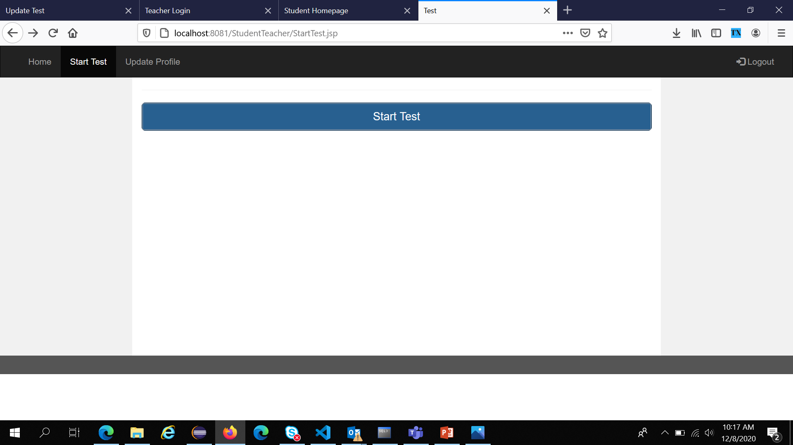
Start Test

Slide 6
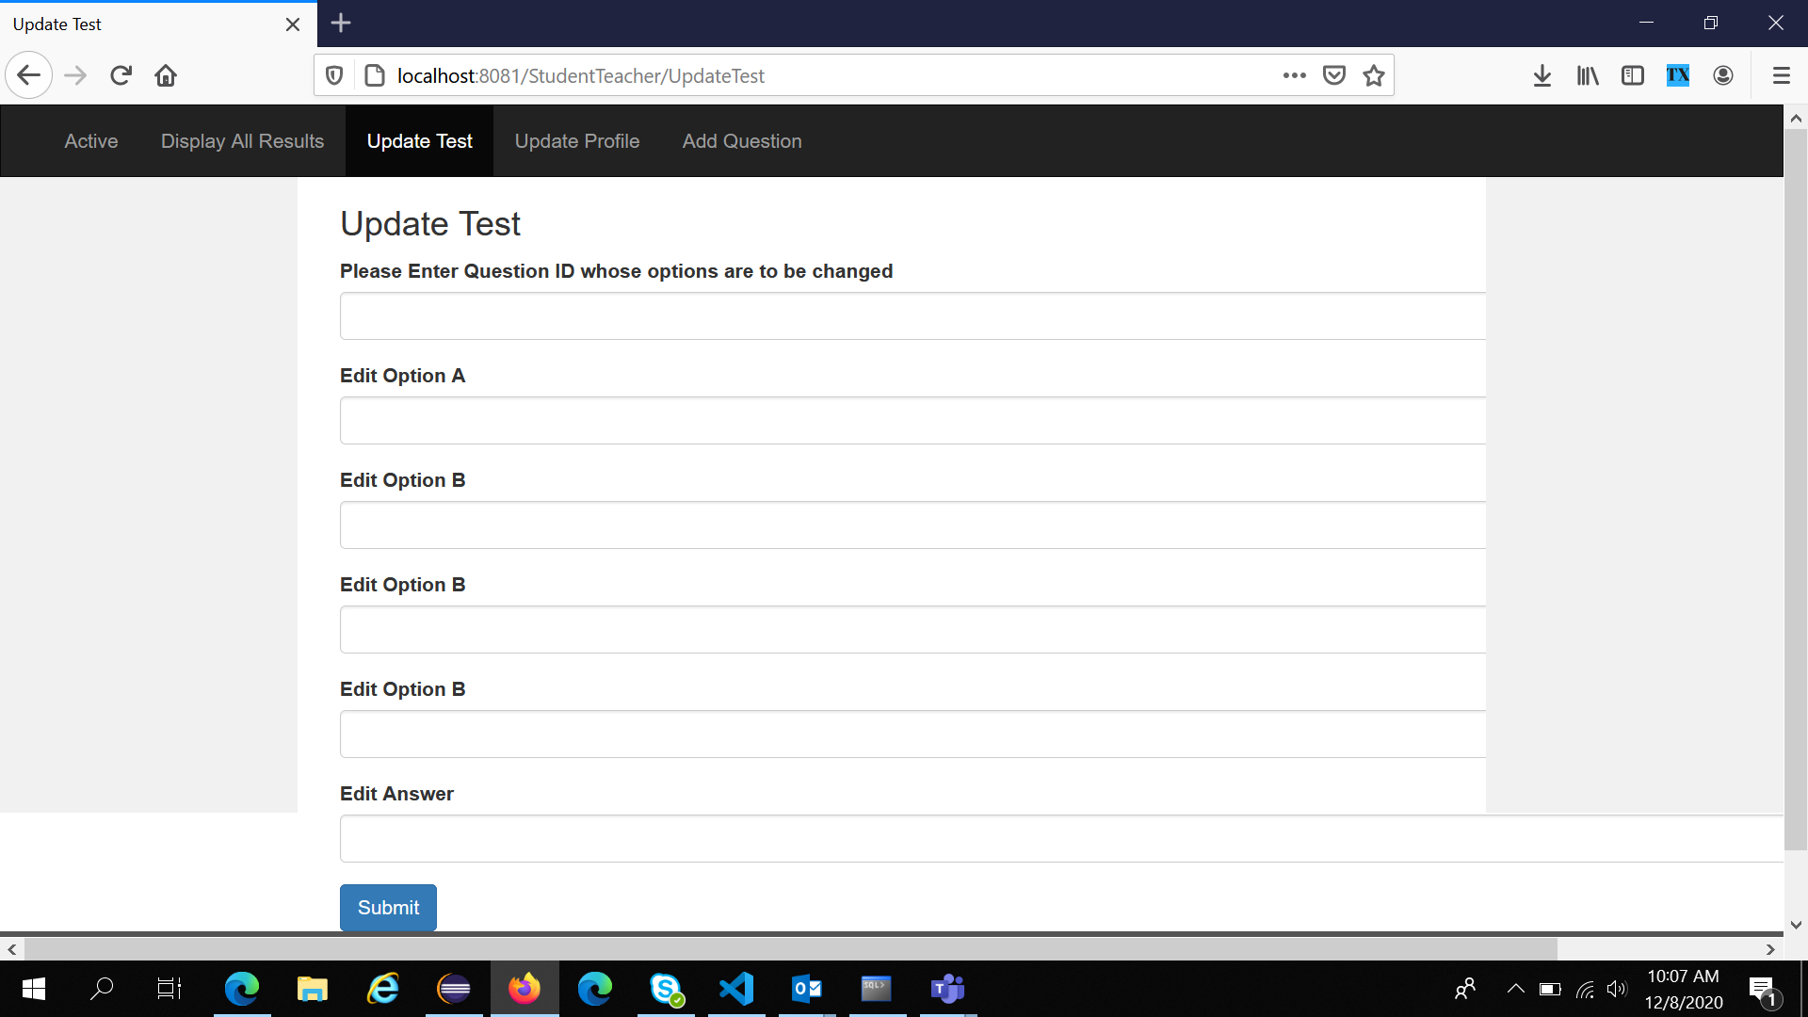
Update Test (Teacher’s feature)

Slide 7
Student Readme
1 Login / Registration Page (StudentLogin.java, StudentRegistration.java)
2 Homepage (StudentHomePage.jsp)
3 Start Test/ Update Profile/ Logout (StartTest.jsp, UpdateStudentProfile.jsp)

Slide 8
Teacher Readme
1 Login / Registration Page (TeacherLogin.java, TeacherRegistration.java)
2 Homepage (StudentHomePage.jsp)
3 Display All Results/ Update Test/ Update Profile/ Add Question Logout (DisplayMultipleResult.jsp, UpdateTest, UpdateTeacherProfile.jsp, AddQuestion.jsp).

Slide 9
Tables
student
teacher
test.

Slide 10
student table description
1) STUDENTID NOT NULL NUMBER(38)
2) SNAME VARCHAR2(20)
3) SUSERNAME VARCHAR2(20)
4) SPASSWORD VARCHAR2(20)
5) RESULT NUMBER(38)

Slide 11
teacher table description
TEACHERID NOT NULL NUMBER(38)
TNAME VARCHAR2(20)
TUSERNAME VARCHAR2(20)
TPASSWORD VARCHAR2(20)

Slide 12
test table description
QUEID NOT NULL NUMBER(38)
QUE VARCHAR2(100)
OPTIONA VARCHAR2(100)
OPTIONB VARCHAR2(100)
OPTIONC VARCHAR2(100)
OPTIOND VARCHAR2(100)
ANS VARCHAR2(20)
Insert test from Teacher > Add Question.

