Slide 1

Python
We need Anaconda IDE which provides Spyder environment to run Python.

Slide 2
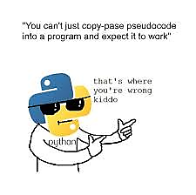
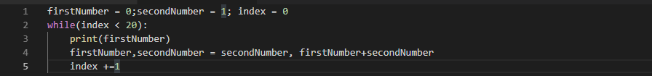
Fibonacci series
The Fibonacci numbers are the numbers in the following integer sequence.
0, 1, 1, 2, 3, 5, 8, 13, 21, 34, 55, 89, 144, ……..
Reverse String

Slide 3
Topics
Introduction to Basic Python
Exception Handling
File Handling
Data structure
Object oriented Concept
Python replacement of matlab

Slide 4
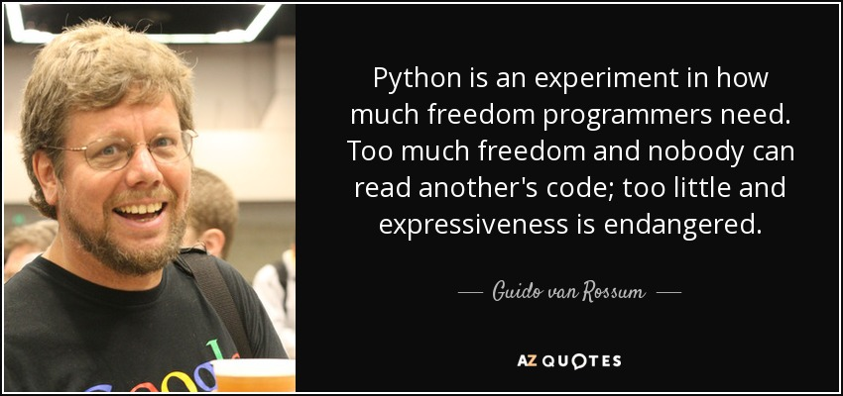
Introduction
A scripting language which is basically used as a type less programming language.
Developed by Guido van Rossum in Dec 1989.
Back to Topic

Slide 5
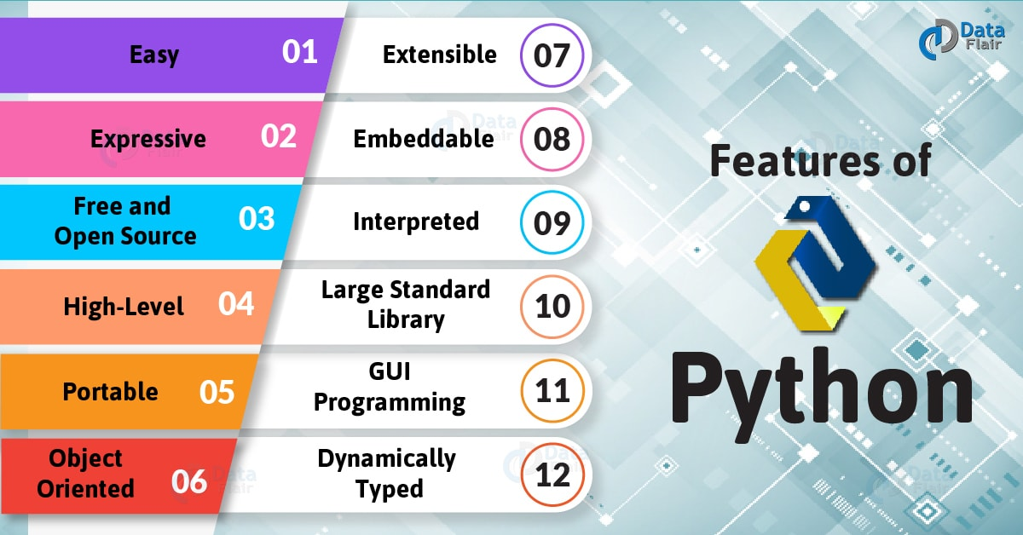

Slide 6
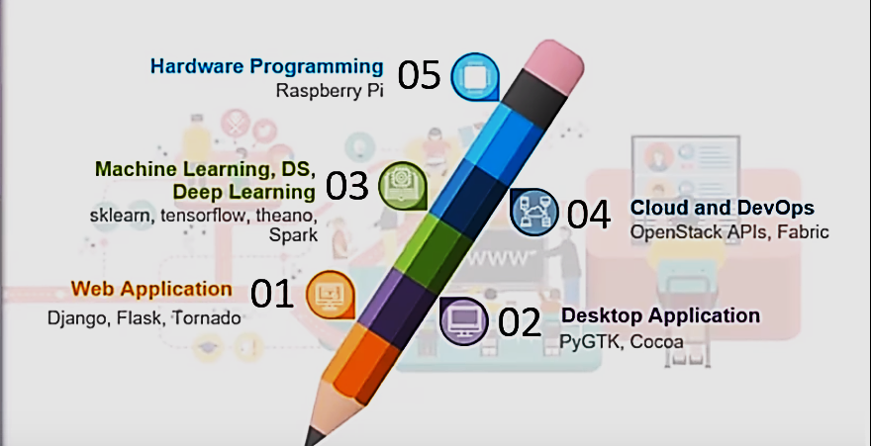
Usage of Python
Back to Topic

Slide 7
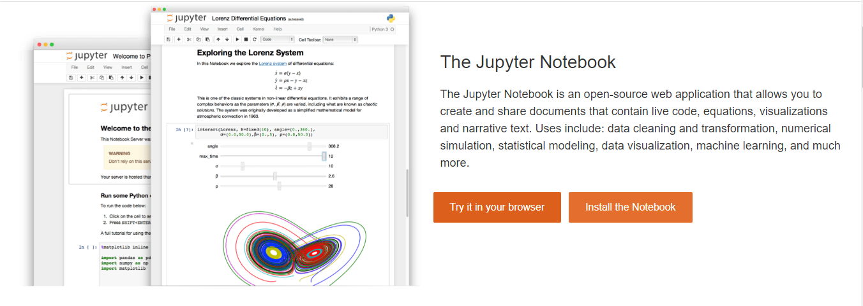
How to Run – Option 1
Back to Topic

Slide 8
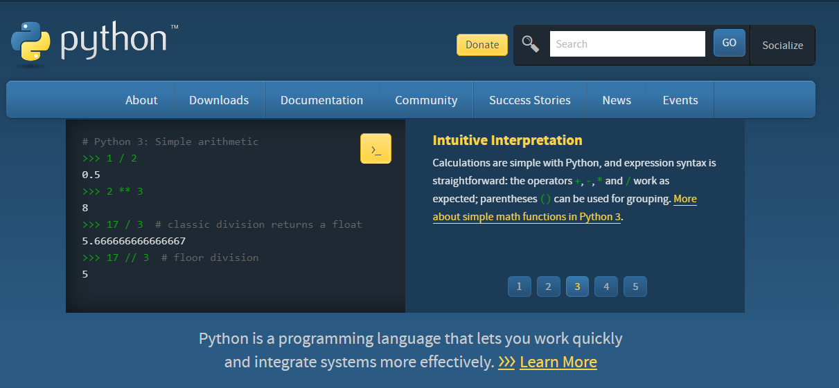
How to Run – Option 2

Slide 9
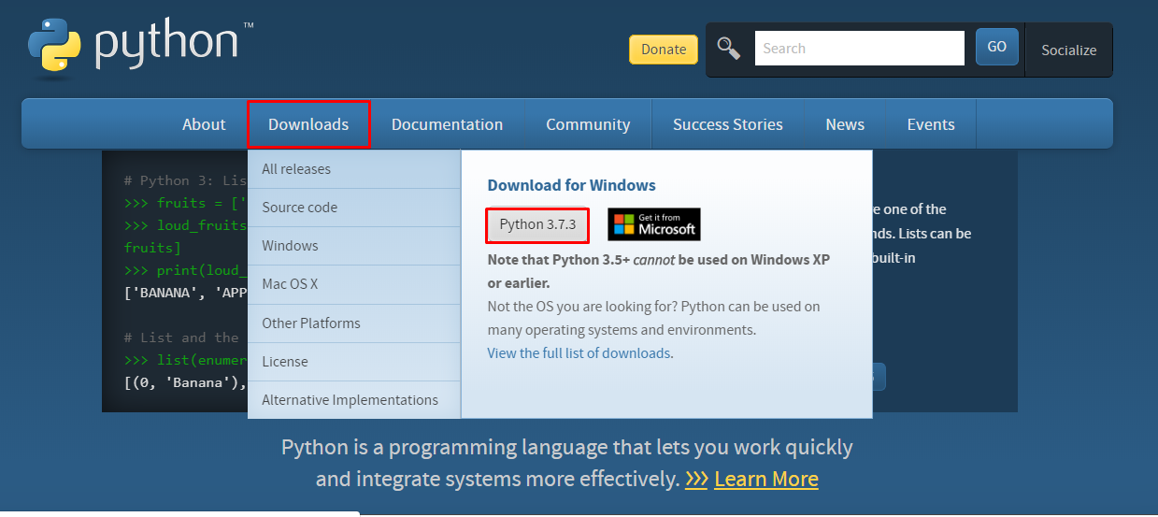
Python 3 : Window Installation
https://www.python.org/downloads/release/python-373/

Slide 10
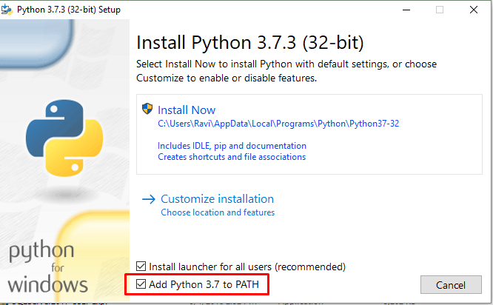
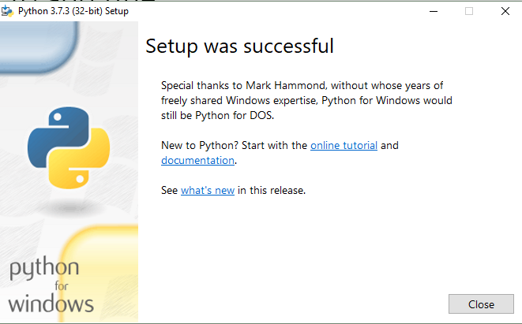
Installation Steps
Back to Topic

Slide 11
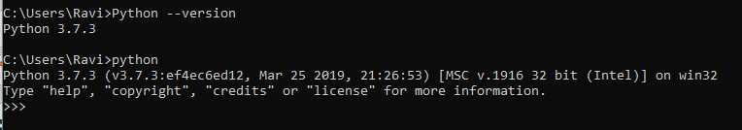
Verify Installation
Open Command Prompt and follow the below Image.
Find the location where python is installed.
Back to Topic

Slide 12
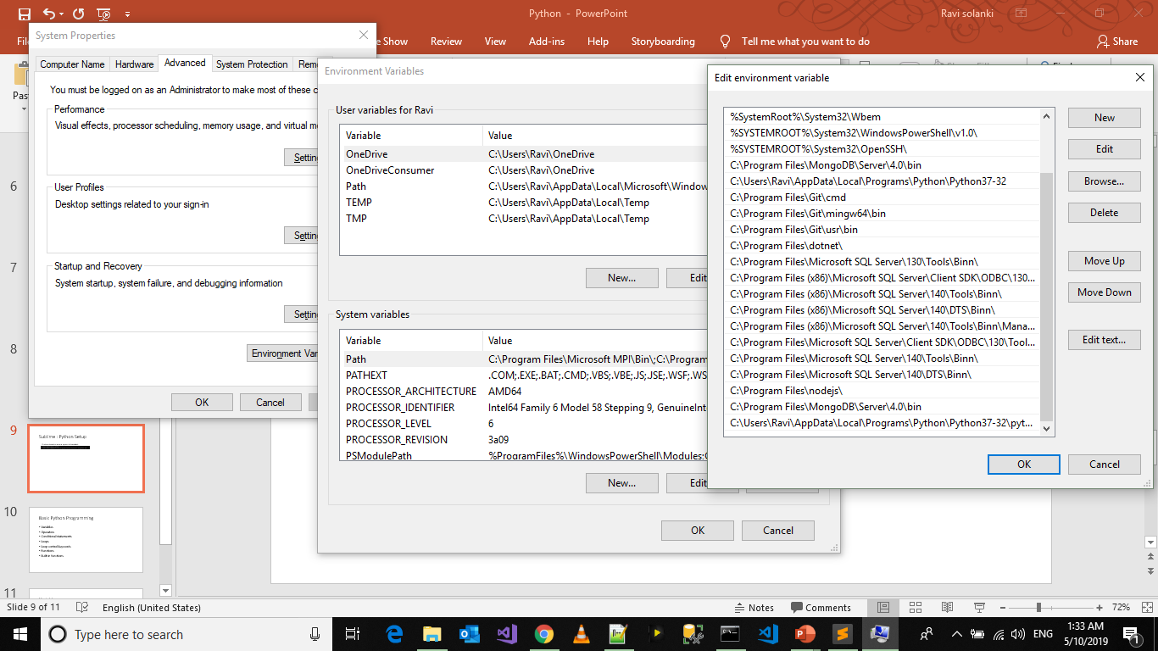

Slide 13
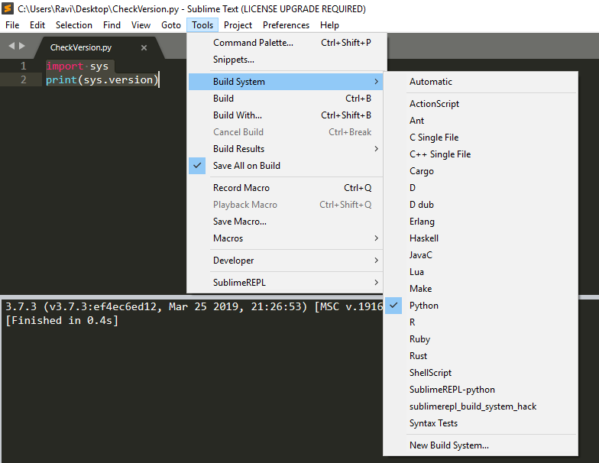
Editor : Python Setup
In Sublime Text, If path is added, press ctrl+B to Build.
Visual studio code will give you options to install python related files when you will save a .py file for the first time.
F5 will start debugging in VS Code.
Back to Topic

Slide 14
Basic Python Programming
Tokens
Conditional statements
Loops
Functions
Exception Handling
File Handling
Back to Topic

Slide 15
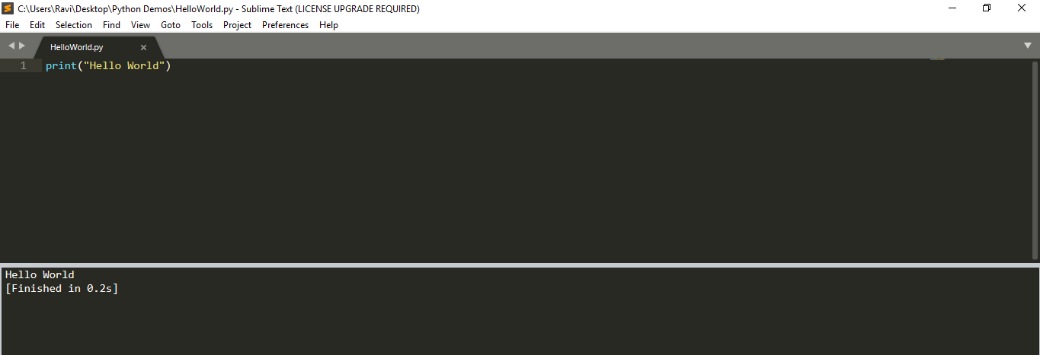
Python : Hello World
Back to Topic
Chapter 1 : Topics

Slide 16
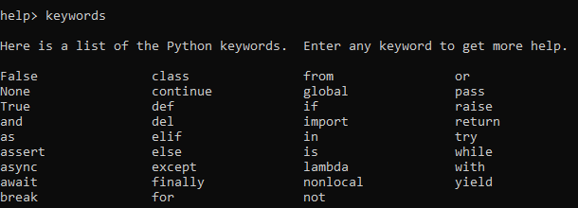
Tokens
Smallest meaningful component
There are mainly 4 types of tokens in Python
Keywords – Reserved variable names
Identifiers – name of variable, class, function, object
Literals – Value assigned to variables
Operators – perform operations on variables.
Back to Topic
Chapter 1 : Topics

Slide 17
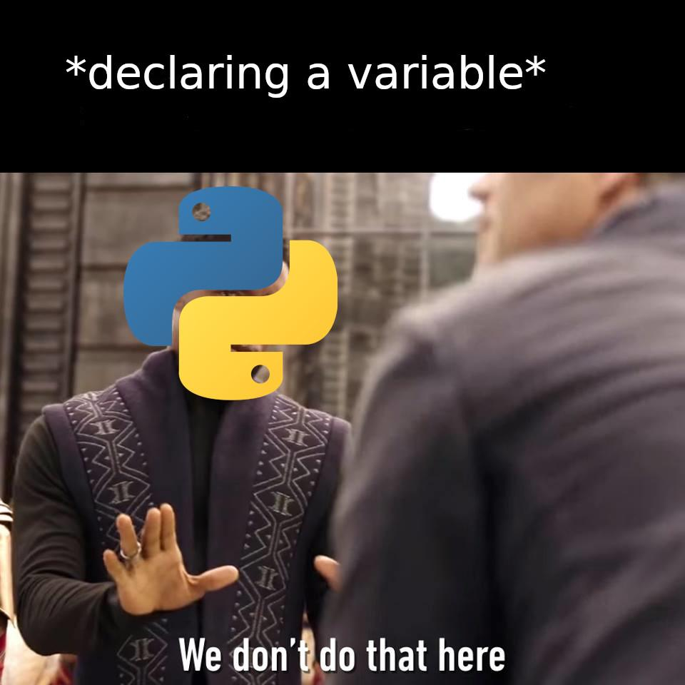
Variable
How to declare a variable?
Types:
1. Local Variable
2. Global Variable
It is just a Placeholder
Naming Convention
Must begin with a letter (a - z, A - B) or underscore (_)
Other characters can be letters, numbers or _
Case Sensitive
Can be any (reasonable) length
Keywords can not be a variable name.
Notes
To determine the data type of variable, use type command.
None Keyword is used to assign a null value to an identifiers.
Back to Topic

Slide 18
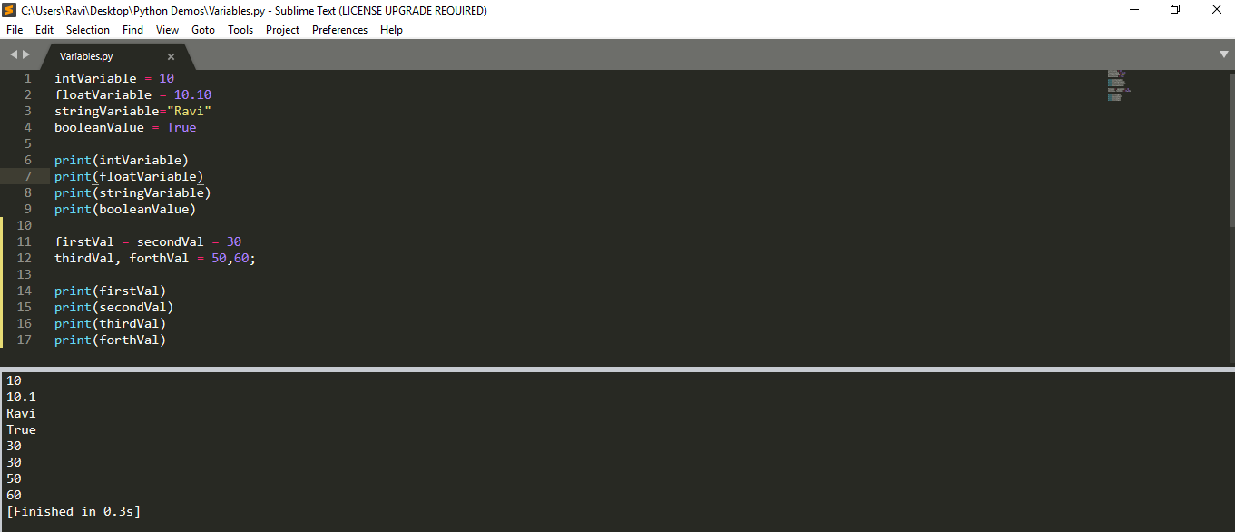
Variables
Back to Topic
Chapter 1 : Topics

Slide 19
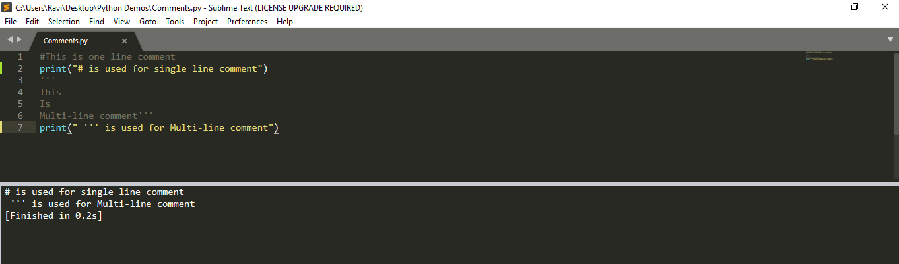
Comments
Back to Topic
Chapter 1 : Topics

Slide 20
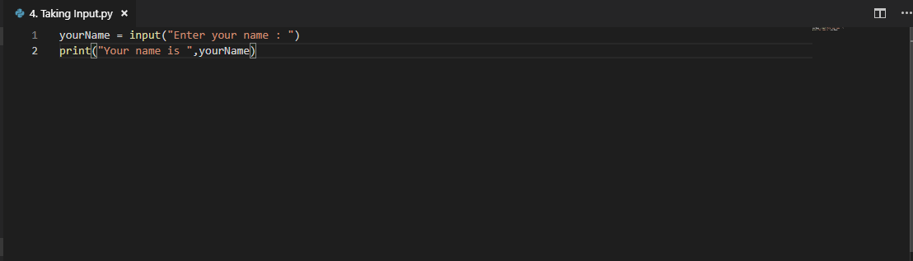
Input from User
Note:
1. It is by default string
Input() method is used to take user Input.
Back to Topic
Chapter 1 : Topics

Slide 21
Operators
Arithmetic
Relational
Logical
Assignment
Bitwise
Membership
Identity
Back to Topic
Chapter 1 : Topics

Slide 22
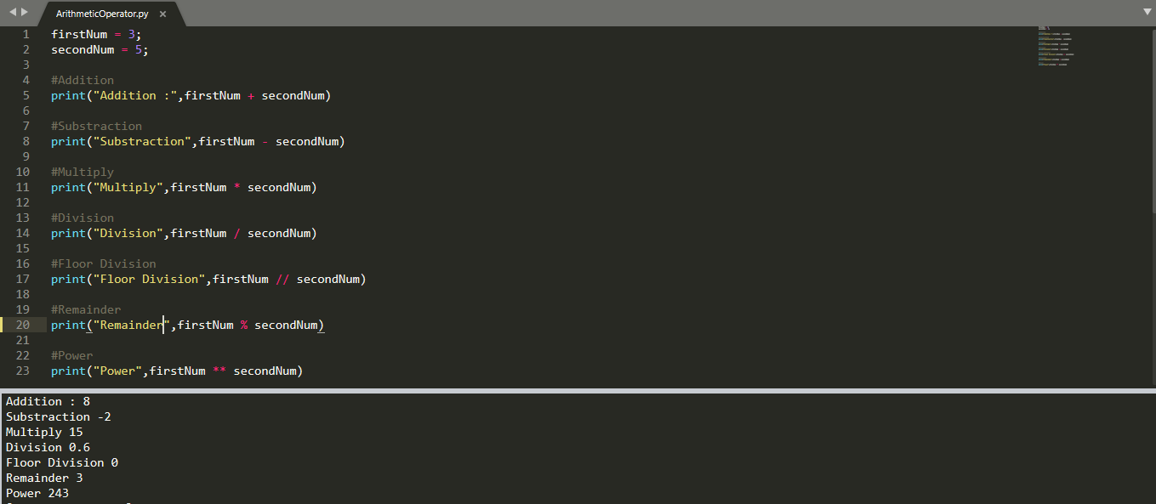
Arithmetic Operator
Back to Topic
Chapter 1 : Topics

Slide 23
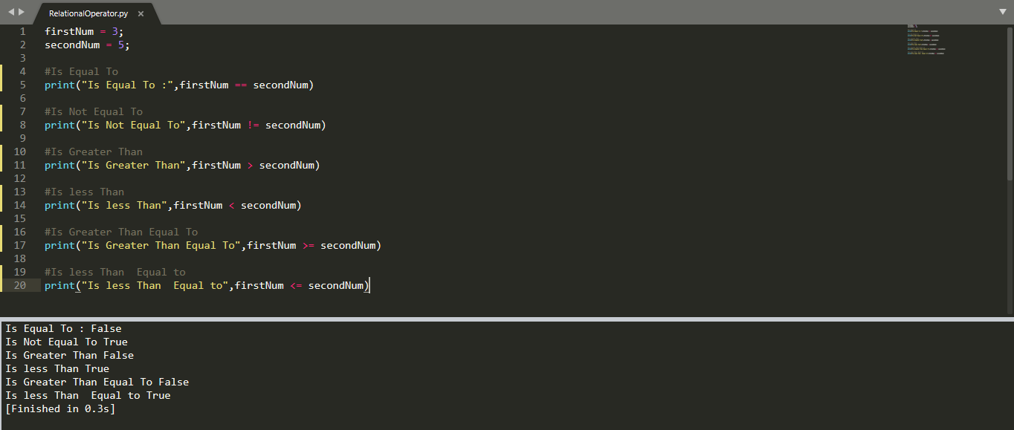
Relational Operator
Back to Topic
Chapter 1 : Topics

Slide 24
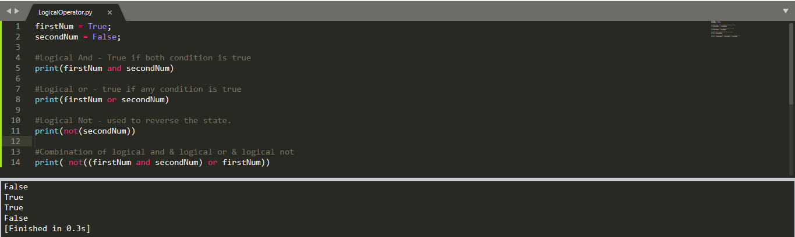
Logical Operator
Back to Topic
Chapter 1 : Topics

Slide 25
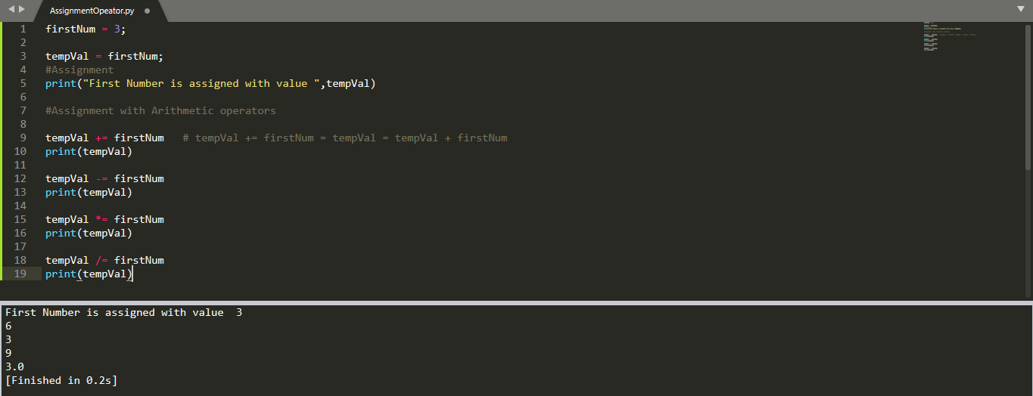
Assignment Operator
Back to Topic
Chapter 1 : Topics

Slide 26

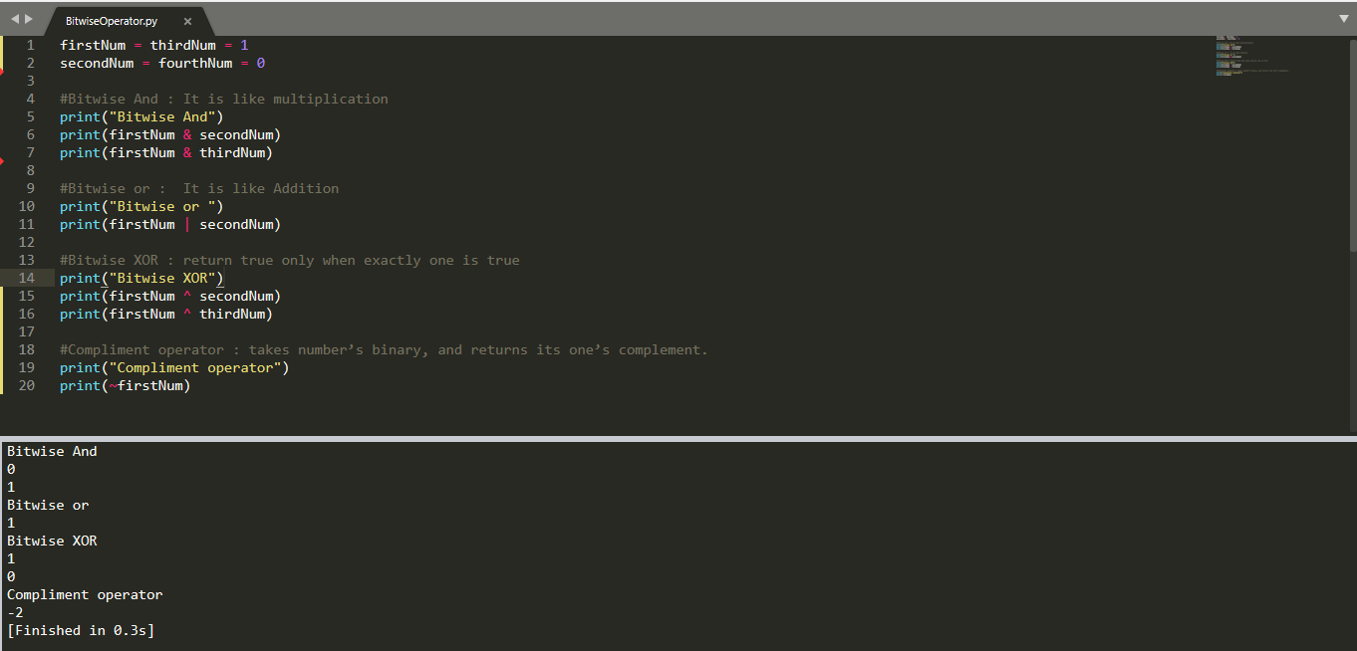
Bitwise Operation
Back to Topic
Chapter 1 : Topics

Slide 27
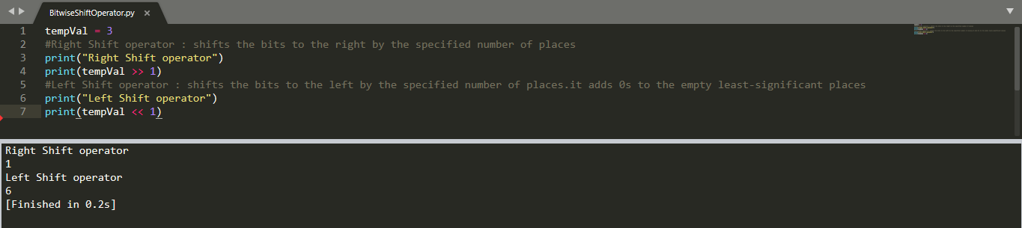
Bitwise Shift Operation
Python Bitwise Operators do find their use in places like encryption, compression, and byte manipulation.
Back to Topic
Chapter 1 : Topics

Slide 28
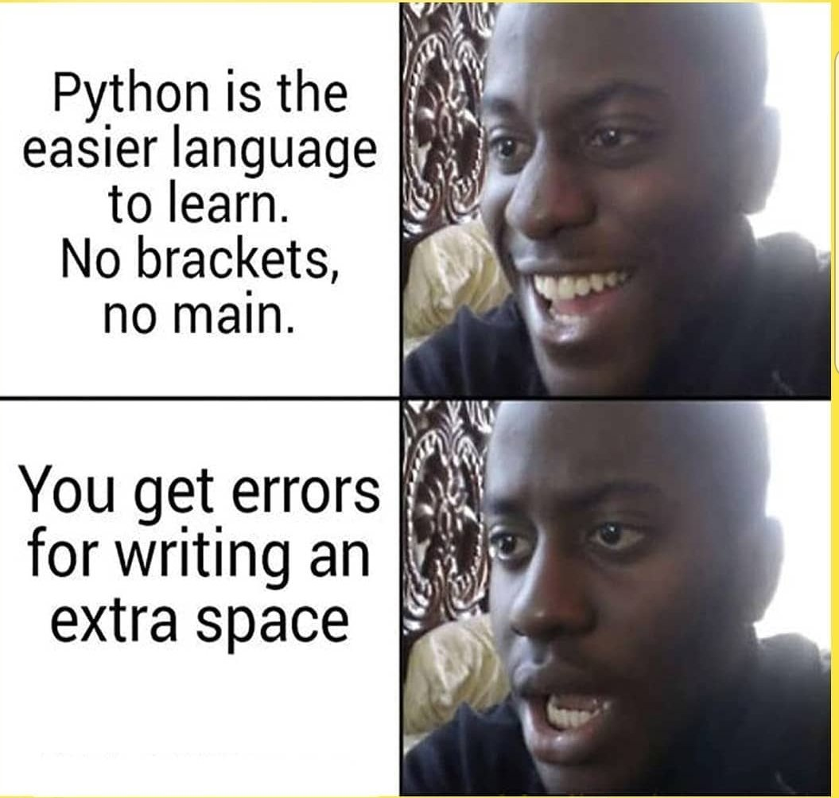
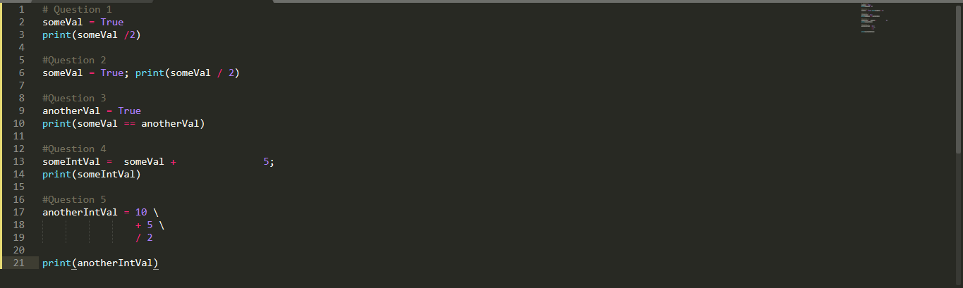
Quiz : 1
What will be the output of below codes?
Back to Topic
Chapter 1 : Topics

Slide 29
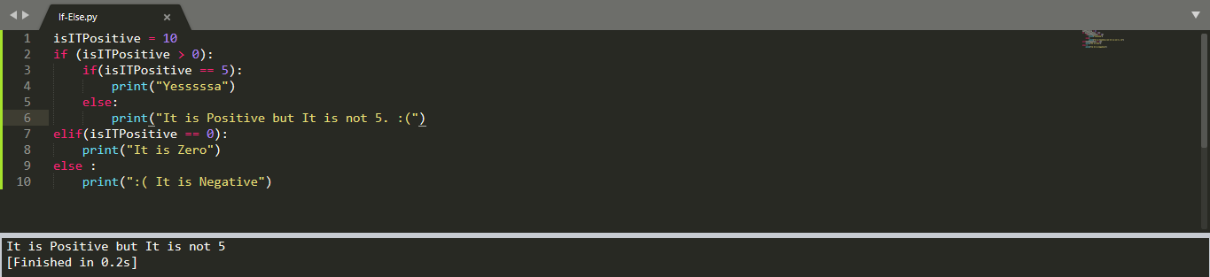
Conditional statements
Notice two Points here:
Indentation
elif instead of else if
Back to Topic
Chapter 1 : Topics

Slide 30
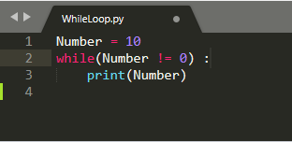
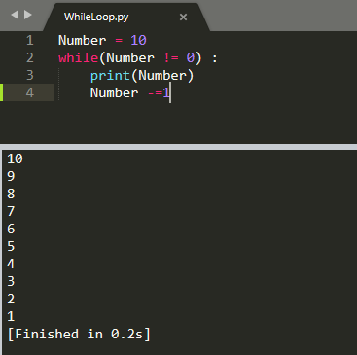
While Loop
Infinite loop printing 10
Back to Topic
Chapter 1 : Topics

Slide 31
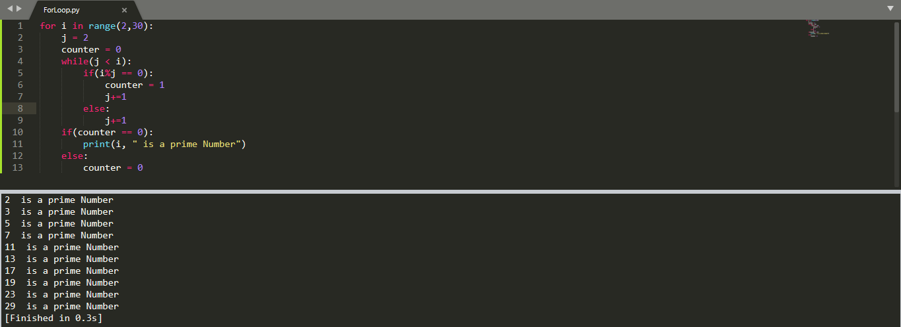
For loop
Back to Topic
Chapter 1 : Topics

Slide 32
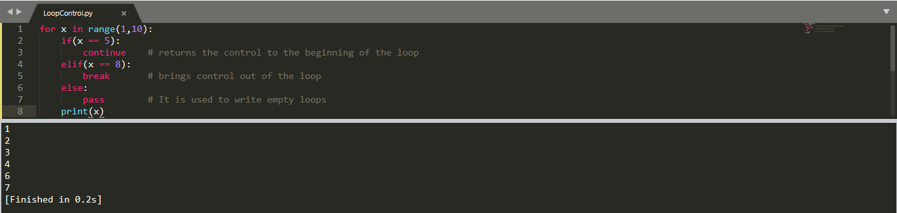
Loop control
Back to Topic
Chapter 1 : Topics

Slide 33
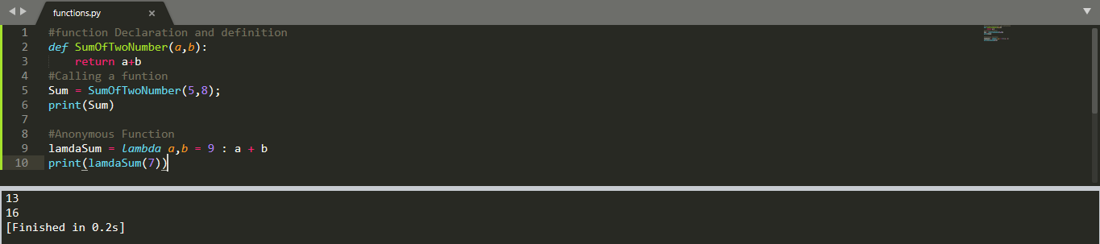
Function
Back to Topic
Chapter 1 : Topics

Slide 34
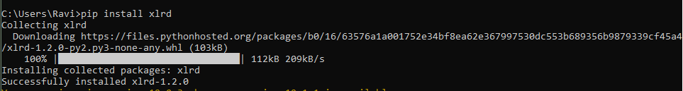
Installing a package
Pip is used to install module.
If you get an error like- “pip is not recognized”
Add environment variable for script folder present in python.

Slide 35
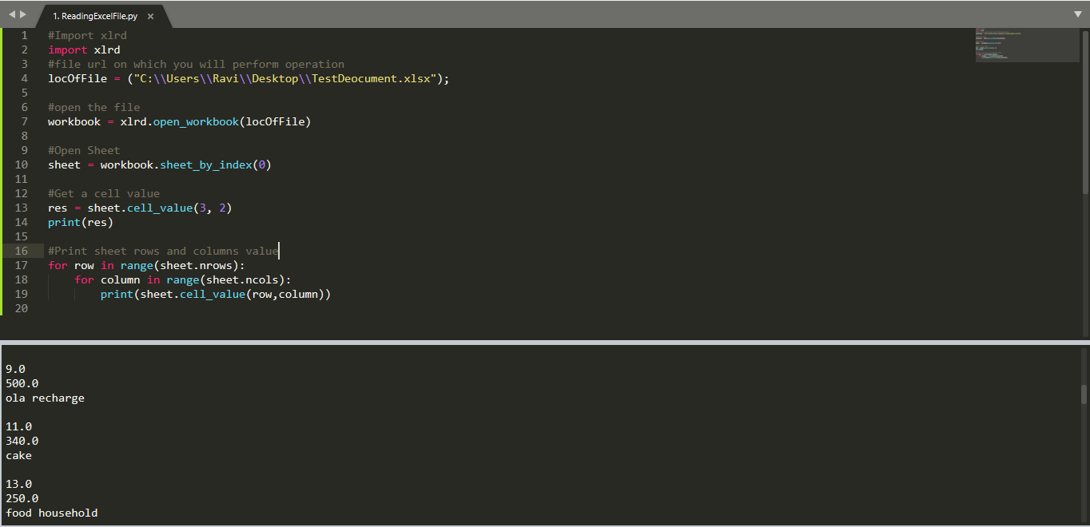
Reading Excel File

