Slide 1

Python Data Structure

Slide 2
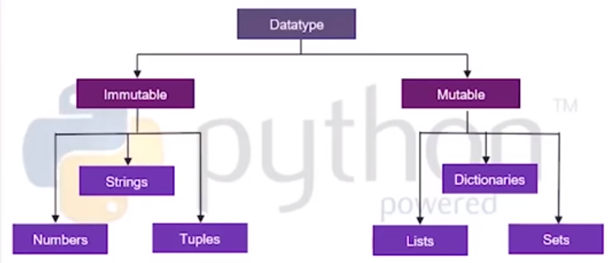
Data Types in Python

Slide 3
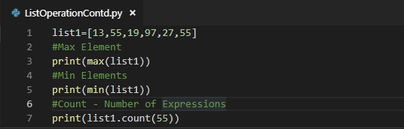
Lists
List Features
LIST ADT
Return an element from the list at any given position.
Insert an element at any position of the list.
Remove the first occurrence of any element from a non-empty list.
Remove the element at a specified location from a non-empty list.
Replace an element at any position by another element.
Return the number of elements in the list.
Heterogenous Elements
Ordered sequence
Mutable
No bound on size
Accessed by index
List Operation
1. Max elements in list
2. Min elements in list
3. Number of occurrence
Back to Topic

Slide 4
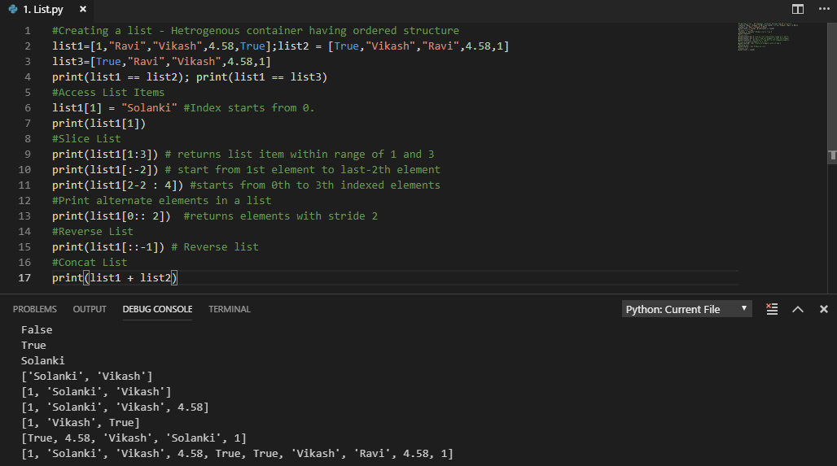
List : Introduction
Back to Topic

Slide 5
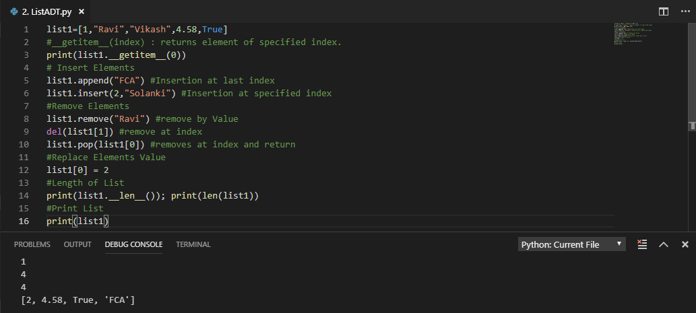
List : ADT
Back to Topic

Slide 6
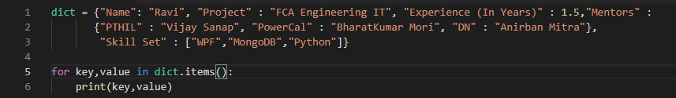
Dictionary
Dictionary Features
Dictionary ADT
Return an element from the list at any given position.
Insert an element in the dictionary.
Remove the first occurrence of any element from a non-empty dictionary.
Remove the element at a specified location from a non-empty dictionary.
Replace an element at any position by another element.
Return the number of elements in the dictionary.
Key-Value pair
Un-ordered sequence
Mutable
Heterogenous
Accessed by Key
Key should be Unique
Dictionary Operation
Dictionary element Iteration
Check specific Key is present or not?
Back to Topic

Slide 7
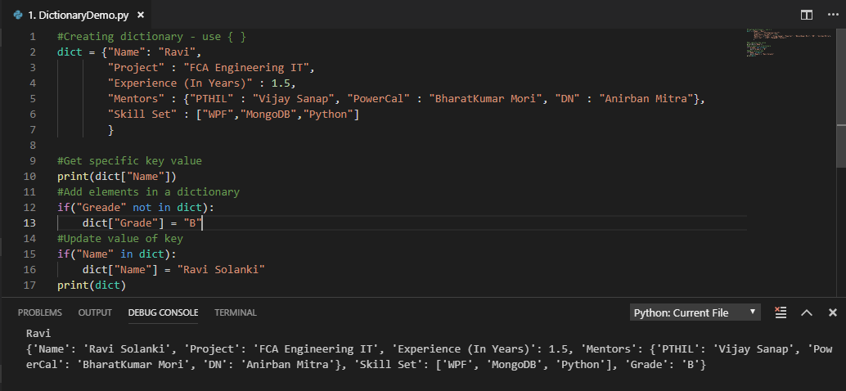
Dictionary : Introduction
Back to Topic

Slide 8
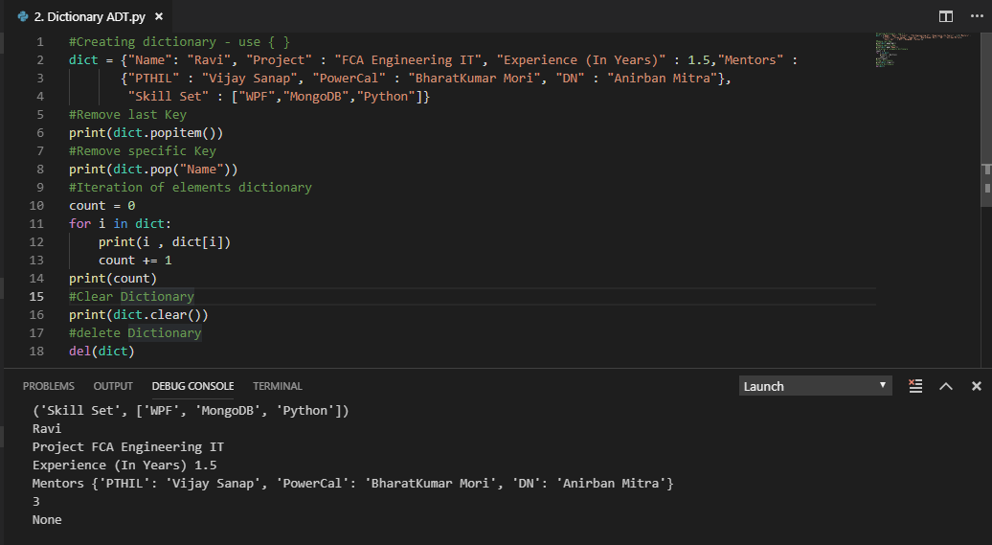
Dictionary : ADT
Back to Topic

Slide 9
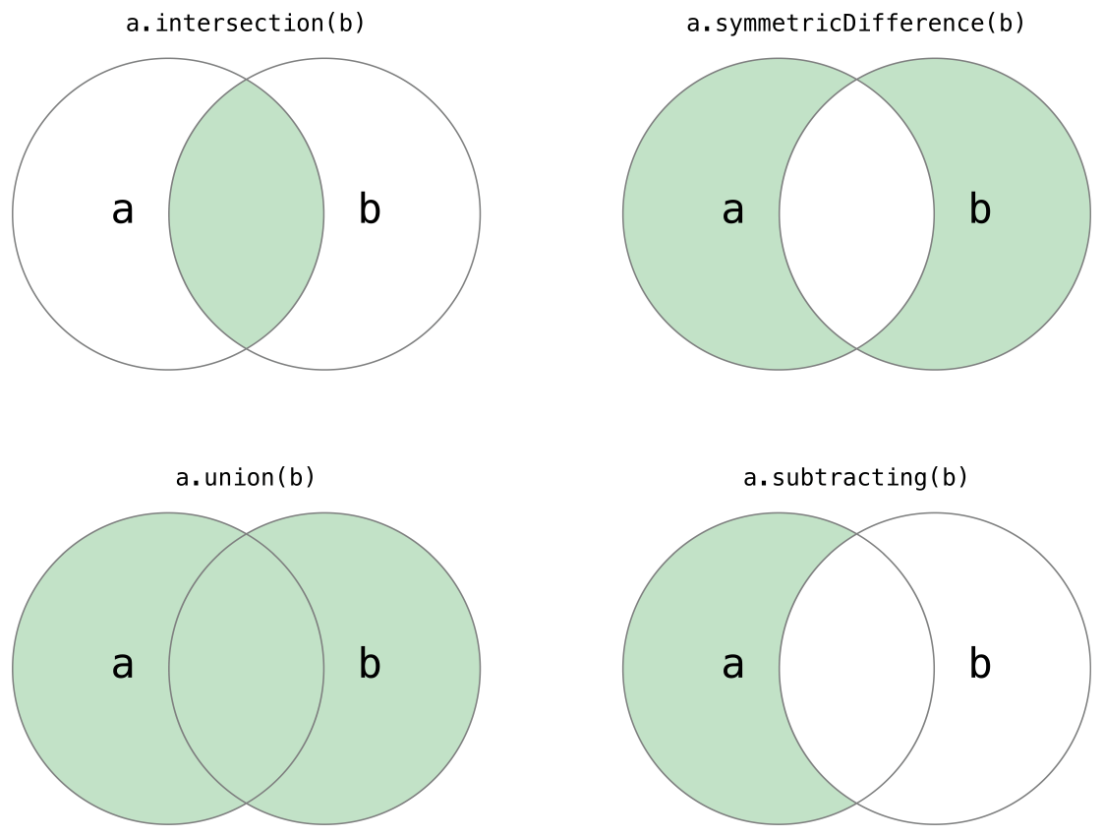

Set
Set Features
Set ADT
Union of two sets.
Intersection of two set.
Difference of two sets.
symmetric difference of two sets.
Adds all elements of array B to the set A.
Remove all elements of array B to the set A.
No Duplicate values
Un-ordered sequence
Mutable
Elements should be immutable.
Heterogenous
Basic uses include membership testing and eliminating duplicate entries.
Back to Topic

Slide 10
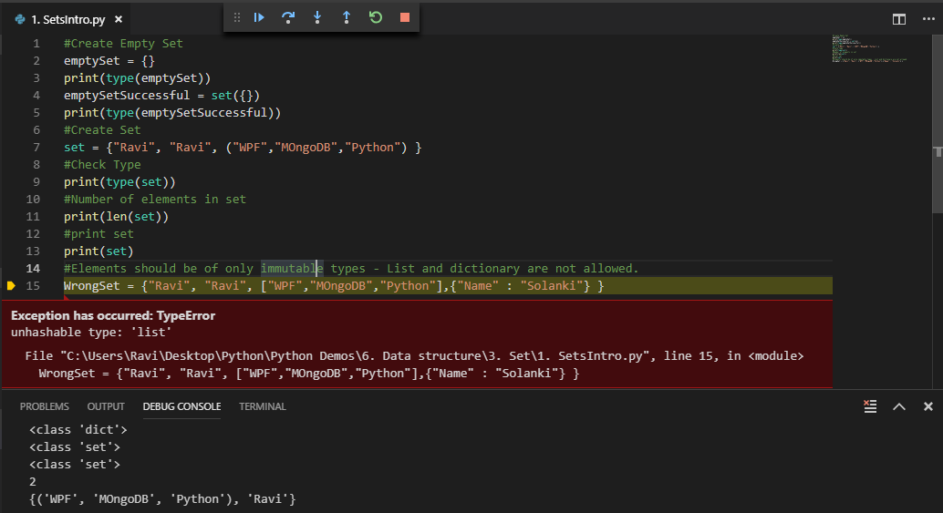
Set : Introduction
Back to Topic

Slide 11
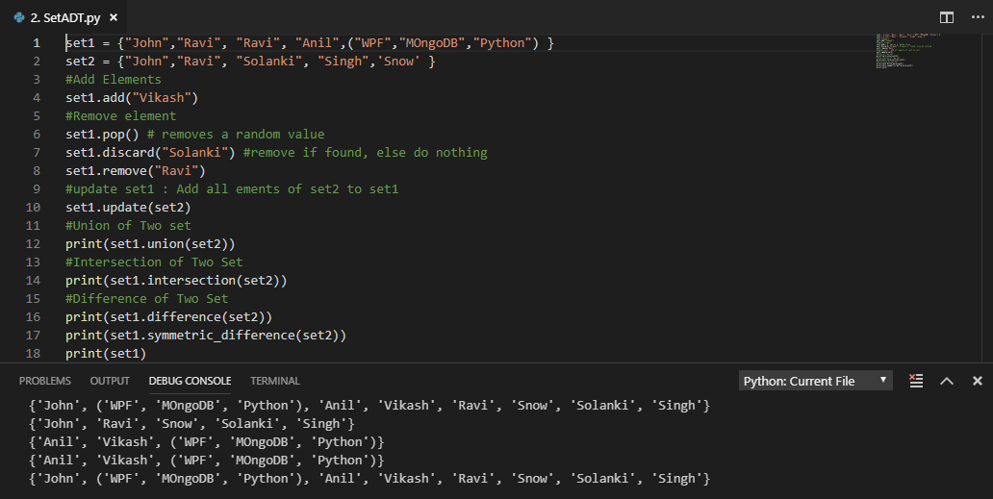
Set : ADT
Back to Topic

Slide 12
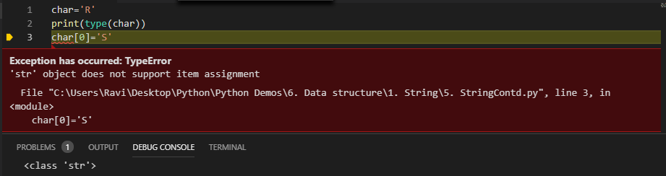
String
String ADT
Return character at specific point
Concatenation of two strings
Search for elements in a string
Extraction of substrings
Matching regular expressions
Text Processing
String Features
collection of alphabets, words or other characters
Immutable
Elements accessed using index
Substring
0 | 1 | 2 | 3 | 4 | 5
S | T | R | I | N | G
char=
There is no type called character – String of length 1 is character.
Back to Topic

Slide 13
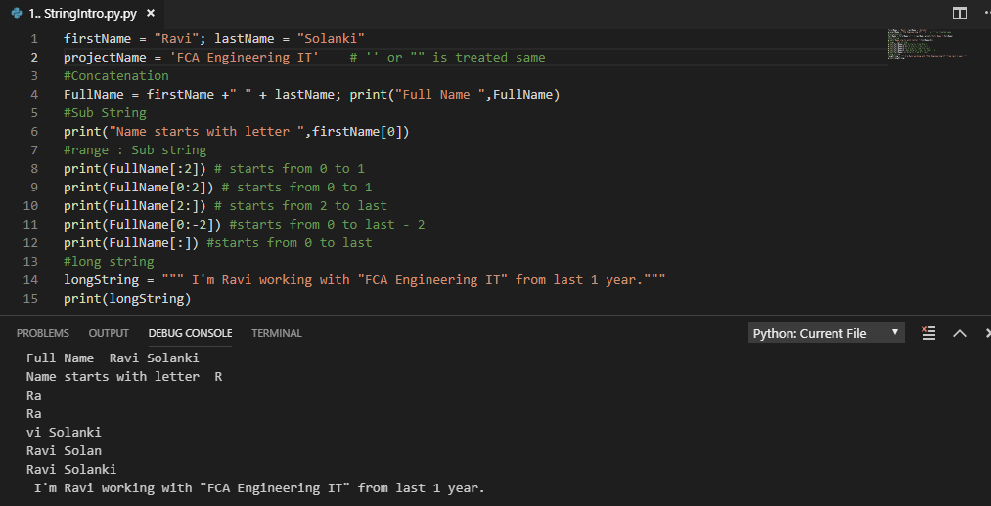
String – Basic Overview
Back to Topic

Slide 14
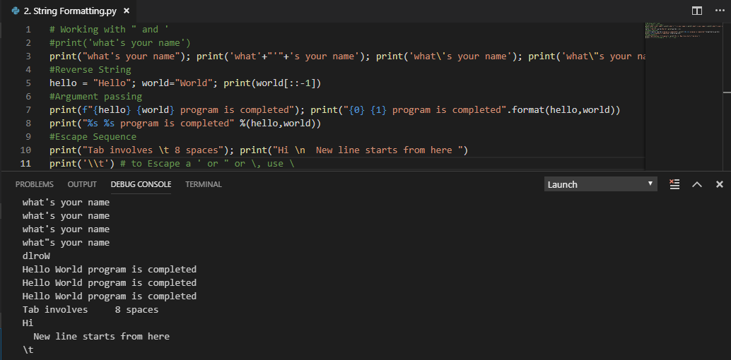
String Formatting
Back to Topic

Slide 15
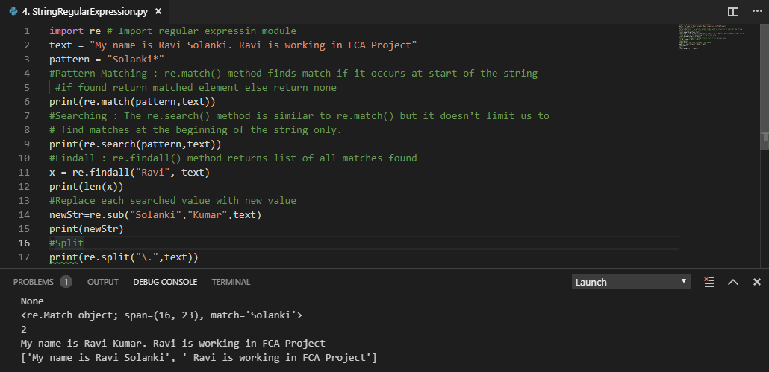
String: Regular Expression
Back to Topic

Slide 16
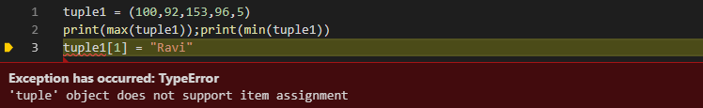
Tuples
Tuple Features
Tuple ADT
Return an element from the tuple at any given position.
Add elements of one tuple to another tuple.
Multiply tuple from n.
Search for an element in a tuple.
Convert list into tuple.
Return the number of elements.
Heterogenous Elements
Ordered sequence
Immutable
No bound on size
Accessed by index
Tuple Operation
1. Max elements in tuple
2. Min elements in tuple

Slide 17
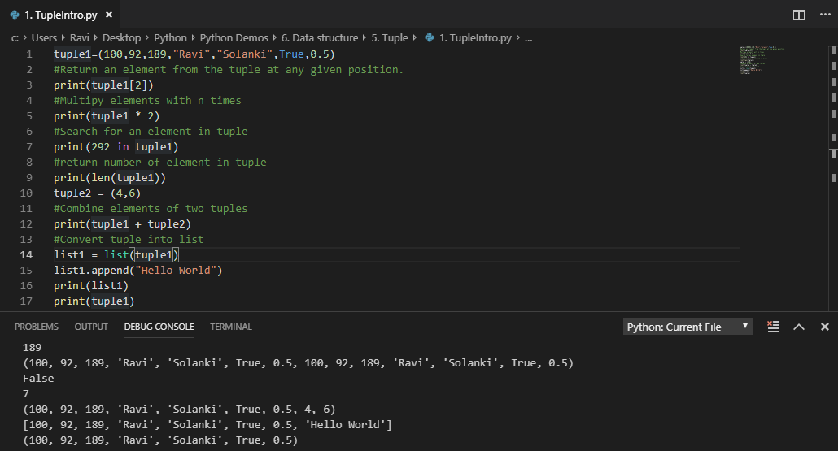
Tuple : ADT

Slide 18
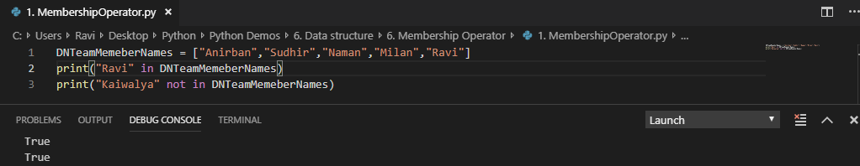
Membership Operator
It test for membership in a sequence, such as strings, lists, or tuples.
There are 2 Operators
In
Not in

Slide 19

Thank you for listening

