Slide 1
Vue.js – A Progressive JavaScript framework

Slide 2
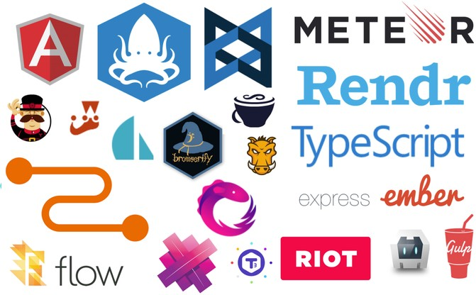
Popular JavaScript Frameworks

Slide 3


The Founder
I figured, what if I could just extract the part that I really liked about Angular and build something really lightweight
--Evan You

Slide 4
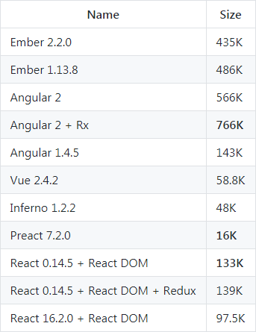
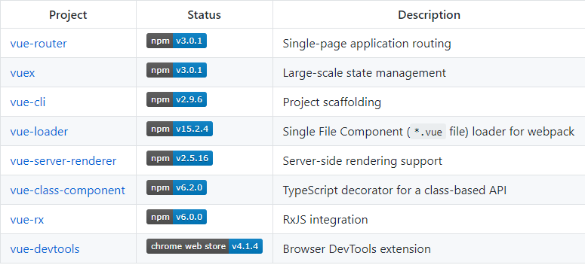
Why Vue.js
Virtual DOM
Data Binding
Event Handling
Computed Properties
Templates
Directive
Dec 2017

Slide 5
The Vue Instance
var vm = new Vue({
// options
})
•
Vue Constructor function
•
Properties and Methods (data / events)
•
Instance Lifecycle Hooks

Slide 6

Github Status
June 2018
vs. React
vs. AngularJS

