Slide 1
WPF
Window Presentation foundation - .Net framework 3.5
Architecture of WPF
Class Hierarchy
Features of WPF
Types of Windows
XAML Basic
Layout Containers
Styling and resources
Triggers
Attached Property
Dependency Property
Routing Events
Tree structure
MVVM Introduction
Data Binding
Command Binding
Converters
Notes:
WPF is a technology introduced by Microsoft in .Net Framework 3.5.

Slide 2
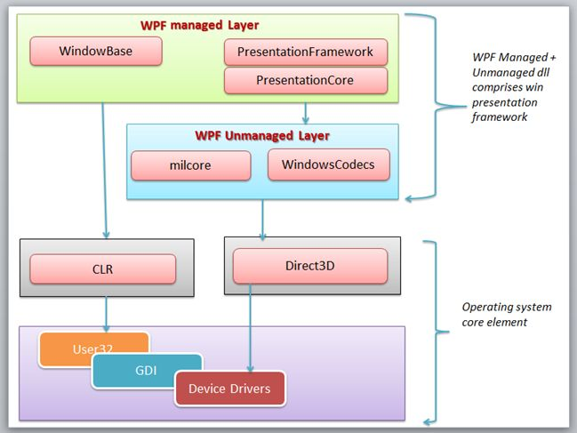
Architecture
Notes:
Managed Module:
PresentationFramework.dll: This section contains high-level features like application windows, panels, styles controls, layouts, content and so on that helps us to build our application.
PresentationCore.dll: This is a low-level API exposed by WPF providing features for 2D, 3D, geometry and so on.
WindowsBase.dll: It holds the more basic elements that are capable to be reused outside the WPF environment like Dispatcher objects and Dependency objects.
UnManaged Layer - This section is unmanaged code because it acts as a bridge between WPF managed and the DirectX / User32 unmanaged API.
milCore.dll: It is called the Media Integration Layer (MIL) and resides in milCore.dll. The purpose of the milCore is to interface directly with DirectX and provide basic support for 2D and 3D surface.
WindowsCodecs.dll: WindowsCodecs support in WPF applications like image processing, image displaying and scaling and so on.
Core operating System Layer (Kernel) This layer has OS core components like User32, GDI, Device Drivers, Graphic cards and so on. These components are used by the application to access low-level APIs.
DirectX: DirectX is the low-level API through which WPF renders all graphics. DirectX talks with drivers and renders the content.
User32: User32 actually manages memory and process separation. It is the primary core API that every application uses. User32 decides which element will be placed where on the screen.
GDI: GDI stands for Graphic Device Interface. GDI provides an expanded set of graphics primitives and a number of improvements in rendering quality.
CLR: WPF leverages the full .NET Framework and executes on the Common Language Runtime (CLR).
Device Drivers: Device Drivers are used by the applications to access low-level APIs.

Slide 3
WPF Architecture
DirectX: Responsible to render all the elements of WPF.
User32: Manages memory and process separation and decides which element will be placed where on screen.
GDI: Graphic Device Interface – Renders the GUI on the screen.
CLR: leverages the full .NET Framework and executes CLR.
Device Drivers: Device Drivers are used by the applications to access low-level APIs.

Slide 4
WPF Architecture
Managed Module
PresentationFramework.dll – contains feature which helps to build application like Windows, Panels, controls, panel...etc.
PresentationCore.dll – contains low level API exposed by WPF to enable 2D and 3D geometry.
WindowsBase.dll – contains elements which can be reused in WPF like dispatcher objects and dependency objects.
Unmanaged Module – Bridge between WPF components and OS
milCore.dll – media integration layer
WindowsCodecs.dll – supports feature like image processing, image display and so on.

Slide 5
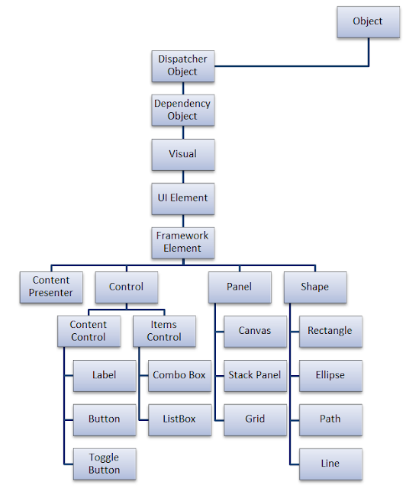
WPF Class Hierarchy
DispatcherObject: Mother of all WPF controls which takes care of UI thread
DependencyObject: Builds the Observer for Dependency Properties
Visual: Links between managed libraries and milcore
UIElement: Adds supports for WPF features like layout, input, events, etc.
FrameworkElement: Implementation of UIElement
Shape: Base class of all the Basic Shapes
Panel: Baseclass of all panels which show one or more controls within it
ItemsControl: Baseclass for all controls that show a collection
ContentControl: Baseclass of all controls that have single content

Slide 6
Types of windows
Normal Window
Navigation Window
Page

Slide 7
Types of containers
Content control
Headered Content Control : Header + Content Control
Items control : List box, List view
Headered Item Control : Tree view

Slide 8
Content Container
Grid | Stack panel | Wrap panel
Dock Panel | Virtualizing panel | Canvas
Uniform grid | Scroll viewer | Expander
Group box | Ink canvas | View box
Pop up | Thumb | Content presenter

Slide 9
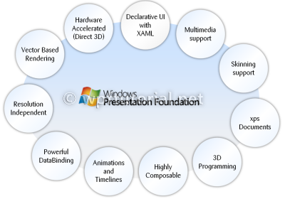
Features
Windows Presentation Framework
Notes:
WPF uses vector rendering engine which uses the hardware acceleration of modern graphic card.
There are 2 types of documents supported by WPF:
Fixed document : They are XPS (Open XML Paper Specification) based fixed type set documents which are print ready.
Flow document

Slide 10
Separation of Appearance and Behavior
Every View screen has two files
1. XAML
2. .cs File
Benefits:
Appearance and behavior are loosely coupled
Designers and developers can work on separate models.

Slide 11
Highly Customizable
Rich Composition
Styling – Style and Template
Resolution Independent
<Style TargetType="Button">
<Setter Property="FontSize" Value="14"/>
</Style>
<Button>
<StackPanel Orientation="Horizontal">
<Image Source="speaker.png" Stretch="Uniform"/>
<TextBlock Text="Play Sound" /> </StackPanel>
</Button>
Notes:
Resolution Independent : All measures in WPF are logical units - not pixels. A logical unit is a 1/96 of an inch.

Slide 12

XAML – Extensible Application Markup Language
Properties
Attached Property
Dependency Property
Markup Extensions
Binding
Value Binding
Template Binding
Resources
StaticResource
DynamicResource
Built-in Types e.g. x:static,x:null,x:string ..etc
Notes:
If you want to use another file’s info, you need to add namespace first - xmlns.

Slide 13
Properties
Attached Properties – XAML Concept
Dependency Properties – WPF Concept
A property that is backed by the WPF property system is known as a dependency property. Attached properties are dependency properties without wrappers.
One purpose of an attached property is to allow different child elements to specify unique values for a property that is actually defined in a parent element.
The idea of Dependency property is to compute the value of the property based on the value of other external inputs.
Notes:
The purpose of dependency properties is to provide a way to compute the value of a property based on the value of other inputs. These other inputs might include system properties such as themes and user preference, just-in-time property determination mechanisms such as data binding and animations/storyboards, multiple-use templates such as resources and styles, or values known through parent-child relationships with other elements in the element tree. In addition, a dependency property can be implemented to provide self-contained validation, default values, callbacks that monitor changes to other properties, and a system that can coerce property values based on potentially runtime information.

Slide 14
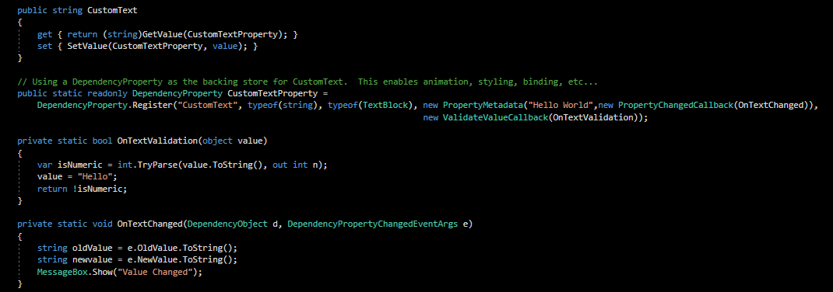
Dependency property can be implemented to provide self-contained validation, default values, callbacks that monitor changes to other properties, and a system that can coerce property values based on potentially runtime information.

Slide 15
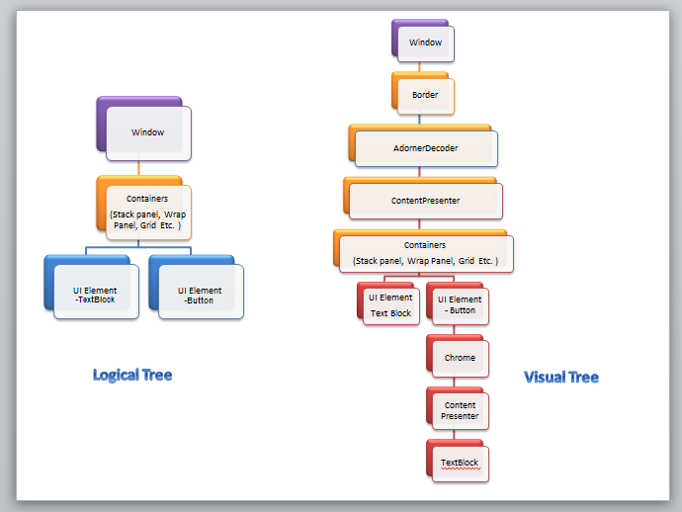
Tree structure
Logical tree structure – xaml structure
Visual tree structure – UI elements rendered on the screen.
Routed Events travels through visual tree structure.

Slide 16
Routed Events
Direct - raised on the source element and must be handled on the source element itself.
Tunneling
Bubbling
Tunneling event’s name will always start with preview word.
For a left-click on a Button, you’ll normally see click-related events in the following order,
PreviewMouseLeftButtonDown (Tunnel)
PreviewMouseDown (Tunnel)
PreviewMouseLeftButtonUp (Tunnel)
PreviewMouseUp (Tunnel)
Click (Bubble)
Notes:
A routed event is a type of event that can invoke handlers on multiple listeners in an element tree rather than just the object that raised the event.
2. Tunneling The event is raised on the root element and navigates down to the visual tree until it reaches the source element or until the tunneling is stopped by marking the event as handeld. By naming convention it is called Preview... and appears before corresponding bubbling event.
3. Bubbling The event is raised on the source element and navigates up to the visual tree until it reaches the root element or until the bubbling is stopped by marking the event as handled. The bubbling event is raised after the tunneling event.
To stop routing then you have to set e.Handled = true;

Slide 17
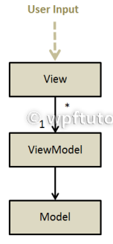
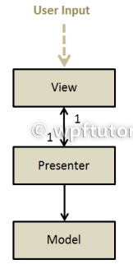
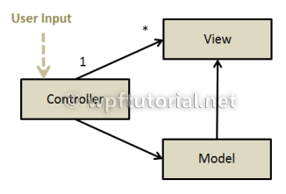
Patterns
MVC
MVP
MVVM
MVC

Slide 18
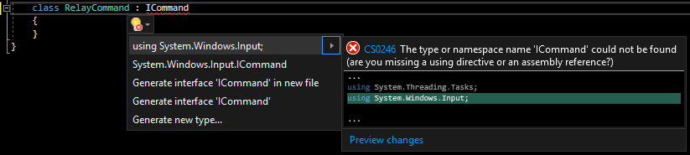
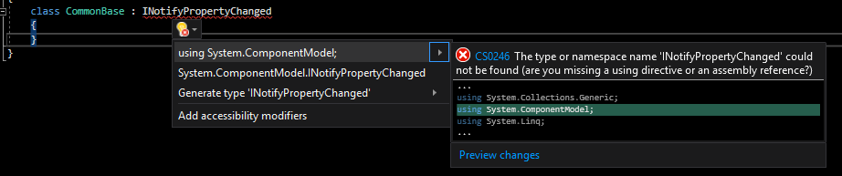
MVVM
Model : Data Class
View : UI Section
View Model:
UI Binds to this class.
Consumes Services of model
Exposes Services/Properties of model
INotifyPropertyChanged
Icommand
IValueConverter

Slide 19
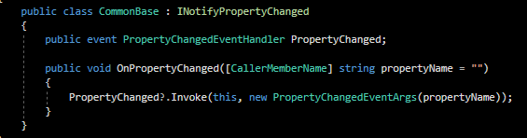
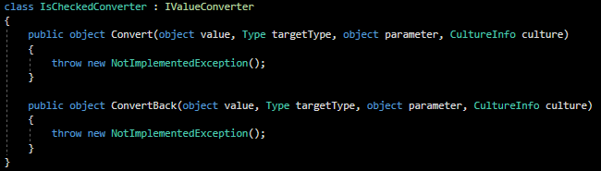
INOtifyPropertyChanged & IValueconverter
Inherit from CommonBase and use OnPropertyChanged in the setter of property.
Give definition of Convert and ConvertBack.
Use it inside XAML file.

Slide 20
Binding mode & Updatesourcetrigger
Default:
This is the default value and it means a lost focus for most of the controls
LostFocus:
Value update will be on hold until the focus moves out of the control
PropertyChanged:
Value update will happen whenever a target property changes
Explicit:
Used to defer source updates until the user does it forcibly by the click of a button or so.
Binding | Target to source | Source to Target
Two way | Yes | Yes
One way to source | Yes | No
One way | No | Yes
One time | No | For first time

Slide 21
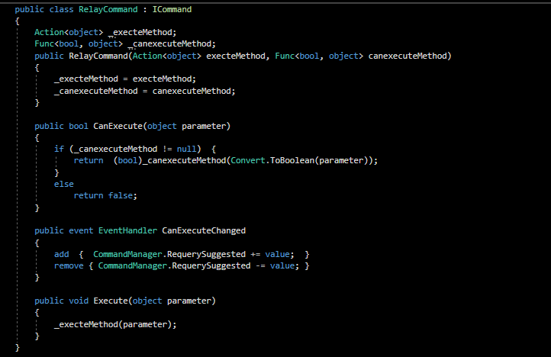
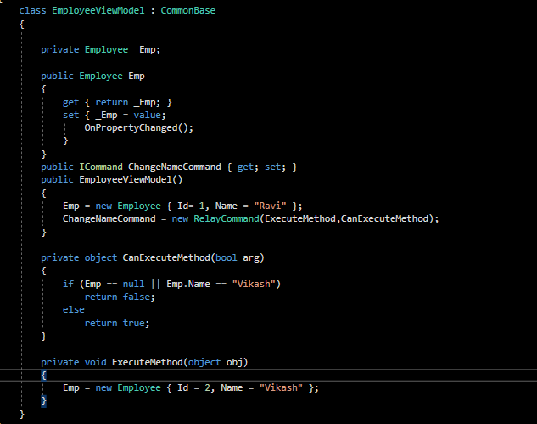
ICommand
Notes:
Icommand has two methods and one event. The first method "CanExecute" decides whether we are allowed to fire the command ( the button click event) or not. The second method "Execute" method contains the actual logic. If CanExecute method returns true, then Execute method is run.

Slide 22
Topics Left
Animations
MultiBinding triggers and converters
Data Validation
ViewModel Communication.

Slide 23


