Slide 1
ZipFood-Food delivery app
ADIT, CVM University
102040601 – Mini Project
Semester - 6
Prepared By: Smit Solanki[12002080601105]
Vishvam Shah[12002080601120]
Raj Patel[12002080601085]
Guided By: Prof. Himanshu Patel

Slide 2
Team Details
No. | Enrollment No. | Student Name | Role In Project
1 | 12002080601105 | Smit Solanki | Frontend/Backend
2 | 12002080601120 | Vishvam Shah | Frontend/Backend
1 | 12002080601085 | Raj Patel | Documentation/Figma Design

Slide 3
Index
Problem Statement
Review of Related Work (if any)
Proposed Solution
Project Planning
Technology Stack (why)
UI Design (Figma Design)
Diagrams
Database Design
Revenue Model
Video
Project Demo

Slide 4
Problem Statement
Problem :-
The main problem that an online food ingredients delivery app aims to solve in today's world is the inconvenience and time-consuming process of traditional grocery shopping. Many people find it challenging to make time for grocery shopping and meal planning, especially those who have busy work schedules or other commitments. Additionally, shopping for ingredients at physical stores can be frustrating, with long lines, crowded aisles, and limited stock of specific items.
Target Audience :-
The peoples that have jobs in such a time that they don’t have time to do shopping for ingredients or food.

Slide 5
Propose Solution
User Registration: Users would need to create an account on the app by providing their basic details like name, address, and contact information.
Select Ingredients: The app would allow users to select the ingredients they need from a list of available items. The user would also be able to specify the desired quantity of each item in terms of servings or individual units.
Payment: The app would integrate a secure payment gateway for users to pay for their order. The user would be able to use various payment methods like credit/debit card, online banking, or mobile wallets.
Delivery Tracking: The app would have a delivery tracking feature that would allow users to track their order in real-time. They could see the status of their order and estimated delivery time.
Customer Support: The app would have a customer support team to handle any queries or issues faced by users. The support team would be available 24/7 via chat, phone, or email.
Quantity: Quantity can be selected on based of the number of the persons.

Slide 6
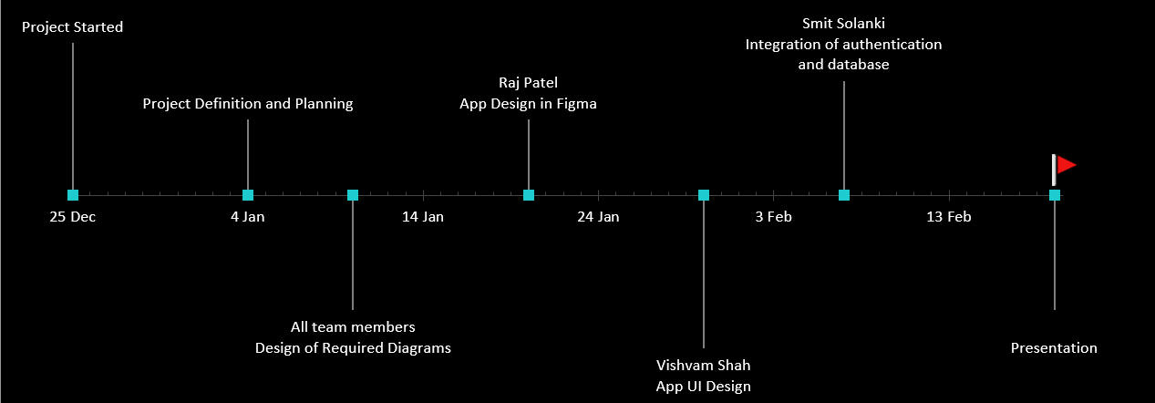
Project Planning

Slide 7
Technology Stack (why)
Flutter : Cross-Platform, Efficient, beautiful and responsive UI
Firebase: It provides services like authentication, real-time database, cloud storage. No need to Write APIs for Backend.

Slide 8
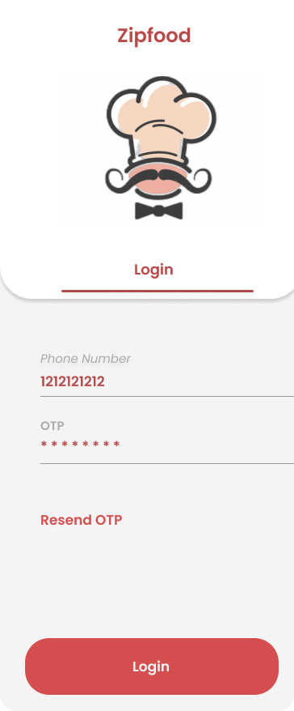
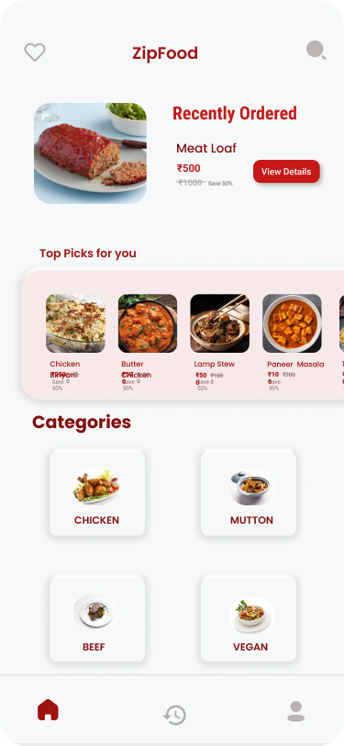
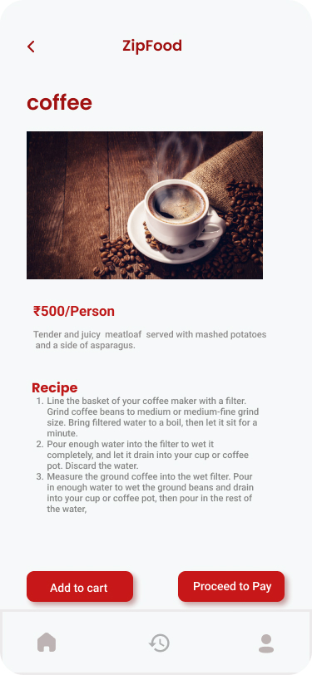
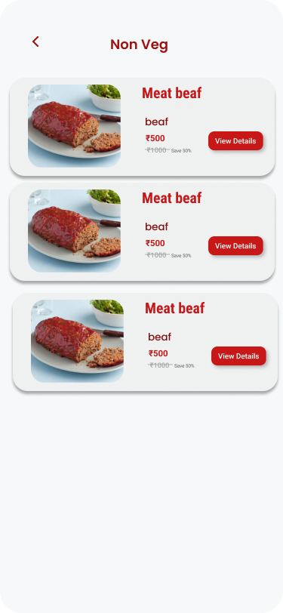
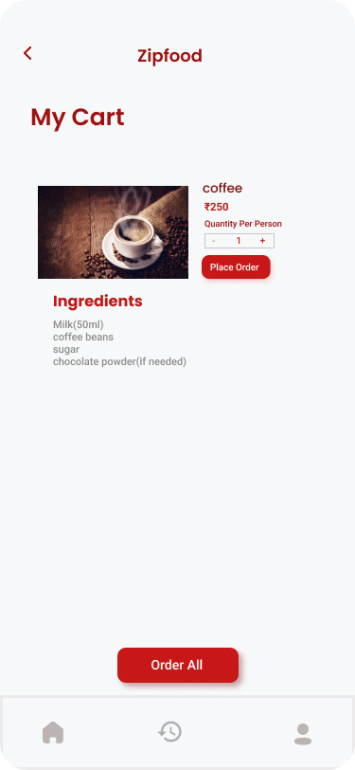
UI Design

Slide 9
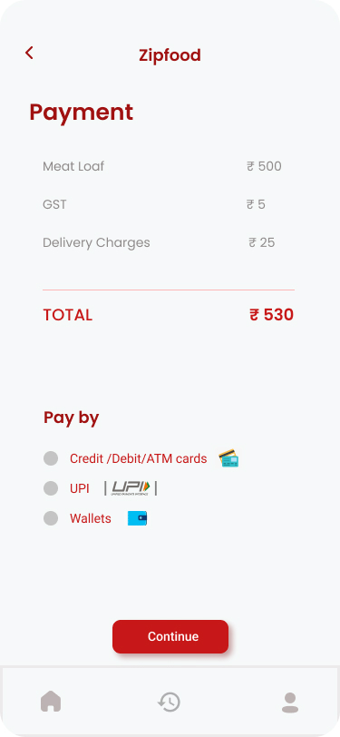
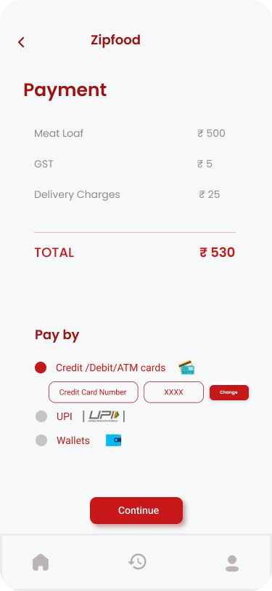
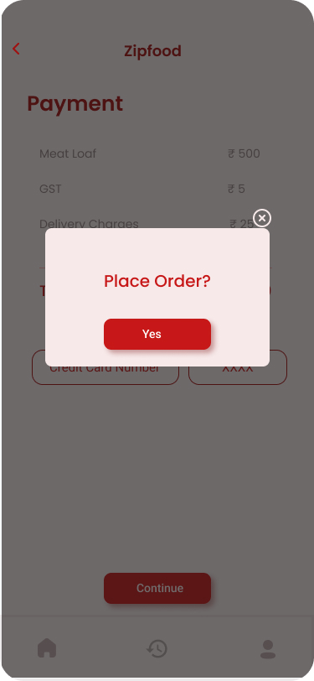
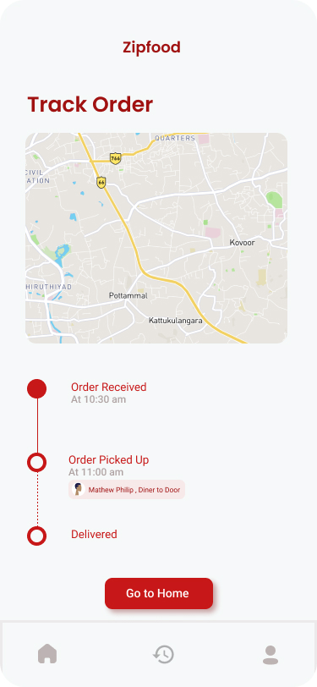
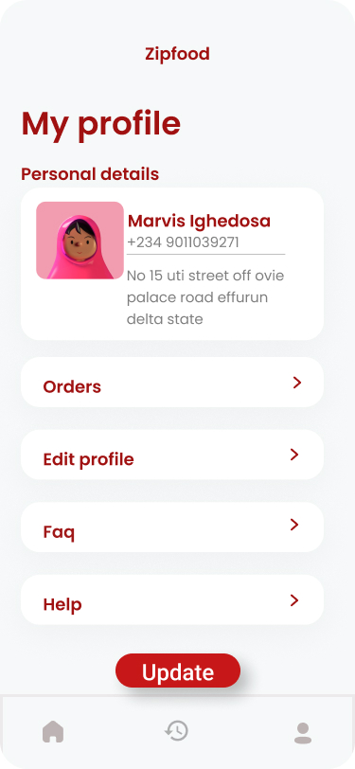
UI Design

Slide 10
Diagrams
UML Diagrams ( Verify by guide)

Slide 11
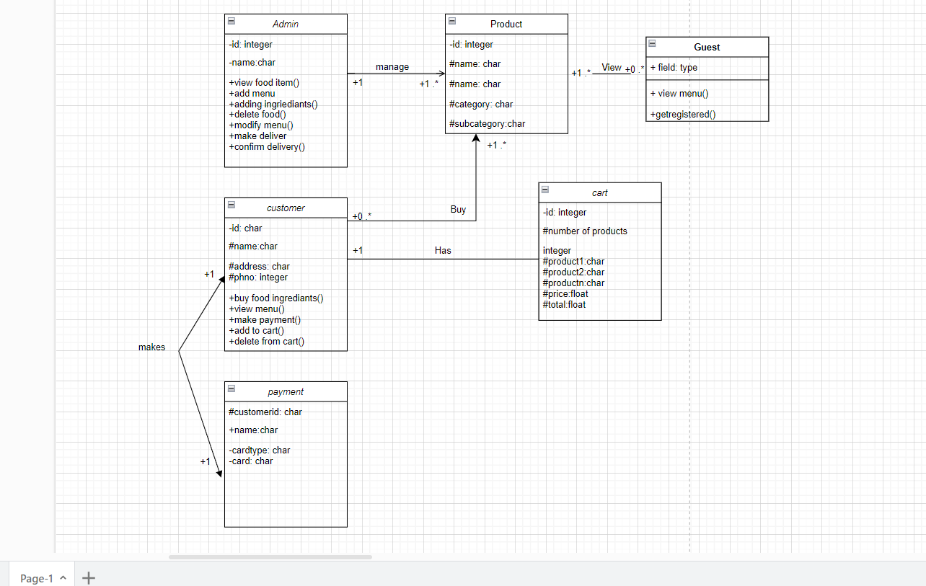
Class Diagram:

Slide 12
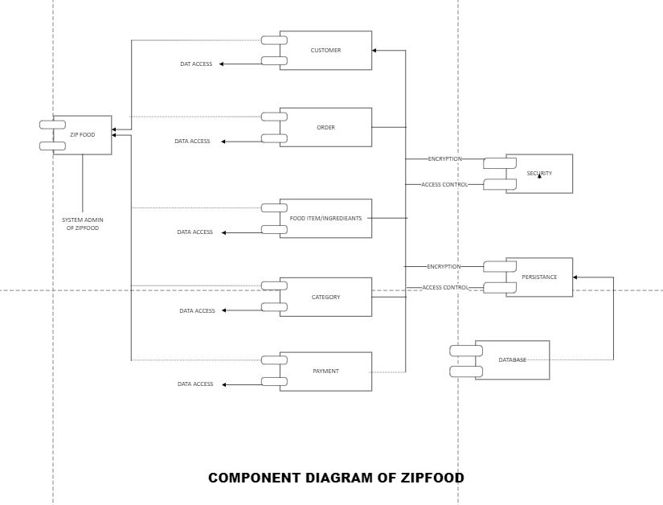
Component Diagram:-

Slide 13
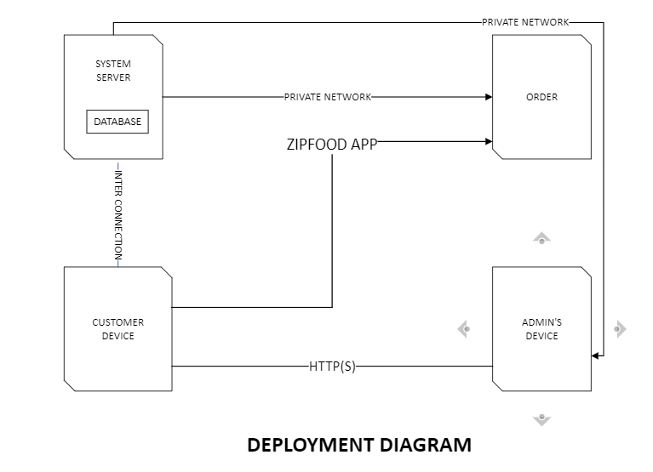
Deployment Diagram:-

Slide 14
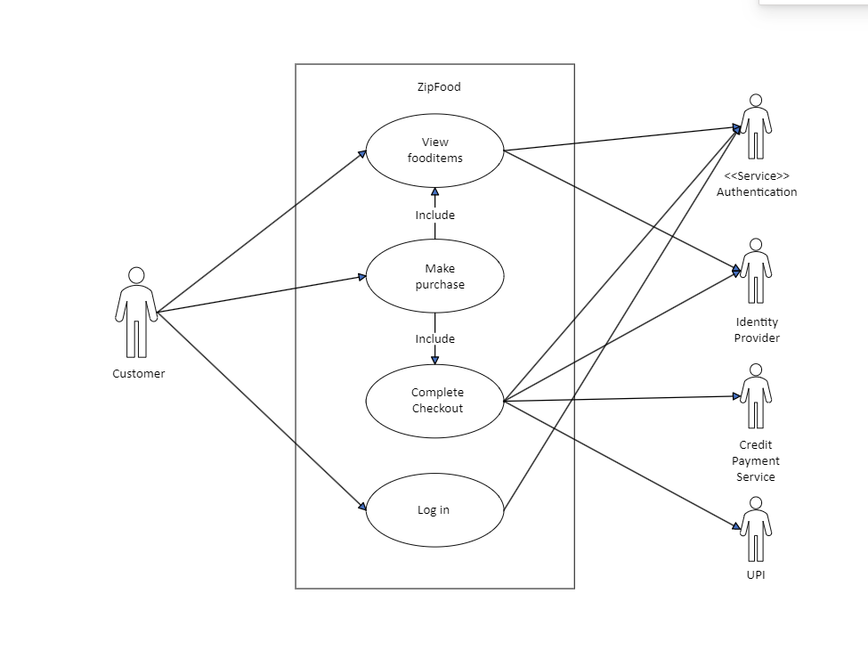
UseCase Diagram:

Slide 15
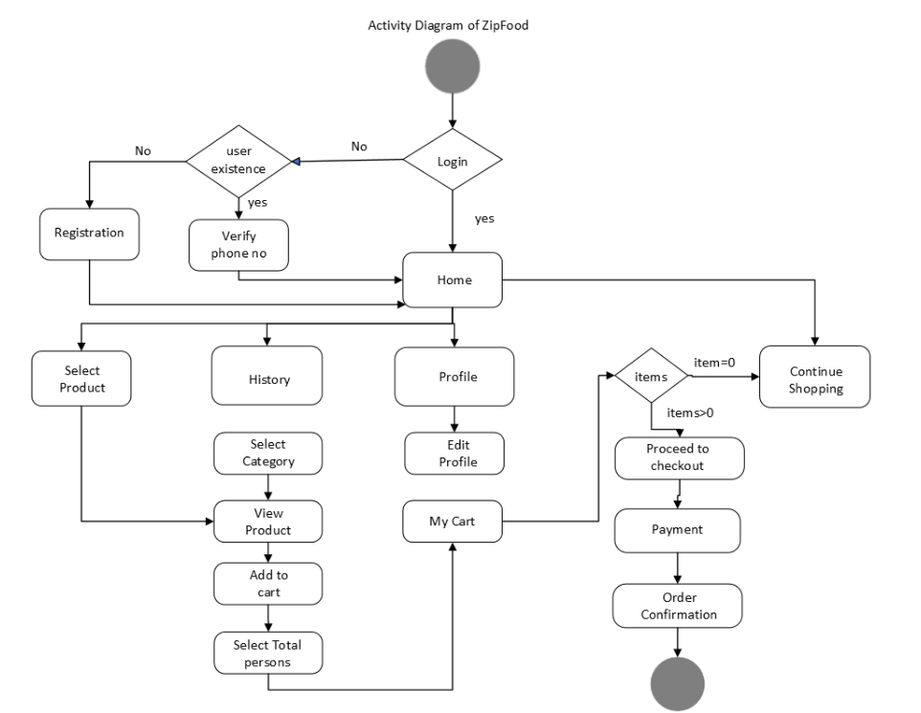
Activity Diagram

Slide 16
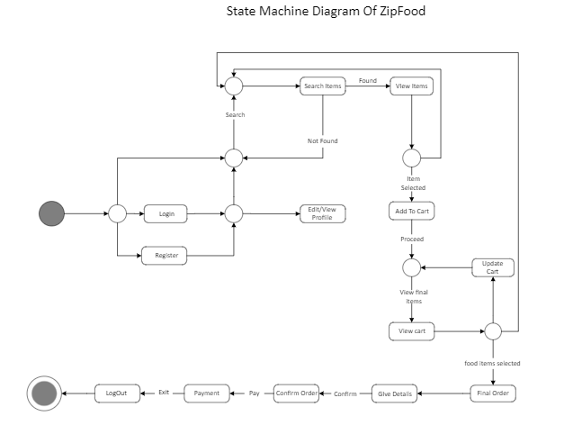
StateMachine Diagram:-

Slide 17
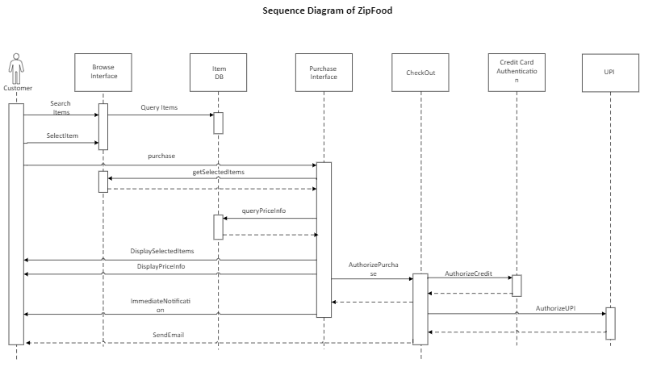
Sequence Diagram:

Slide 18
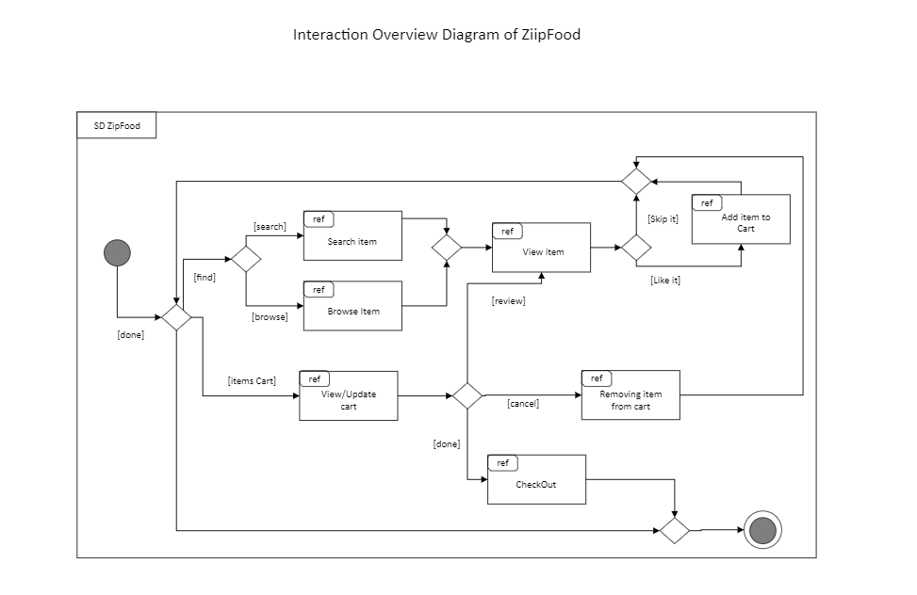
Interaction Overview Diagram:

Slide 19
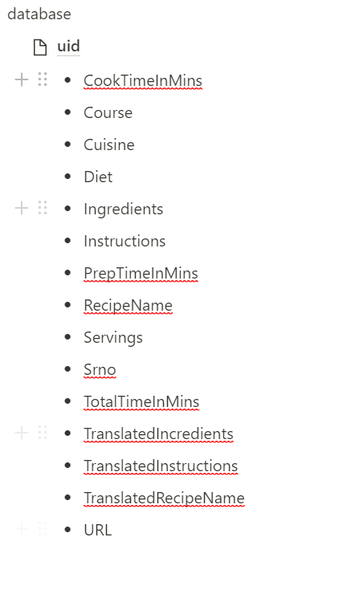
Database Design

Slide 20
Revenue Model
Sales
Revenue generated from the purchase of meal ingredients by users
Health and Wellness
By offering healthy meal options and personalized meal plans based on users' dietary preferences and goals
Data Analytics
Leverage the data collected from user behavior on your app to offer insights and analytics to food manufacturers and retailers.
Subscription Model
monthly fee for access to exclusive deals, discounts, and personalized meal plans

Slide 21
Thank you!

