Slide 1

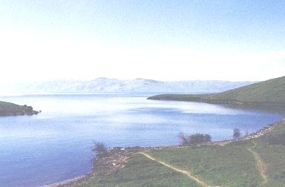
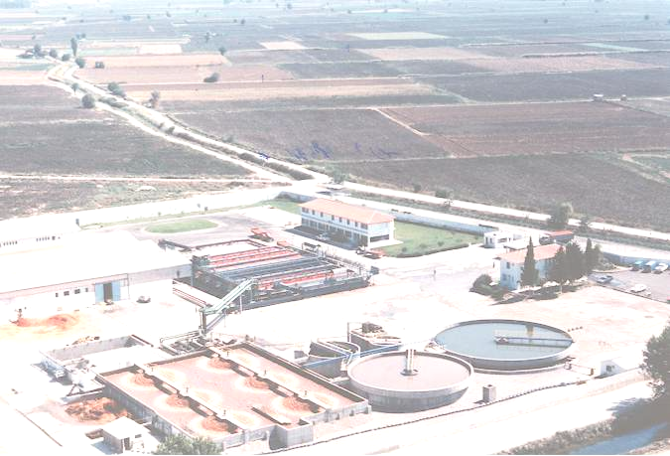
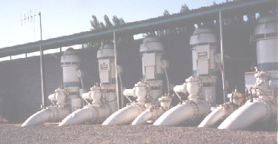
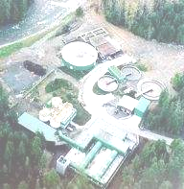
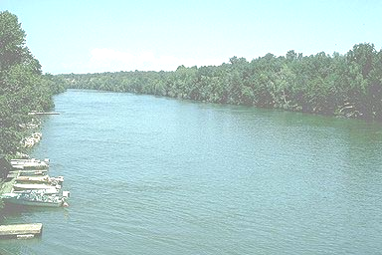
Energy Workshops for W&WW Agencies
UTILITY STRATEGIES FOR SHIFTING PEAK DEMAND PERIOD WATER & ENERGY USE
REGIONAL STRATEGIES:
PEAK DEMAND GAP & CRITICAL PEAK PRICING
Shahid Chaudhry
California Energy Commission
August 2005

Slide 2
California Energy Commission
CA’s Energy Policy and Planning Agency
  Historical Energy Data/Forecast Future Energy Needs
  License Power Plants
  Advance Energy Technologies
  Promote Energy Efficiency/Conservation
  Plan for State Response to Energy Emergency

Slide 3
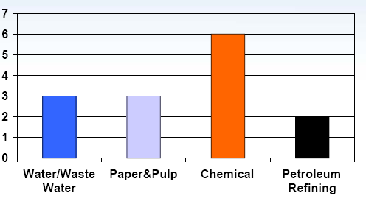
U.S. Energy Consumption by W&WW Sector
(% of Total Elect. Generation)
Energy & Water
Worldwide –
7.62x10⁵ GWh (i.e. 7%) Energy Used Just for Pumping Water
~ = Energy Used in Japan + Taiwan
2 – 3 % to Pump + Treat Water for Urban and Industry
U.S.
75 GWh, i.e. 3% of the Total Elec. Use in U.S.
California
15 GWH, i.e. 7% of the Total Elec. Use in the State

Slide 4
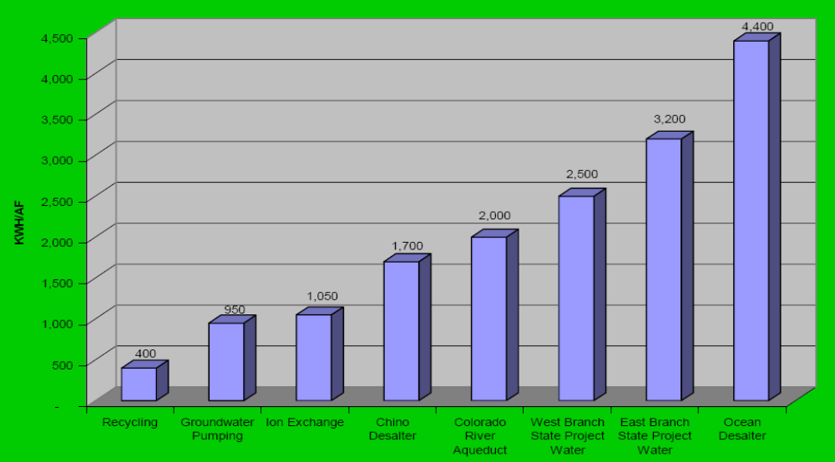
Energy-Water Link in Southern California

Slide 5
Energy-Water Link
Water for Energy Production
(e.g. Cooling Water / Hydro)
ENERGY
Energy--Water Link
WATER
Energy for Water & WW
  Single Largest Expense for Many Utilities
  Large Portion is Pumping Energy

Slide 6
BOTH, WATER & ELECTRICITY,
HAVE PEAKS IN DEMAND

Slide 7
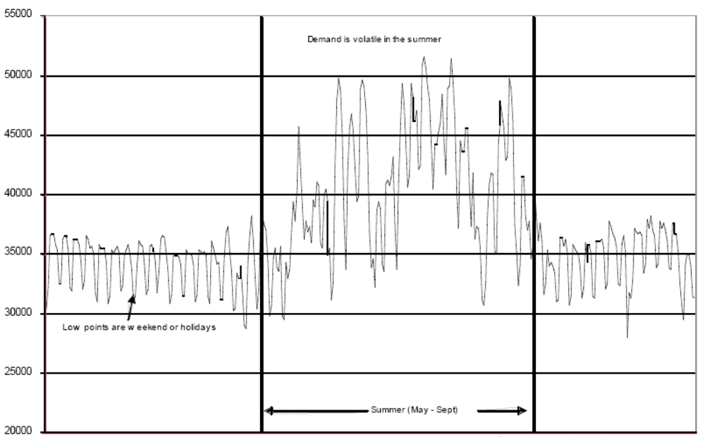
Pattern of Daily Peak Demand in California

Slide 8
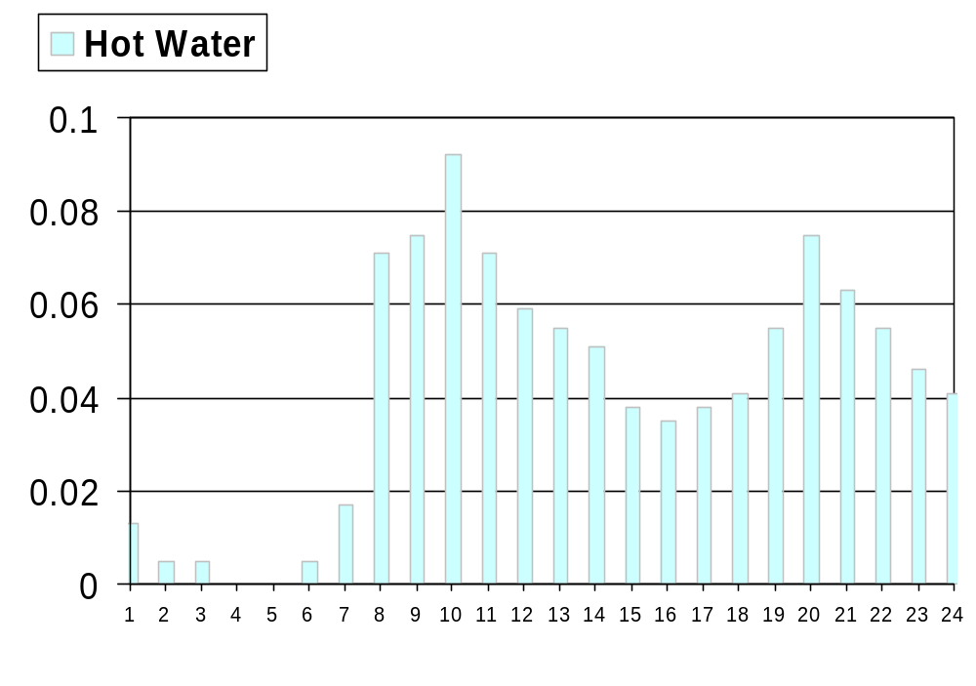
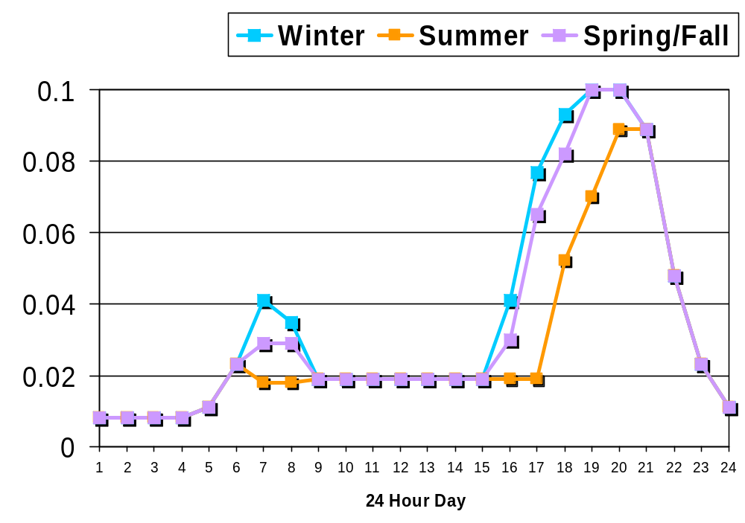
Residential Water Use and Lighting Pattern
Total Water

Slide 9
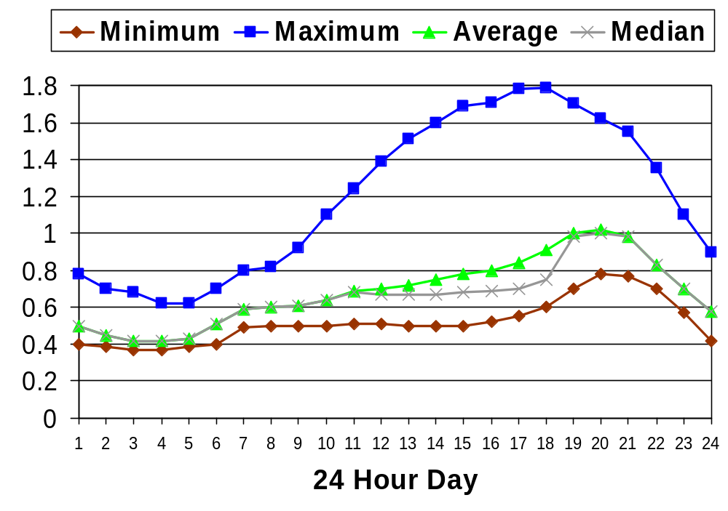
Hourly Avg. Residential Load Profile
(SCE Territory, 1999)
Typical TOU Rate Structure

Slide 10
Energy for Water; Water for Energy; Water/Energy Used Jointly (in Many Processes / Products)
Potential Solutions
Dual Approach → Supply Side & DS Management
→ Both Energy & Water Resources
Water Use Efficiency/Conservation/Loss Reduction Electric Resources Management
TOU Rates; Water Storage/Pump Management; Electric Demand Management through Water System Conservation, Efficiency, and Distributed Generation
Market Transactions to Reduce Long-Distance Pumping (Exchanges, etc.), Water System Generation
Technology Alone is Not Enough – A Change in Behavior/Approach is More Important

Slide 11
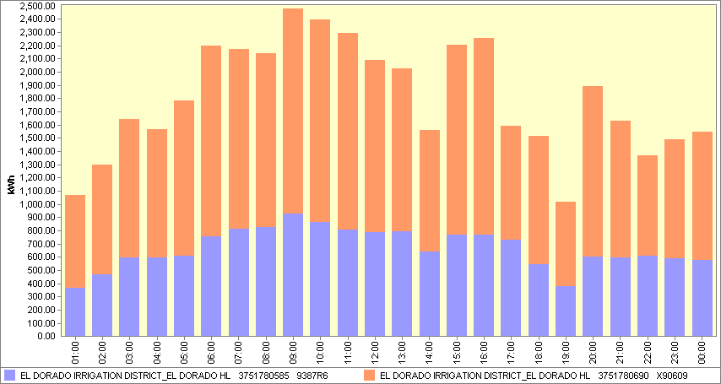
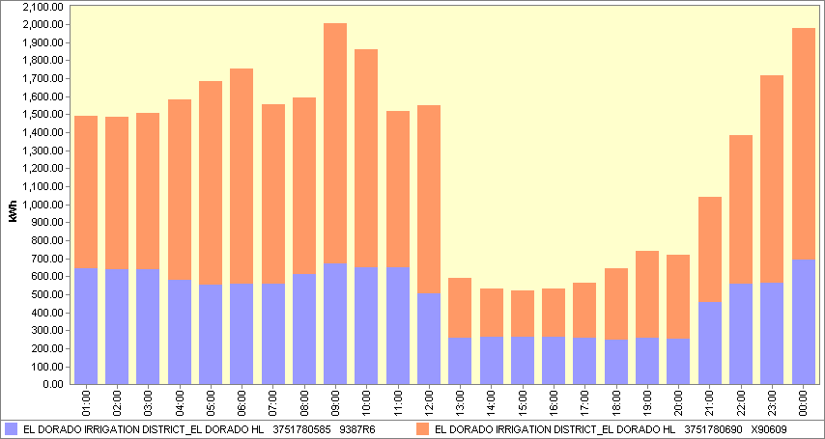
EID Electric Demand Management through Rescheduling Pumping –
June 2004 (11.56 MG) vs. June 2005 (11.03 MG)
Raw Water Pump Station
Water Treatment Plant

Slide 12
Peak Demand Gap Concerns
Statewide Demand is More than Generation Capacity
Statewide Operating Reserves (7%) are Low under Hot Weather especially in Southern California
During Extended Hot Weather may Impact Economic Growth due to:
Higher Than Expected Demand
More Than Expected Outages
Lower Than Expected Imports
Transmission Problems Due to Forest Fires
Reduced Hydro Resources etc.
Regional Strategies
Regional Coordination / Planning Needed
Emphasis on Energy Efficiency & Conservation
Focus on Demand Reduction
Add Generation / Renewables / DG Resources
Build Transmission Lines
Expand Natural Gas Infrastructure

Slide 13
PIER -- $62 Million/Year RD&D Program
IAW End Use Energy Efficiency, Environmental Research, Renewable Energy Technologies, Innovative Small Grants Program
CEC’s Self Generation/Cogeneration/ Emerging Renewable Energy Rebates*
< 30 kW System** –
PV $2.80 / Watt
Wind $1.70 / Watt for First 7.5 kW
$0.70 / Watt for 7.5 kW to 30 kW
Solar Thermal - & Fuel Cells (using Renewable Fuels)
$3.40 / Watt
> 30 kW Systems:
CPUC’s Program Administered by IOUs
* Effective 1.1.2005 ** For Owner Installed Systems, Rebates are 15% Less

Slide 14
Peak Load Reduction Programs
AB970 / SB5X
Curtailment, Energy Efficiency Retrofits, Distributed Generation, & Load Shifting
AB970 52.16 MW Peak Load Reduced
CEC Grants: $ 4.54 Million
SB5X 17.78 MW Peak Load Reduced
CEC Grants: $ 4.35 Million
Total Projects Costs: $13.80 Million → $776 / Peak kW
Energy Efficiency & Partnership Programs
Technical Assistance & Low Interest Rate Loans to the W&WW Facilities to Identify and Implement Energy Efficiency Projects
Up to 100% of the Cost of Energy Efficiency Related Project; No Minimum, No Match Needed; Maximum $3 M / Application; Simple Payback Period → 10 years or Less; First Come First Served Basis. Eligibility → Broad Range of Projects

Slide 15
For More Information on CEC’s Water-Energy Activities/Programs
Shahid Chaudhry 916-654-4858
schaudhr@energy.state.ca.us

