Slide 1
Bridging Text and Molecule: A Survey on Multimodal Frameworks for Molecule
ArXiv
Yi Xiao, Xiangxin Zhou, Qiang Liu and Liang Wang
University of Chinese Academy of Sciences, Beijing, China
Presented by: Yijingxiu Lu

Slide 2
Bridging Text and Molecule: A Survey on Multimodal Frameworks for Molecule
Summary
Encoding Techniques:
1D molecule sequences,
2D molecular structures
3D molecular structures.
Model Architectures:
single-stream architectures
multi-stream architectures
Pre-training Tasks:
Molecule-Text Contrastive Learning(CL), Molecule-Text Matching (MTM), Conditional Generation (CG), Masked Language Modeling (MLM), and Causal Language Modeling (CLM).
Prompting Techniques:
prompting-based fine-tuning
instruction tuning (IT), in-context learning (ICL), and chain-of-thoughts (CoT) prompting.
Summary
Encoding
Methodology
Data
Application
Conclusion

Slide 3
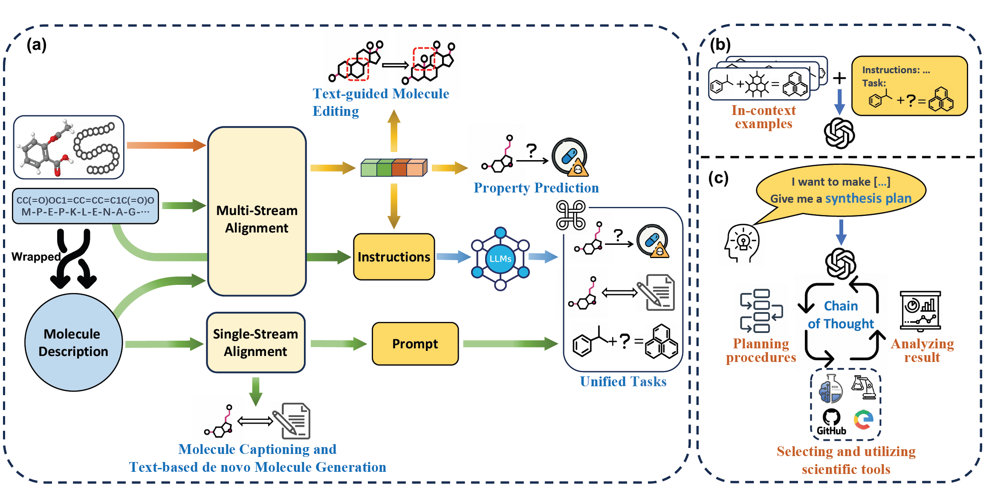
Bridging Text and Molecule: A Survey on Multimodal Frameworks for Molecule
Summary
Encoding
Methodology
Data
Application
Conclusion

Slide 4
Bridging Text and Molecule: A Survey on Multimodal Frameworks for Molecule
Encoding
1D Molecule Sequence
2D Molecule Structure
3D Molecule Structure
Small-molecule Sequence
Simplified Molecular Input Line Entry System (SMILES)
Self-referencing embedded strings (SELFIES)
International Union of Pure and Applied Chemistry (IUPAC)
Molecular FP
Protein Sequence
Amino Acid Sequence
Protein Language Model (PLM)
2D Graph
Atom (Node), Bond (Edge)
3D Geometric Graph
2D Graph + 3D Coordinates
Protein Graph
Residue (Node), Distance (Edge)
Summary
Encoding
Methodology
Data
Application
Conclusion

Slide 5
Bridging Text and Molecule: A Survey on Multimodal Frameworks for Molecule
Methodology
Model Architecture
Pre-training Tasks
Prompting Techniques
Single-Stream Architecture
Assume the latent space of molecules and text share similar semantic meaning
Multi-Stream Architecture
Employ intra-modality processing for text and molecules
Molecule-Text Contrastive Learning (CL)
Matched pair closer
Molecule-Text Matching (MTM)
Pair prediction
Conditional Generation (CG)
Token generation
Masked Language Modeling (MLM)
Masked token prediction
Causal Language Modeling (CLM)
Next Token Generation
Prompting-based fine-tuning
task-specific prompt
Instruction tuning (IT)
Multi-task instructions for seamlessly transferring
In-context learning (ICL)
prompt with question-answering
Chain-of-thoughts (CoT)
reasoning step-by-step
Summary
Encoding
Methodology
Data
Application
Conclusion
Notes:
Molecule-Text Contrastive Learning (CL):
pushes the embeddings from matched text and molecules closer in latent space while enlarging the distance between pairs from different molecules.
Molecule-Text Matching (MTM):
predict whether a molecule-text pair is matched or not.
Conditional Generation (CG):
generate tokens based on given conditions or constraints.
Masked Language Modeling (MLM):
predict the masked components using the remaining context.
Causal Language Modeling (CLM):
predict the next token in a sequence in a left-to-right direction.

Slide 6
Bridging Text and Molecule: A Survey on Multimodal Frameworks for Molecule
Methodology
Model Architecture
Single-Stream Architecture
Assume the latent space of molecules and text share similar semantic meaning
Multi-Stream Architecture
Employ intra-modality processing for text and molecules
Summary
Encoding
Methodology
Data
Application
Conclusion
Notes:
Molecule-Text Contrastive Learning (CL):
pushes the embeddings from matched text and molecules closer in latent space while enlarging the distance between pairs from different molecules.
Molecule-Text Matching (MTM):
predict whether a molecule-text pair is matched or not.
Conditional Generation (CG):
generate tokens based on given conditions or constraints.
Masked Language Modeling (MLM):
predict the masked components using the remaining context.
Causal Language Modeling (CLM):
predict the next token in a sequence in a left-to-right direction.

Slide 7
Bridging Text and Molecule: A Survey on Multimodal Frameworks for Molecule
Model Architecture
Single-Stream Architecture:
Assume the latent space of molecules and text share similar semantic meaning.
Multi-Stream Architecture:
Employ intra-modality processing for text and molecules.
Summary
Encoding
Methodology
Data
Application
Conclusion

Slide 8
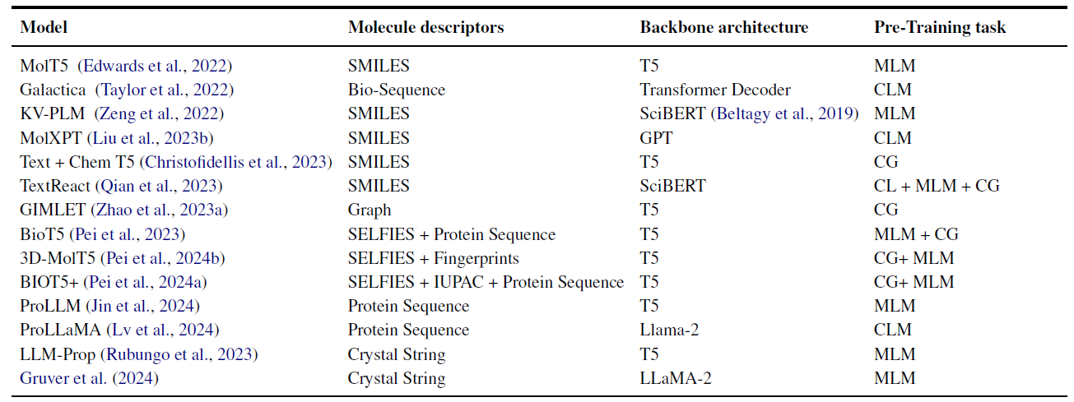
Bridging Text and Molecule: A Survey on Multimodal Frameworks for Molecule
Model Architecture
Single-Stream Architecture
T5 [Raffel et al., 2020]: A general text-to-text transformation model used for multi-language pretraining.
KV-PLM [Zeng et al., 2022]: Utilizes Byte-Pair Encoding (BPE) to tokenize SMILES and replaces molecular names in sequences with SMILES tokens to create training data.
MolXPT [Liu et al., 2023b]: Also applies BPE for molecular tokenization and embeds SMILES into textual sequences to enhance text-molecule alignment.
BioT5 [Pei et al., 2023]: Creates separate vocabularies for molecules, proteins, and text to prevent token ambiguity arising from different semantic spaces.
GIMLET [Zhao et al., 2023a]: Serializes molecular graphs as node sequences and introduces position embeddings to jointly encode nodes with textual tokens, preserving graph-level inductive bias while avoiding additional graph encoding modules.
Advantages:
Leverages existing NLP pretraining frameworks.
Weaknesses:
Over-reliance on SMILES as a molecular representation may lead to information loss (e.g., structural details).
Assumes molecules and text share the same semantic space, despite molecules having fundamentally different structural characteristics.
Summary
Encoding
Methodology
Data
Application
Conclusion

Slide 9
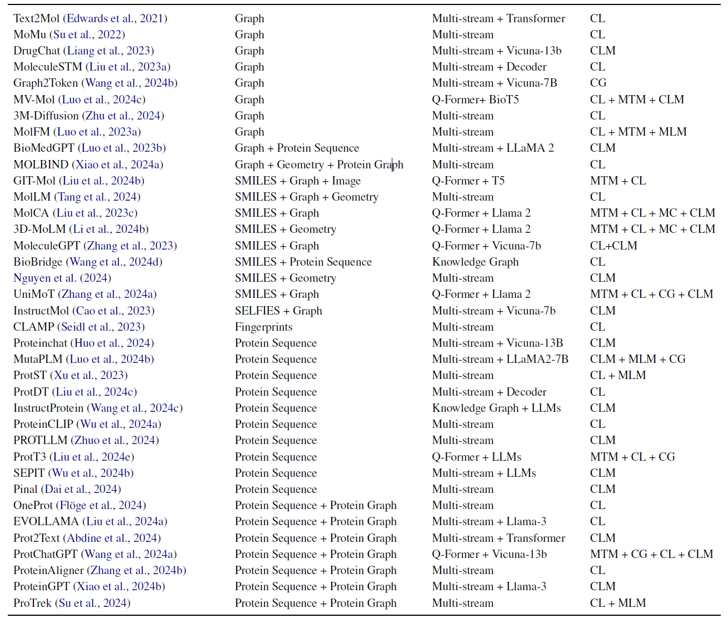
Bridging Text and Molecule: A Survey on Multimodal Frameworks for Molecule
Model Architecture
Multi-Stream Architecture
[Abdine et al., 2023]: Fuses protein sequence and protein graph features using element-wise addition and feeds them into a cross-attention module to adapt to textual information.
[Xu et al., 2023]: Selects both text and protein representations as keys and applies two separate cross-attention modules to generate fused-text and fused-protein representations.
Q-Former [Li et al., 2023]: A vision-language modeling architecture that leverages cross-attention layers to bridge the modality gap.
[Li et al., 2024; Liu et al., 2023d; Zhang et al., 2023]: Adopt Q-Former to connect molecular graphs with text and extract text-related molecular features using a learnable query.
GIT-Former [Liu et al., 2023a]: A variant of Q-Former that incorporates additional input modalities, such as molecular images and sequences, to enhance multimodal information fusion.
Summary
Encoding
Methodology
Data
Application
Conclusion

Slide 10
Bridging Text and Molecule: A Survey on Multimodal Frameworks for Molecule
Methodology
Model Architecture
Pre-training Tasks
Single-Stream Architecture
Assume the latent space of molecules and text share similar semantic meaning
Multi-Stream Architecture
Employ intra-modality processing for text and molecules
Molecule-Text Contrastive Learning (CL)
Matched pair closer
Molecule-Text Matching (MTM)
Pair prediction
Conditional Generation (CG)
Token generation
Masked Language Modeling (MLM)
Masked token prediction
Causal Language Modeling (CLM)
Next Token Generation
Summary
Encoding
Methodology
Data
Application
Conclusion
Notes:
Molecule-Text Contrastive Learning (CL):
pushes the embeddings from matched text and molecules closer in latent space while enlarging the distance between pairs from different molecules.
Molecule-Text Matching (MTM):
predict whether a molecule-text pair is matched or not.
Conditional Generation (CG):
generate tokens based on given conditions or constraints.
Masked Language Modeling (MLM):
predict the masked components using the remaining context.
Causal Language Modeling (CLM):
predict the next token in a sequence in a left-to-right direction.

Slide 11
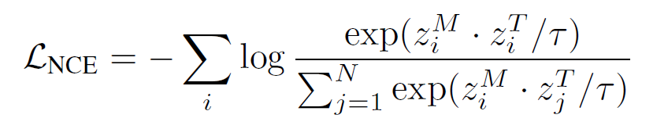
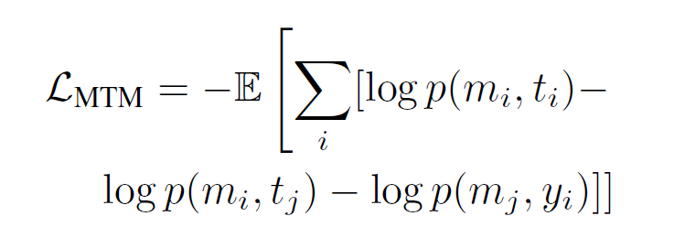
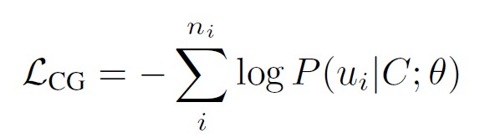
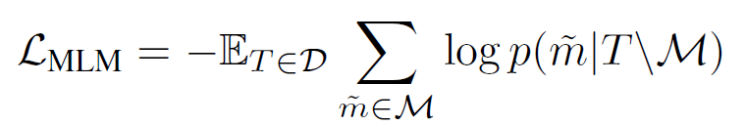
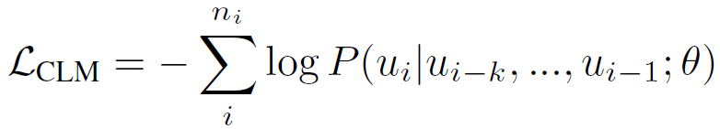
Bridging Text and Molecule: A Survey on Multimodal Frameworks for Molecule
Pre-training Tasks
To align the fused representation in a unified latent space
Molecule-Text Contrastive Learning (CL):
pushes the embeddings from matched text and molecules closer in latent space while enlarging the distance between pairs from different molecules.
Molecule-Text Matching (MTM):
predict whether a molecule-text pair is matched or not.
Conditional Generation (CG):
generate tokens based on given conditions or constraints.
Masked Language Modeling (MLM):
predict the masked components using the remaining context.
Causal Language Modeling (CLM):
predict the next token in a sequence in a left-to-right direction.
Summary
Encoding
Methodology
Data
Application
Conclusion
Notes:
CL: limitation: structural info loss and limited pairs; solution: graph augmentation techs.
CG: e.g. molecule captioning, text-based molecule generation.

Slide 12
Bridging Text and Molecule: A Survey on Multimodal Frameworks for Molecule
Methodology
Model Architecture
Pre-training Tasks
Prompting Techniques
Single-Stream Architecture
Assume the latent space of molecules and text share similar semantic meaning
Multi-Stream Architecture
Employ intra-modality processing for text and molecules
Molecule-Text Contrastive Learning (CL)
Matched pair closer
Molecule-Text Matching (MTM)
Pair prediction
Conditional Generation (CG)
Token generation
Masked Language Modeling (MLM)
Masked token prediction
Causal Language Modeling (CLM)
Next Token Generation
Prompting-based fine-tuning
task-specific prompt
Instruction tuning (IT)
Multi-task instructions for seamlessly transferring
In-context learning (ICL)
prompt with question-answering
Chain-of-thoughts (CoT)
reasoning step-by-step
Summary
Encoding
Methodology
Data
Application
Conclusion
Notes:
Molecule-Text Contrastive Learning (CL):
pushes the embeddings from matched text and molecules closer in latent space while enlarging the distance between pairs from different molecules.
Molecule-Text Matching (MTM):
predict whether a molecule-text pair is matched or not.
Conditional Generation (CG):
generate tokens based on given conditions or constraints.
Masked Language Modeling (MLM):
predict the masked components using the remaining context.
Causal Language Modeling (CLM):
predict the next token in a sequence in a left-to-right direction.

Slide 13
Bridging Text and Molecule: A Survey on Multimodal Frameworks for Molecule
Prompting Techniques
Multi-modal LLM in molecular science
Prompting-based fine-tuning
to unify the fine-tuning framework among different tasks with task-specific prompts.
e.g. “We can conclude that the BBBP of <SMILES> is <tag>”
Instruction tuning (IT)
models are trained in multiple tasks which have been unified through task-specific instructions.
<instruction> that clarifies the task
<input> which is usually molecular feature
<output> that embodies the expected outcome
In-context learning (ICL)
usually combines instruction-based prompts with a few molecular Question-Answer examples.
Chain-of-thoughts (CoT)
Few-shot:
demonstrates the reasoning steps in one or few prompts
Zero-shot:
e.g. put “Let’s think step by step” at the end of the problem description
Summary
Encoding
Methodology
Data
Application
Conclusion

Slide 14
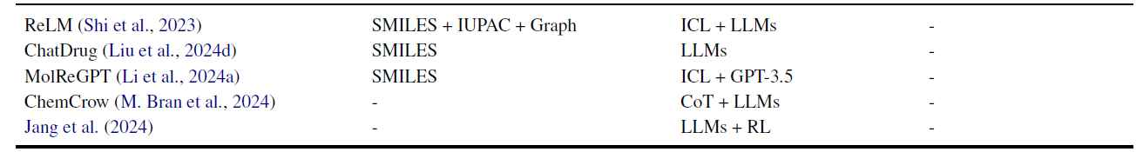
Bridging Text and Molecule: A Survey on Multimodal Frameworks for Molecule
Prompting Techniques
Multi-modal LLM in molecular science
Prompting-based fine-tuning
to unify the fine-tuning framework among different tasks with task-specific prompts.
e.g. “We can conclude that the BBBP of <SMILES> is <tag>”
Instruction tuning (IT)
models are trained in multiple tasks which have been unified through task-specific instructions.
<instruction> that clarifies the task
<input> which is usually molecular feature
<output> that embodies the expected outcome
In-context learning (ICL)
usually combines instruction-based prompts with a few molecular Question-Answer examples.
Chain-of-thoughts (CoT)
Few-shot:
demonstrates the reasoning steps in one or few prompts
Zero-shot:
e.g. put “Let’s think step by step” at the end of the problem description
Summary
Encoding
Methodology
Data
Application
Conclusion

Slide 15
Bridging Text and Molecule: A Survey on Multimodal Frameworks for Molecule
Dataset Construction
Data Processing:
Collect and construct dataset from multiple datasets (due to imbalance of descriptions in database).
Replace unnecessary annotations.
Remove redundant information.
Rearrange descriptions to ensure consistency.
Integrating Generative AI:
GPT-3.5 + PubChem (Li et al. 2024).
GPT-3.5 + QA (Fang et al. 2023).
GPT4 + molecule captioning (Sakhinana et al. 2023).
Fabricate an “artificially-real” database through ChatGPT with retrieval-based few-shot prompting (Chen et al. 2024).
Summary
Encoding
Methodology
Data
Application
Conclusion

Slide 16
Bridging Text and Molecule: A Survey on Multimodal Frameworks for Molecule
Applications
Text-molecule Retrieval:
retrieve the corresponding molecule from a given text query.
usually use the similarity score to evaluate the distance between text and molecules.
Property Prediction:
binary classification task achieved by molecular features and simple prediction head.
predict property in a QA format.
Molecule Design:
De novo Generation: molecule captioning, text-guided de novo generation
Molecule Editing: optimize current molecules with desired properties.
e.g. sample a latent representation close to both text and molecule in latent space.
Others:
Reaction Prediction: product prediction, reaction condition prediction, retrosynthesis prediction.
Intelligent Agent for Scientific Research:
[Liu et al., 2023b] design a drug editing agent with conversational interaction.
[Boiko et al., 2023] develop a “Coscientist” based on GPT-4 similar to ChemCrow [Bran et al., 2023] which can autonomously design and execute chemical research.
Summary
Encoding
Methodology
Data
Application
Conclusion

Slide 17
Bridging Text and Molecule: A Survey on Multimodal Frameworks for Molecule
Future Outlooks
Appealing for High-Quality Data and Reliable Benchmarks:
Data scarcity.
Authenticity and correlation of retrieved text cannot be guaranteed.
How to fairly evaluate the performance among different models.
Extending the Interpretability of Model:
Develop interpretable tools to improve interpretability of latent space.
Improving the Reasoning Ability:
In some cases, models may generate unrealistic predictions or even replicate the values in examples as prediction.
Integration with Foundation Models:
Integrate Foundation models (FMs) in the biomedical domain with LLM.
Learning from Human/AI Feedback:
Reinforcement learning from human/AI feedback (RLHF) + LLM
Summary
Encoding
Methodology
Data
Application
Conclusion

