Slide 1
UMURENGE SACCO
SAVINGS & LOAN MANAGEMENT SYSTEM
Database Programming Capstone Project
PRESENTED BY
Uwitonze Solange
STUDENT ID
31997/2025
COURSE
DPR400210 – Database Programming
INSTRUCTOR
Eric Maniraguha
ACADEMIC YEAR
2025-2026
DATE
July 2026

Slide 2
GETTING STARTED
Introduction
i
Background
✓
Project Goal
SACCOs are widespread across Rwanda
Currently using manual ledgers and spreadsheets
Leads to errors, delays, and poor tracking
To design and implement an Oracle database system that automates:
Member management
Savings deposits
Loan processing
Interest calculation
Repayment tracking
Financial reporting
02 / 10

Slide 3
WHY THIS MATTERS
Problem Statement
Community savings groups and local SACCOs manage operations using manual methods.
KEY ISSUES
Frequent errors in interest calculations
Missed repayment tracking
!
!
Difficulty enforcing loan policies
Members cannot check their savings balance easily
!
!
Loan officers spend hours calculating interest manually
No automated system to prevent overdue members from taking new loans
!
!
03 / 10

Slide 4
WHO IT'S FOR
Target Users
1
2
3
👤
💼
⚙
SACCO Members
Loan Officers / Staff
SACCO Administrators
Individuals saving money
Borrowers applying for loans
Need to check their balance easily
Process loan applications
Record savings deposits
Track repayments
Generate financial reports
Oversee operations
Monitor loan performance
Ensure compliance with policies
04 / 10

Slide 5
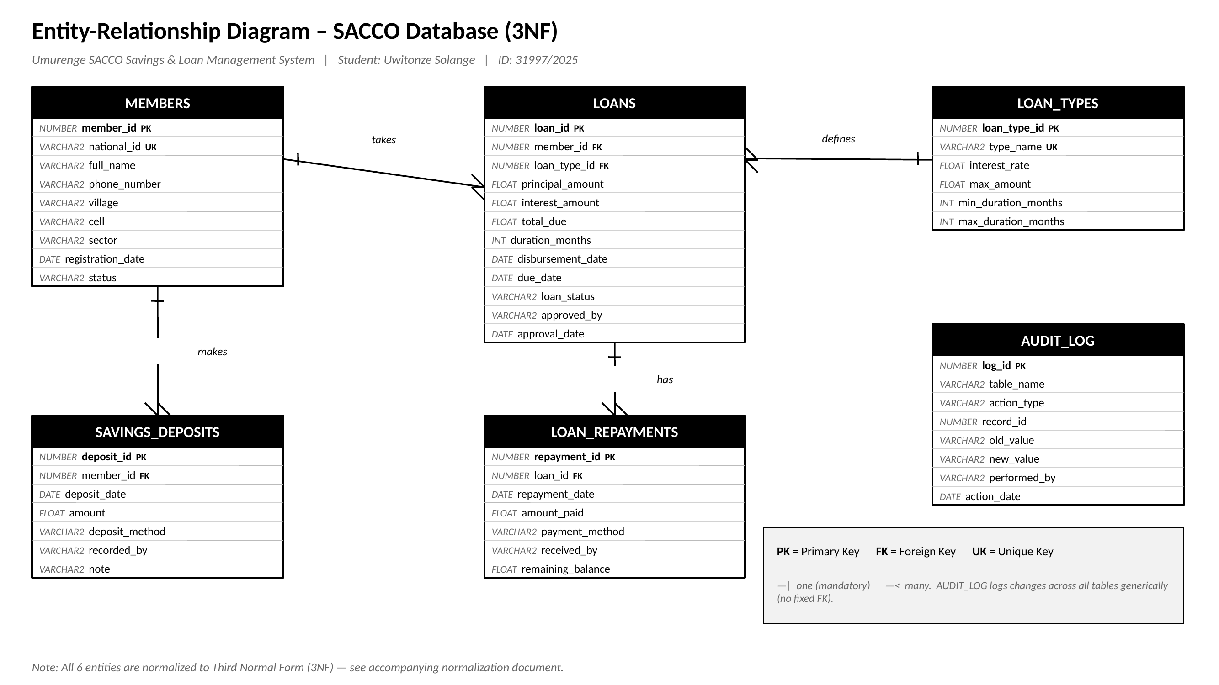
DATABASE DESIGN
Entity Relationship Diagram
6 TABLES (3NF NORMALIZED)
1
MEMBERS – Store member personal details
2
LOAN_TYPES – Define loan products (Inkunga, Ubucuruzi, Amakuru)
3
LOANS – Track loans with auto-calculated interest
4
SAVINGS_DEPOSITS – Record member savings deposits
5
LOAN_REPAYMENTS – Track loan repayments
6
AUDIT_LOG – Log all changes for security
RELATIONSHIPS
MEMBERS 1 : M LOANS
LOAN_TYPES 1 : M LOANS
MEMBERS 1 : M SAVINGS_DEPOSITS
LOANS 1 : M LOAN_REPAYMENTS
05 / 10

Slide 6
IMPLEMENTATION
Table Structures & Constraints
Primary Keys (PK) for unique identification
Foreign Keys (FK) for referential integrity
CHECK constraints for data validation
UNIQUE constraints for national_id and type_name
DEFAULT values for dates and status
EXAMPLE – MEMBERS TABLE
Column | Type | Constraint
member_id | NUMBER | PRIMARY KEY
national_id | VARCHAR2(16) | UNIQUE, NOT NULL
full_name | VARCHAR2(100) | NOT NULL
phone_number | VARCHAR2(15) | NOT NULL
status | VARCHAR2(20) | CHECK (ACTIVE/SUSPENDED/CLOSED)
06 / 10

Slide 7
BUSINESS LOGIC
PL/SQL Implementation
Functions
Procedures
fn_get_savings_balance – Returns total savings for a member
sp_weekly_financial_report – Generates weekly report with cursor
Package: pkg_loan_mgmt
Triggers
approve_loan – Approves a loan application
record_repayment – Records a loan repayment
get_loan_status – Returns loan status
generate_overdue_alert – Lists overdue loans
trg_calc_loan_interest – Auto-calculates interest
trg_block_overdue_loan – Blocks overdue members
trg_update_loan_balance – Updates balance
trg_audit_loan_changes – Logs all changes
trg_block_weekend_holiday – Blocks weekend/holiday txns
07 / 10

Slide 8
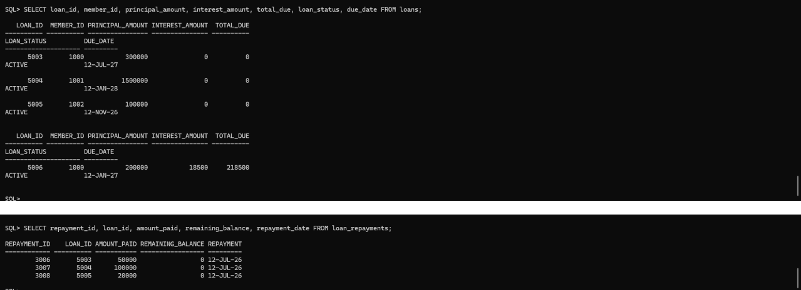
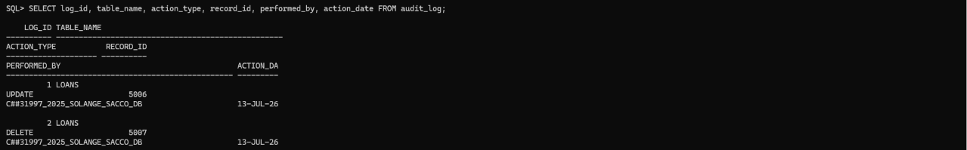
VERIFICATION
Testing & Results
SAMPLE DATA INSERTED
3
3
4
3
Members
Savings Deposits
Loans
Repayments
KEY TESTS PERFORMED — ALL PASSED
✓ Interest auto-calculation
✓ Member savings balance function
✓ Weekly financial report
✓ Loan approval package
✓ Overdue loan alert
✓ Audit logging
✓ Weekend/holiday blocking
TESTING EVIDENCE
🖼
ORA-20001 holiday-block error (pending)
Loans & repayments results
audit_log query result
08 / 10

Slide 9
GOING FURTHER
Innovation Component – Power BI Dashboard
1
2
3
4
Total Savings vs Total Loans
Top Members by Savings
Loan Status Breakdown
Overdue Loans Alert
Bar chart comparison
Horizontal bar chart
Pie chart (Active / Paid / Defaulted)
Red flag notification
BENEFITS
Real-time visibility into SACCO performance
Easy decision-making for administrators
Quick identification of overdue loans
Visual tracking of member contributions
🖼
Insert Power BI / Excel dashboard screenshot here
09 / 10

Slide 10
WRAPPING UP
Conclusion
Project Summary
Challenges Overcome
Future Enhancements
Designed and implemented a complete Oracle database for SACCO operations
Automated interest calculation, loan approval, and repayment tracking
Enforced business rules using triggers and constraints
Created a comprehensive PL/SQL package for loan management
Implemented audit logging and security controls
Built a dashboard for real-time visualization
Oracle 21c CDB environment requiring C## prefix for users
Trigger testing and debugging
Mobile app for member self-service
Integration with mobile money APIs
Automated SMS alerts for overdue loans
Thank You!

