Slide 1

Planning A Computing Project:
The Impact of Weak Authentication on IoT Device Security
Thet Htoo Zin (Pearson ID: UE22116)

Slide 2
Project Overview & Objectives
The Problem
Research Goal
Scope
IoT devices are convenience
but it might happen critical
network vulnerabilities because of weak authentication.
Gather data on the vulnerabilities caused by authentication weakness and deliver systematic framework for security enhancement.
Examine user behavior in device configuration and
Technical vulnerabilities discovered across 52 different IoT management platforms.

Slide 3
Sector Analysis and Business Alignment
Iot Management Platform Sector
Organizational Needs
In this sector, it goes beyond the Consumer and Enterprise and the Industrial. Real time monitoring, automated environment notification and multi user access control structure are essential core operations capabilities.
The focus of this research is clear and shows how "broken authentication" paths can result in data forging in the context of the requirements of the sectors involved. It will align with the University's critical requirement to provide security to safeguard vital student data and financial transactions from cyberthreats.

Slide 4
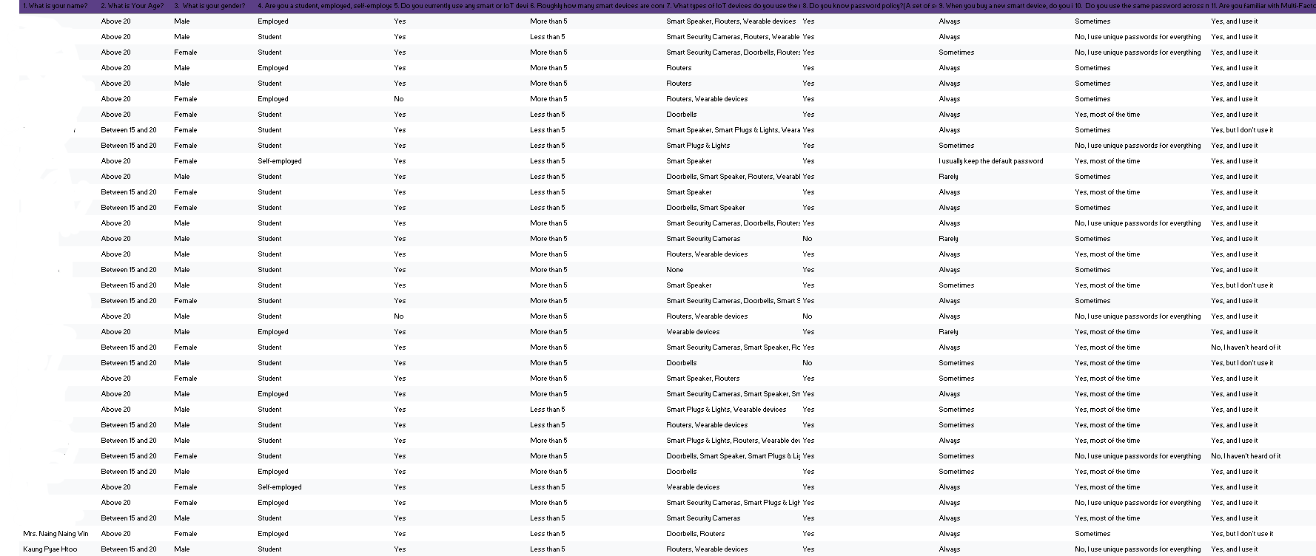
Methodology and Reliability
Mixed Methods Approach: same accuracy as the quantitative approach combined with qualitative analysis of actual device setups.
Primary Research: 46 respondents had been surveyed. Provides detailed behavioural information but has restricted inferences because of small samples of participants and a possible bias from the self-report data.
Secondary Research: 52 IoT platforms were tested using the empirical approach and analyzed after peer review is performed. Very stable reference level of technical gaps.

Slide 5
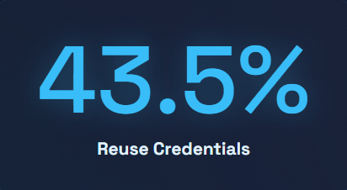
Key Findings: The Awareness Gap
High Awareness But Poor Action
While it is clear that both policy adherence to passwords (93.5%) and actively using MFA (80.4%) have improved, the spread of dangerous credentials reuse continues to be common across devices.
Users cite this friction as “cognitive fatigue” (loss of memory of setting up, making them feel like they cannot remember the unique strings), and frustrating configurations that make it too hard to make security changes.

Slide 6
Challenges In Myanmar
Infrastructure Failure: 63% of respondents consider power failures and regular drops in the internet connection to be a significant cyber security danger.
Bricked Firmware: Power is off during operation when updating/modifying devices, the systems are reset to highly insecure factory default settings.
Security Firmware Updates: Many users are deterred from downloading important large security firmware updates on the cellular device due to costs associated with data usage.

Slide 7
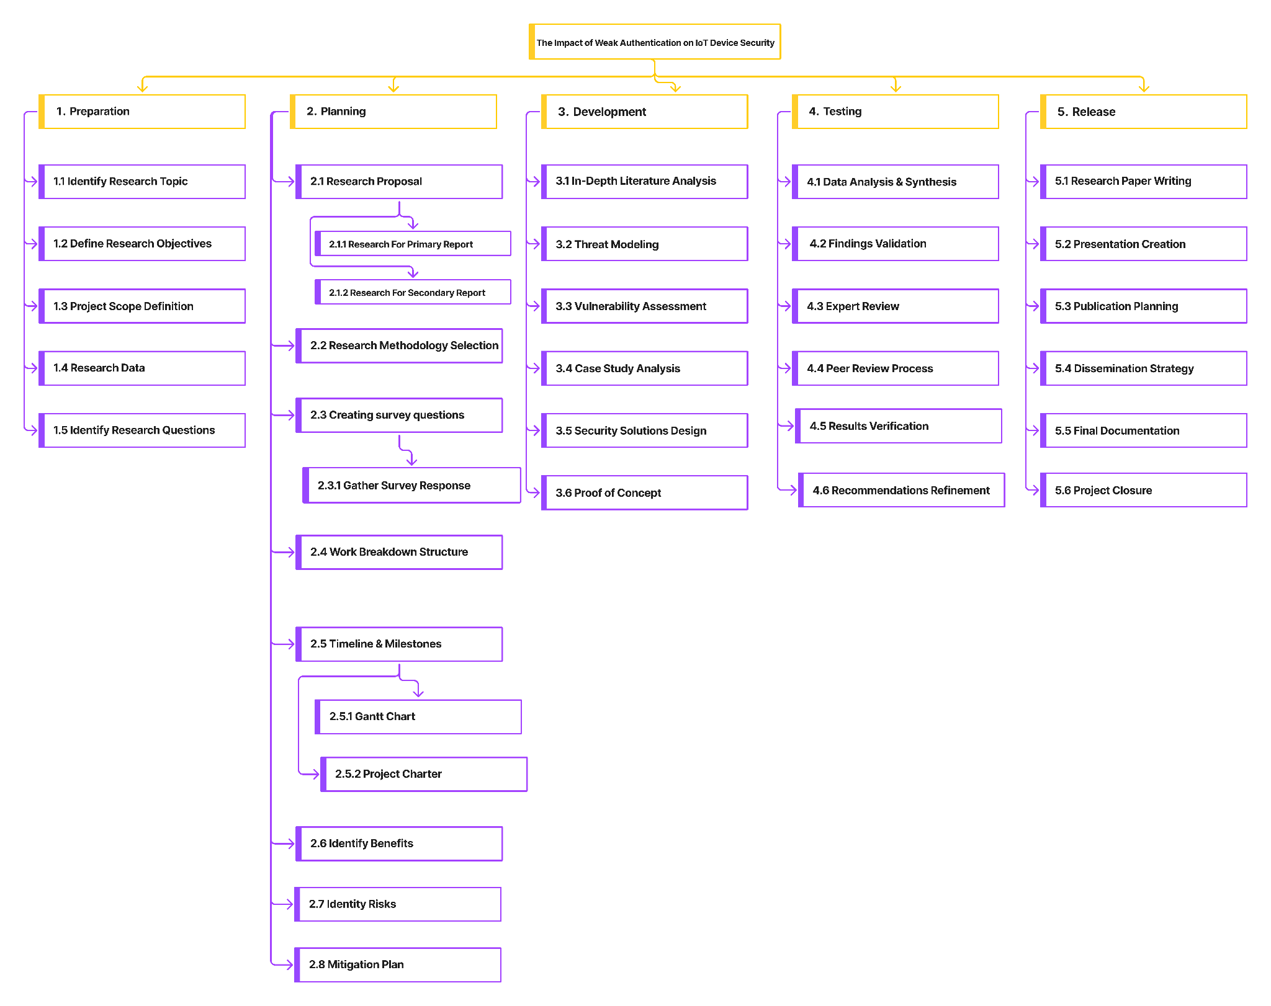
Work Breakdown Structure
The WBS breaks the project down into 5 stages:
Preparation, Planning, Development, Testing and Release. The hierarchical approach allows for a systematic flow from theoretical studies, modelling of vulnerabilities to final dissemination of tested security recommendations.

Slide 8
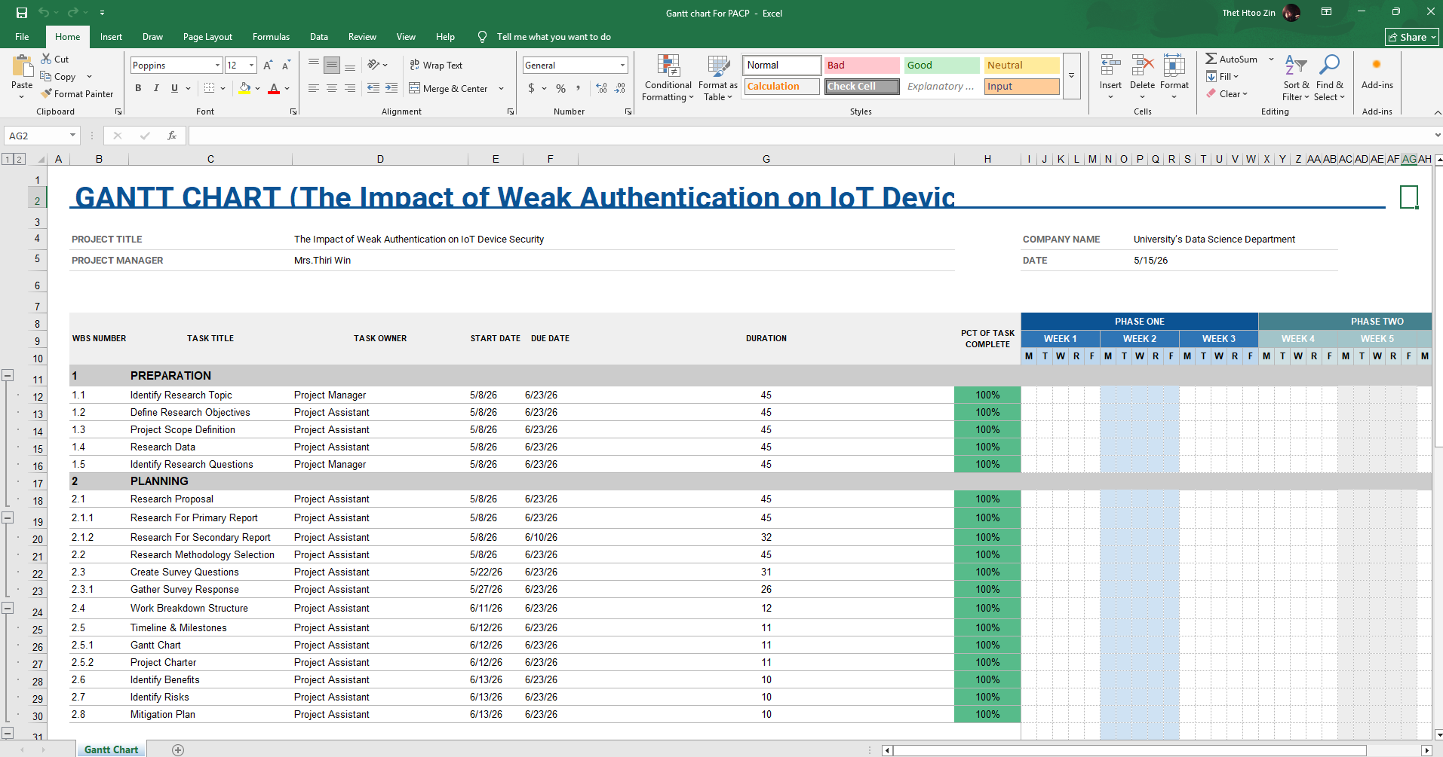
Project Plan and Timeline
Duration: 12 weeks
Milestones: Preparation, Planning will be completed in mid June. Then, The Development,Testing and Release phases.
Team Roles: Project is managed by Project Manager, assisted by Data Analysts, IoT Security Specialists, and Faculty Advisors.

Slide 9
Planning Decisions
Structural Approach
Timeline Alignment
This 5-phase hierarchical strategy allows to complete theoretical research and threat modeling before trying to create complex security solutions.
This 5-phase hierarchical strategy allows to complete theoretical research and threat modeling before trying to create complex security solutions.

Slide 10
Risks & Benefits
Project Benefits
Project Risks
Significantly improves the security posture of the University when it comes to digital security.
Makes sound suggestions to safeguard academics and monetary records.
Develops a repeatable research process for vulnerability assessment in the future.
Schedule: Reduced length of time for wide testing.
Low Survey Generalizability: Number of responses to survey is low (46 responses).
External Factors: Shifting threats in the cyber world and budget constraints.

Slide 11
Technical Recommendations
Offline-First Upgrades
Dual-Firmware Banks
Resilient Authentication
Use USB or local LAN configuration to update the firmware and fully avoid the danger of "bricking" in case of sudden power failures and other circumstances.
Focus on getting devices to backup to an OS version, so that you will be safe if an over the air update goes wrong.
Eliminate credential stuffing and credential overload by using Passkeys or smartphone-linked biometric authentication instead of traditional passwords.

Slide 12
Non-Technical Recommendations
Security Blueprints
Failure Audits
Community Support
Create playbooks to guide the setup of Wi-Fi networks, to clearly separate IoT from the outside world.
Train users to check for settings after a power failure to avoid restorations to insecure factory defaults.
Fill skill gaps in the region actively, address it in local tech community trainings and document particularly easily.

Slide 13
Conclusion
“The key to securing a network against a grid failure is to make it resilient to that failure and to keep the user in mind with passkeys”
Summary
The overall level of awareness of security is fairly good, but there are vulnerabilities in the infrastructure of Myanmar that can be exploited and result from various circumstances, and are not susceptible to a software patch.

