Slide 1
P54
Multimodal LLM for
Industrial Task Planning
Overall Project Progress — Sprint 1 to Sprint 5
Computing Technology Project B
Minh · Lakshit · Ved · Dinith · Kaveesha

Slide 2
Project Overview
2
OUR GOAL
LLM converts user instructions into structured commands.
1
Build a system that can understand a natural-language robot task, observe the workspace, create an action plan and execute it.
2
Computer vision identifies objects in the workspace.
3
The task planner converts the instruction into robot actions.
4
The executor sends those actions to the simulation robot.
Instruction
→
Vision
→
Planning
→
Robot Execution

Slide 3
The Team
3
Five members, each owning part of the pipeline
MD
LB
VM
DT
KD
Minh Hoang Duong
Lakshit Bansal
Ved Jay Makhijani
Dinith Thejana
Kaveesha Dulanjana
Simulation backend architecture, integration and visualisation
Execution layer, robot integration and simulation design
LLM parser, task planning and evaluation lead
Vision pipeline, YOLO fine-tuning and scene integration
QA, regression testing, planner safety and documentation

Slide 4
Current System
11
User
Instruction
→
LLM
Parser
→
YOLO
Vision
→
Task
Planner
→
Executor
→
KUKA /
PyBullet
What it can currently do
Parse structured pick/place/move instructions
LLM in, rules out
The LLM only handles language. It turns a free-form instruction into a validated command — action, object, destination, confidence.
Everything after that is deterministic: a rule-based planner expands the command into a fixed LOCATE → MOVE → PICK → MOVE → PLACE sequence. The same instruction always produces the same plan, and low-confidence instructions are rejected before the robot moves.
Detect and represent workspace objects in simulation
Generate basic action plans such as LOCATE → MOVE → PICK → MOVE → PLACE
Execute pick-and-place tasks using MockRobot or the KUKA simulation controller
Reject some invalid instructions and stop when execution reports a failure

Slide 5
How Far We Have Come
5
Sprint 1
LLM parser, structured instructions and early PyBullet/vision prototype
1
Sprint 2
Task planner, MockRobot, executor and connected pipeline
2
Sprint 3
Spatial planning, multi-step planning API and broader testing
3
Sprint 4
KUKA simulation, configurable workspace and fine-tuned YOLOv8
4
Sprint 5
Qwen/Ollama, response cache, Docker work and ROS2 preparation
5

Slide 6
Sprint 1
6
Foundations — instruction parser and simulation prototype
LLM parser built
Model selected
Structured instruction schema, prompt design and edge-case handling, tested without API calls.
GPT-4o, Gemini and DeepSeek compared over 25 instructions; GPT-4o chosen on accuracy and latency.
Vision approach chosen
Simulation prototype
YOLOv8 with OpenCV selected as the hybrid detector, plus a scene format for the planner.
PyBullet workspace built from scratch: KUKA arm, coloured blocks, camera and colour detection.

Slide 7
Sprint 2
7
Task planning, execution and the connected pipeline
Rule-based task planner
Robot command schema
Four action types, each decomposed into a fixed, deterministic sequence of robot primitives.
A shared command contract between planner and executor, validated at the boundary.
MockRobot and executor
Pipeline connected
A stateful stand-in robot with per-command timeouts and graceful failure handling.
All five stages wired together end to end, with vision stubbed until Sprint 3.

Slide 8
Sprint 3
8
Spatial reasoning, evaluation baseline and real execution
Spatial language handled
Multi-step planning
Eight relations such as left of, near and on top of resolved into workspace offsets.
Several parsed instructions combined into a single renumbered action plan.
Baseline parser
Real robot execution
A zero-LLM keyword matcher built as the control group for measuring what the LLM adds.
PyBullet inverse kinematics and grasping: the first full pick-and-place end to end.

Slide 9
Sprint 4
9
Beta stabilisation, fine-tuned vision and report integrity
Fine-tuned YOLOv8n
KUKA execution path
Trained on a synthetic PyBullet dataset covering seven workspace classes.
Full LOCATE → MOVE → PICK → MOVE → PLACE runs completed on the KUKA IIWA in simulation.
Evaluation expanded
Consistency audit
Test set grown from 25 to 35 instructions, with end-to-end parse latency benchmarked.
Reported figures re-derived from committed code and data; the known safety gap logged openly.

Slide 10
Sprint 5
10
Local LLM, packaging and multi-action instructions
Local LLM backend
Response cache
Qwen 2.5 through Ollama, giving an offline option for privacy-sensitive deployment.
Repeated instructions served from disk instead of the API — 107 s down to 4 ms.
Docker packaging
Multi-action commands
Ollama and the pipeline run as containers, with a ROS2/MoveIt image prepared.
One instruction can now carry several actions, planned and executed in order.

Slide 11
Key Progress So Far
12
Fine-tuned YOLOv8n for 7 workspace classes.
KUKA/PyBullet pick-and-place implementation and recorded successful simulation execution.
Qwen 2.5 integrated through Ollama for local LLM processing.
Persistent response cache added to speed up repeated instructions.
Docker configurations and ROS2/UR5 integration scaffold prepared.
General multi-action command integration.

Slide 12
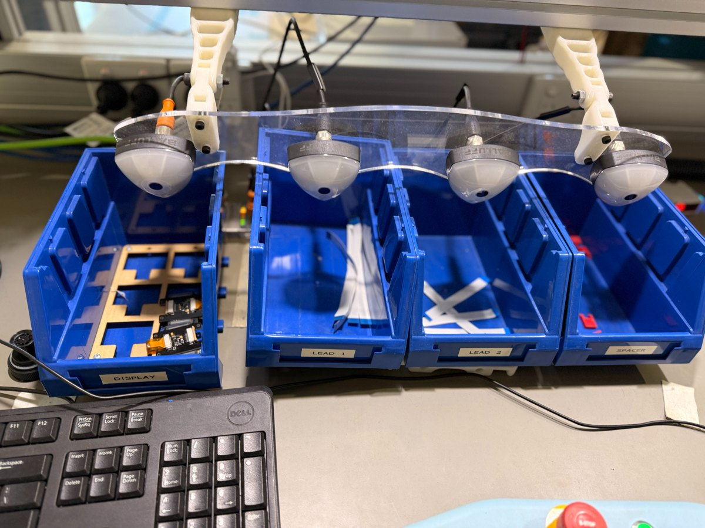
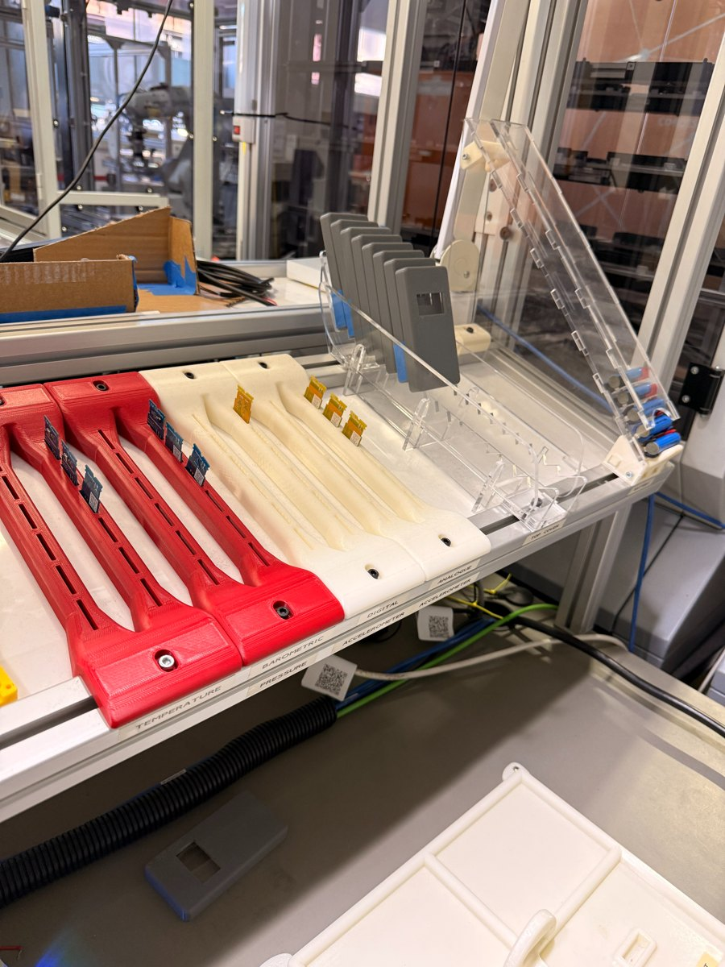
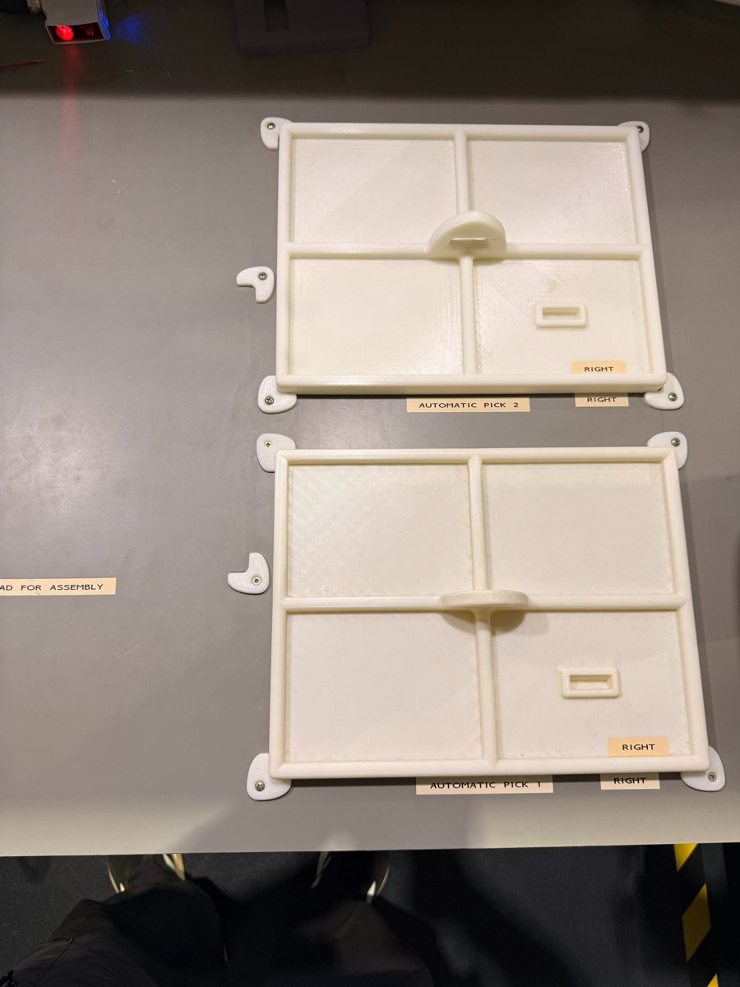
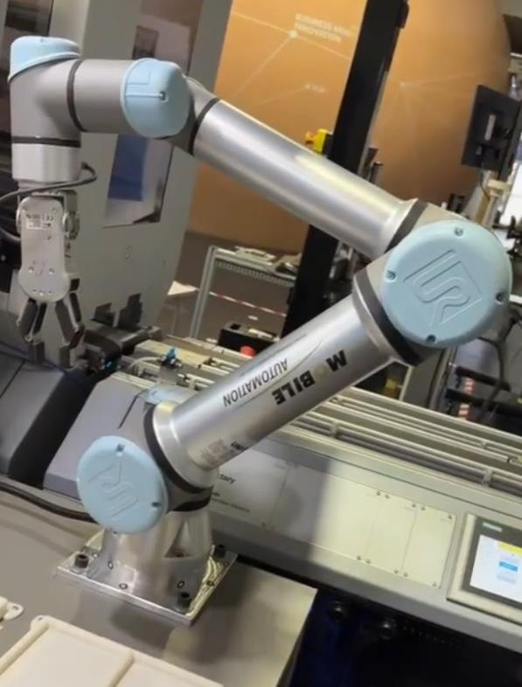
Into the Physical World
13
Induction completed at the Factory of the Future (FOF) lab
Workspace bins and overhead sensors
Component trays and part fixtures
Assembly pick fixtures
The physical UR robot arm
Robot, controller and workspace
A real workspace, not a simulated one
Introduced to the physical arm, its controller and the assembly cell we will deploy into.
Labelled bins, component trays and printed fixtures replace the simulated blocks and trays.

Slide 13
Next Steps
1
2
3
Physical cameras
Re-finetune YOLOv8
Rewrite detection maths
Mount and calibrate real cameras over the FOF workspace.
Retrain on the physical parts, bins and lighting of the real cell.
Inverse kinematics and camera-to-robot coordinates currently assume PyBullet.
4
5
6
Rewrite robot controller
Spatial command execution
Final integration and testing
Drive the real arm through the robot controller, reached over TCP via the PLC.
Improve spatial handling against the real workspace geometry.
Complete end-to-end testing on the physical system.
Thank You!!!

