Slide 1
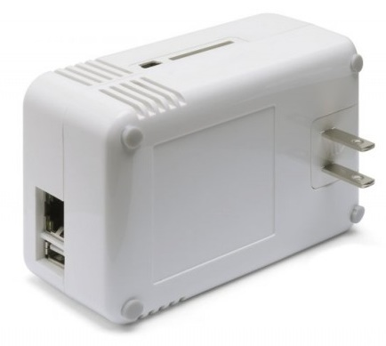

Plug Computers
What they are, and what they can do!

Slide 2
Plug Computing
A relatively new form factor, in general the size of a wall wart
Almost all use the same SOC (system on a chip) made by Marvell. (Krikwood architecture)
They use around 2-5 watts!
Usually use the ARM cpu.

Slide 3
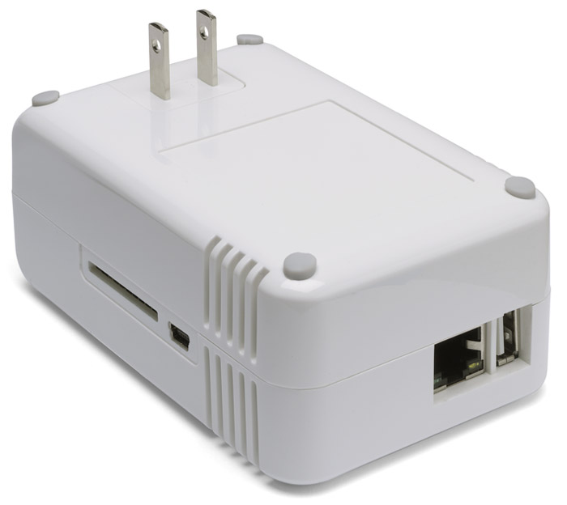
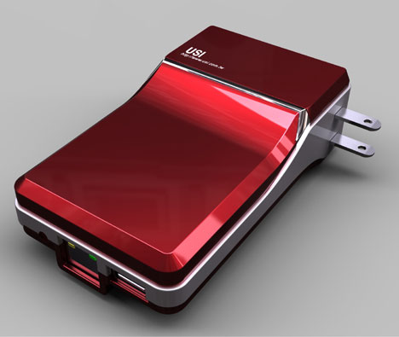
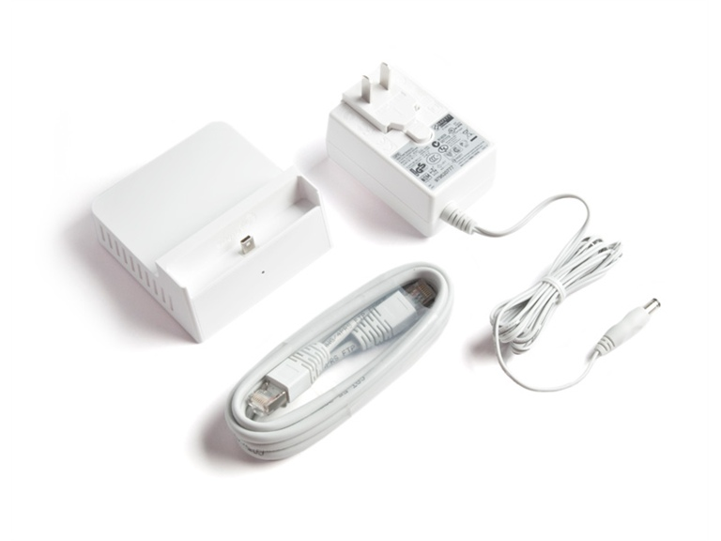
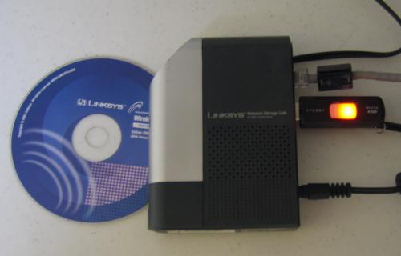
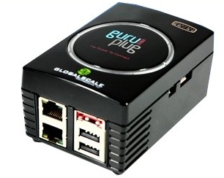
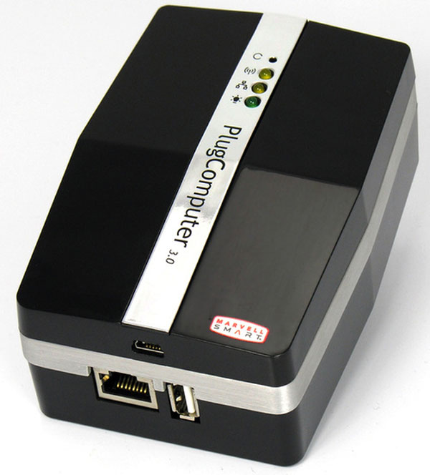
A Quick Survey of Some Computers

Slide 4
Marvell Sheevaplug
About $100 New – The first “plug” computer
1 Usb Ports
1.2Ghz Arm
512MB Flash
512MB Ram
Gigabit Ethernet
SD Card Port
This is a development Platform, designed for manufactures to customize into their own devices
Other Names: Pogoplug V1, TonidoPlug, etc

Slide 5
The Seagate Dockstar
About $35 New!
4 Usb Ports
1Ghz Arm
256MB Flash
128MB Ram
Gigabit Ethernet
Convenient dock for Seagate Go Drives

Slide 6
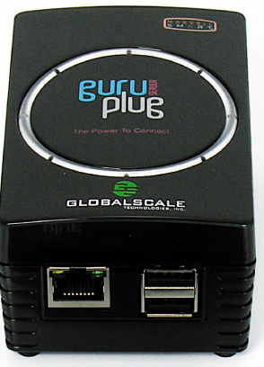
GlobalScale GuruPlug
About $125 New
1.2Ghz Arm
512MB Flash
512MB Ram
2 USB Ports
Gigabit Ethernet
802.11G + Bluetooth
Heating Problems

Slide 7
GlobalScale GuruPlug PLUS
About $160 New
1.2Ghz Arm
512MB Flash
512MB Ram
2 USB Ports
2 Gigabit Ethernet Ports
802.11G + Bluetooth
MicroSD slot
3Gb/s eSata

Slide 8
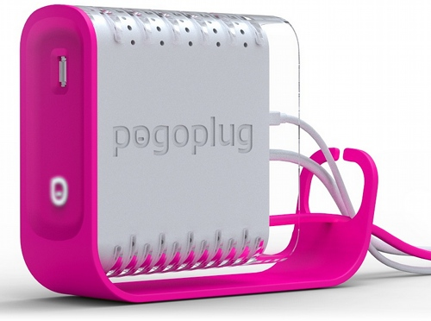
Cloud Engines Pogoplug V2
Pink!
About $80 New
4 Usb Ports
Gigabit Ethernet
128MB Ram
256MB Flash
Comes with a really good stock OS

Slide 9
Marvell Future Plug 3.0
Winter of 2010
Built in Drive
Probably Expensive

Slide 10
Possible Operating Systems
Ubuntu 9.04 Arm port
(Most come with this, last supported version for this architecture)
Openwrt
(Embedded linux OS, mostly used for routers)
PlugOS/OpenPogo
(Comes with Pogoplugs/Dockstars, great NAS os with cloud capabilities, sharing etc)
Debian Arm Port (Big Standard Repo)
Fedora Arm Port
Freebsd (For Chad Only :)

Slide 11
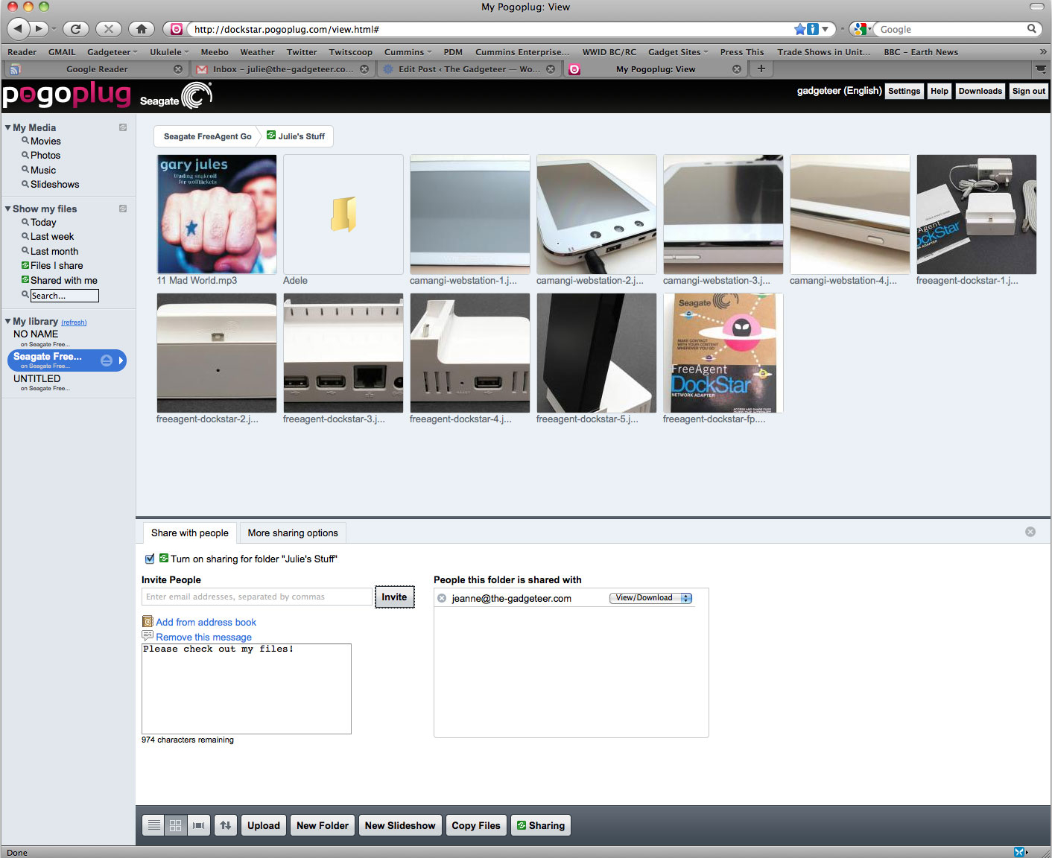

Slide 12
Possible Applications
“Cloud” File Server (Pogoplug OS / Openplug)
Basic Firewall
NAS Storage / File Sharing
Security Camera / Home Automation
Media Server (DNLA, iTunes, Daapd, Squeezebox, etc)
Backups (Backuppc)
Standard LAMP server

Slide 13
Do A Demo Already!
How do we install Linux on something with no monitor, keyboard, or cdrom drive?
How do we use a serial port?
What pieces do we need to make it happen?

Slide 14
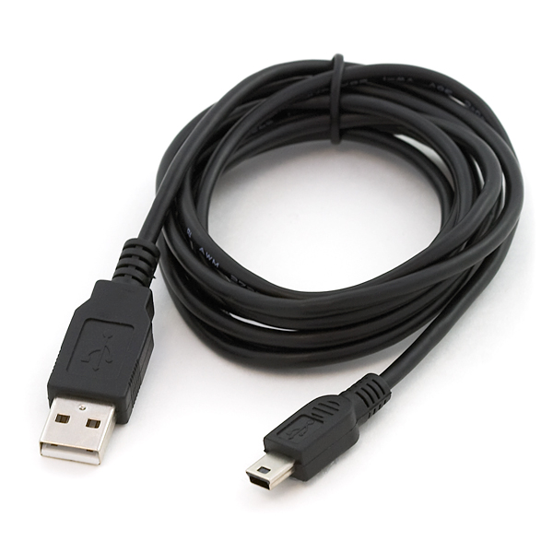
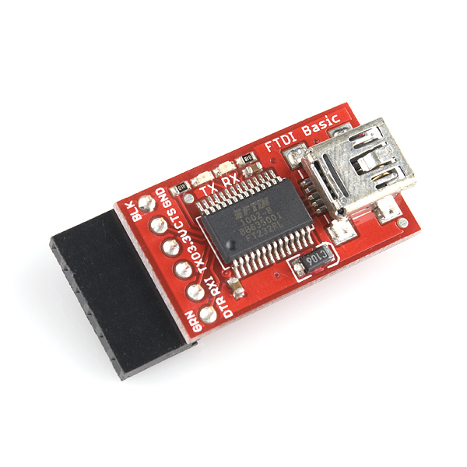
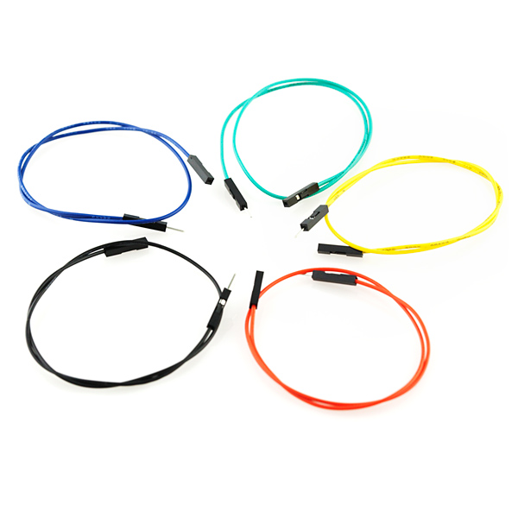
What I Recommend for Working With Plug Computers
The Plug Computer
Some sort of serial cable
A Knife (see next slide)

Slide 15
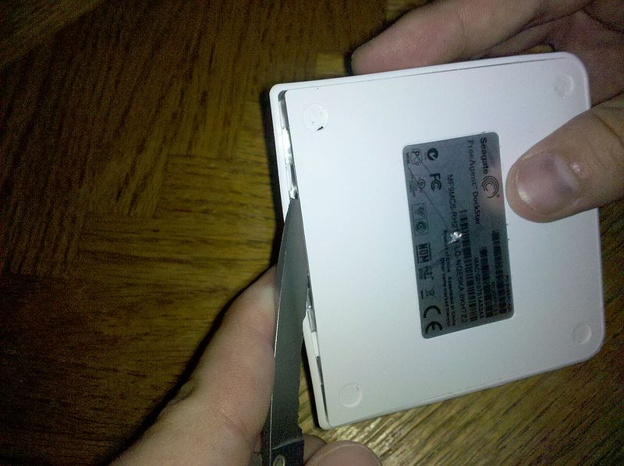

Slide 16
Openwrt Install Demo Procedure
Boot up the device
Tftp over a “Live” environment to get going
Mkfs and untar our stuff
Reboot and install the kernel
Boot Fully

Slide 17
This slide intentionally left blank

Slide 18
A Quick Word About Filesystems
Nothing special if you are planning to use usb harddrives. Ext3/4 would be fine.
Installing onto the NAND is different, and is not like installing to a USB thumbdrive
  Bad blocks are exposed
  It doesn't do wear leveling, it leaves that up to the filesystem
  JFFS2 and UBIFS are good choices
  Be aware, put logs and stuff on tmpfs
  Try not to kill your flash
  OS installers are not usually NAND enabled or aware

Slide 19
A Quick Word about Bootloaders
You basically only get the one, Uboot to work with.
Very low level, kinda hard to get used to.
Has the potential to overwrite itself, for upgrade purposes, but also means you can brick yourself
  It can never be bricked if you have a JTAG cable
May or may not be able to boot from SD or USB, but Linux can.

Slide 20
A Quick Word About Compilers
These are of the ARM architecture, if you have never worked with anything outside of x86, you are in for and adventure.
Most distros come with their own compiler and dev packages, so they can build software right on the thing. (Debian, Fedora, Freebsd)
Other embedded distros do not have native compilers, but are designed to be cross-compiled and then copied over. (Openwrt)

Slide 21
Audience Requests, Discuss Applications
Install Apps on Request
  Use the Power of Apt-get on the Debian dockstar
Talk about Power consumption / Cost
  My celeron “server” costs $9/mnt ($109/yr) to run
    Using 1 dockstar in place of this will pay for itself 2 times over.
  A plug computer costs $2/year to run

Slide 22
Going Further
Decide about your financial and time commitment
  Money is $35-$125, time is a few good weekends
Decide on an Application
  Filesharing, media storage, backups...
Pick your desired hardware
  Dockstar, guruplug, sheevaplug...
Pick and OS / Stick with the stock
  Stock Plug OS w/cloud capabilities, Debian...

Slide 23
Take Notes and Share them with the World
Blog about your experience
Take Notes and share them
  I keep my notes in wiki form:
  http://wiki.xkyle.com/plugcomputers

