Slide 1

May 1, 2009
Analyzing CAPTCHAs
Kyle Anderson
Michelle Krause
Matthew Turner

Slide 2
Objective
In the March 2005 College Mathematics Journal (Volume 36, Number 2), Dr. Edward Aboufadel along with students Julia Olsen and Jesse Windle published an article entitled “Breaking the Holiday Inn Priority Club CAPTCHA.”
Our objective was to report on their method and reproduce their results.

Slide 3
Overview
CAPTCHA stands for Completely Automated Public Turing tests to tell Computers and Humans Apart.
What is the purpose of a CAPTCHA?
A CAPTCHA is considered broken if a computer algorithm can quickly solve the puzzle at least four out of five times on average.

Slide 4
Motivation
The general motivation for decoding CAPTCHAs is financial gain e.g. through spamming, spreading viruses.
However, another motivation for decoding CAPTCHAs is improvement of Object Character Recognition.

Slide 5

Variety of CAPTCHAs
First CAPTCHA broken:
EZ-Gimpy
EZ-Gimpy CAPTCHA broken by Mori and Malik using object recognition techniques and dictionary crosschecking. Their program correctly interprets this CAPTCHA 93% of the time.

Slide 6
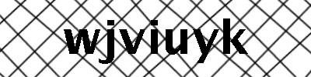

Variety of CAPTCHAs
CAPTCHA used by General Electric
CAPTCHA used by Chicago Cubs

Slide 7
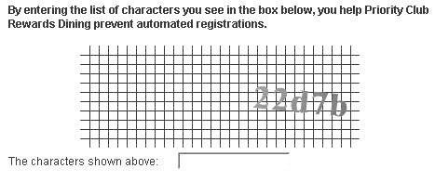
Holiday Inn Priority Club CAPTCHA
Used by Holiday Inn when members of the Priority Club sign up for Rewards Dining Program.

Slide 8
The Process
Generate CAPTCHA
Align CAPTCHA
Cut CAPTCHA
Transform CAPTCHA
Decode CAPTCHA

Slide 9
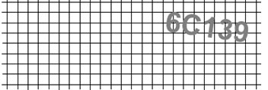
Generate CAPTCHA
CAPTCHA generated with our Mathematica code.

Slide 10


Align CAPTCHA
Remove gridlines.
Undo angle of rotation.

Slide 11

Align CAPTCHA
Crop CAPTCHA.

Slide 12

Cut CAPTCHA
Cut CAPTCHA cut into 5 pieces.

Slide 13
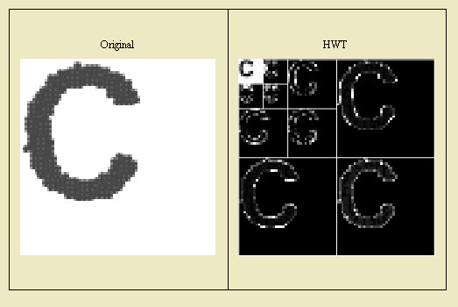
Transform CAPTCHA
Perform the HWT on each of the 5 pieces.

Slide 14
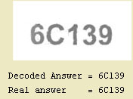
Decode CAPTCHA

Slide 21
Mathematics involved
Perform linear regression on the CAPTCHA to find the line of best fit for the data points that make up the CAPTCHA.
Matrix multiplication using the rotation matrix to undo the angle of rotation.
Three iterations of the Haar Wavelet Transform on each of the cut pieces.
Each cut letter is compared to the canonical letters by comparing the Norms.

Slide 22
Generalizations of Method
Dr. Aboufadel’s Maple code was successful nearly 100% of the time.
Our Mathematica algorithm was about 75% successful at decoding the generated CAPTCHAs.
This type of algorithm could be generalized to any CAPTCHA that uses a standardized font and removable background.

Slide 23
Limitations of procedure
Line of regression not symmetric about x-axis.

Slide 24
Limitations of procedure
Code is built to handle situations where letters are a different color from background.
Code can only deal with distortion related to rotation.

Slide 25

Future of CAPTCHA decoding
Gimpy-r CAPTCHA used by Yahoo! mail

Slide 26
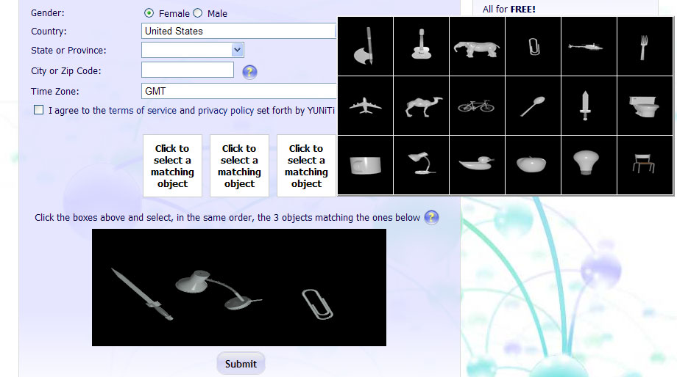
Future of CAPTCHA decoding
New “unbreakable CAPTCHA.”
CAPTCHA used at http://www.yuniti.com/register.php

Slide 27
Future of CAPTCHA decoding
On Thursday, April 23, 2009, USA TODAY ran a cover story, entitled “Cracking the Code,” about CAPTCHA decoding methods currently being used.
As “Captcha designers have made their work increasingly distorted and camouflaged,” captcha-breaking groups have turned to “human captcha-solvers ,” employing humans and paying them ½ cent per decoded captcha.

Slide 28
Future of CAPTCHA decoding
ReCAPTCHA
“Digitizing Books One Word at a Time”
Goal of ReCAPTCHA project is “to archive human knowledge and to make information more accessible to the world.”
Uses Object Character Recognition to transform the photographically scanned books into text.
Users are given two words to decipher – one to which the answer is known and another that cannot be read correctly by OCR.

Slide 29
Questions?
Can we answer your questions about CAPTCHA?
YOU BETCHA!!!!

