Slide 1
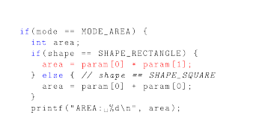
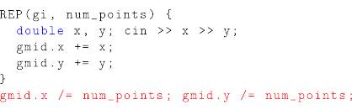
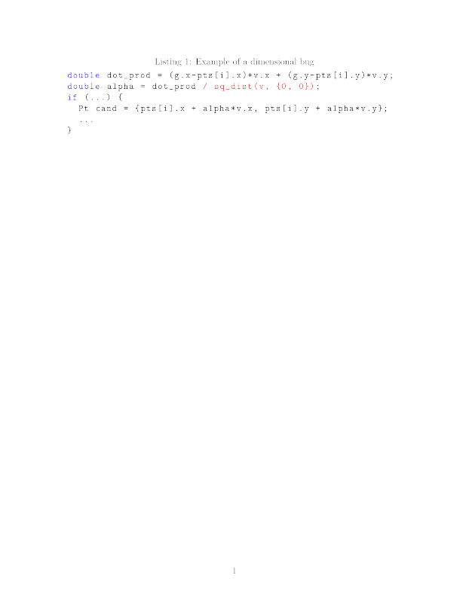
Bug Detection using Dimensional Analysis
15-745 Optimizing Compilers Final Project
Goran Zuzic and Sol Boucher
Introduction
Mathematical Model
Case Study
Logical bugs are notoriously hard to find
Try to find probable bugs by semantic mismatches
Associate each variable with a one-dimensional degree
Relations between variables impose restrictions on their degrees:
Variables that can't be assigned non-zero degrees are dimensionless and probable bugs
Instructions generate equations between degrees
Leading to a linear system , where is degree vector
If the i'th component in all nullspace vectors is 0, then the variable i'th is dimensionless
The nullspace can be efficiently obtained by a full SVD
Problem: how to find offending source lines?
  Idea: if removing an equation e makes a variable non-dimensionless, then the source line corresponding to e is suspicious
  Inefficient to find
Case 1:
Line in red found as the potential bug (correct)
The other line (with the addition, real culprit) was not found because we generate 2 identical equations which mask each other
Case 2:
Line in red implies that num_points is a dimensionless variable
  Correct, but useless
Worked Example
Implementation
Implemented as a in LLVM 3.7 analysis pass
Heavy usage of LLVM source level debugging
  Linking IR registers and stack locations to source variables
Sol................................ …........... !!!!!!!!!!!!!!!!!! ????????
Without “sq_dist(v, {0, 0})” the code has a dimensional bug
Variables g, pts[], v contains 2D points with deg E
We can infer the deg of dot_prod and alpha to be E²
Then the expression “pts[i].x + alpha*v.x” is of degree E + E³, which is clearly a bug
This bug appeared on a Codeforces contest, problem 394E
Problem: the example requires annotations of variables, temporaries, structs and arrays
Problem: C++ code with multiple templated objects
Conclusion
Prototype successfully and autonomously finds dimensional bugs in nontrivial contest C++ programs
Can be simply extended for other types of semantic analysis, e.g. modulus consistency checks
Future work: empower with user-annotated dimensions to help the analysis

