Slide 1
Chapter01
What’s reinforcement learning

Slide 2
List
Reinforcement Learning(RL)이 다른 머신러닝과 다른 점
RL공식(마르코브 의사결정 과정)
simple input-output Machine Learning(supervised learning)
-> add time dimension -> RL

Slide 3
Supervised Learning
input - automatically generated function - output
labeled training set

Slide 4
Unsupervised learning
No labeled training set
→ clustering
→ generative adversarial network
: two neural networks, generate fake data vs discriminate btw fake data & dataset
→ Reinforcement Learning
: use methods from supervised learning in different ways
: between supervised & unsupervised learning

Slide 5
Why is Reinforcement Learning special?
Goal = try to maximize "rewards" .
Rewards
→ can be positive or negative
→ how well did the agent do
Ex. Robot Mouse finding cheese in maze
- no hard-coding maze or best actions
- relate rewords to actions

Slide 6
어려운점
1. Depends on result of action
→ if do many mistake? false impression
= non-iid data(independent and identically distributed data)
2. Exploit, “and Explore” : needs balance
In supervised learning, we only exploit
3. Reward delayed from actions
(어느 정도 행동해야 한번에 큰 보상을 받을 수도 있다.->체스)

Slide 7
Formalisms
Entities: agent, environment
Communication Channels: actions, reward, observations
Agent
Actions
Environment
Reward
Observations

Slide 8
Formalisms
Reward:
try to maximize accumulated rewards. can be given periodically(for convenience), once at a lifetime, or else.
Agent:
one that interacts with environment by taking actions, observe, receive rewards.
= our program(SW)
Environment: rest of universe
→ communication is limited by rewards, actions, and observations

Slide 9
Formalisms
Actions:
something agent can do in the environment
→ discrete vs continuous
Observations:
what we can "see" from environment
→ separate dataset for convenience
→ can effect next reward(or not!)

Slide 10
Related Domain
Machine Learning
Engineering
Neuroscience
Psychology
Economics
Mathematics

Slide 11
Markov Decision Process(MDP)
Theoretical foundation of Reinforcement Learning
Markov Process
Markov Reward Process
Markov Decision Process
Add layer
Add layer

Slide 12
Markov Process
= Markov Chain
What I can do?
→ watch states changing in finite state space
sequence of states = chain
ex. chain over time = history

Slide 13
Markov Property
Future system dynamics from any state have to depend on this state only.
States are stationary(not change over time)
n x n transition matrix of probability
→ (i, j) = prob of state i causing state j
Episode
→ a traverse according to transition matrix(stationary)

Slide 14
Markov Reward Process
From Markov Process,
(add) n x n transition matrix of weight(reward)
(add) gamma value (0 < g < 1)

Slide 15
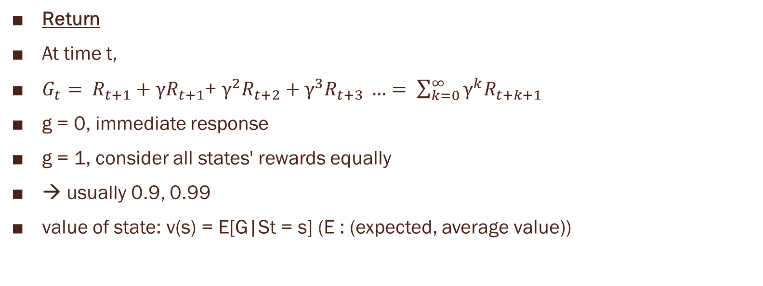
Markov Reward Process
Return
At time t,
$G_{t}= R_{t+1}+γR_{t+1}$+ $γ^{2}R_{t+2}+γ^{3}R_{t+3} …= \sum_{k=0}^{∞}{γ^{k}R_{t+k+1}}$
g = 0, immediate response
g = 1, consider all states' rewards equally
→ usually 0.9, 0.99
value of state: v(s) = E[G|St = s] (E : (expected, average value))

Slide 16
Markov Decision Process
From Markov Reward Process,
(add) actions matrix
Three dimension cube: (i, j, k)
→ probability for i -> j give action k
→ agent can affect the probabilities of target states
Policy
= some set of rules that control agent's behavior
→ if policy is fixed, MDP = MRP

