Slide 1
Chapter05
Tabular Learning and the Bellman Equation

Slide 2

Value, State, Optimality
Value
Total reward at the state
V(s) = E[$\sum_{t=0}^{∞}{r_{t}γ^{t}}$] (r: local reward obtained at step t of the episode)
Total reward
Effected by our agent’s policy

Slide 3
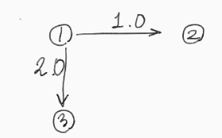
Value, State, Optimality
3 state environment
Deterministic environment
항상 1에서 시작해서 모든 action이 성공한다
Value of state 1?
어떤 policy의 agent인지에 따라 다르다.
→ Total reward와 같다.(One-step environment)
Policy
항상 오른쪽으로 갈 경우 : 언제나 1을 얻고 종료
항상 밑으로 갈 경우 : 언제나 2를 얻고 종료 ➔ 최대, optimal policy
왼쪽 50% 밑으로 50% : 1.0 * 0.5 + 2.0 * 0.5 = 1.5
왼쪽 10% 밑으로 90% : 1.0 * 0.1 + 2.0 * 0.9 = 1.9
항상 최댓값이 optimal policy인 건 아니다.

Slide 4
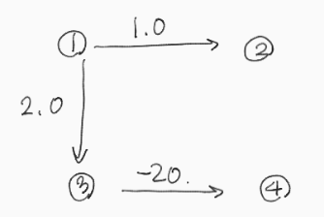
Value, State, Optimality
4 state environment
Policy
항상 오른쪽으로 갈 경우 : 언제나 1을 얻고 종료 ➔ 최대, optimal policy
항상 밑으로 갈 경우 : 2 + (-20) = -18
왼쪽 50% 밑으로 50% : 1.0 * 0.5 + (2.0 + (-20)) * 0.5 = -8.5
왼쪽 10% 밑으로 90% : 1.0 * 0.1 + (2.0 + (-20)) * 0.9 = -16.1

Slide 5
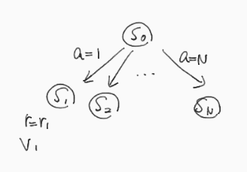

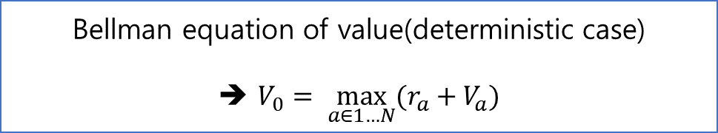
The Bellman equation of optimality
$r_{i} :respective reward$
$V_{i} :value at state i$
Best course action at $s_{0}?$
At action $a_{i}$ → $V_{0}\left(a=a_{i}\right)=r_{i}$ + $V_{i}$
Bellman equation of value(deterministic case)
➔ $V_{0}= \max_{a∈1…N}{(r_{a}+V_{a})}$

Slide 6
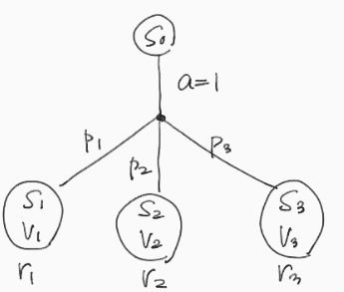
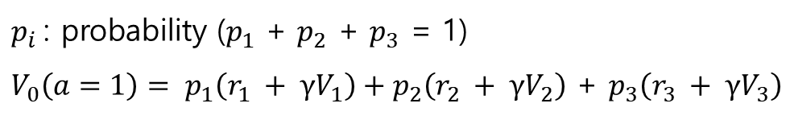
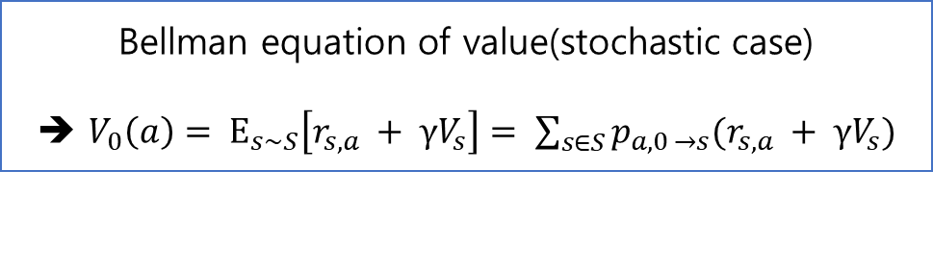
The Bellman equation of optimality
Stochastic case
Actions have the chance to end up in different states
→ calculate the expected value of every action
$p_{i}$: probability ($p_{1}$ + $p_{2}$ + $p_{3}$ = 1)
$V_{0}\left(a=1\right)= p_{1}\left(r_{1} + γV_{1}\right)+p_{2}\left(r_{2} + γV_{2}\right)$ + $p_{3}\left(r_{3} + γV_{3}\right)$
Bellman equation of value(stochastic case)
➔ $V_{0}\left(a\right)= Ε_{s\sim S}\left[r_{s,a} + γV_{s}\right]= \sum_{s∈S}{p_{a,0 →s}(r_{s,a} + γV_{s})}$

Slide 7
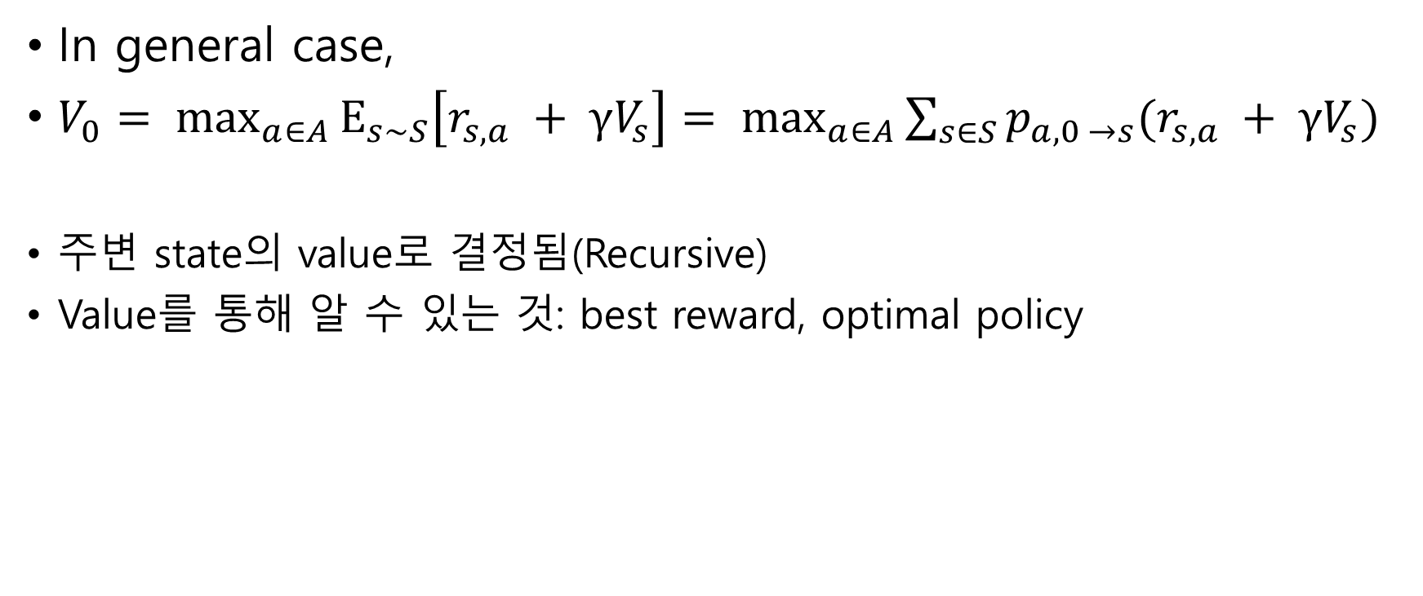
The Bellman equation of optimality
In general case,
$V_{0}= \max_{a∈A}{Ε_{s\sim S}\left[r_{s,a} + γV_{s}\right]}= \max_{a∈A}{\sum_{s∈S}{p_{a,0 →s}(r_{s,a} + γV_{s})}}$
주변 state의 value로 결정됨(Recursive)
Value를 통해 알 수 있는 것: best reward, optimal policy

Slide 8
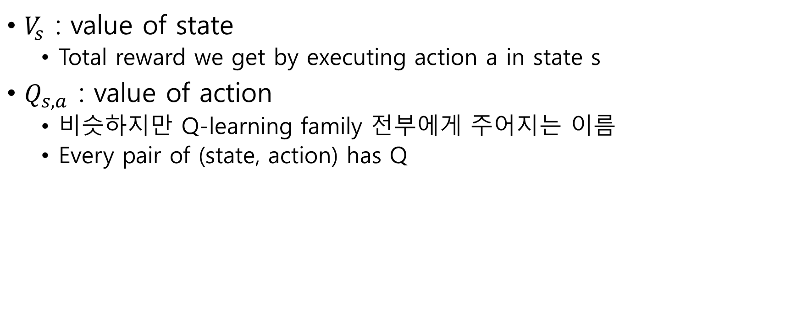
Value of action
$V_{s}$ : value of state
Total reward we get by executing action a in state s
$Q_{s,a}$ : value of action
비슷하지만 Q-learning family 전부에게 주어지는 이름
Every pair of (state, action) has Q

Slide 9

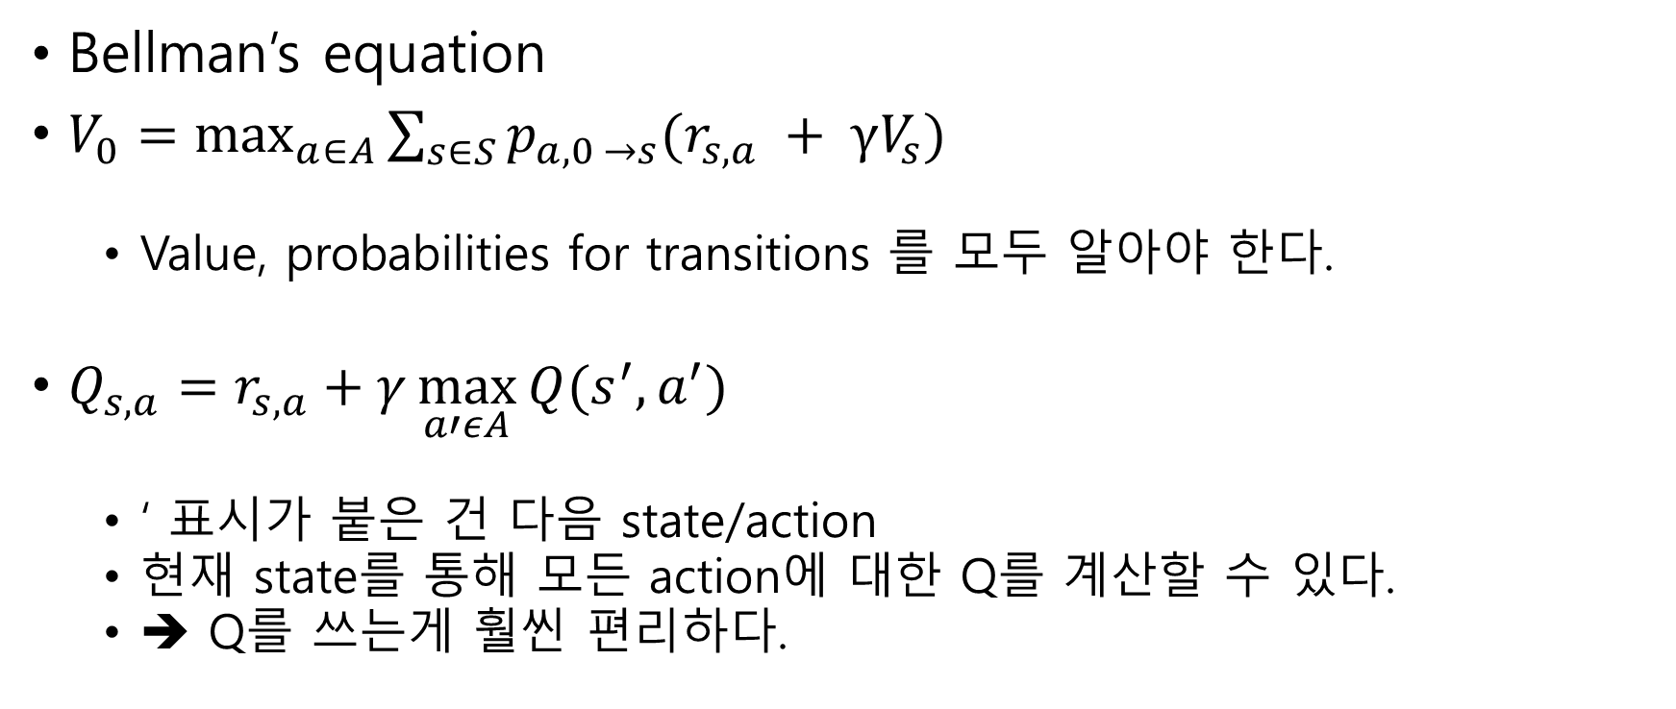
Value of action
$$Q_{s,a}$$
Bellman’s equation
$V_{0}=\max_{a∈A}{\sum_{s∈S}{p_{a,0 →s}(r_{s,a} + γV_{s})}}$
Value, probabilities for transitions 를 모두 알아야 한다.
$Q_{s,a}=r_{s,a}+γ\max_{a′εA}{Q(s^{′}, a^{′})}$
‘ 표시가 붙은 건 다음 state/action
현재 state를 통해 모든 action에 대한 Q를 계산할 수 있다.
➔ Q를 쓰는게 훨씬 편리하다.

Slide 10
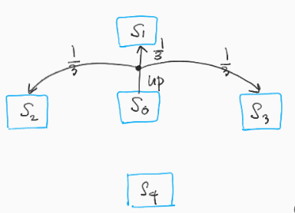

Value of action
$γ=1 ,$Final state $s_{1}$… $s_{4}$ → Q = 0
Terminal state’s value = immediate reward
Let $V_{1}=1, V_{2}=2, V_{3}=3,{ V}_{4}=4$
이 때 $V_{0}는$?
Q($s_{0}, up)= \frac{1}{3}$ $V_{1}+ \frac{1}{3}$ $V_{2}+ \frac{1}{3}$ $V_{3}$ = 2.31
같은 방식으로 4방향을 모두 구해보면 down일 때 최대(2.97)
해당 화살표가 동서남북으로 있다.
(up인 경우만 표시한 그림)

Slide 11
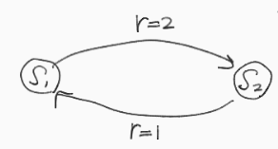
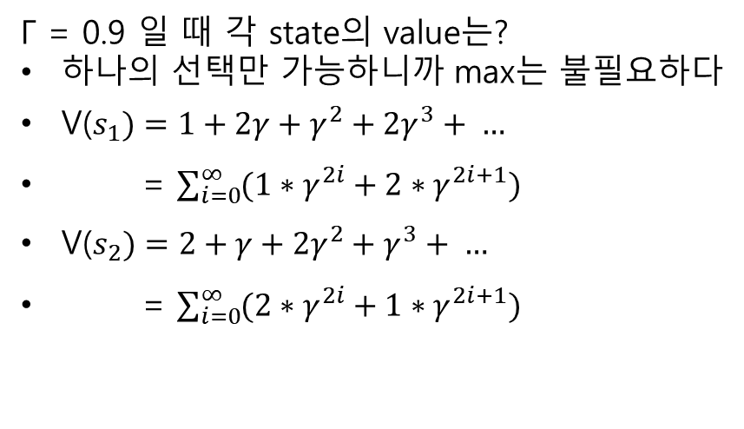
The value iteration method
A diagram with loops
Γ = 0.9 일 때 각 state의 value는?
하나의 선택만 가능하니까 max는 불필요하다
V($s_{1})=1+2γ+γ^{2}+2γ^{3}+ …$
= $\sum_{i=0}^{∞}{(1∗γ^{2i}+2∗γ^{2i+1})}$
V($s_{2})=2+γ+{2γ}^{2}+γ^{3}+ …$
= $\sum_{i=0}^{∞}{(2∗γ^{2i}+1∗γ^{2i+1})}$

Slide 12
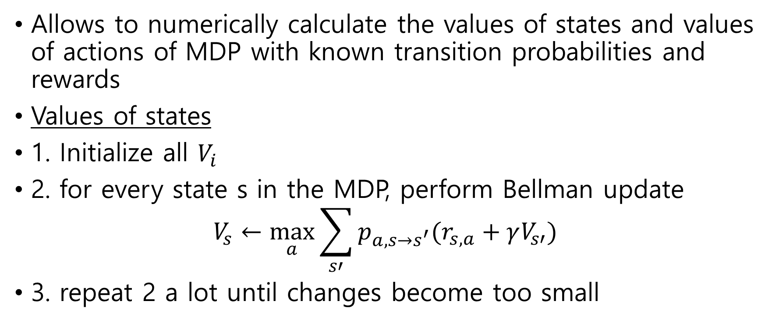
Value iteration algorithm
Allows to numerically calculate the values of states and values of actions of MDP with known transition probabilities and rewards
Values of states
1. Initialize all $V_{i}$
2. for every state s in the MDP, perform Bellman update
$$V_{s}←\max_{a}{\sum_{s′}{p_{a,s→s^{′}}(r_{s,a}+γV_{s′})}}$$
3. repeat 2 a lot until changes become too small

Slide 13
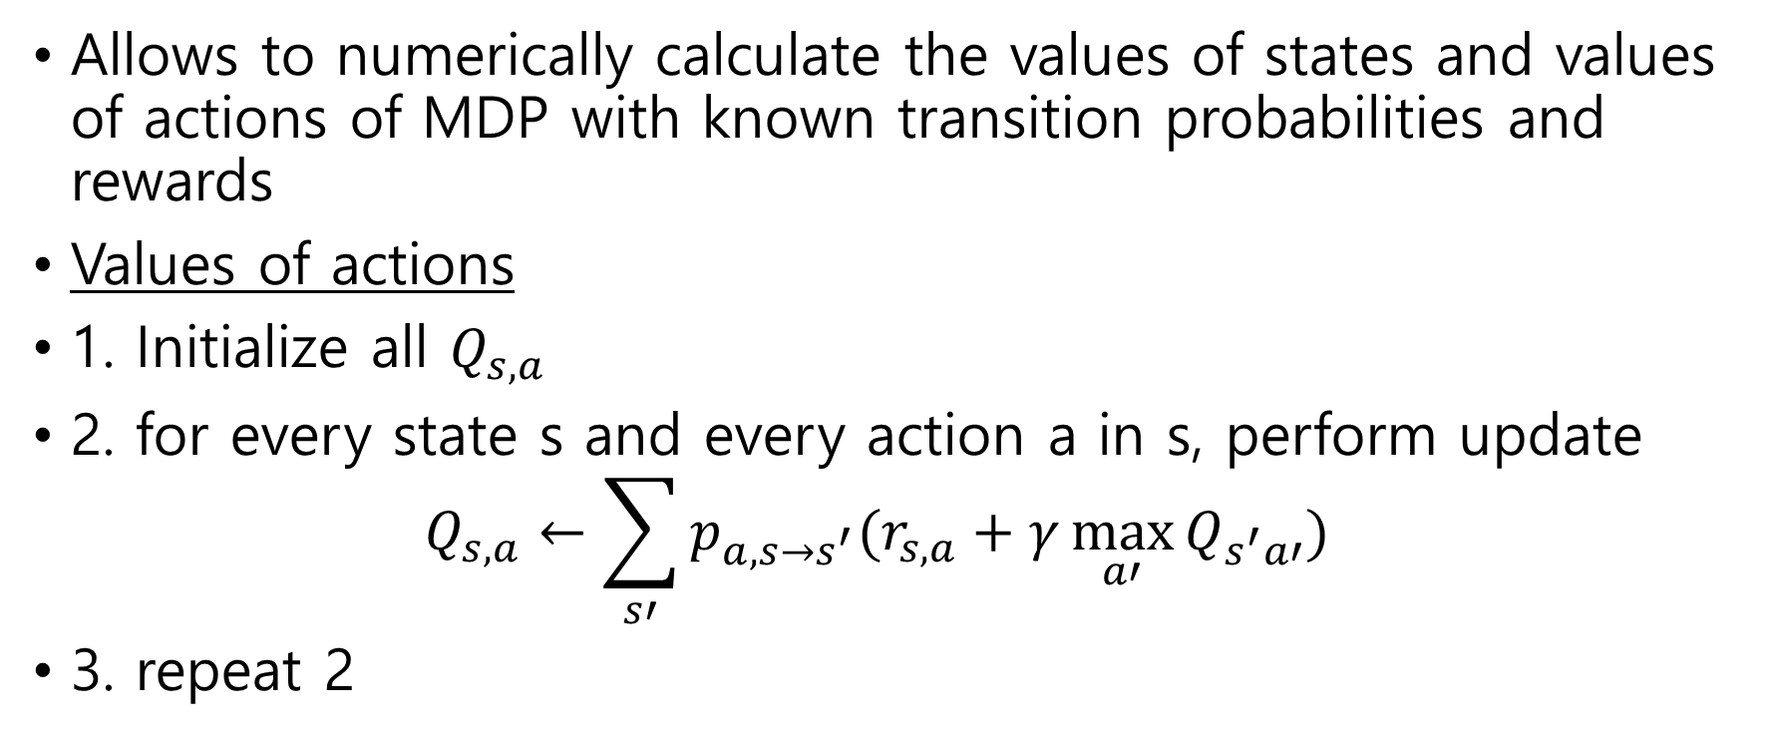
Value iteration algorithm
Allows to numerically calculate the values of states and values of actions of MDP with known transition probabilities and rewards
Values of actions
1. Initialize all $Q_{s,a}$
2. for every state s and every action a in s, perform update
$$Q_{s,a}←\sum_{s′}{p_{a,s→s^{′}}(r_{s,a}+γ\max_{a′}{Q_{s^{′}a′}})}$$
3. repeat 2

Slide 14
Value iteration algorithm
Limits at practice
1) state space should be discrete and small enough
2) transition probabilities for actions/rewards matrix are rarely known(need this for Bellman update)
→ use agent’s experience

Slide 15
Value iteration in practice(v)
Central data structure
Reward table: dictionary
[(source state, action, target state) : (immediate reward)]
Transitions table: dictionary
keep counters of the experienced transitions
[(state, action) : [(target state) : (count of times we’ve seen it)]]
Value table: dictionary, our policy
[state : calculated value of this state]

Slide 16
Value iteration in practice(v)
Overall logic
1) play 100 random steps from the environment
Populating reward/transition tables
2) value iteration loop
Over all states, updating value table
3) play several full episodes to check improvements
Using updated value table
4) stop
when average reward for those test episodes is above 0.8

Slide 17
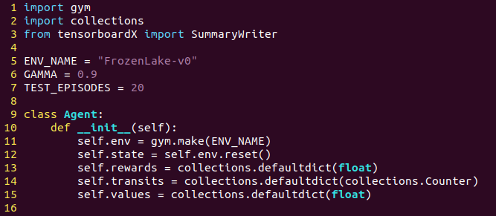
Value iteration in practice(v)
초기화
FrozenLake-v0 환경 만들고
처음 state를 초기화한 다음
주요 자료구조 3개 만들기

Slide 18
Value iteration in practice(v)
Overall logic
1) play 100 random steps from the environment
Populating reward/transition tables
2) value iteration loop
Over all states, updating value table
3) play several full episodes to check improvements
Using updated value table
4) stop
when average reward for those test episodes is above 0.8

Slide 19
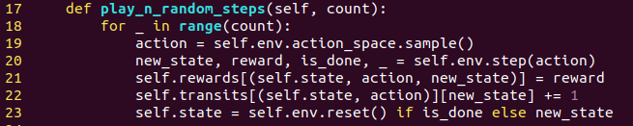
Value iteration in practice(v)
N개의 step생성
Vs. Cross Entropy
Cross Entropy는 에피소드의 끝까지 봐야 learning 가능
Value iteration은 적당히 N step의 결과들을 기억하면 된다.

Slide 20
Value iteration in practice(v)
Overall logic
1) play 100 random steps from the environment
Populating reward/transition tables
2) value iteration loop
Over all states, updating value table
3) play several full episodes to check improvements
Using updated value table
4) stop
when average reward for those test episodes is above 0.8

Slide 21
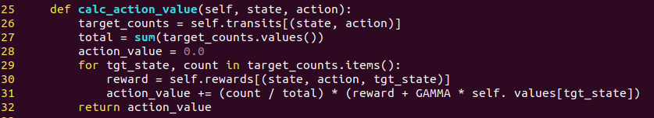
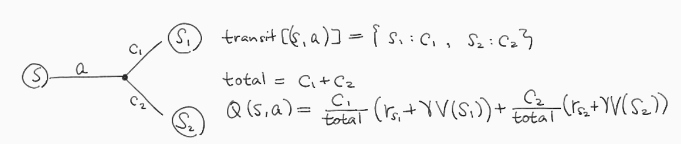
Value iteration in practice(v)

Slide 22
Value iteration in practice(v)
Calculate the value of the action from the state
Purpose
1) select action
2) calculate new value of the state
Process
1) sum all counters in transits table
2) iterate every target state, calculate its total action value(Bellman)

Slide 23
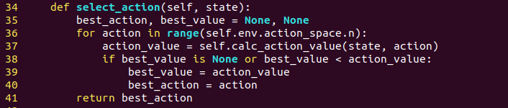
Value iteration in practice(v)
Choose best action to take from the given state
Process
1) Iterate every action, calculates its value
2) Returns action with largest value

Slide 24

Value iteration in practice(v)

Slide 25
Value iteration in practice(v)
Overall logic
1) play 100 random steps from the environment
Populating reward/transition tables
2) value iteration loop
Over all states, updating value table
3) play several full episodes to check improvements
Using updated value table
4) stop
when average reward for those test episodes is above 0.8

Slide 26
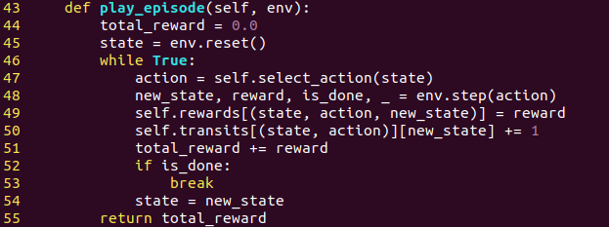
Value iteration in practice(v)
Plays one full episode
Argument env?
This function is used to test episodes → should not mess up with main env
Use second environment passed as an argument

Slide 27
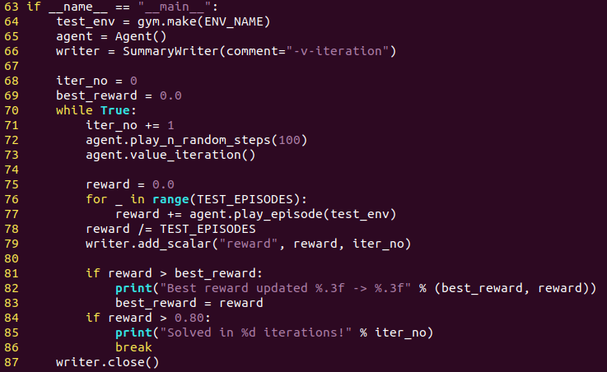
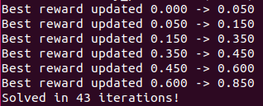
Value iteration in practice(v)
Main function
결과적으로 Cross entropy보다 훨씬 적게 걸린다.

Slide 28
Value iteration in practice(v)
Cross Entropy 보다 빠른 이유
1. 확률적인 action의 결과들 + 에피소드의 길이
cross entropy는 뭐가 잘 간 거고 뭐가 잘못간 것인지 알기 어렵다.
?? 개별 state value를 돌면서 action outcome의 확률을 추정하고 예상 값을 계산함으로써 자연히 action outcome의 확률적 결과를 통합
2. full episode를 필요로 하지 않는다.
극적인 경우 one example로 value updating이 가능하지만 Frozenlake는 그게 어렵다.(마지막에만 보상 1을 받을 수 있어서 끝까지 가는게 하나는 있어야한다.)

Slide 29
Value iteration in practice(q)
V를 쓸 때와 다른 점
Learns the values of actions
different value table
Has key, (state) → need (state and action)
Replace calc_action_value() function with modified value_iteration() function
Bellman equation needs value of the state
select_action() : choose the state with largest Q value

Slide 30
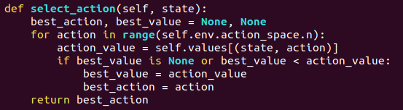
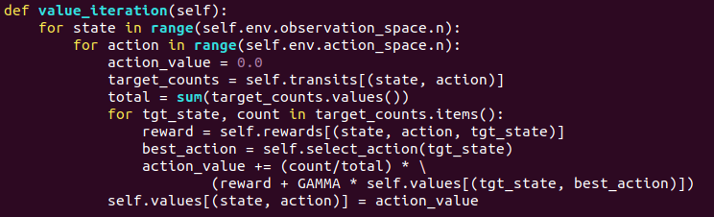
Value iteration in practice(q)

Slide 31
Value iteration in practice(q)
Vs value of state?
In this example, requires four times more memory
Convergence speed almost the same
Requires less information(no need of each state’s value)

