Slide 1
EDA Project
By: FAISAL BANDER ALJOWAIE

Slide 2
abstract
A dataset of 10,000 participants from four different age bands in five different locations must complete three different tasks has been visualized.
The score of each task for each individual was measured from 0 to 100 in percentage.
The relationship of demographics and location with the scores and time taken to complete the tasks was analysed.

Slide 3
Let me take you through the dataset
10000 rows, 8 columns.
Gender: M or F
Location: A, B, C, D, E
Age.Band: U = (Under 16 (< 16), Y = Young Adult (16 – 39), M = Middle Aged (40 – 64), O = Older Adult (65+))
Completion.Time: Time to complete tasks A to C
Age: Numeric Value
Part.A.Score: Percentage (0 to 100)
Part.B.Score: Percentage (0 to 100)
Part.C.Score: Percentage (0 to 100)

Slide 4
problems
Outliers needs to be handled.
Column names needs to be changed.
Unrealistic values needs modification.

Slide 5
Challenges
Choosing the dataset.
Extracting some interesting questions.
Use clearer graphics.

Slide 6
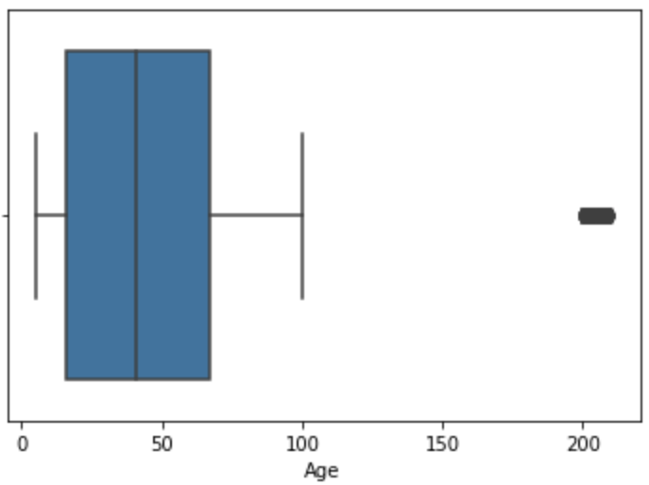
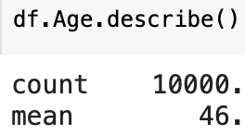
any outliers in the dataset?
200 outliers in age column.
Gave them the mean age which is 46.

Slide 7
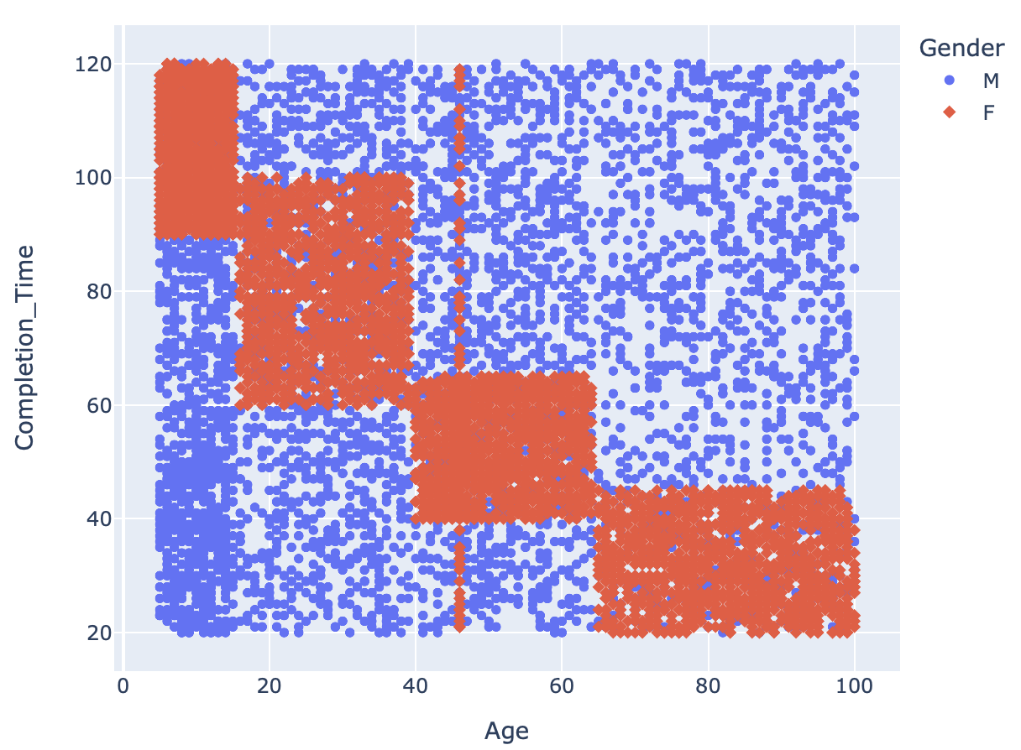
Is there a relationship between age and completion time?
It was found that younger females complete the tasks faster then older ones.
Screenshot 2021-11-18 at 06.59.05

Slide 8
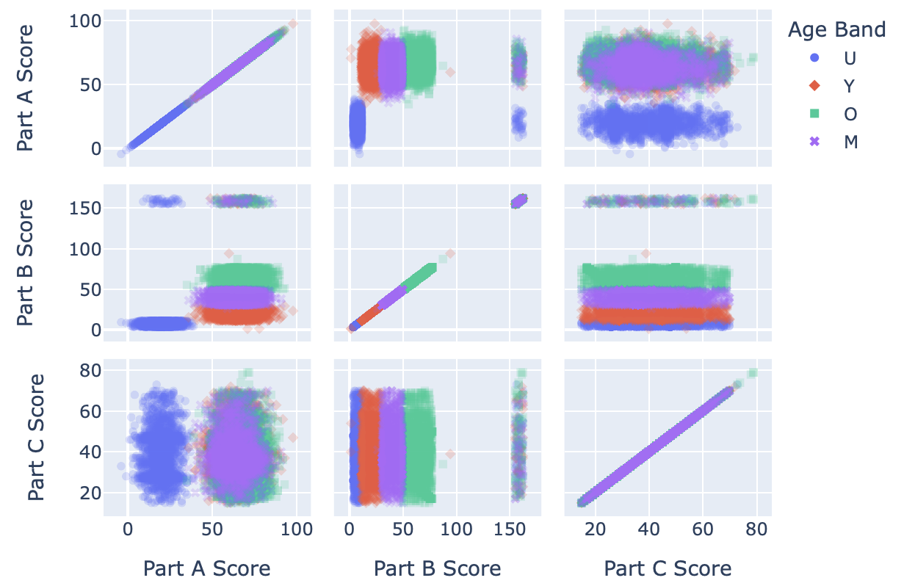
Does age band matter regard scores?
For task A, the people with age below 16 perform badly as compared with other age groups.
Doesn’t have much impact on the scores of task C.
The scores increases with the increase in maturity of age group.

Slide 9
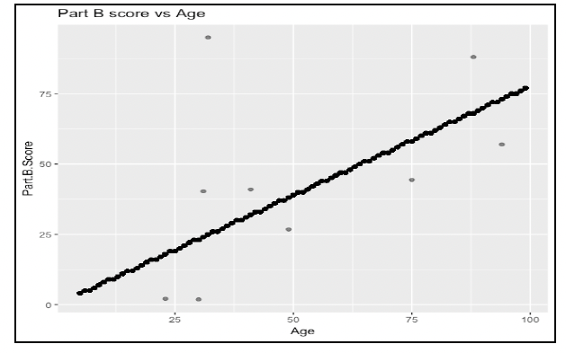
Most interesting Relationship
completion time and score from task B were related to age in a significant way.
It can be observed from the plot that a positive linear relationship exists between part B scores and age.
The higher age, higher chances to score well in task B.

Slide 10
tools
Google colaboratory.
Numby.
Pandas.
Matplotlib.
Seaborn.
PowerPoint

Slide 11
Thanks any questions?

