Slide 1
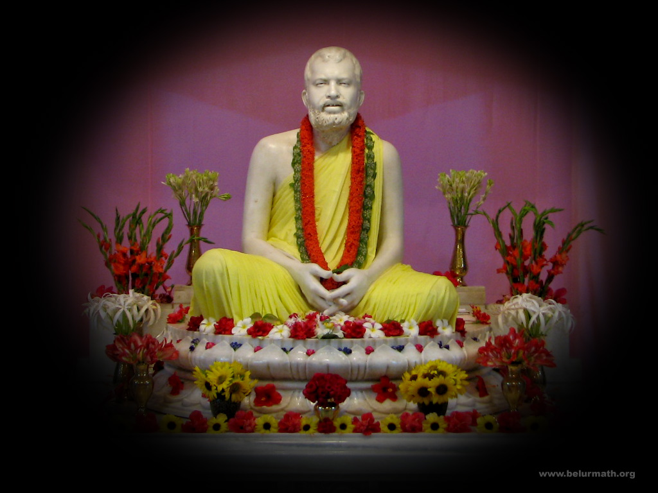
Test Slide 2

Slide 2

Test Slide 3

