Slide 1
Connecting to Ethereum’s Sepolia testnet and
interacting with it.
Tools:
Sepolia: A test network for the Ethereum blockchain
MetaMask: Wallet
Remix Ethereum: Online Solidity compiler

Slide 2
Outline
We show how to connect to Ethereum’s Sepolia testnet and interact with it.
Steps:
Install MetaMask. Create an account (i.e. an address and public-private key) via MetaMask
Request some Ether from a Sepolia faucet
Get familiar with Solidity and the Remix compiler:
Write smart contracts, debug and compile them online
Send/deploy the latest version of the contract to the blockchain and interact with the deployed contract

Slide 3
Step 1.1: Install Metamask
It is a browser extension for Ethereum wallets (works on Firefox, Google Chrome, Brave and Edge)
Allows us to create our public/private keys and connect to the blockchain
We recommend using MetaMask on Firefox
Download it from: https://metamask.io/
Follow the instructions to install it, then refer to the next slides

Slide 4
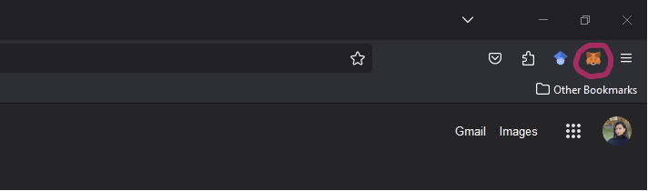
Step1.2: Create an Account in MetaMask
Click on the MetaMask icon on the top right side of your browser (or in the extensions folder).

Slide 5
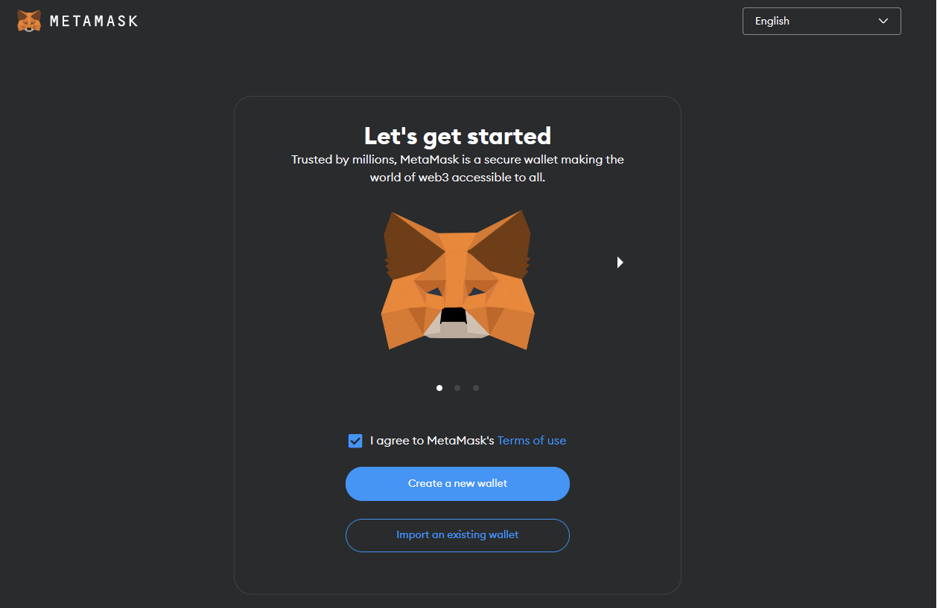
Step1.2: Create an Account in MetaMask
Follow the instructions to create an account

Slide 6
Step1.2: Create an Account in MetaMask
After you provide a password, an account (i.e. an address, public and secret keys) will be created for you – you can also create more than one accounts per wallet
Select “Secure my wallet” to generate a seed phrase
Store your seed: you will need it to restore your wallet in case you delete Metamask

Slide 7
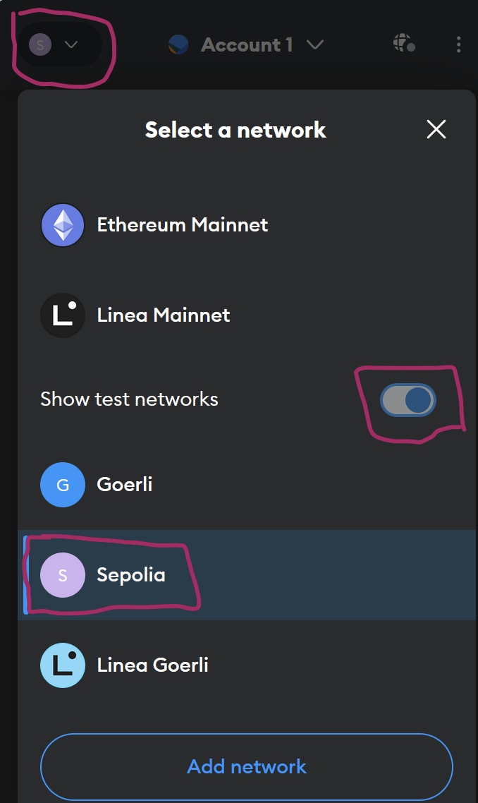
Step1.3: Connect MetaMask to Sepolia Testnet
Open the MetaMask extension
Click on the Network dropdown on the top left corner
Select “Show test networks”
Select “Sepolia” from the list

Slide 8
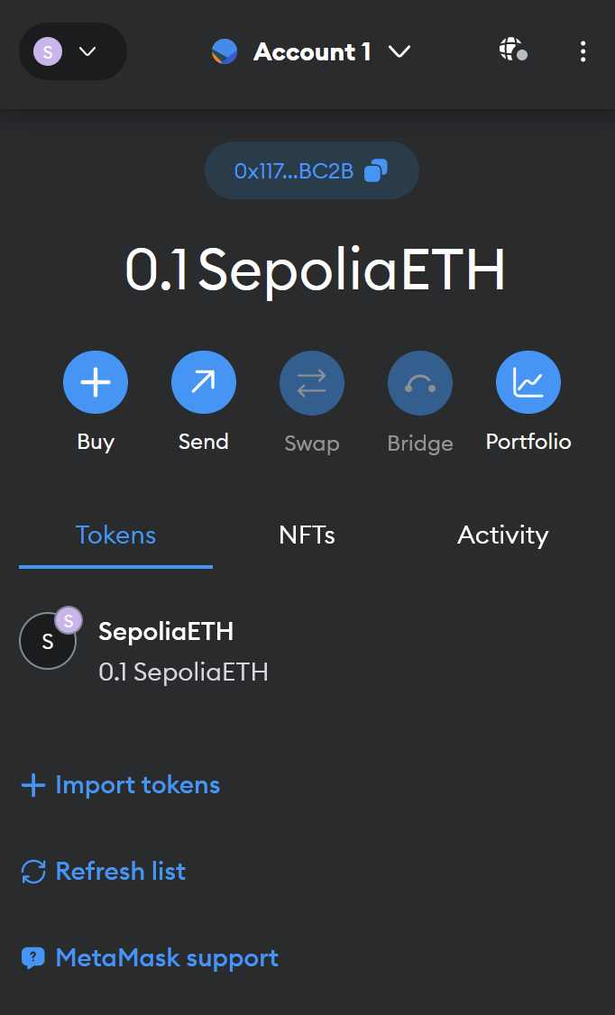
Step1.4: Your Address
When you have successfully connected to the chain, this page will appear
Your address is under the account’s name – here it starts with “0x117” and ends with “BC2B”
Click on it to copy it and then send it to those who want to pay you

Slide 9
Step 2: Request your Ether
You need some (Sepolia) Ether to send a transaction and interact with a smart contract in the testnet
Request some Ether from a Sepolia Faucet, e.g., from here by providing the address that you copied (for more faucet options see https://faucetlink.to/sepolia)
Attention: most faucets give only small amounts of Ether every 24 hours, so you are advised to start accumulating your Ether early, to make sure you have sufficient funds to use during your coursework

Slide 10
Step 3: Getting Familiar with Remix Ethereum: Online Solidity Compiler
You can write, debug, deploy (i.e. send to a blockchain) your smart contract via remix Ethereum: https://remix.ethereum.org
After you deploy your contract, you can also interact with it using Remix
Before you deploy your smart contract to the test chain, run and debug it online

Slide 11
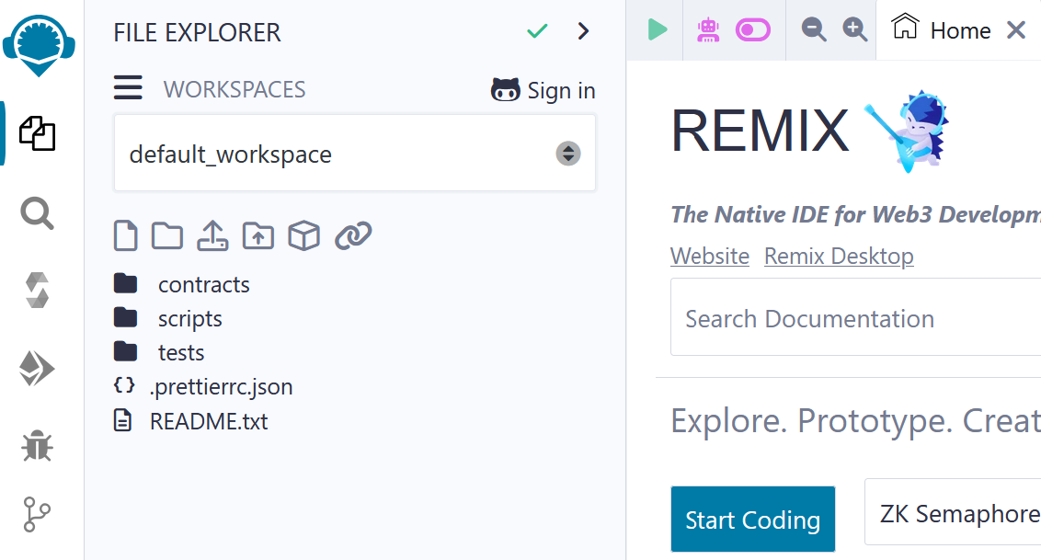
Step 3: Getting familiar with Remix Ethereum: Online Solidity Compiler
To view your files and create a new, click on the file explorer, create a new file and write your Solidity code

Slide 12
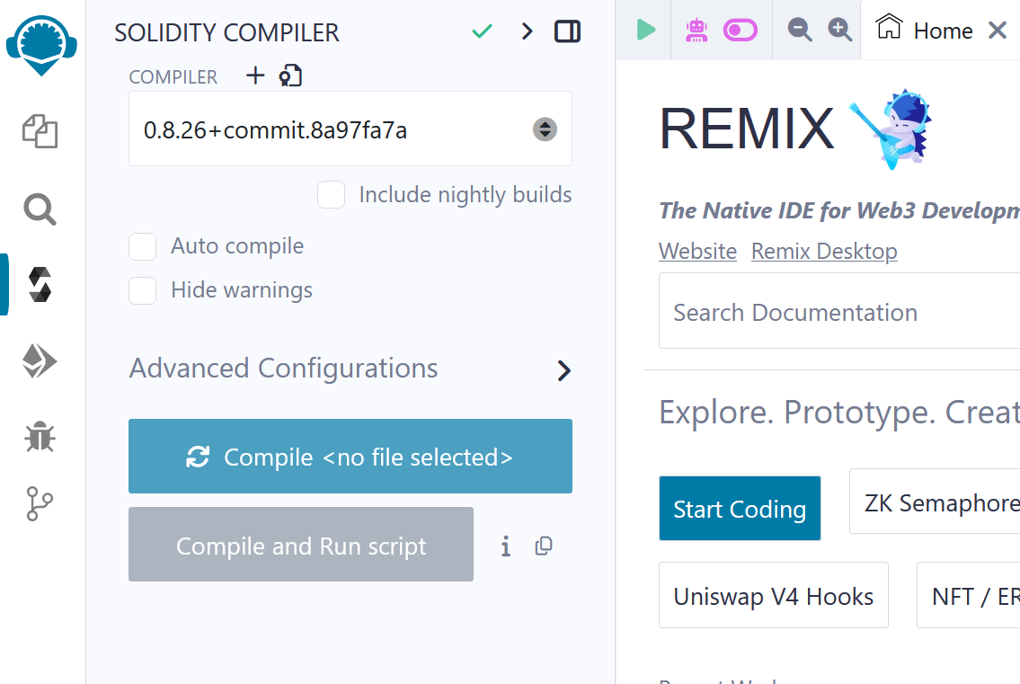
Step 3: Getting familiar with Remix Ethereum: Online Solidity Compiler
Next, click the compiler button and then choose the Solidity environment

Slide 13
Step 3: Getting familiar with Remix Ethereum: Online Solidity Compiler
Next, compile your smart contract (every time you change your contract you need to recompile it)

Slide 14
Step 3: Getting familiar with Remix Ethereum: Online Solidity Compiler
Next, to deploy and test your contract, choose the deployment explorer

Slide 15
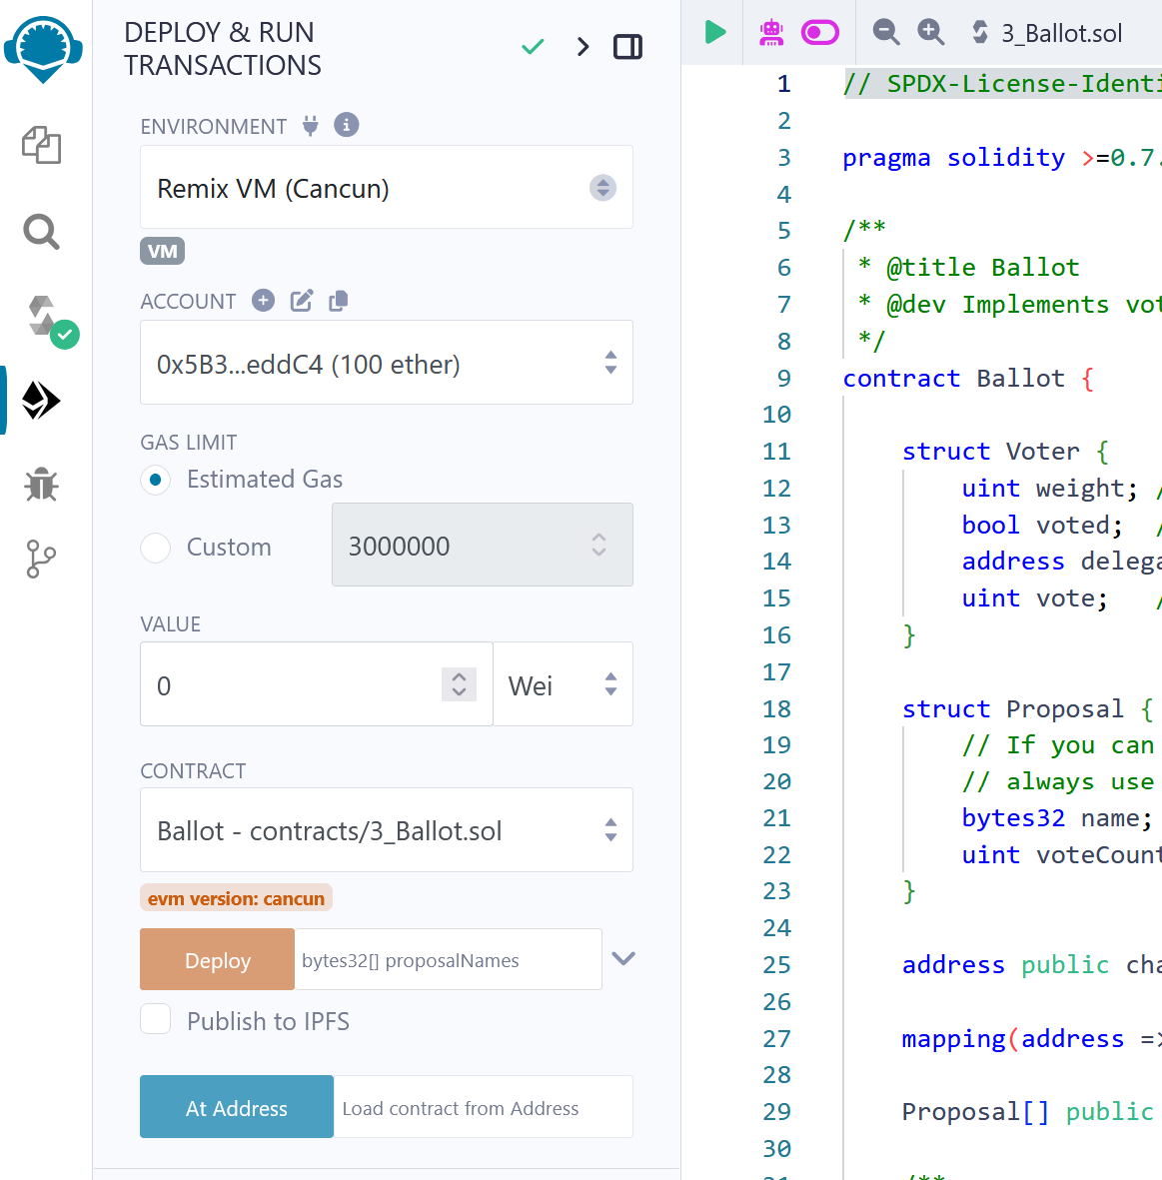
Step 3: Getting familiar with Remix Ethereum: Online Solidity Compiler
You can deploy your contract in a number of environments

Slide 16
Step 3: Getting familiar with Remix: Javascript VM environment
Remix VM (Cancun)
This is a testing environment
It is a local environment that lives on your browser’s tab
Whatever you do in this environment does not affect your funds, i.e. it does not have access to your wallet
When you close the browser it is deleted and when you open it again it is created fresh, so every time you use this environment you need to re-deploy your contracts

Slide 17
Step 3: Getting familiar with Remix: Injected Provider environment
Injected Provider - Metamask
This environment has access to your Metamask
It connects to the network to which Metamask is connected and uses the funds of your wallet
Every time you try to use a contract, Metamask will request permission before completing the operation – this is because an actual transaction is posted and the actual funds in your wallet are used

Slide 18
Step 3: Getting familiar with Remix Ethereum: Online Solidity Compiler
To test your smart contract, click on Deploy
Remix creates a user interface to interact with the contract

Slide 19
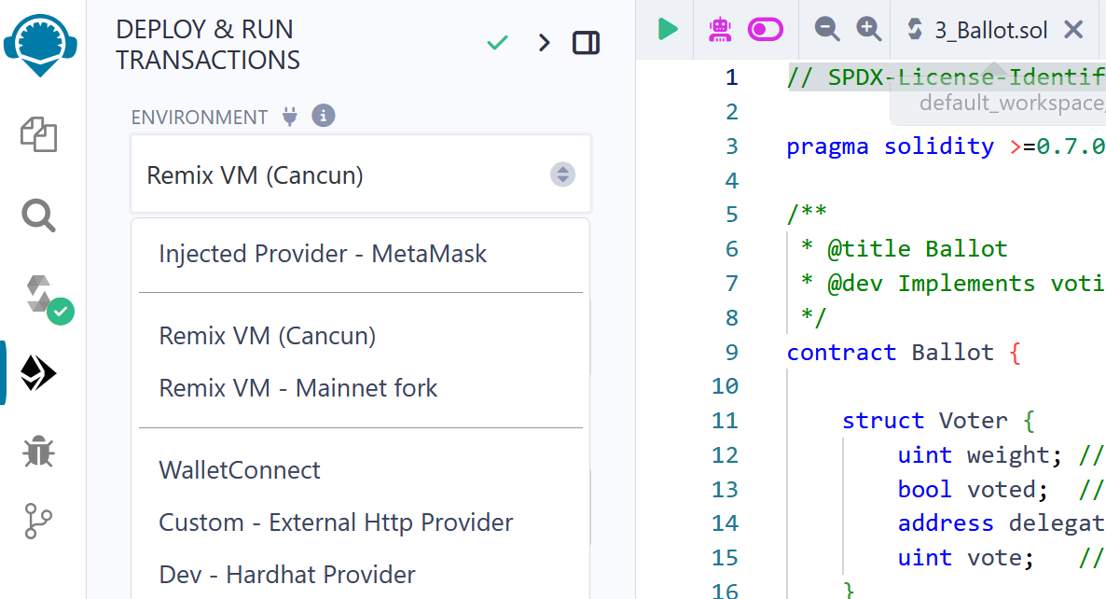
Step 4.1: Deploying Smart Contract to the Sepolia testnet Configurations
First, you need to allow Remix to connect to Metamask
In Remix, set the environment to Injected Provider - Metamask.

Slide 20
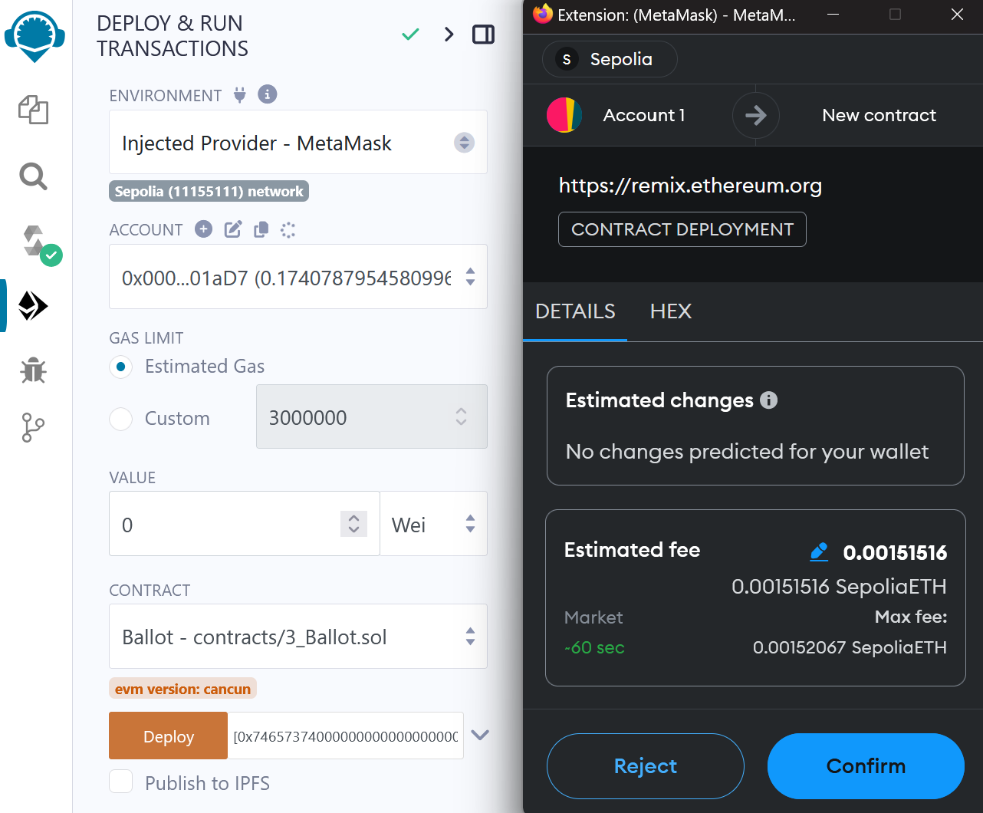
Step 4.2:
Deploying Smart Contract to the Sepolia testnet
Deploying a Contract to the Blockchain
Click on Deploy
MetaMask will request your permission to send your contract to the Sepolia testnet - by clicking on confirm, you publish your contract (and pay the fee)

Slide 21
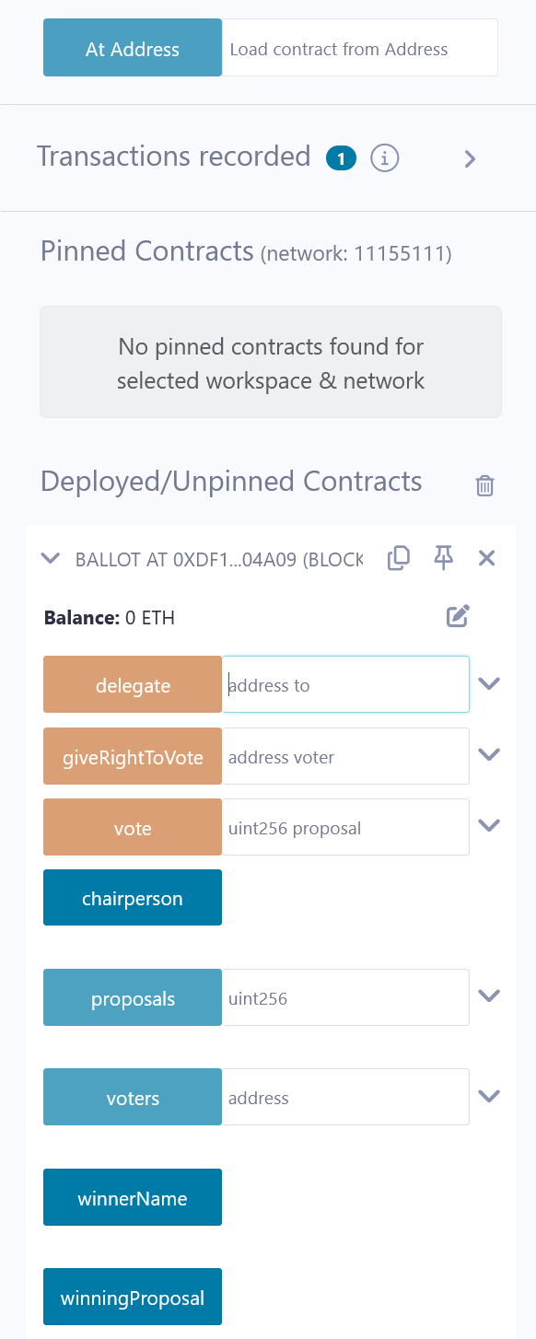
Step 4.3:
Deploying Smart Contract to the Sepolia testnet
Saving the Deployed Contract's Address
When, your contract is successfully submitted & deployed, Remix provides the contract’s address
You need the contract’s code and the address next time you want to interact with your deployed contract.

Slide 22
Step 4.3:
Deploying Smart Contract to the Sepolia testnet
Interacting with a Deployed Contract
Log in to MetaMask, connect to the Sepolia testnet (as previously explained)
In Remix, write and compile your contract, and set the environment to Injected Provider - Metamask.
3. Insert the deployed contract’s address and click on: At Address.

Slide 23
Step 4.3:
Deploying Smart Contract to the Sepolia testnet
Interacting with a Deployed Contract
4- All the public/external functions in the contract are provided and you can pass arguments on them and invoke them
Orange fields change the contract’s state, so you create a transaction and spend funds - at minimum you pay the fees, if your transaction does not send funds to the contract
Blue fields just show you the contract’s state and are free

Slide 24
Troubleshooting
If you don’t see your funds in Metamask
Double check that you are connected to the correct network, i.e. the Sepolia testnet and not e.g. the Ethereum mainnet
If you are connected to the right testnet, try connecting to a different network (e.g. the Ethereum mainnet) and then reconnecting back to the testnet – sometimes Metamask’s connection breaks down, so this will reset the network
If you still don’t see your funds, try deleting Metamask from your browser (remember to store your seed first), and then re-install it, recreate your wallet using your seed (if you have more than one accounts in your wallet, you have to create them all manually again) and connect to the private network – sometimes Metamask’s internal transaction generator breaks down (due to temporary network issues), so this will reset your wallet from scratch
If you still don’t see your funds contact the course’s TA

Slide 25
Troubleshooting
If you want to find past transactions’ IDs
Metamask keeps a list of all transactions that you have made
Click on a transaction and it will redirect you to Etherscan – the public Ethereum network’s explorer
Etherscan will show you details of your transaction, including itsID (transaction hash)
If you only see “Injected Provider” in the environment
Make sure your metamask extension can read and write data on the remix website
If the site access is restricted, click the metamask button and reload the page
If you interact with a contract but don’t see your changes published
Make sure that you have set the environment to Injected Provider - Metamask
Double check that the address of the contract to which you connect is the correct one and the contract’s code is exactly the same as the deployed contract

