Slide 1


Progress with the MX Control System Toolkit
William M. Lavender
Biological, Chemical, and Physical Sciences Dept.
Illinois Institute of Technology
Chicago, IL 60616 USA
http://mx.iit.edu/

Slide 2
What is MX?
A portable beamline control toolkit: BSD, Cygwin, DJGPP, eCos, HP/UX, Irix, Linux, MacOS X, QNX, RTEMS, Solaris, Tru64, VMS, VxWorks, Windows.
Written in C, with Python and Tcl interfaces available.
Designed as middleware.
Comes with a set of servers and clients so that it can run standalone.
Has an extensive set of over 440 device drivers (motors, scalers, MCAs, MCSs, area detectors, ...).
Not tied to one specific network protocol.
MX servers and clients share the same set of drivers.
Servers can act as clients and clients can act as servers.
Easy to interface to other people's drivers.
Easy to embed in other applications and servers.

Slide 3
Recent Changes to MX
Debian Packages are now available for MX and EPICS Base. They can be found at:
deb http://fermi.phys.iit.edu/debian/sarge binary/
deb-src http://fermi.phys.iit.edu/debian/sarge source/
We plan to submit these packages for inclusion in the main
Debian distribution.
MX now runs on 64-bit architectures: tested on Alpha, AMD64, Itanium, MIPS, PARISC, and SPARC.
Cross platform threading and synchronization primitives were added for use in enhanced multi-protocol event support.
Moving to embedded computers for MX servers.

Slide 4
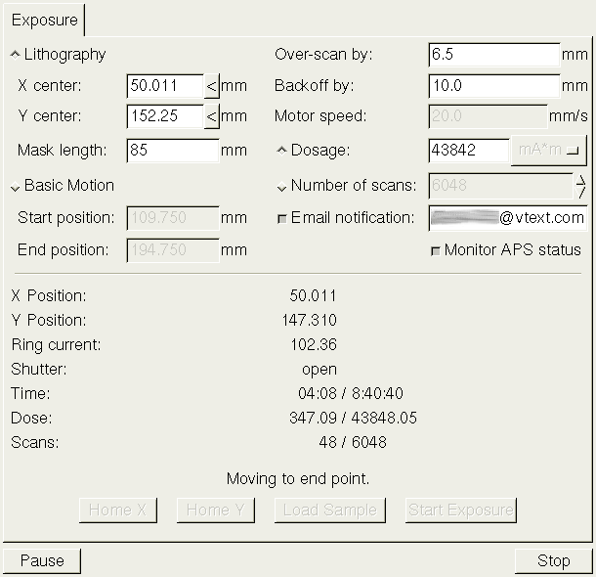
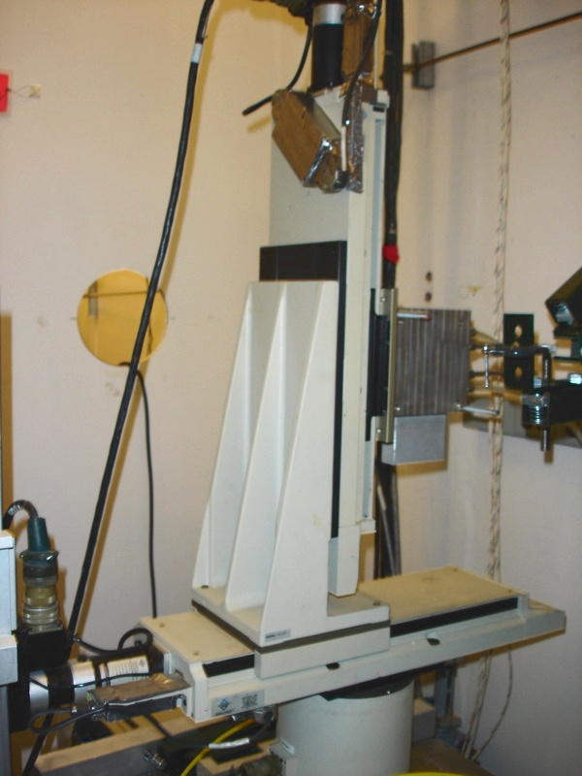
MX for Physical Sciences Applications
Deep X-ray Lithography
A graphical user interface has been developed by Ken McIvor for lithography measurements at MR-CAT (APS Sector 10).

Slide 5
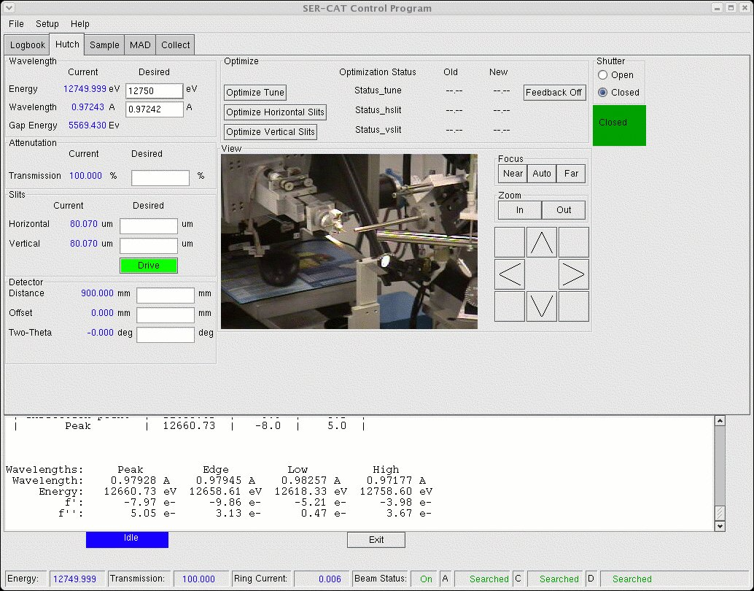
SERGUI – Macromolecular Crystallography for MX
Jim Fait (U. Georgia) has developed a user interface for
crystallography experiments at SER-CAT (APS Sector 22)

Slide 6
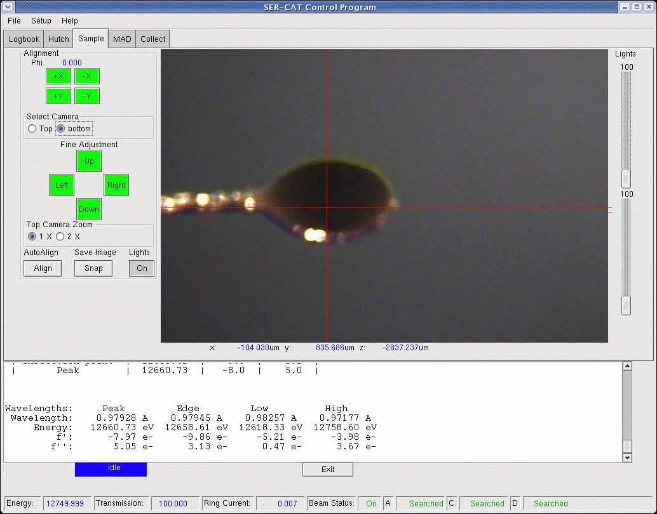
Sample Alignment with SERGUI

Slide 7
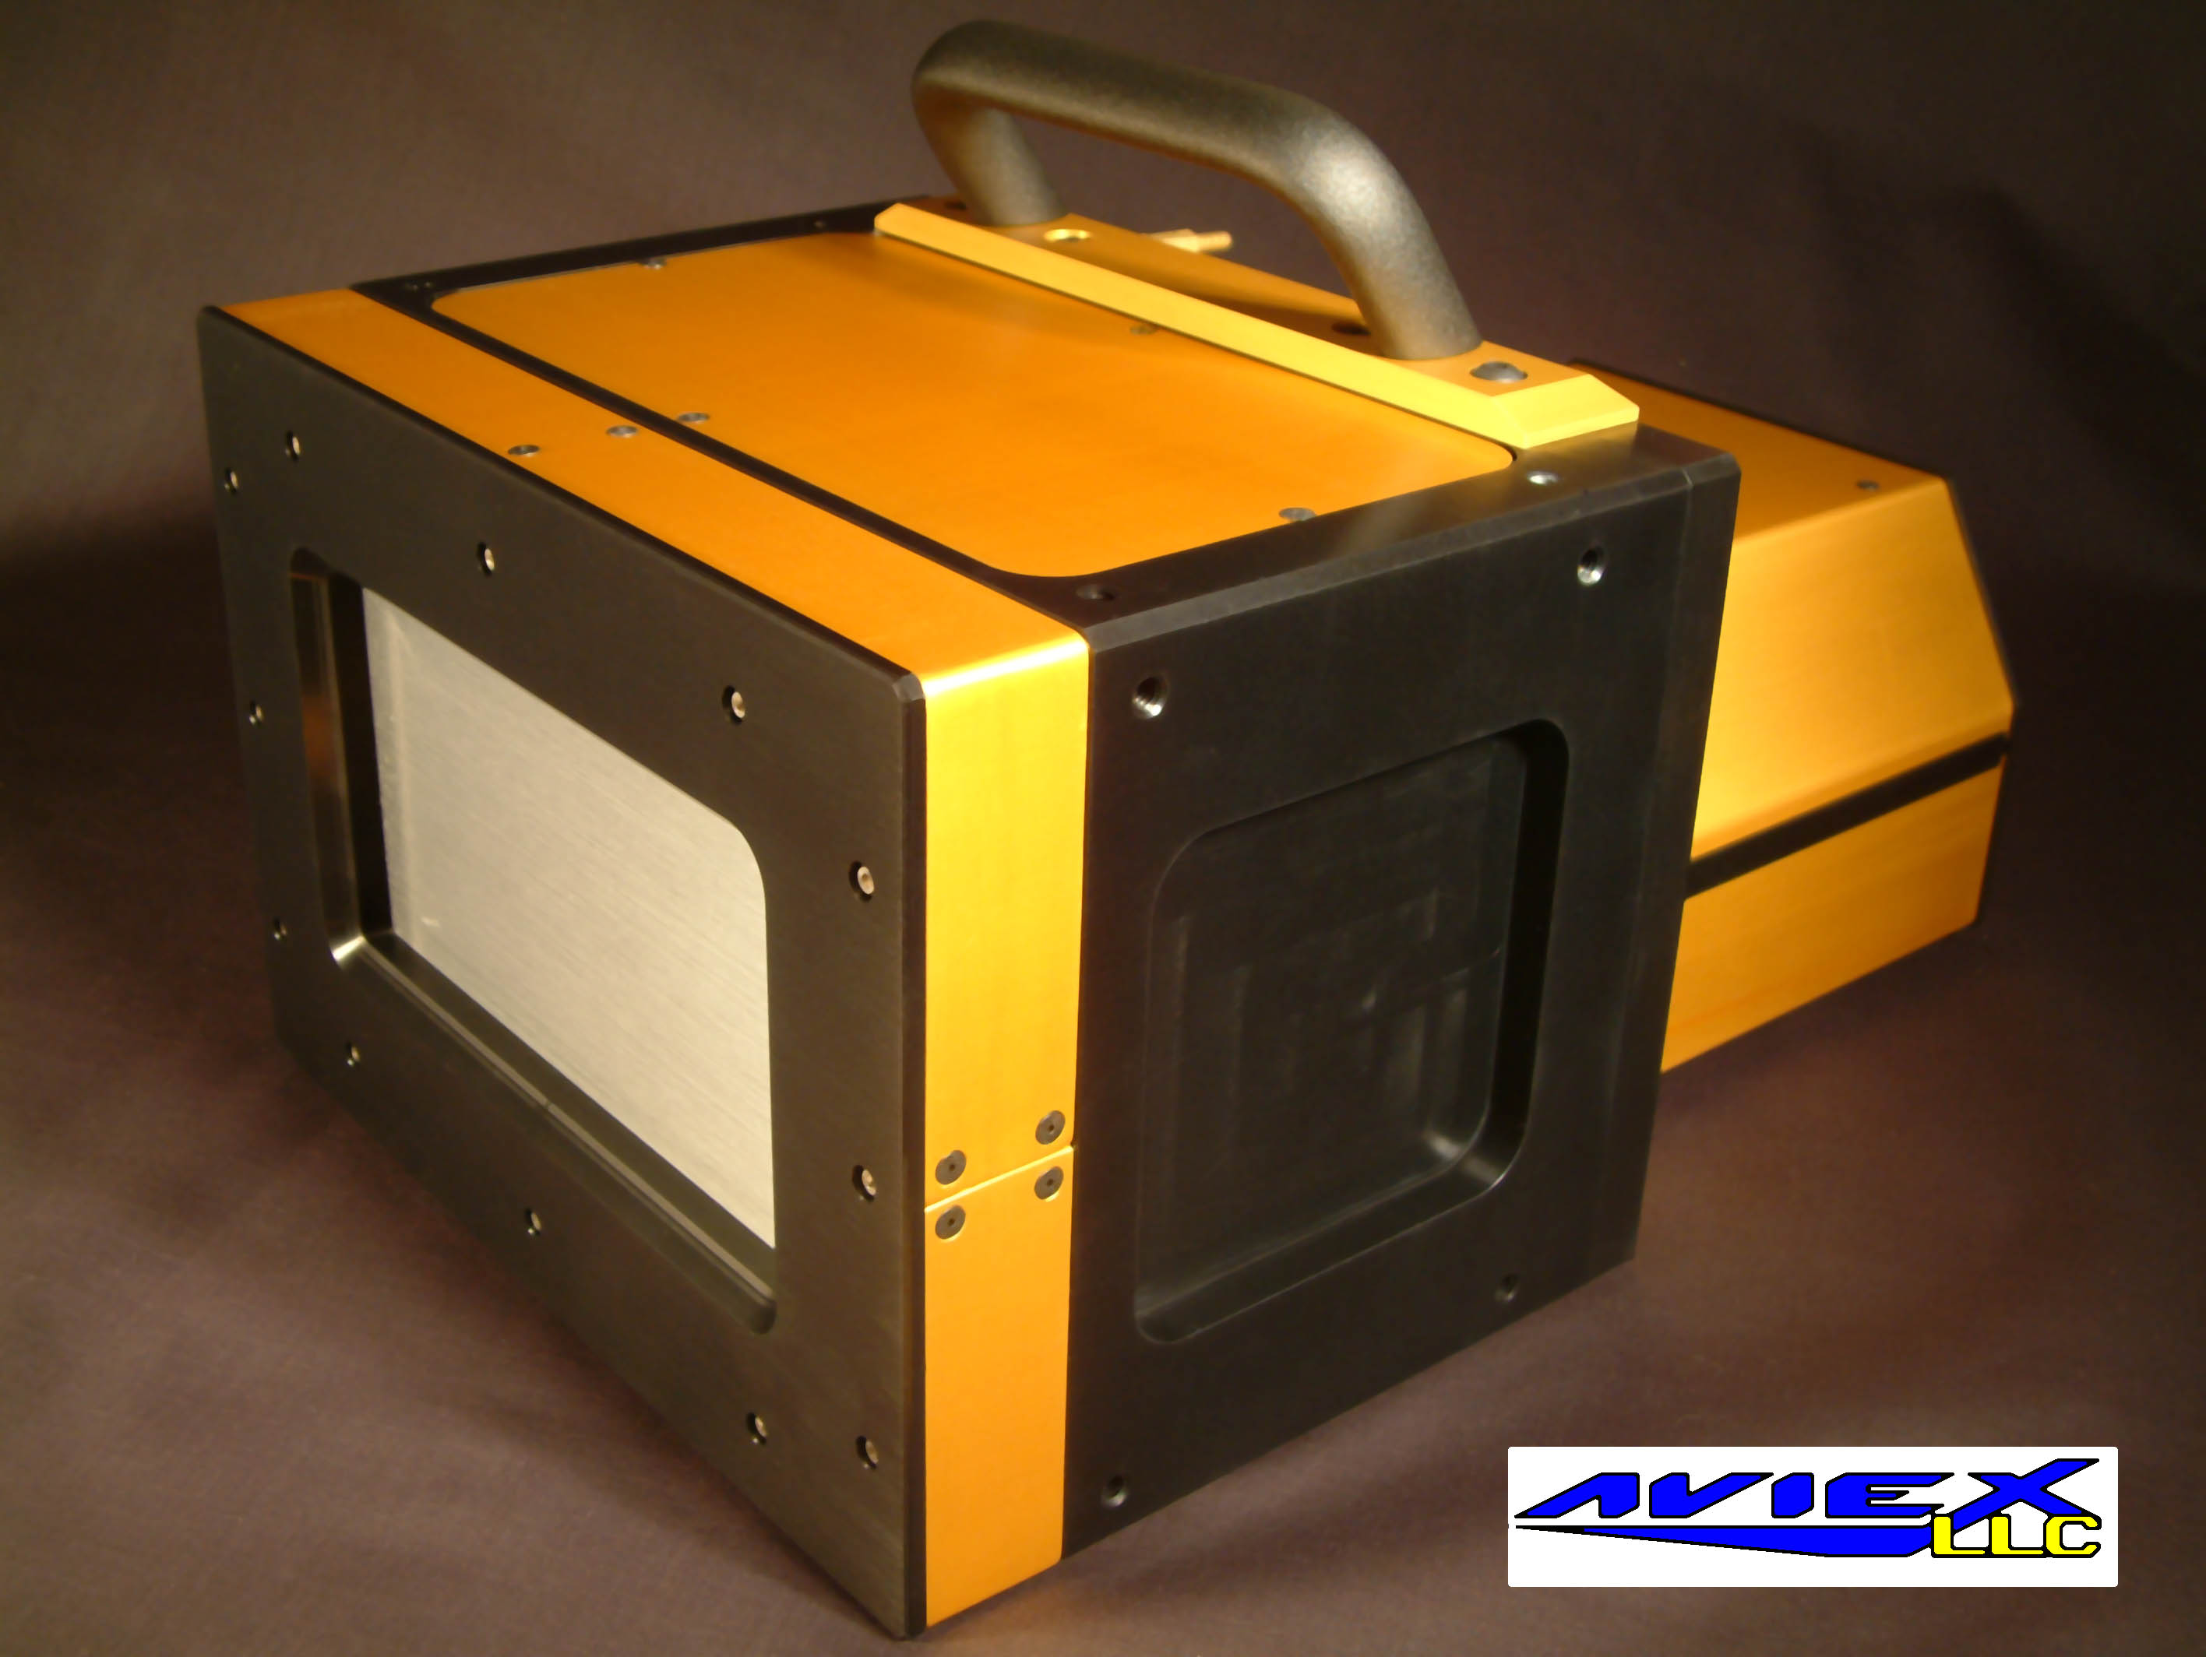
AVIEX CCD Detector (PCCD-170170)
This will be the first commercial application for MX.
4096 by 4096 pixel CCD detector.
2 by 2 module design with 16 taps and fiber-optic coupling.
Can be used both as an area detector and as a streak camera.
High dynamic range: ~30,000
High sensitivity: Single X-ray photon signal is above the read-noise floor.
Very fast readout.
Can operate in a vacuum.
Supports ROIs to reduce the amount of data transferred.
First installation will be at SOLEIL.
The PCCD-170170 will be similar in appearance to the PCCD-16080 shown in this picture.

Slide 8
MX as a CCD Control System
The main components controlled by MX are:
  - EPIX PIXCI E4 imaging board controlled via PCI-Express.
  - AVIEX CCD detector electronics controlled via Camera Link.
The high-level object seen by application programs is an MX area_detector record.
The area detector record controls the imaging board through an MX video_input record and the CCD detector electronics through an MX camera_link record.
The modularity of the design allows one to easily switch imaging boards or detector electronics without requiring large changes to the rest of the software.
Network transparency for MX clients is implemented via the MX network_area_detector driver.
Both Linux and Windows are supported for the detector computer.
Future plans include support for EPICS and Blu-Ice clients.
SOLEIL plans to write their own Tango-based wrapper for MX.

Slide 9
Near Term Plans
Finish enhancements of the event and callback system for MX. (Winter 2006-2007)
Finish the full implementation of an MX-based Portable Channel Access Server for EPICS clients.
Implement an MX-based Blu-Ice Device Hardware Server.
Implement loadable device drivers and extensions.

Slide 10
Supported Devices
Motor Controllers
Pseudomotors
Counter/Timers
Analog and Digital I/O
Area Detectors
ACS MCU-2
Aerotech Unidex 500
Am9513
Animatics SmartMotor
APS insertion device
Blu-Ice motor
Bruker D8
Compumotor 6K
Compumotor 6000
Cryostream 600 temp ctrl
DAC output
Delta Tau PMAC
DSP E500
EPICS motor record
IMS IM483
IMS MDrive
IMS Panther
Joerger SMC24
Kohzu SC-series motor
LakeShore 330 temp ctrl
MarDTB motor
Mclennan PM304
Mclennan PM600
MX network motor
NI ValueMotion
New Focus Picomotor
Newport MM3000
Newport MM4000
Newport ESP
NSLS MMC32
OMS VME58
OSS BCW μ-GLIDE
Oxford Inst. ITC503 temp ctrl
Pan/Tilt/Zoom motor
Phidget stepper motor
Physik Instrumente E-662
Pontech STP100
Prairie Digital Model 40
Precision Microcontrol MCAPI
Radix Databox motor
SCIPE motor
SI 9650 temp ctrl
Software emulated motor
spec motor
Velmex VP9000
XIA HSC-1
ALS dewar positioner
APS 18-ID monochromator
CCD detector A-Frame
Compumotor linear interp.
CrystalLogic 2θ
Delta
Elapsed time
Gated backlash
Linear function
Monochromator
MX record field
PMAC coordinate system
Q (momentum transfer)
Segmented move
Sine arm
Slit center/width
Table rotation/translation
Tangent arm
θ-2θ
Translation
X-ray energy
X-ray wavelength
X-ray wavenumber
XAFS wavenumber
Am9513
Black Cat Systems GM series
Blu-Ice timer
DSP QS-450 scaler
DSP RTC-018 timer
EPICS scaler record
Joerger VSC-16
Kinetic Systems 3610 scaler
MCS scaler/timer
MX network scaler/timer
Ortec 974
Prairie Digital Model 45
Radix Databox
SCIPE scaler/timer
Software emulated scaler/timer
spec scaler/timer
XIA Handel/Xerxes timers
XIA PFCU shutter timer
Animatics SmartMotor I/O
Bit manipulation
Blu-Ice ion chamber
Compumotor I/O
Crossbow CXTILT02
Data Track Tracker
Delta Tau PMAC I/O
EPICS I/O
General PC I/O port
IMS MDrive I/O
Intel 8255
Keithley 2000 series
Keithley 2400 series
Keithley 2700 series
Kinetic Systems 3063
Kinetic Systems 3112
Kinetic Systems 3512
MarDTB status
MCAI function
MCA value
Mclennan PM600 I/O
MODBUS I/O
Motorola 6821
MX network I/O
New Focus Picomotor I/O
Newport Elec. P6000A
Omega iSeries
PC parallel port
Pfeiffer TPG 261/262
Prairie Digital Model 45
Precision Microcontrol I/O
SCIPE I/O
Software emulated I/O
Stanford Res. Syst. SR630
VME I/O
Wago 750-specific MODBUS
X10 CM17A
XIA PFCU filter summary
AVIEX PCCD-170170
MarCCD
MX network AD
Software emulated AD
Video Input
EPIX PIXCI
MX network video
Software test pattern
Video4Linux 2
Pan/Tilt/Zoom
Hitachi KP-D20A/B
MX network PTZ
Panasonic KX-DP702
Software emulated PTZ
Sony VISCA
Pseudocounter/timers
Relays
Autoscale scaler
Gain tracking scaler
Interval timer
MCA alternate time
MCA channel
MCA ROI integral
Scaler function
Timer fanout
Blind relay
Blu-Ice shutter
Generic relay
MarCCD shutter
MarDTB shutter
MX network relay
Pulsed relay
XIA PFCU filter
XIA PFCU shutter
Amplifiers
APS QuadEM
Keithley 428
MX network amplifier
Oxford Danfysik IC PLUS
Oxford Danfysik QBPM
SCIPE amplifier
Software emulated amp
Stanford Res. Syst. SR570
UDT Tramp
Multichannel Encoder
Single Channel Analyzers
MCS encoder
MCS time MCE
MX network MCE
PMAC MCE
Radix Databox encoder
MX network SCA
Oxford Danfysik Cyberstar X1000
Software emulated SCA
Multichannel Analyzer
Multichannel Scaler
Multichannel Analog Input
EPICS MCA record
MX network MCA
Ortec Trump
Roentec RCL
Software emulated MCA
XIA DXP-2X
XIA Saturn
EPICS MCA record (as an MCS)
MX network MCS
Radix Databox MCS
Scaler function MCS
Software emulated MCS
Struck SIS3801
Pulse Generators
Oxford Danfysik QBPM
Encoders
MX network pulser
Prairie Digital Model 45
Struck SIS3801
Struck SIS3807
Kinetic Systems 3640

Slide 11
Serial ports
USB
Goniostat Tables
Scans
Camera Link
DOS COM
DOS Fossil
EPICS RS-232
Linux/Unix tty
Kinetic Systems 3344
MX network RS-232
spec command
TCP socket
VMS RS-232
VxWorks RS-232
Wago 750 serial
Win32 COM
libusb
ADC table
File list step scan
Input device step scan
MCS quick/fast/slew scan
Motor step scan
Pseudomotor step scan
θ-2θ step scan
XAFS step scan
Port I/O
Sample Changers
DOS port I/O
DriverLINX for Win32
Linux iopl/ioperm
MX portio for Linux
VxWorks port I/O
MX network sample changer
SER-CAT robot
Software emulated sample changer
Autoscale
Variables
VME I/O
Amplifier autoscale
Filter autoscale
Filter/amp autoscale
MX network autoscale
APS topup/time to inject
Blu-Ice variables
EPICS variables
Inline variables
Mathop calc
MX network variables
PMAC variables
Position select calc
spec variables
EPICS VME record
mmap() VME I/O
NI VXI MEMACC
RTEMS VME I/O
Struck SIS1100/3100
VxWorks VME I/O
GPIB
Servers
EPICS GPIB
Iotech Micro488EX
Keithley K500
Linux GPIB
MX network GPIB
NI 488
TCP/IP MX servers
Unix domain socket MX servers
MODBUS
MODBUS/TCP
MODBUS Serial RTU
CAMAC
DSP 6001
ESONE CAMAC
Software emulated CAMAC

