Slide 1






Power Platform Back-End Cluster
Azure Storage
Azure SQL
Service Bus
Azure Key Vault
Azure Storage
Azure Cache
Azure SQL
Service Bus
Azure Key Vault
Azure Cache
API Management
Back-End Services
(private)
Back-End Services
(private)
Gateway Service

Slide 2
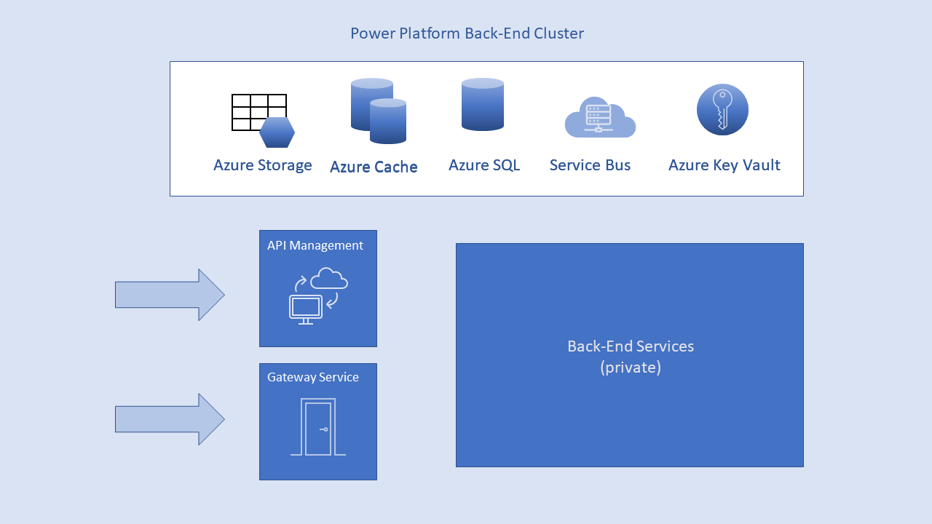
Azure Traffic Manager
Azure Active Directory
Power Platform Back-End Cluster
Browser
Web Front-End Cluster
Azure App Service Environment
ASP.NET
Azure CDN

Slide 3
Azure Traffic Manager
Azure Active Directory
1,2. DNS resolution
5. Redeem auth code for token
Power Platform Back-End Cluster
Browser
Web Front-End Cluster
2. Return WFE IP address
3. Redirect to sign-in page
Azure App Service Environment
8. Get data with token
4. Redirect with auth code
7. Load app page
ASP.NET
3,4. Sign in
5. Auth code
6. ID back-end cluster
Azure CDN
Global Back-End Service

Slide 4

Power Platform Back-End Cluster
Back-End Services
(private)
Power Apps Resource Provider
App Host
1. Request data
Dataverse
Data Runtime
2. Query results

Slide 5
Power Platform Back-End Cluster
Back-End Services
(private)
10. Query results
Connector
1. Request connection
API Hub/
APIM
Power Apps RP
2. Create connection
6. Consent
7. Get data
3. Request data
8. Data query
9. Query result
4. Request consent
5. Consent credentials
Consent Service
SQL
Excel
SharePoint

