Slide 1
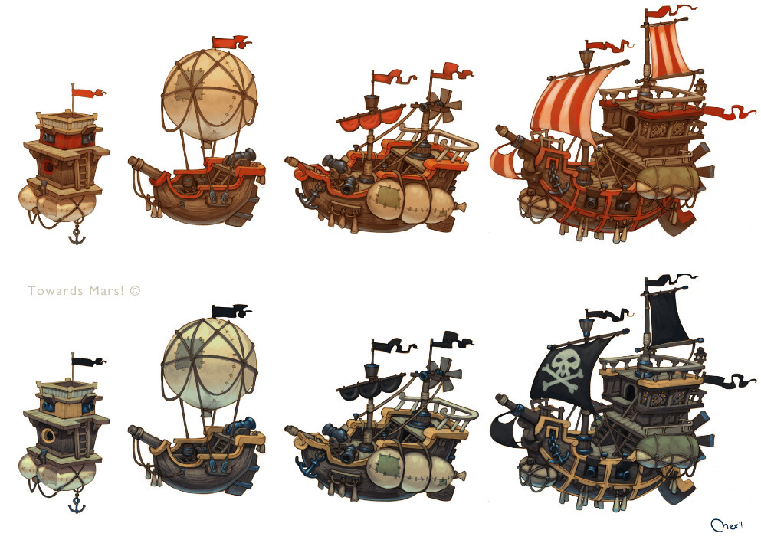
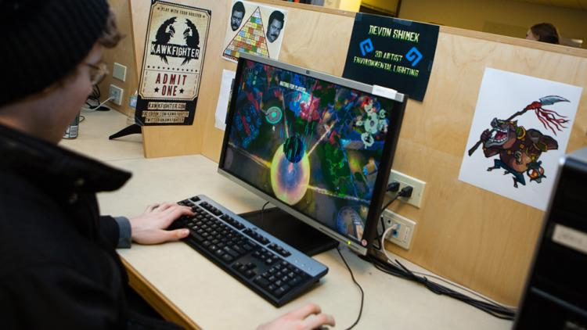

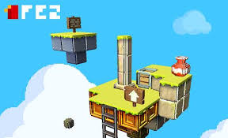
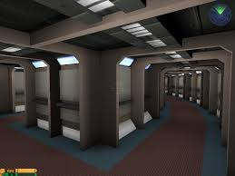

GAMES
Art – Indie – Design – Software Development

Slide 2
PyGame
Writing a Game with Python
Crash Course (1 hour)
Python & PyGame
Tutorials
https://www.pygame.org/docs/
(Optionally – 4 Minute Crash Course on Python:
http://www.nerdparadise.com/programming/python4minutes)

Slide 3
Games (Art, Indie, Design, Software Development)
Specialist Hardware
Cross-Discipline Opportunities
Transferable Skills
Specialist Staff (Industry Experts)

