Slide 1
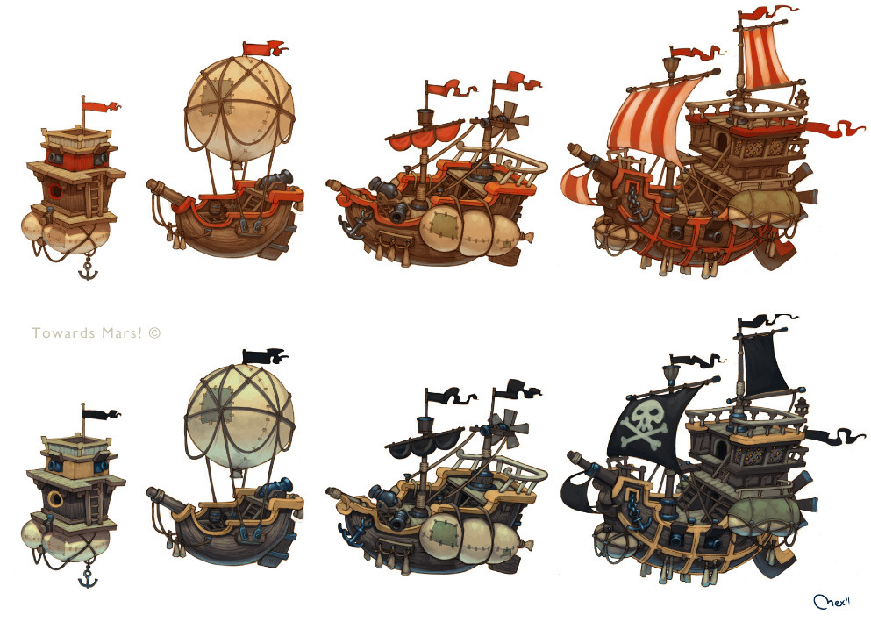
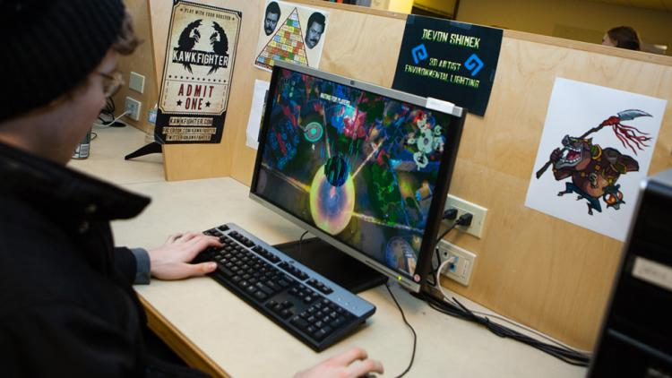


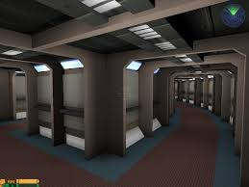

GAMES
Art – Indie – Design – Software Development

Slide 2
Games (Art, Indie, Design, Software Development)
Specialist Hardware
Cross-Discipline Opportunities
Transferable Skills
Staff (Industry Experts)
Friendly Atmosphere

Slide 3
Questions/Discussion

